Slide 1
UpToDate

Slide 2
What is UpToDate?
UpToDate is an electronic evidence-based clinical decision support tool written by physicians to help clinicians:
  Answer clinical questions
  Update clinical knowledge
  Improve patient care

Slide 3
Quick Facts about UpToDate
Founded by Dr. Burton Rose, leading nephrologists
Established in 1992
Since 2008 part of Wolters Kluwer Health
Only focusing on UpToDate, no traditional publishing company
Strong editorial values: no commercial bias
Internal editorial staff (practicing MD’s)
External network of world-renowned authors

Slide 4
Quick Facts about UpToDate
  4,800+ world-renowned authors, editors and peer reviewers.
  97,000+ pages text, graphics and abstracts are included in UpToDate.
  9,000+ clinical topics in 19 specialties (not including drug information).
  700+ Patient information topics included written specifically for patients.
  Drug database and drug interactions database (in partnership with Lexi-Comp®)
  Medline abstracts provide access to over 328,000 references with optional link to full text
  125 medical calculators, eliminating the need to remember formulas or use separate devices
  Email tool allows you to send topics to your colleagues or patients.
  Feedback button allows you to submit questions and comments to our editors.
  450,000+ users worldwide
  Present in 149 countries
  Clinicians read over 120 million UpToDate topics last year (2010)

Slide 5
UpToDate – Depth and Breadth
UpToDate offers comprehensive information in the following specialties, which are all included with every subscription:
Adult and Pediatric Emergency Medicine
Adult Primary Care and Internal Medicine
Allergy and Immunology
Cardiovascular Medicine
Endocrinology and Diabetes
Family Medicine
Gastroenterology and Hepatology
Geriatrics
Hematology
Hospital Medicine
Infectious Diseases
Nephrology and Hypertension
Neurology
Obstetrics, Gynecology and Women’s Health
Oncology
Pediatrics
Pulmonary, Critical Care and Sleep Medicine
Rheumatology
General Surgery (NEW)
And:
covering several other specialties (e.g. pathology, anesthesia)
drug database
drug - interaction
information for nurses and other medical staff
patient information (basic & advance)
Specialties in development:
Psychiatry
Dermatology

Slide 6
And even more important!
Doctors do not have enough time to search for all answers
Doctors are overloaded by the huge volume of (new) information (every day 800 - 1000 new publications in Medline)

Slide 7
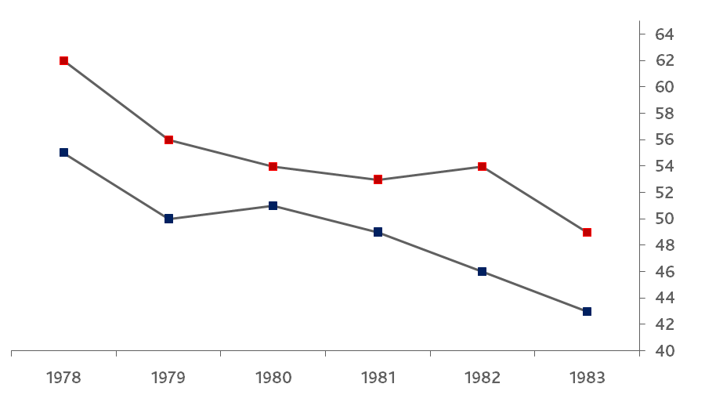
The knowledge base of practicing physicians deteriorates over time
Cardiologists / Gastroenterologists
Board Scores
General Internists
Ramsey P.G., Carline J.D., Inui T.S., Larson E.B., LoGerfo J.P., Norcini J.J., Wenrich M.D., “Changes over time in the knowledge base of practicing internists”, JAMA 266-8 (1991) 1103:1107

Slide 8
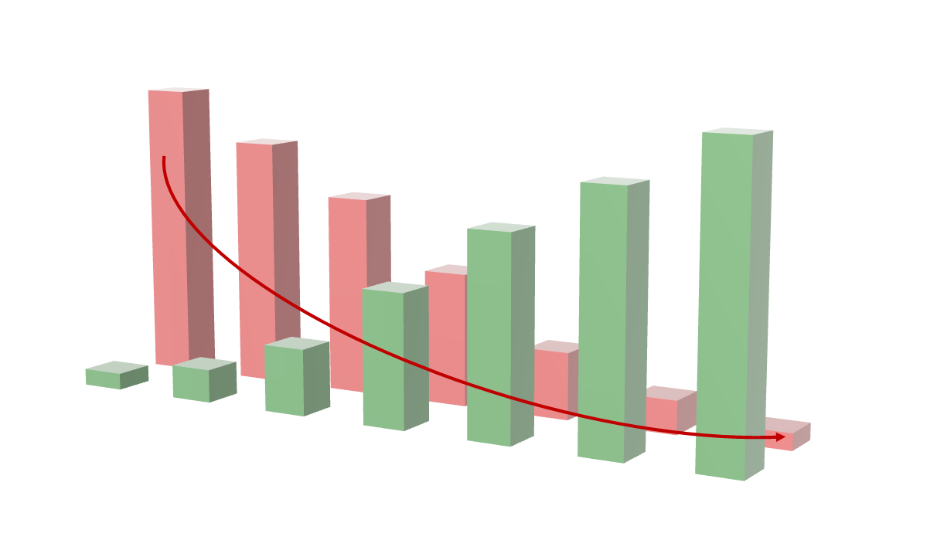
Doctors’ Challenge
Too much information and not enough time
Amount of Information
GAP
Time to meet information needs

Slide 9
Doctors’ Statement
We do not need more information, but the right information, directly on the spot that is:
    objective / unbiased
    Valid
    evidence based
    graded recommendations

Slide 10
Good Clinical Practice
YOU!
Best Clinical Evidence
UpToDate
Clinical Expertise
Patient’s Values and Circumstances

Slide 11
Several Independent studies show that UpToDate …
is used more than other resources
is efficient (saves time for clinicians)
has impact on patient care (better decisions)
improves doctor’s performance
brings savings for hospitals (Solucient study):
        hospital length of stay
        decreased complication rates
        reduce adverse events
        less referrals
        save money (ROI)

Slide 12
Users rely on UpToDate
85% German Doctors agree that UpToDate is integral to their practice.
UpToDate Subscribers’ Survey 2004, analysis confined to respondents in Germany

Slide 13
UK Study 2008

Slide 14
Impact across the world

Slide 15
UpToDate saves time

Slide 16
Clinicians choose UpToDate
Medline
UpToDate
MD Consult
Cochrane Library
Micromedex
NEJM Web Sites
Internet Search
Other
73%
70%
6%
3%
# of times a resource was used to answer questions (as %)
2%
1%
8%
(eg, Google)
4%
0 10 20 30 40 50 60 70 80
Schilling LM, et al. Acad Med. 2005:80(1):51.
Notes:
As a matter of fact, Independent research shows that UpToDate is used more than other information resources. This graph shows that the most frequently used methods to retrieve clinical information were Medline and UpToDate in a study of residents from the University of Colorado Health Sciences Center.

Slide 17
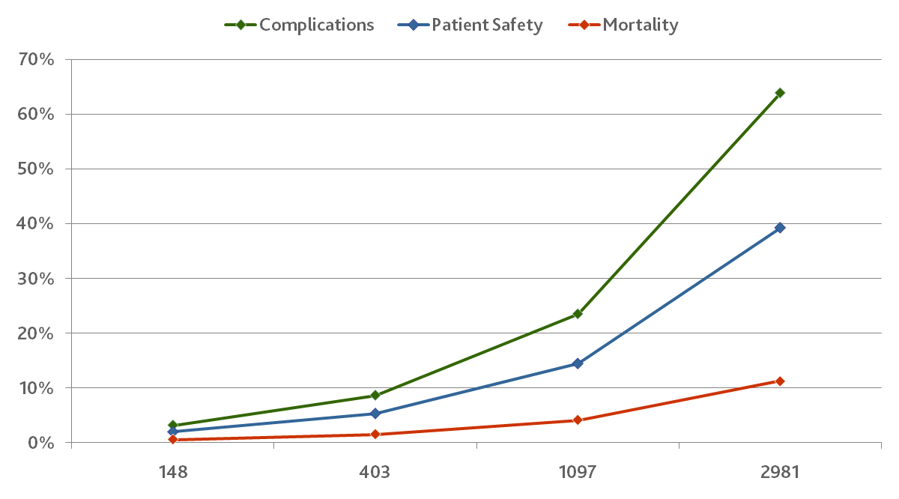
Increased UpToDate use results in better hospital performance
Estimated Impact of UpToDate usage levels on complications, patient safety and mortality
Improvement in Risk Percent
UpToDate Topic Reviews per Week
Bonis P.A., Pickens G.T., Rind D.M., Foster D.A.,
“Association of a clinical knowledge support system with improved patient safety, reduced complications and shorter length of stay among Medicare beneficiaries in acute care hospitals in the United States” International Journal of Medical Informatics Nov 77:11 (2008) 745:753

Slide 18
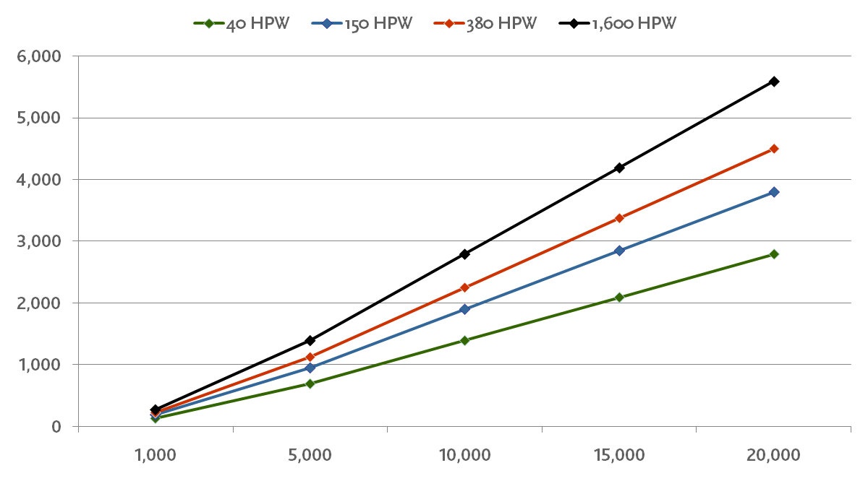
Effect on length of stay
Days of stay avoided given differing numbers of hits per week
(Hit per Week (HPW) for varying numbers of inpatient discharges)
Number of Days of Stay Avoided
Number of discharges per Year
Bonis P.A., Pickens G.T., Rind D.M., Foster D.A.,
“Association of a clinical knowledge support system with improved patient safety, reduced complications and shorter length of stay among Medicare beneficiaries in acute care hospitals in the United States” International Journal of Medical Informatics Nov 77:11 (2008) 745:753

Slide 19
Top Hospitals & Universities Have UpToDate
UpToDate is also currently part of the clinical practice at many prominent hospitals in the Gulf including:
  Bahrain: Bahrain Defense Forces Hospital - RCSI –Medical University of Bahrain
  Iran: Ministry Of Health for all University hospitals in Iran (49)
  Kuwait: Kuwait Medical Collage & hospital – Kuwait University
  Oman: Oman Medical Specialist Board (OMSB) - Sultan Qaboos University Hospital
  - Sohar Medical College - The Royal Hospital
  Qatar: Hamad Hospital & Medical Collage - ASPETAR -Qatar Ortho & Medicine Hospital
  Saudi Arabia:
    - King Abdul Aziz Medical City (NGH) - King Faisal Specialist Hospital
    - King Fahad Medical City - International Medical Hospital
    - Aramco Medical Services - Saad Specialist Hospital
    King Khalid Hospital (Riyadh) - King Abdulaziz University Hospital (Jeddah)
    Riyadh Military Hospital - Security Forces Hospital
    King Fahad Specialist Hospital - Al Hammadi Hospital
    University of Dammam - Northern Area Armed Forces Hospital
  UAE:
    SEHA for all Government Hospitals & Clinics in Abu Dhabi
    American Hospital in Dubai - Iranian Hospital in Dubai
    - The City & Welcare Hospitals & Clinics - Al Zahra Hospital (Sharjah)
    - Al Noor Hospital (Abu Dhabi) - Sharjah University - Medical College

Slide 20
Summing up
UpToDate is a resource available at your fingertips… just a few key-strokes away.
UpToDate (based on many studies):
  Is efficient (saves time for physicians)
  Has impact on patient care (better decisions)
  Brings savings (length of stay, less referrals,..)
  Increases satisfaction rates (physicians & patient)
UpToDate has no pop-ups, advertising or sponsors.
Written by physicians for physicians.
Certified by groups of specialties societies.
18 Covered Specialties and growing (more in progress)

Slide 21
Thank You

