Slide 1



IEEE

Slide 2
… Our Agenda …
Specifications of IEEE Xplore® Digital Library
Searching & Filtering Results
Personalization (IEEE Personal Account)
Browsing Journals & Magazines
Browse Conference Proceedings
Browse IEEE Online Standards Dictionary
Additional IEEE Support (Tutorials - FAQs)
IEEE Xplore Mobile

Slide 3

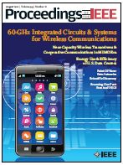


IEEE = Leader in Technology:
Institute of Electrical and Electronics Engineers
It ‘s Containing:
#1 journal in Electrical and Electronic Engineering
17 of the top 20 journals in Electrical and Electronic Engineering
8 of the top 10 journals in Telecommunications
6 of top 10 journals in Computer Science, Hardware & Architecture
3 of the top 5 journals in Computer Science, Cybernetics
3 of the top 5 journals in Automation & Control Systems
# 1 in Artificial Intelligence
# 1 in Information Systems
# 1 in Transportation Science
# 3 in Robotics
# 5 in Biomedical Engineering
IEEE Journals Continue to Dominate Citation Rankings: Journal Citation Reports.- accessed: 15 March 2013.- available at: http://www.ieee.org/publications_standards/publications/journmag/journalcitations.html
Journal Citation Report Results, by Impact Factor: The ISI JCR presents “quantifiable statistical data that provides a systematic, objective way to evaluate the world’s leading journals” (2010 report released June 2011)

Slide 4
Coming in 2013 – Patent Data Integration to STM Publishers
IEEE
is 1st!
IEEE is cited nearly 3x more than any other publisher
Source: 1790 Analytics 2011
U.S. patent references from the top 25 patenting organizations to top publishers
Based on number of references to papers/standards/conferences
33% of sci-tech citations by the top 25 patenting organizations are to IEEE papers

Slide 5
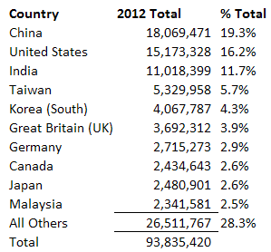
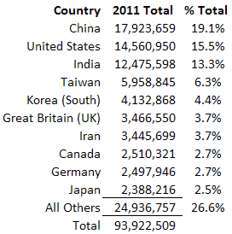
Top 10 Usage Countries - 2011 vs. 2012

Slide 6

Biggest Xplore users Five top corporate customers 2012
Customer | # documents downloaded in 2012
Intel | 446,880
Huawei (China) | 338,631
Samsung (Korea) | 198,719
IBM | 189,405
Alcatel-Lucent (France/USA) | 166,369

Slide 7
Depth of Content
IEEE Xplore Digital Library includes …
More than 3 millions full-text documents
158+ IEEE journals & magazines
1100+ annual IEEE conferences
3,000+ IEEE standards
IET conferences, journals & magazines
Inspec index records for all articles
Backfile to 1988
Select legacy data back to 1872

Slide 8
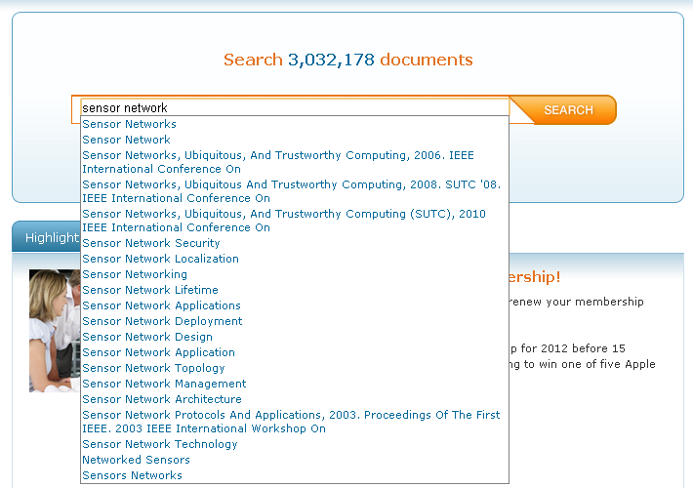
Start your search here …

Slide 9
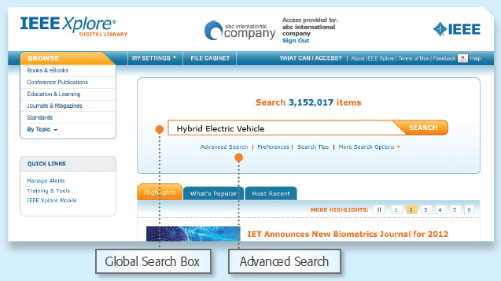
GLOBAL SEARCH BOX …

Slide 10
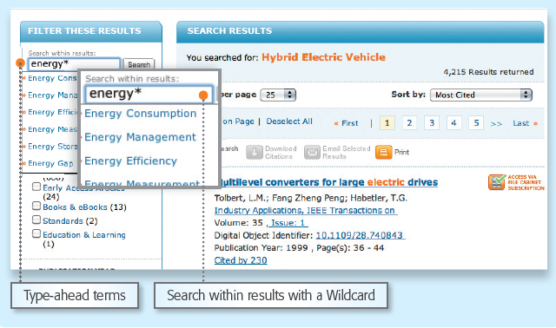
Filtering Your Results …

Slide 11
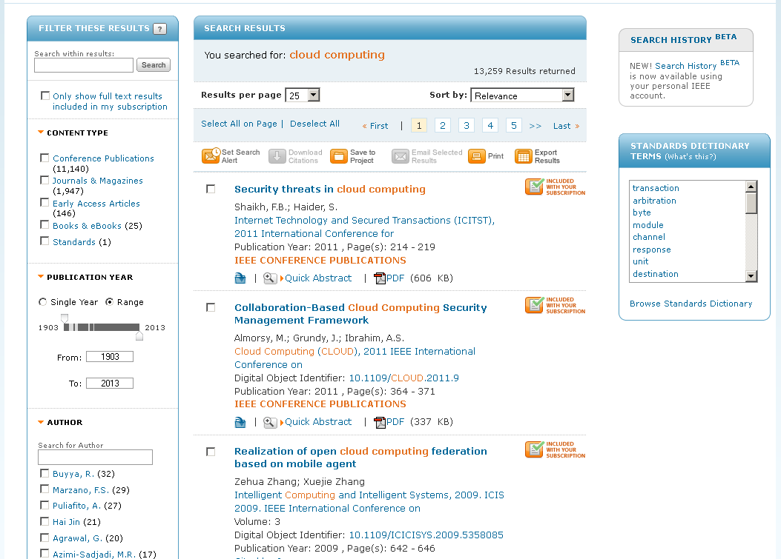
Launched in 2012 – Subscribed Content Filter

Slide 12
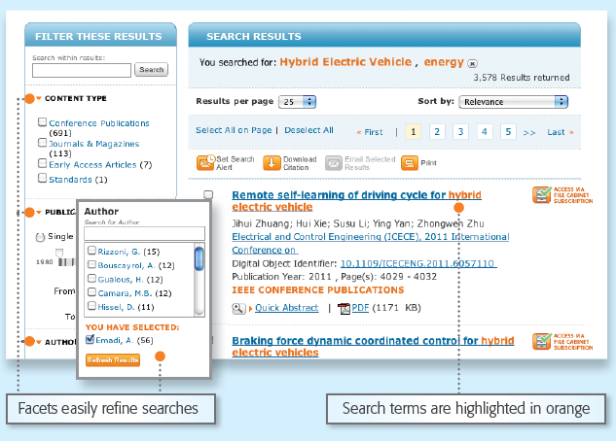
Refine your results with many facets …

Slide 13
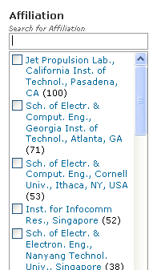
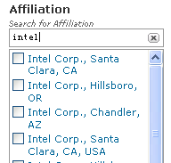
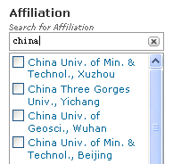
Clustering- Affiliation Search …
Top 25 affiliations by record count
Look for a special affiliation name, city name or country name

Slide 14
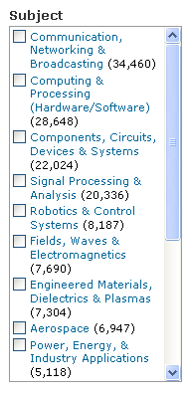
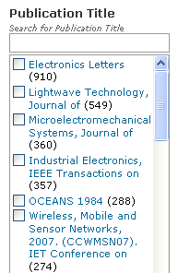
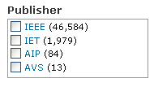
Clustering- More Facets …
16 subjects from IEEE thesaurus

Slide 15
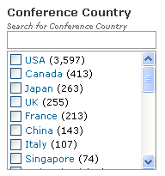
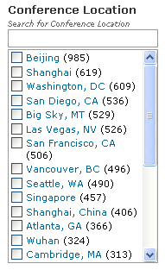
Clustering- Locate Conference

Slide 16
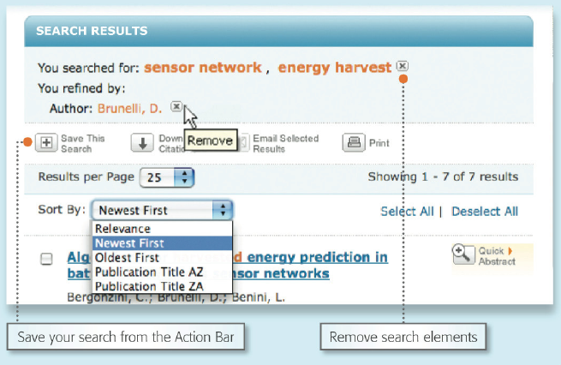
Search Results : saving, sorting and many actions

Slide 17
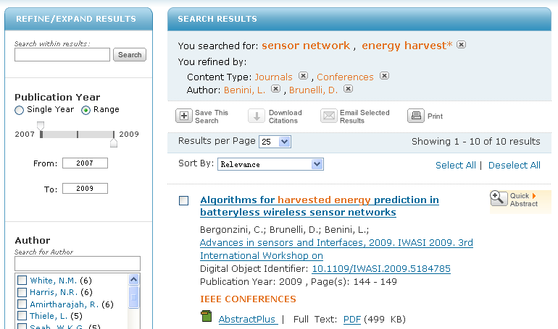
Abstract Plus: Retrieve All Related Articles

Slide 18
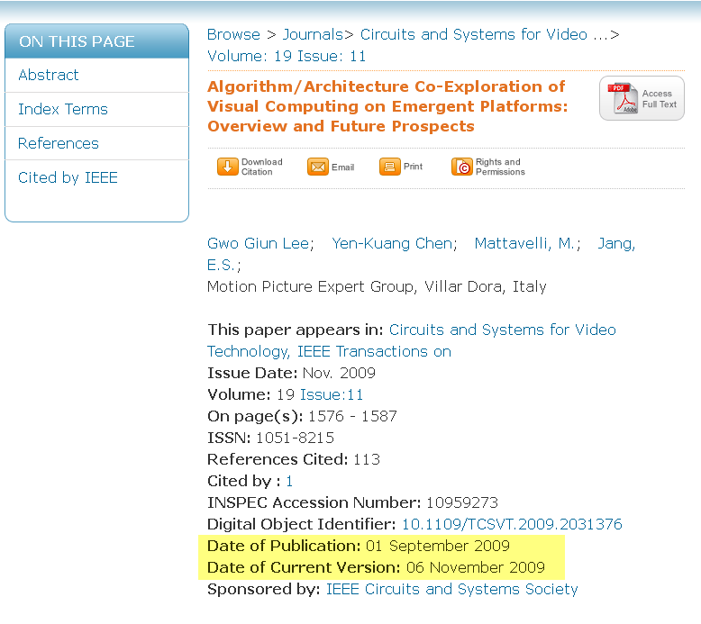
AbstractPlus – Date fields
Pre published date & Final published date
Notes:
Date of publication shows it was an early access paper, Date of Current Version is when it was published in it’s final format

Slide 19
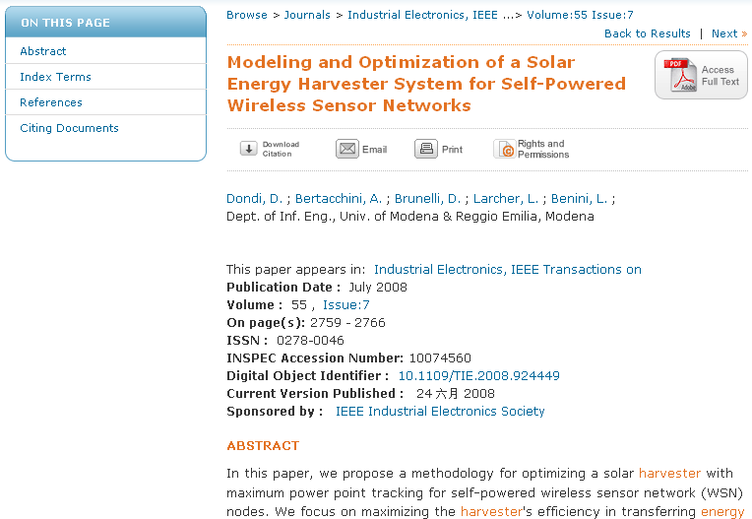
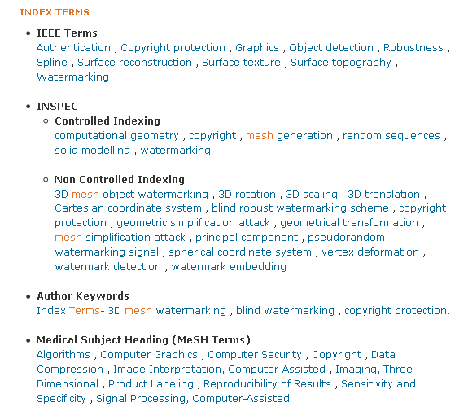
Expanded Index Terms …

Slide 20
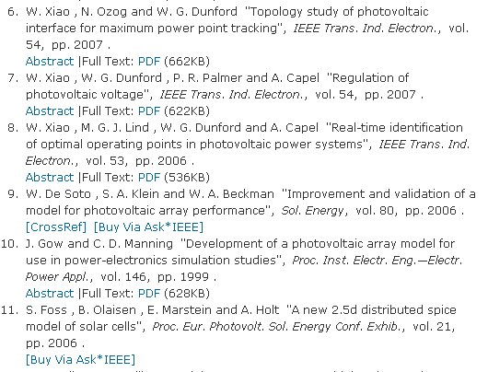
Linked References …

Slide 21
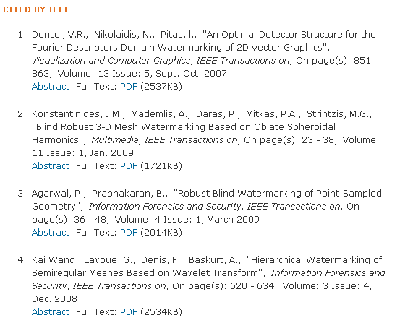
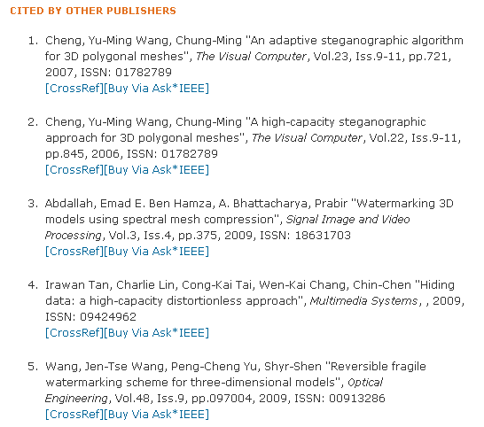
Citations by IEEE & Other Publishers …

Slide 22
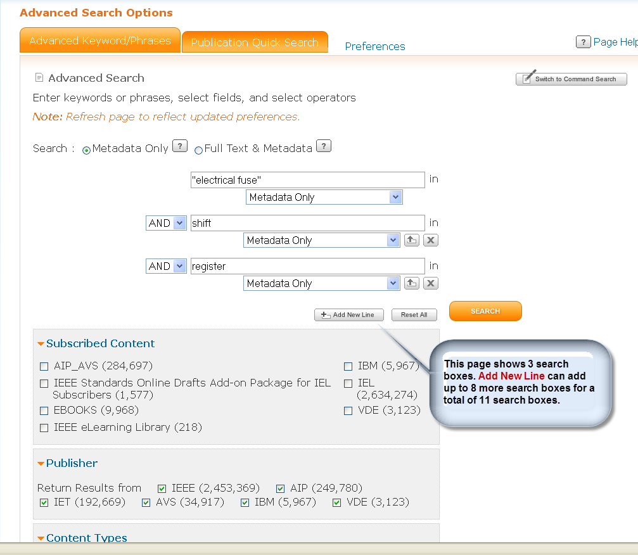
Advanced Search …

Slide 23
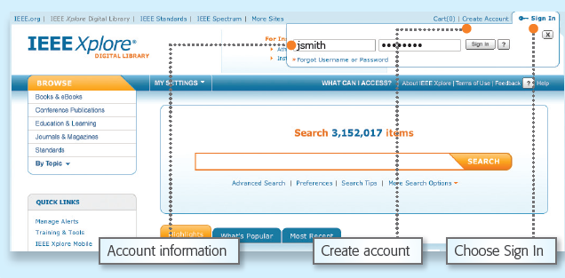
Personalization: IEEE Personal Account

Slide 24
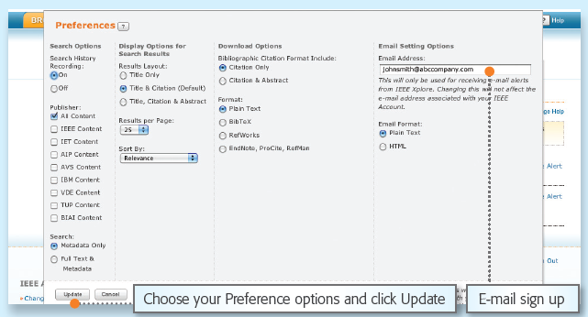
Set Your Preferences …

Slide 25
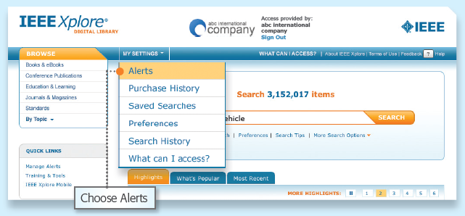
Set up Table of Contents Alerts …
Set up Table of Contents Alerts

Slide 26
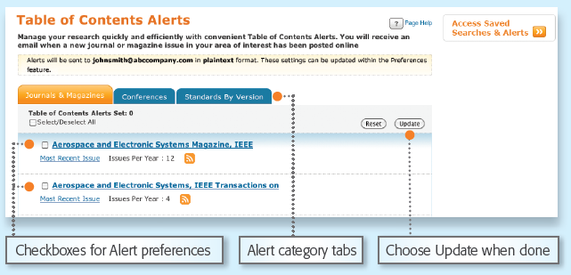
Set up Table of Contents Alerts (ToC) …
Set up Table of Contents Alerts

Slide 27
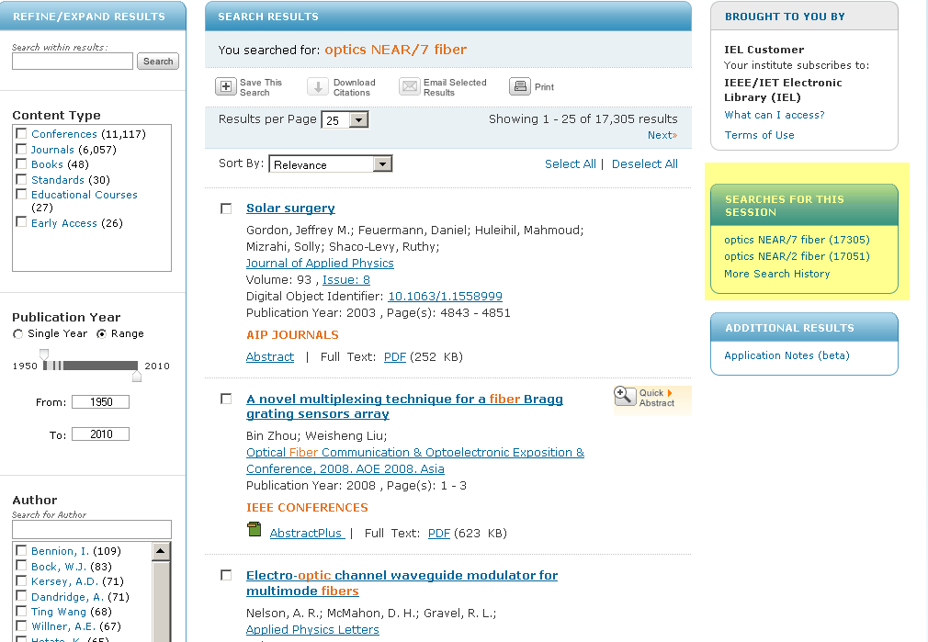
Search History …

Slide 28
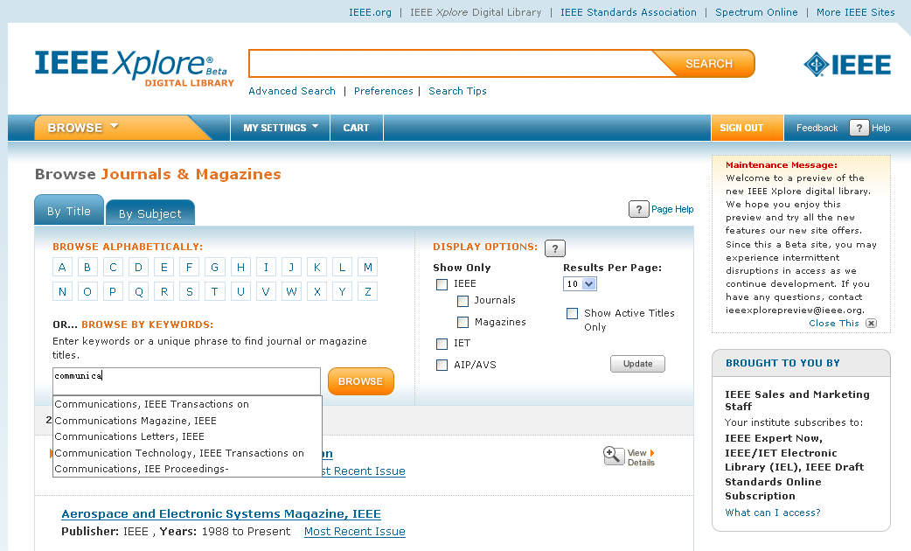
Identifying The Best of Your Needs:
Browsing Journals & Magazines

Slide 29
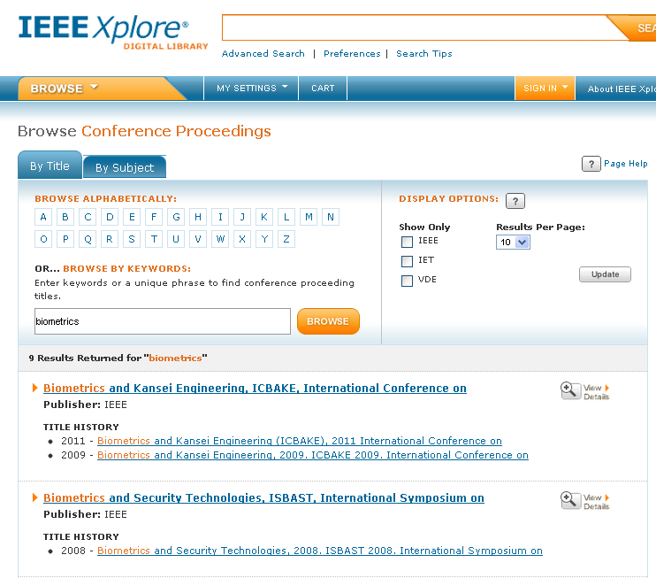
Identifying The Best of Your Needs:
Browse Conference Proceedings

Slide 30
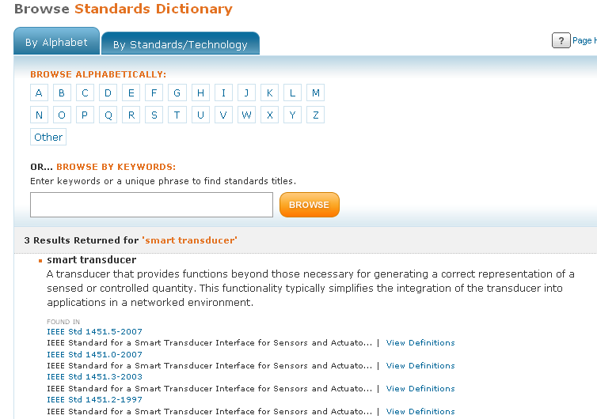
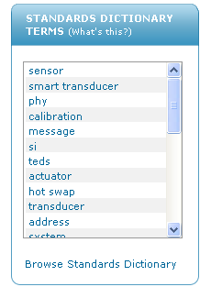
Identifying The Best of Your Needs:
Browse IEEE Online Standards Dictionary

Slide 31
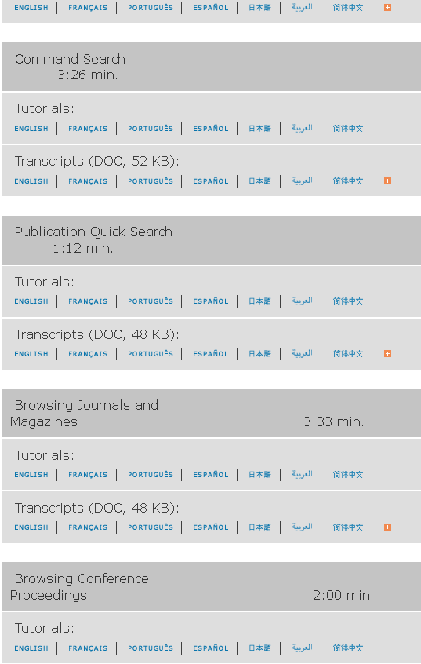
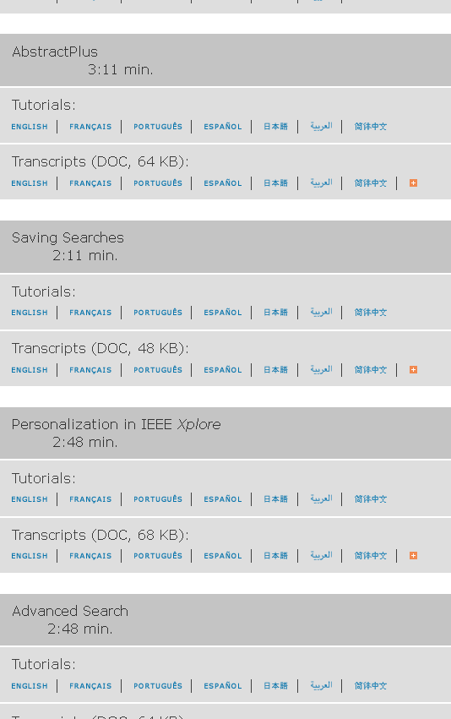
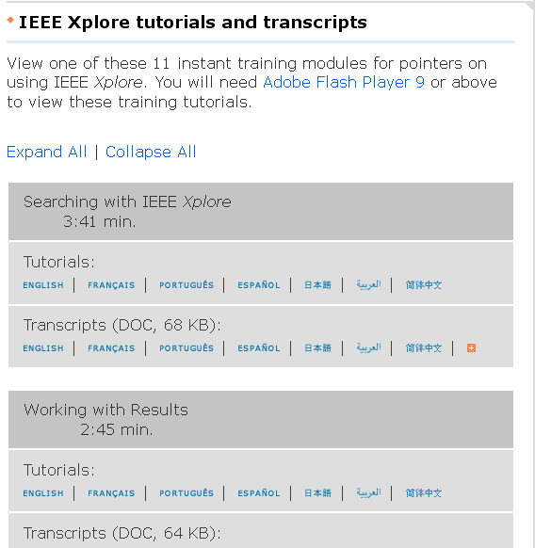
Additional IEEE Support:
http://www.ieee.org/training

Slide 32
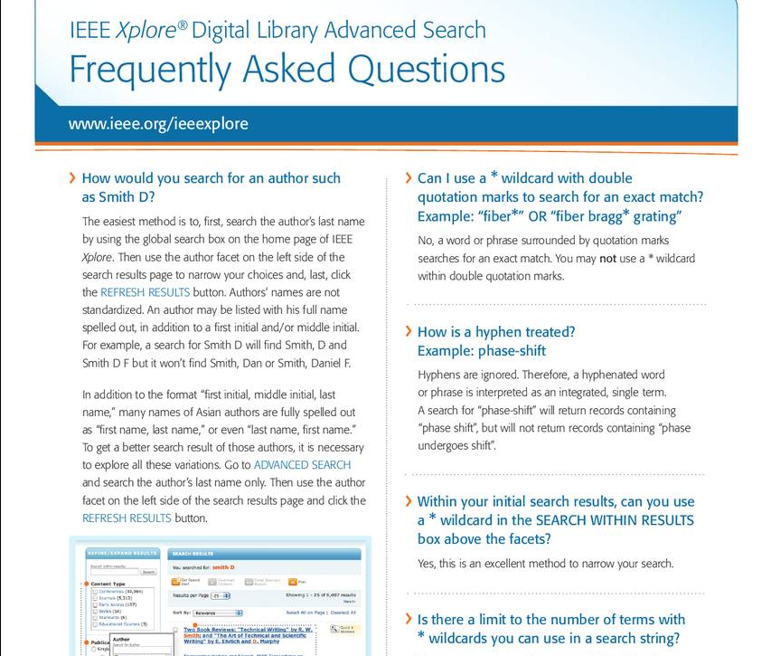
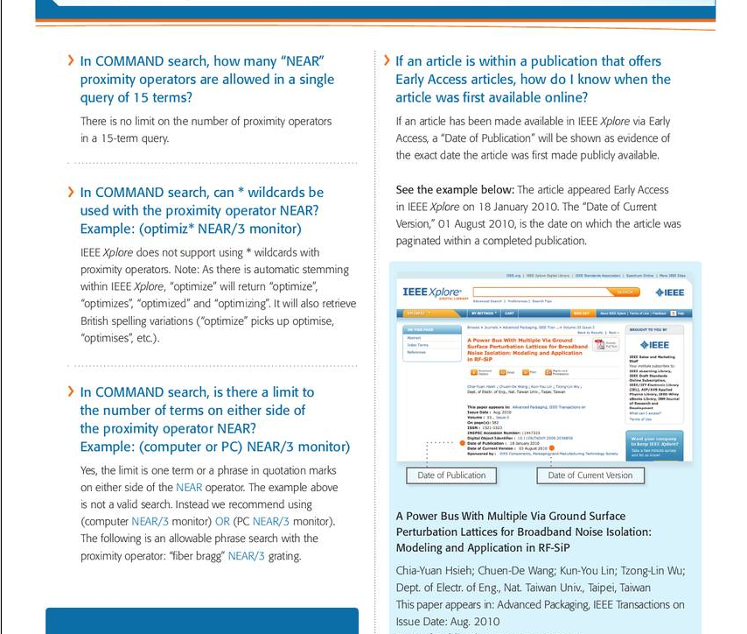
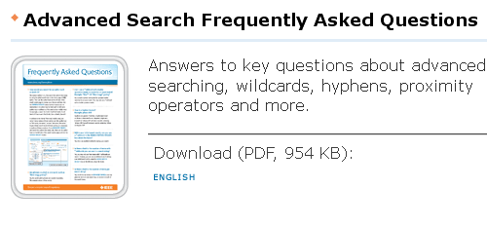
Advanced Tip Sheet http://www.ieee.org/publications_standards/publications/subscriptions/clientservices/promote/user_guides.html

Slide 33

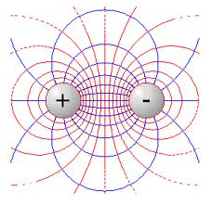
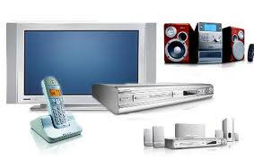
New IEEE Journals for 2012
IEEE Consumer Electronics Magazine
Biomedical Engineering, IEEE Reviews in
IEEE RFID Virtual Journal
IEEE RFIC Virtual Journal
Medical Imaging, IEEE transaction on
For a complete listing of titles, go to: http://ieeexplore.ieee.org/xpl/opacjrn.jsp

Slide 34
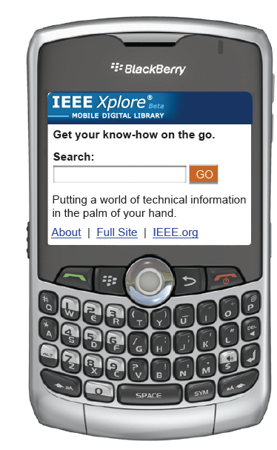
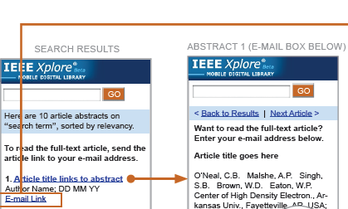
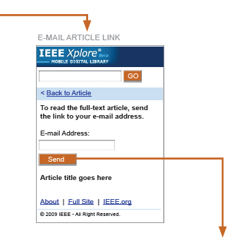

Now Available: IEEE Xplore Mobile
http://m.ieeexplore.ieee.org/

Slide 35
Thanks for good listening
Questions? .. Questions? .. Questions?
Please contact:
Dr.Muhammad Mustafa Mahmoud
m.abdulrahman@naseej.com.sa
“The best way to have a good idea is to have lots of ideas”
Linus Pauling

