Slide 1

الملصقات العلميةPosters
Prof. Yasser B. Saddeek

Slide 2
الملصقات العلمية الأكاديمية (Research Posters)
الملصق العلمي هو ورقة مطبوعة يمكن إلصاقها على الحائط ويستخدم في الجامعات و المؤتمرات. ويتم تصميم الملصق لإيصال فكرة معينة بشكل جذاب و ملفت من أجل عرض أفكار أبحاث ومشاريع الباحثين بشكل علمي حتي يتم فتح مجال النقاش ليتم تبادل الخبرات فيما بينهم.
هناك نوعان رئيسيان لأشكال الملصقات العلمية و هما:
الملصق العرضي: عند وجود محتوى كبير يحتوي علي العديد من المعلومات والرسومات.
الملصق الطولي: في حال كان محتوى البحث ليس فيه الكثير من المعلومات والرسومات.

Slide 3
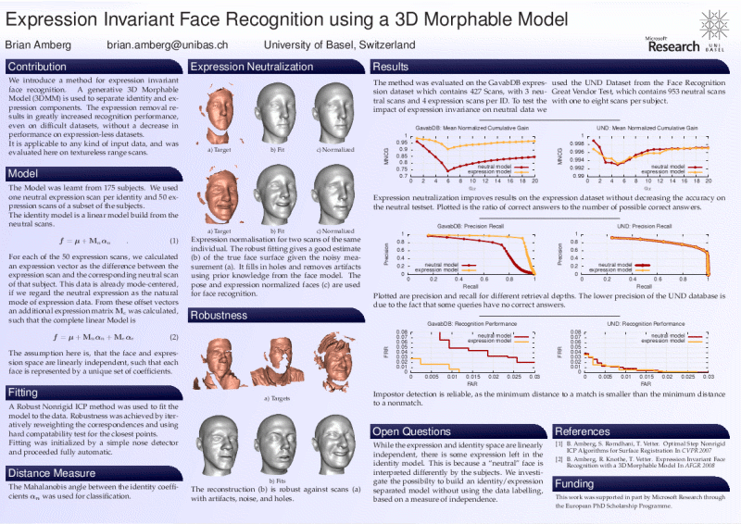

Slide 4
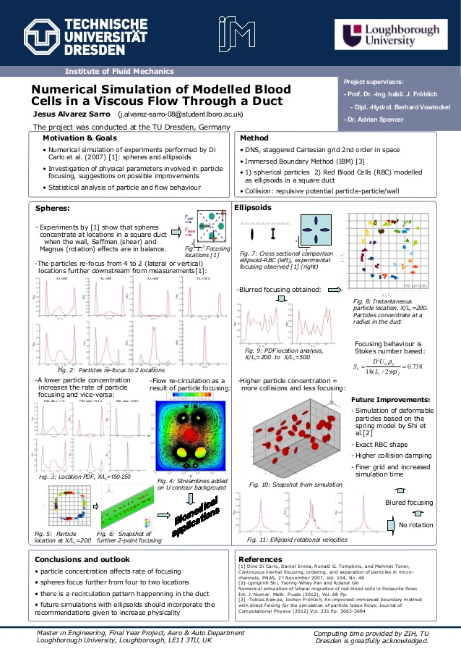

Slide 5
أحجام الملصقات المتعارف عليها
مقاسات الملصقات العلمية المتعارف عليها هي أربعة:
A0: 118.9 cm x 84.1 cm
A1: 84.1 cm x 59.4 cm
A2: 59.4 cm x 42.0 cm
A3: 42.0 cm x 29.7 cm
قبل البدء بالتصميم يجب معرفه المقاس المطلوب من قبل الجهة التي سوف تعرض فيها ملصقك. بعد ذلك، و عند البدء في التصميم الفعلي باستخدام أحد برامج التصميم (كالبوربوينت مثلا أو مواقع علي شبكة الانترنت مثل www.canva.com)، حدد مقاس مساحة العمل في البرنامج لضمان تصميم الملصق بالحجم المقبول.

Slide 6
بعض مواقع علي شبكة الانترنت الخاصة بالأنواع المختلفة للملصقات
Stencil
Snappa
DesignBold
Crello
Fotor
Piktochart
PicMonkey
Desygner
Adobe Spark

Slide 7
أهمية تواجد الصور والجداول في أي ملصق عملي
عند ترتيب الملصق العلمي لابد من الاهتمام باخراج الرسوم البيانية والصور لأن الصورة تبقى في ذهن المتلقي أكثر من الكلام، لذلك يمكن التعبير عن الكثير من الخطوات و العمليات المتواجدة في البحث برسوم بيانية أو صور تعبيرية مناسبة وهذا لجذب إنتباه الجمهور,وحتي يكون الملصق أسهل للفهم.
ويمكن أيضا كتابة النتائج وتجميعها في جدول بسيط و مرتب.

Slide 8
التوازن ما بين النص والصور
عند تصميم الملصق العلمي يراعي التنسيق بين الفقرات النصية في الملصق وبين الصور و الرسومات البيانية بحيث يكون هناك توازن بينهما. ولنتذكر أن الملصق لابد أن يعبر عن كل أفكار الباحث.
و يوضح الشكل التالي هذه الفكرة أكثر َ.

Slide 9
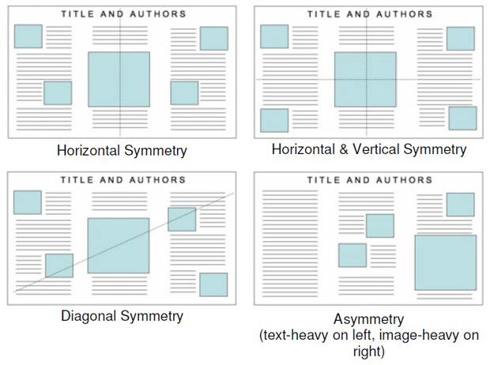

Slide 10
اعتبارات فنية
لابد من إمكانية رؤية الملصق بوضوح من مسافة مترين علي الأقل
استخدام نوعية وحجم خط مناسب مثل
Headings → Arial
  Text → Times
تناسق الألوان وإخراجها في الملصق ككل
Title → at least 72 point
Headings → 36-48 point
Text → at least 24 point
Chart labels → 24 point

Slide 11
وضوح ودقة الوان الاشكال البيانية
Print formats: 600-1200 DPI (dots per inch)
  TIFF, EPS, WMF, JPG?
Screen formats: 72 DPI (dots per inch)
  GIF, JPG, WMF
Scan new color graphics at 150-200 DPI
  Higher for black and white
عند طباعة الملصق لابد من مراعاة الأتي
ترك مسافات بيضاء عند الحواف وإجراء فحص لغوي دقيق
الخطوط العريضة فقط لأبراز العبارات المهمة فقط

Slide 12
ونصائح بسيطة قبل عرض الملصق
1- وصول الباحث مبكرا الي مكان العرض.
2- تعليق الملصق بعناية شديدة واختيار المكان الأبرز.
3- يتواجد الباحث بجانب ملصقه العلمي عند عرضه ولأن المساحة المحددة للملصق والتي سيتم عرض المحتوى والرسومات فيها تكون محدودة لذلك تحتاج إلى مهارة في التلخيص.

Slide 13
العناصر الأساسية التي تكون الملصق
العنوان الرئيسي في الملصق العلمي
يتواجد في أعلى الملصق العلمي مع توسيطه، ويكون حجم الخط أكبر من جميع خطوط المحتويات الأخرى.
العنوان الرئيسي هو مفتاح فهم الملصق لذلك لابد من العناية الفائقة باختيار العنوان المناسب والجذاب.
أسماء المشاركين في الملصق العلمي
يتم وضع أسماء المشاركين تحت العنوان الرئيسي مباشرة مع ذكر إسم و مكان الجهة التي يتبعون لها والبريد الإلكتروني للتواصل معهم
ملخص الملصق العلمي
الملخص (Abstract) يكون دائماً في بداية الملصق

Slide 14
مقدمة البحث (Introduction)
أهداف البحث (Aims of the research)
منهجية البحث العلمي (Methodology)
النتائج ومناقشتها (Results and Discussions)
خاتمة الملصق (Conclusions)
وهذا الجزء الأخير هو ملخص شديد لمناقشة نتائج الملصق ويستلزم عناية خاصة عند كتابته

Slide 15
عند وجود جهة داعمة للبحث أو باحثين أخرين قاموا بالمساعدة ولم توضع أسمائهم في المشاركين فلابد من ذكر الجهة او الباحثين في الشكر (Acknowledgement)
المراجع (References)
عند ذكر المراجع المستخدمة في البحث فيمكن ذكر جزء منها وهذا لعدم توافر المساحة لذلك.

Slide 16
نماذج من الملصقات

Slide 17
Poster title goes here, containing strictly
only the essential number of words...
Author’s Name/s Goes Here, Author’s Name/s Goes Here, Author’s Name/s Goes Here
Address/es Goes Here, Address/es Goes Here, Address/es Goes Here
Introduction
First…
Check with conference organisers on their specifications of size and orientation, before you start your poster eg. maximum poster size; landscape, portrait or square.
The page size of this poster template is A0 (84x119cm), landscape (horizontal) format. Do not change this page size, MIU can scale-to-fit a smaller or larger size, when printing. If you need a different shape start with either a portrait (vertical) or a square poster template.
Bear in mind you do not need to fill up the whole space allocated by some conference organisers (eg. 8ftx4ft in the USA). Do not make your poster bigger than necessary just to fill that given size.
Method
Tips for making a successful poster…
Re-write your paper into poster format ie.
Simplify everything, avoid data overkill.
Headings of more than 6 words should be in upper and lower case, not all capitals.
Never do whole sentences in capitals or underline to stress your point, use bold characters instead.
When laying out your poster leave breathing space around you text. Don’t overcrowd your poster.
Try using photographs or coloured graphs. Avoid long numerical tables.
Spell check and get someone else to proof-read.
Results
Importing / inserting files…
Images such as photographs, graphs, diagrams, logos, etc, can be added to the poster.
To insert scanned images into your poster, go through the menus as follows: Insert / Picture / From File… then find the file on your computer, select it, and press OK.
The best type of image files to insert are JPEG or TIFF, JPEG is the preferred format.
Be aware of the image size you are importing. The average colour photo (13 x 18cm at 180dpi) would be about 3Mb (1Mb for B/W greyscale). Call MIU if unsure.
Do not use images from the web.
Notes about graphs…
For simple graphs use MS Excel, or do the graph directly in PowerPoint.
Graphs done in a scientific graphing programs (eg. Sigma Plot, Prism, SPSS, Statistica) should be saved as JPEG or TIFF if possible. For more information see MIU.
Printing and Laminating…
Once you have completed your poster, bring it down to MIU for printing. We will produce a A3 size draft print for you to check and proof read. The final poster will then be printed and laminated.
Note: Do not leave your poster until the last minute. Allow at least 5 working days before you need to use it.
Simply highlight this text and replace.
Cost…
For poster-printing and laminating charges contact to MIU
Captions to be set in Times or Times New Roman or equivalent, italic, between 18 and 24 points.
Left aligned if it refers to a figure on its left. Caption starts right at the top edge of the picture (graph or photo).
Conclusion
For more information on:
Poster Design, Scanning and Digital Photography,
and Image / file size.
Contact:
Medical Illustration Unit
Prince of Wales Hospital
Ph: 9382 2800
Email: miunsw@unsw.edu.au
Web: http://miu.med.unsw.edu.au
Aim
How to use this poster template…
Simply highlight this text and replace it by typing in your own text, or copy and paste your text from a MS Word document or a PowerPoint slide presentation.
The body text / font size should be between 24 and 32 points. Arial, Helvetica or equivalent.
Keep body text left-aligned, do not justify text.
The colour of the text, title and poster background can be changed to the colour of your choice.
Captions to be set in Times or Times New Roman or equivalent, italic, between 18 and 24 points. Right aligned if it refers to a figure on its right. Caption starts right at the top edge of the picture (graph or photo).
Captions to be set in Times or Times New Roman or equivalent, italic, between 18 and 24 points.
Left aligned if it refers to a figure on its left. Caption starts right at the top edge of the picture (graph or photo).
Acknowledgements
Just highlight this text and replace with your own text. Replace this with your text.
Captions to be set in Times or Times New Roman or equivalent, italic, 18 to 24 points, to the length of the column in case a figure takes more than 2/3 of column width.
Captions to be set in Times or Times New Roman or equivalent, italic, 18 to 24 points, to the length of the column in case a figure takes more than 2/3 of column width.

Slide 18
Poster title goes here, containing strictly
only the essential number of words...
Author’s Name/s Goes Here, Author’s Name/s Goes Here, Author’s Name/s Goes Here
Address/es Goes Here, Address/es Goes Here, Address/es Goes Here
Introduction
Method
Results
First…
Check with conference organisers on their specifications of size and orientation, before you start your poster eg. maximum poster size; landscape, portrait or square.
The page size of this poster template is A0 (84x119cm), landscape (horizontal) format. Do not change this page size, MIU can scale-to-fit a smaller or larger size, when printing. If you need a different shape start with either a portrait (vertical) or a square poster template.
Bear in mind you do not need to fill up the whole space allocated by some conference organisers (eg. 8ftx4ft in the USA). Do not make your poster bigger than necessary just to fill that given size.
Tips for making a successful poster…
Re-write your paper into poster format ie.
Simplify everything, avoid data overkill.
Headings of more than 6 words should be in upper and lower case, not all capitals.
Never do whole sentences in capitals or underline to stress your point, use bold characters instead.
When laying out your poster leave breathing space around you text. Don’t overcrowd your poster.
Try using photographs or coloured graphs. Avoid long numerical tables.
Spell check and get someone else to proof-read.
Importing / inserting files…
Images such as photographs, graphs, diagrams, logos, etc, can be added to the poster.
To insert scanned images into your poster, go through the menus as follows: Insert / Picture / From File… then find the file on your computer, select it, and press OK.
The best type of image files to insert are JPEG or TIFF, JPEG is the preferred format.
Be aware of the image size you are importing. The average colour photo (13 x 18cm at 180dpi) would be about 3Mb (1Mb for B/W greyscale). Call MIU if unsure.
Do not use images from the web.
Notes about graphs…
For simple graphs use MS Excel, or do the graph directly in PowerPoint.
Graphs done in a scientific graphing programs (eg. Sigma Plot, Prism, SPSS, Statistica) should be saved as JPEG or TIFF if possible. For more information see MIU.
Printing and Laminating…
Once you have completed your poster, bring it down to MIU for printing. We will produce a A3 size draft print for you to check and proof read. The final poster will then be printed and laminated.
Note: Do not leave your poster until the last minute. Allow at least 5 working days before you need to use it.
Simply highlight this text and replace.
Cost…
For poster-printing and laminating charges contact to MIU
Captions to be set in Times or Times New Roman or equivalent, italic, between 18 and 24 points.
Left aligned if it refers to a figure on its left. Caption starts right at the top edge of the picture (graph or photo).
Conclusion
Aim
For more information on:
Poster Design, Scanning and Digital Photography,
and Image / file size.
Contact:
Medical Illustration Unit
Prince of Wales Hospital
Ph: 9382 2800
Email: miunsw@unsw.edu.au
Web: http://miu.med.unsw.edu.au
How to use this poster template…
Simply highlight this text and replace it by typing in your own text, or copy and paste your text from a MS Word document or a PowerPoint slide presentation.
The sub-title text boxes can be moved up or down depending on how big or small your ‘Introduction’, ‘Aim’, ‘Method’, ‘Results’ and ‘Conclusion’ are.
The body text / font size should be between 24 and 32 points. Arial, Helvetica or equivalent.
Keep body text left-aligned, do not justify text.
The colour of the text, title and poster background can be changed to the colour of your choice.
Captions to be set in Times or Times New Roman or equivalent, italic, between 18 and 24 points. Right aligned if it refers to a figure on its right. Caption starts right at the top edge of the picture (graph or photo).
Captions to be set in Times or Times New Roman or equivalent, italic, between 18 and 24 points.
Left aligned if it refers to a figure on its left. Caption starts right at the top edge of the picture (graph or photo).
Acknowledgements
Just highlight this text and replace with your own text. Replace this with your text.
Captions to be set in Times or Times New Roman or equivalent, italic, 18 to 24 points, to the length of the column in case a figure takes more than 2/3 of column width.
Captions to be set in Times or Times New Roman or equivalent, italic, 18 to 24 points, to the length of the column in case a figure takes more than 2/3 of column width.

Slide 19
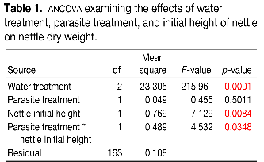
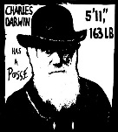
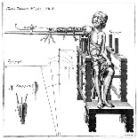

Title that hints at the underlying issue or question and is formatted in “sentence case”
Your name(s) here
Department of Biology, Swarthmore College, Swarthmore, Pennsylvania 19081
Maintain a good amount of space between your columns. Although you could squeeze them right up against each other, the poster’s aesthetics would suffer.
This means only the “t” in “title” gets capitalized.
This is a header. If you make the font size large, and then add bolding…there is no need to also apply underlining or italicization.
Make sure the edges of your columns are aligned with adjacent columns. Don’t trust your eyes: select the columns, then “Align” with the proper tool
Introduction
This is a Microsoft Powerpoint template that has column widths and font sizes optimized for printing a 36 x 56” poster—just replace the “tips” and “blah, blah, blah” repeat motifs with actual content, if you have it. Try to keep your total word count under 500 (yea, this suggestion applies to everyone, even you). More tips can be found at the companion site, “Advice on designing scientific posters,” at the Swarthmore College Biology Department web site.
This paragraph has “justified” margins, but be aware that simple left-justification (other paragraphs) is infinitely better if your font doesn’t “space” nicely when fully justified. Sometimes spacing difficulties can be fixed by manually inserting hyphens into longer words. (Powerpoint doesn’t automatically hyphenate, by the way.)
Your main text is easier to read if you use a “serif” font such as Palatino or Times (i.e., people have done experiments and found this to be the case). Use a non-serif font for your title and section headings.
Results
The overall layout for this section can, and probably should, be modified from this template, depending on the size and number of charts and photographs your specific experiment generated. You might want a single, large column to accommodate a large map, or perhaps you could arrange 6 figures in a circle in the center of the poster: do whatever it takes to make your results graphically clear. To see examples of how others have abused this template to fit their presentation needs, perform a Google search for “powerpoint template for scientific posters.”
Paragraph format is fine, but sometimes a simple list of “bullet” points can communicate results more effectively:
  9 out of 12 brainectomized rats survived
  Control rats completed maze faster, on average, than rats without brains (Fig. 3b) (t = 9.84, df = 21, p = 0.032)
If you can orient your label horizontally, viewers with fused neck musculature are more likely to read it.
Rats with brains navigate mazes faster
Conclusions
You can, of course, start your conclusions in column #3 if your results section is “data light.”
Conclusions should not be mere reminders of your results. Instead, you want to guide the reader through what you have concluded from the results. What is the broader significance? Would anyone be mildly surprised? Why should anyone care? This section should refer back, explicitly, to the “burning issue” mentioned in the introduction. If you didn’t mention a burning issue in the introduction, go back and fix that -- your poster should have made a good case for why this experiment was worthwhile.
Blah, blah, blah. Blah, blah, blah. Blah, blah, blah. Blah, blah, blah. Blah, blah, blah. Blah, blah, blah. Blah, blah, blah. Blah, blah, blah. Blah, blah, blah. Blah, blah, blah. Blah, blah, blah. Blah, blah, blah. Blah, blah, blah. Blah, blah, blah. Blah, blah, blah. Blah, blah, blah. Blah, blah, blah. Blah, blah, blah. Blah, blah, blah. Blah, blah, blah. Blah, blah, blah. Blah, blah, blah. Blah, blah, blah.
Blah, blah, blah. Blah, blah, blah. Blah, blah, blah. Blah, blah, blah. Blah, blah, blah. Blah, blah, blah. Blah, blah, blah. Blah, blah, blah.
Time (s)
Brainectomized
The first sentence of the first paragraph does not need to be indented.
Control (brain intact)
Maze difficulty index
Figure 4. Avoid keys that force readers to labor through complicated graphs: just label all the lines (or bars) and then delete the silly key altogether. The above figure would also be greatly improved if I had the ability to draw mini rats with and without brains. I would then put these little illustrations next to the lines they represent.
(a)
(b)
(c)
Be sure to separate figures from other figures by generous use of white space. When figures are too cramped, viewers get confused about which figures to read first and which legend goes with which figure.
Figures are preferred but tables are sometimes unavoidable. A table looks best when it is first composed within Microsoft Word, then “Inserted” as an “Object.” If you can add small drawings or icons to your tables, do so!
Materials and methods
Be brief, and opt for photographs or drawings whenever possible to illustrate organism, protocol, or experimental design. Viewers don’t actually want to read about the gruesome details, however fascinating you might find them.
Blah, blah, blah. Blah, blah, blah. Blah, blah, blah. Blah, blah, blah. Blah, blah, blah. Blah, blah, blah. Blah, blah, blah. Blah, blah, blah. Blah, blah, blah. Blah, blah, blah.
Blah, blah, blah. Blah, blah, blah. Blah, blah, blah. Blah, blah, blah. Blah, blah, blah. Blah, blah, blah. Blah, blah, blah. Blah, blah, blah. Blah, blah, blah. Blah, blah, blah.
Blah, blah, blah. Blah, blah, blah. Blah, blah, blah. Blah, blah, blah. Blah, blah, blah. Blah, blah, blah.
Remember: no period after journal name.
Literature cited
Bender, D.J., E.M Bayne, and R.M. Brigham. 1996. Lunar condition influences coyote (Canis latrans) howling. American Midland Naturalist 136:413-417.
Brooks, L.D. 1988. The evolution of recombination rates. Pages 87-105 in The Evolution of Sex, edited by R.E. Michod and B.R. Levin. Sinauer, Sunderland, MA.
Scott, E.C. 2005. Evolution vs. Creationism: an Introduction. University of California Press, Berkeley.
Society for the Study of Evolution. 2005. Statement on teaching evolution. < http://www.evolutionsociety.org/statements.html >. Accessed 2005 Aug 9.
Figure 3. Make sure legends have enough detail to fully explain to the viewer what the results are. Note that for posters it is good to put some “Materials and methods” information within the figure legends or onto the figures themselves—it allows the M&m section to be shorter, and gives viewer a sense of the experiment(s) even if they have skipped directly to figures. Don’t be tempted to reduce font size in figure legends, axes labels, etc.—your viewers are probably most interested in reading your figures and legends!
Often you will have some more text-based results between your figures. This text should explicitly guide the reader through the figures.
Blah, blah, blah (Figs. 3a,b). Blah, blah, blah. Blah, blah, blah. Blah, blah, blah. Blah, blah, blah. Blah, blah, blah. Blah, blah, blah. Blah, blah, blah.
Blah, blah, blah. Blah, blah, blah. Blah, blah, blah. Blah, blah, blah. Blah, blah, blah. Blah, blah, blah. Blah, blah, blah. Blah, blah, blah (Fig. 3c). Blah, blah, blah. Blah, blah, blah. Blah, blah, blah. Blah, blah, blah. Blah, blah, blah. Blah, blah, blah (data not shown).
Blah, blah, blah. Blah, blah, blah. Blah, blah, blah. Blah, blah, blah. Blah, blah, blah. Blah, blah, blah. Blah, blah, blah. Blah, blah, blah. Blah, blah, blah. Blah, blah, blah (God, personal communication).
This area is “white space” that adds tremendously to the readability of your poster. Resist the urge to fill it with text. Yea, this means you.
Acknowledgments
We thank I. Güor for laboratory assistance, Mary Juana for seeds, Herb Isside for applying the greenhouse stress treatment, and M.I. Menter for statistical advice and scintillating discussions. Funding for this project was provided by the Swarthmore College Department of Biology, a Merck summer stipend, and my mom. [Note that people’s titles are omitted.]
I sure wish I’d presented my theory with a poster before I wrote my book.
Abutting these last sections can save you a little space, and subtly indicates to viewers that the contents are not as important to read.
Put a figure here that explores a statistical result
Figure 1. Photograph or drawing of organism, chemical structure, or whatever. Don’t use graphics from the web (they look terrible when printed).
This is the gene of interest!
Same for this space.
Figure 5. You can use connector lines and arrows to visually guide viewers through your results. Making logical points this way is much, much better than making it in the text section. These lines can help viewers read your poster even when you’re not present.
For further information
Please contact email@swarthmore.edu. More information on this and related projects can be obtained at www.swarthmore… (give the URL for general laboratory web site). A link to an online, PDF-version of the poster is nice, too.
If you just must include a pretentious logo,
hide it down here. But don’t include a pretentious logo.
Use the space for something else.
Figure 2. Illustration of important piece of equipment, or perhaps a flow chart summarizing experimental design. Scanned, hand-drawn illustrations are usually preferable to computer-generated ones.
Blah, blah, blah. Blah, blah, blah. However, blah, blah, blah.

Slide 20
This is the Title of Your Presentation
Your Name, Title, Affiliation
Introduction and Objectives
Lay in your introduction
x
x
x
x
x
x
x
x
x
x
xxxxxxxxxxxxxxxxxxxxxxxxxxxxxxxxxxxxxxxxxxxxxxxxxxxx
Methodology
x
xxxxxxxxxxxxxxxxx
Study conclusions and ideas for new research
x
x
Population Studied
x
x
x
x
x
x
x
x
x
x
x
x
xx
x
x
xxxxxxxx
Discussions
xxxxx
Funding Source

Slide 21
References
1- fac.ksu.edu.sa › sites › default › files › lmlsq_llmy
2- https://1biblothequedroit.blogspot.com › المكتبة الالكترونية
3- http://forums.arabsbook.com/threads/48346/
4- https://www.almrsal.com/post/510288
5- https://www.aoua.com/vb/showthread.php?t=109279

Slide 22
أشكر الحضور الكريم
والسلام عليكم ورحمة الله وبركاته

