Slide 1

Standard 10
Research(**)
البحث العلمي
)**(

Slide 2
Overview
In spite of MU was mandated to give priority to the teaching of students, its involvement in research an its output have so far been modest.
Established a Deanship of Scientific Research to facilitate the research progress.
  Strategic Plan
  Research Priorities
Web of Knowledge and Thomson Reuters for research performance indicators of scientific institutions in KSA during the period from 2008 to 2012.
  Reference citation rate of MU is 0.85
  Reference citation rate of King Saud University is 0.99 (H10-6).

Slide 3
Standard Preparation
Timetable for task performance.
Conducting meetings with sub-teams from MU’s to discuss the requirements for this standard .
Data collection supported by evidences
  Vice Rector for Graduate Studies
  Scientific Research and Deanship of Scientific Research.
  Colleges
Conducting meetings for evaluation based on (*) mechanism.
Internal and external reviews by experts in the field of quality assurance.
Conclusions and recommendations for future continuous

Slide 4
10.1 Institutional Research Polices (***)
Research strategic plan
Research proprieties
Three research centers and one unit
  Essential and Health Sciences Research Center.
  Engineering and Applied Sciences Research Center.
  Human and Administrative Sciences Research Center.
Two chairs
  Chair Sheikh Abdullah Al-Tuwaijri Research Applied for cases of stroke has registered 5 patents and 10 research,
  Chair of Aljazeera for modern Media Studies has registered 5 in progress researches
Ethical standards in the field of research, publications, and translation.
Research Laboratories
(** )

Slide 5
10.1 Institutional Research Polices (***)
(** )

Slide 6
10.2 Teaching Staff and Student Involvement in Research (**)
Promotion and evaluation of faculty members
  Nine faculty members obtained promotion to higher level in last academic year
National and international conferences
  20 faculty members had approval from scientific council to attend international training
Supporting Faculty member members to pursue their research, establish research teams, and apply for centers to obtain research funding support
  MU
  KACST
Distinguished research and high-quality international publications
Innovation unit for students
Center for Innovation and Ideas Outstanding Students
  3 workshops, several visits to MU colleges, 6 participations in conferences and exhibitions, 5 scientific activities, and 3 publications. In addition, the university had 4 international innovation awards
  Publishing and Translating Center
    issued 3 scientific journals, reviewed 40 composed and translated books, accepted 6 books for publishing, conducted 4 workshops
( * )

Slide 7
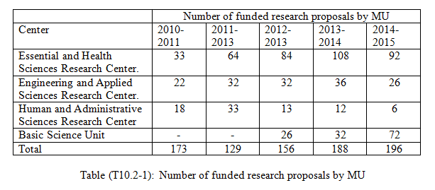
10.2 Teaching Staff and Student Involvement in Research (**)
( * )

Slide 8
10.3 Commercialization of Research (**)
King Salman Institute for Studies & Advisory Services
Main representative for management of
  research
  studies
  advisory services
  scientific research
  training
Coordination and integration among the university sectors to perform its tasks, and make full use of the university potential.
( * )

Slide 9
10.4 Research Facilities and Equipment (**)
Scientific journals, proceedings, books, software, and other needed resources.
  Main library
  Deanship of IT
Equipment, software, and labs are regularly maintained by
  Maintenance and Operation Department
  Deanship of IT.
Security policy and arrangements
  Department of security and safety
Ownership of equipment, software, or any other materials
  Contract between the faculty member and agencies that support the project.
( * )

Slide 10
KPIs

Slide 11
KPIs

Slide 12
KPIs

Slide 13
KPIs

Slide 14
KPIs

Slide 15
KPIs

Slide 16
اهم نقاط القوة للمعيار كامل Strengths
A research strategic plan, research priorities, and ethics charter for research, publication, and translation are identified.
Importance of research in the process of faculty promotion and evaluation.
Establishing scientific chairs, centers, and Prince Salman Institute for Studies & Advisory Services to support faculty member in their research and consolations

Slide 17
نقاط التطوير للمعيار كامل Areas for improvement
The research supporting infrastructure needs more improvement including space and equipment for research centers.
Encourage faculty members to increase their ISI productions.
Working on attracting more funds from private sectors and KACST.
Working on establishing connections with international research centers and collaborators.
Publishing the annual reports on the website of the university and colleges.

