Slide 1
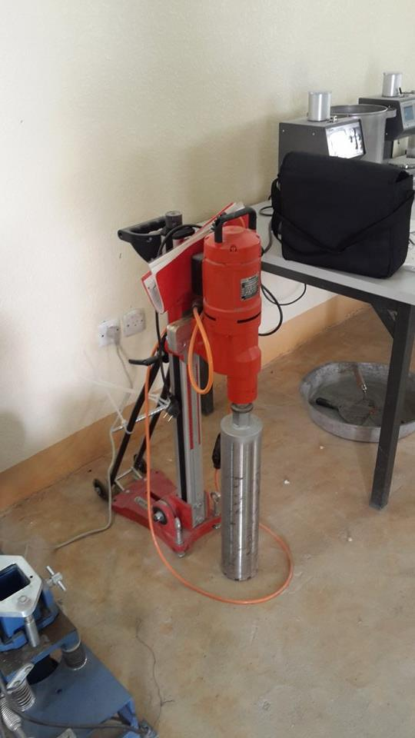
Kingdom of Saudi Arabia
Ministry of Education
Majmaah University
College of Engineering
Department of Civil and Environmental Engineering
The Core Test Machine
Technical Description
Specification
To take Samples of asphalt pavement after roads constructed. It collects using the coring method may be used to evaluate various characteristics of an asphalt concrete pavement for construction quality control testing, quality assurance testing and product acceptance testing. Core samples may also be used for research testing purposes.
Core Drill Machine:
A Core Drill Machine of sufficient horsepower and depth to minimize distortion of the compacted cores of Hot Mix Asphalt. • Core Bit – The cutting edge of the core drill bit shall be of hardened steel or other suitable material with diamond chips embedded in the metal cutting edge or as recommended by the core drill bit manufacturer. Typically the core drill bit should have an inside diameter of 4” ± 0.25” (100 mm ± 6 mm) or 6” ± 0.25” (150 mm ± 6 mm), these core bit dimensions are agency preferred alternatives. Suitable larger and smaller diameter core bit alternatives shall be employed as required by the agency.
Tools:
Core layers may be separated using a saw or other suitable device which provides a clean smooth surface and does not damage the core. • Retrieval Device (Optional) –The retrieval device used for removing core samples from holes must preserve the integrity of the core. The device may be a steel rod of suitable length and with a diameter that will fit into the space between the core and the pavement material. There may be a 90 degree bend at the top to form a handle and a 90 degree bend at the bottom, approximately 2 in (50 mm) long, forming a hook to assist in the retrieval of the core or other suitable device.
Safety:
This standard does not purport to address all of the safety concerns, associated with its use. It is the responsibility of the user of this standard operating procedure to establish a pre activity safety plan prior to use.
Filling Core Holes:
When necessary, the hole made from the coring operation shall be filled with a material that will not separate from the surrounding material. If Hot Mix Asphalt is available and used, it shall be compacted into the hole. A ready mix concrete or fast set grout product may be used in lieu of a Hot Mix Asphalt. A black dye can be used to color the grout on driving surface. • Prior to backfilling a core hole on a bridge deck, ensure that the hole and sidewalls are dry enough to bond with the sealant before applying. • Acceptable sealants include; asphalt binder or any waterproof sealant designed for asphalt applica-tions as stated by the manufacturer. • Apply sealant to bottom surface and side walls of core hole as needed. • Backfill the core hole with Hot Mix Asphalt, cold mix asphalt, ready mix concrete or grout and compact as needed.
Technical Data
Test Site Location:
The quantity of cores to be obtained shall be determined by the test procedure to be performed or agency requirements. Refer to AASHTO when taking correlation cores. • Determine the location of the core(s) as required by the agency.
Transporting Cores
Transport cores in a suitable container(s) that prevents damage from jarring, rolling, hitting together, and/or impact with any object. • Prevent cores from freezing or excessive heat above 130º F (54º C), during transport. Note 1: In extreme ambient temperature conditions, cores should be placed in water during transport. • If the core is damaged in transport to a point it can not be utilized for its intended purpose the core will not be used.
Report information:
• The date the cores were obtained • Paving date • Contract number • Project title • Location of test • The lift being evaluated • Type of material being evaluated • Mix Design Lab Number • Average thickness of each core (to the nearest 0.01’ or ⅛ “) • Average Theoretical Maximum Density.

