Slide 1
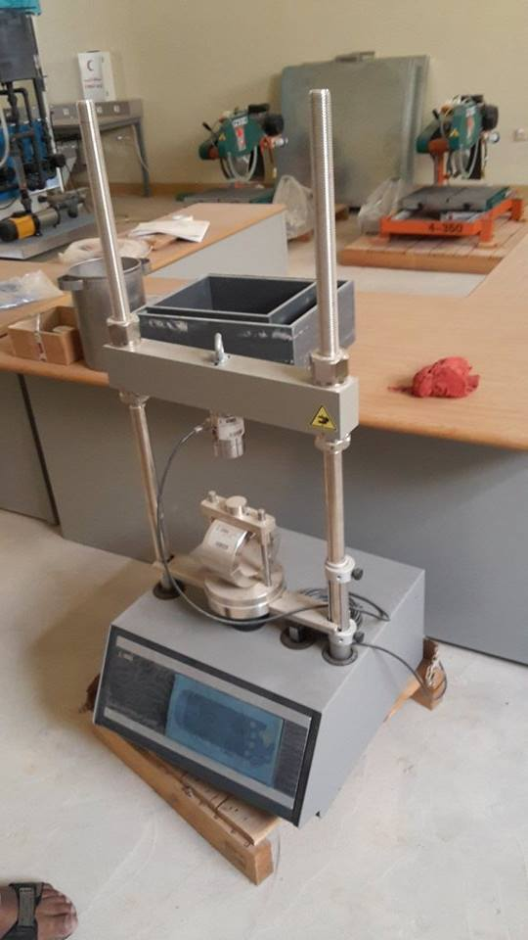
Kingdom of Saudi Arabia
Ministry of Education
Majmaah University
College of Engineering
Department of Civil and Environmental Engineering
Marshall Machine
Technical Description
Specification
To measure Marshall stability of a test specimen
It is the maximum load required to produce failure when the specimen is preheated to a prescribed temperature placed in a special test.
While the stability test is in progress dial gauge is used to measure the vertical deformation of the specimen.
[1] Control Panel:
The control panel is situated on the front side of the machine base.
[2] Preset Speed:
2.00 in/min. (50.80mm/min.)
[3] Direction of Travel:
It is necessary to ensure that the direction of the platen (up or down) has been correctly selected. The platen travel direction switch has three positions: up, off, down. Before changing travel direction, you must first switch to the “off” position and pause for a second before changing travel direction.
[4] Maximum Travel Limits:
The maximum up travel limit occurs when the loading screw extends beyond the reach of the drive gear and remains there – it is not indicated by a light. The down travel limit is indicated on the control panel with a red indicating light. The machine will stop operation in that direction when this light is illuminated. The maximum travel of the platen is 3.50" (88mm).
[4] Load Ring:
When a load ring is used it can be attached directly to the cross-beam using the 3/4-16 x 3" long bolt.
[5] Maximum Load:
The Marshall Compression and Testing Machine is rated at 10,000lbf (or 50kN).
[6] Flow Measurement:
It requires a Marshall Test accessory, e.g., H-1344 Flow meter with dial gage, 1" travel, 0.001" divisions, or H-1344M with 25 mm travel and .25 mm divisions.
[7] Load Ring Calibration:
It must be calibrated before leaving the factory. Periodically you should have it re-calibrated.
[8] Maintenance:
The machine and transducers should be kept clean and the machine should not be over lubricated. Light oiling with synthetic instrument oil at most is required on exposed spindles and threads; the jack and gear box are serviced with a premium wheel bearing grease such as Pennzoil 707L Lubriplate Grease applied thru the grease fitting no more than annually, or when an indication of power train friction appears.
Learning Objectives / Experiments
The objective to be achieved using the Marshall Method for hot-mix asphalt concrete mix Design is to determine an economical blend and gradation of aggregates (within the limits Of project specifications) and asphalt that yields a mix having;
Sufficient asphalt cement to ensure a durable asphalt concrete surface course.
Sufficient mix stability to satisfy the demands of traffic without distortion or displacement.
Sufficient voids in the total compacted mix to allow for a slight amount of additional compaction under traffic loading without flushing, bleeding and loss of stability, yet low enough to keep out harmful air and moisture.
Sufficient workability to permit efficient placement of the mix without segregation.
Characteristics which allow normal construction operating variations without falling outside of the specified requirement.

