Slide 1
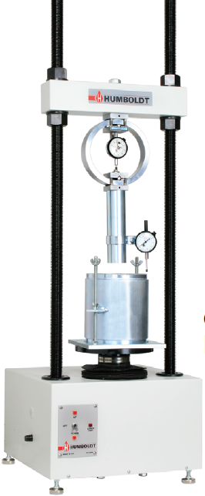
Kingdom of Saudi Arabia
Ministry of Education
Majmaah University
College of Engineering
Department of Civil and Environmental Engineering
California Bearing Ratio Machine
Technical Description
Specification
California Bearing Ratio (CBR) is defined as the ratio expressed in percentage of force per unit area required penetrating a soil mass with a circular plunger of 50 mm diameter at the rate of 1.25 mm/min to that required for corresponding penetration in a standard material. Tests are performed out on natural or compacted soils in water soaked or un-soaked conditions and the results so obtained are compared with the curves of standard test.
[1] Control Panel:
The control panel is situated on the front side of the machine base.
[2] Preset Speed:
05 in/min. (1.27mm/min.)
[3] Direction of Travel:
It is necessary to ensure that the direction of the platen (up or down) has been correctly selected. The platen travel direction switch has three positions: up, off, down. Before changing travel direction, you must first switch to the “off” position and pause for a second before changing travel direction.
[4] Maximum Travel Limits:
The maximum up travel limit occurs when the loading screw extends beyond the reach of the drive gear and remains there – it is not indicated by a light. The down travel limit is indicated on the control panel with a red indicating light. The machine will stop operation in that direction when this light is illuminated. The maximum travel of the platen is 3.50" (88mm).
[4] Load Ring:
When a load ring is used it can be attached directly to the cross-beam using the 3/4-16 x 3" long bolt.
[5] Maximum Load:
The CBR Compression and Testing Machine is rated at 10,000lbf (or 50kN).
[6] Flow Measurement:
It requires a CBR Test accessory, e.g., H-1344 Flow meter with dial gage, 1" travel, 0.001" divisions, or H-1344M with 25 mm travel and .25 mm divisions.
[7] Load Ring Calibration:
It must be calibrated before leaving the factory. Periodically you should have it re-calibrated.
[8] Maintenance:
The machine and transducers should be kept clean and the machine should not be over lubricated. Light oiling with synthetic instrument oil at most is required on exposed spindles and threads; the jack and gear box are serviced with a premium wheel bearing grease such as Pennzoil 707L Lubriplate Grease applied thru the grease fitting no more than annually, or when an indication of power train friction appears.
Technical Data
CBR mould with detachable perforated base plate
Spacer disc with a removable handle (to be placed inside the mould)
Collar of 50mm high.
Penetration plunger of 50 mm diameter.
One annular and a few slotted surcharge masses 2.5 kg each.
Rammer (2.6 kg with 310mm drop for standard proctor results) and (4.89 kg with 450mm drop for modified proctor results).
Straight cutting edge.
Loading machine of 50 kN capacity fitted with a calibrated proving ring to which plunger has to be attached.
Penetration measuring dial gauge of 0.01mm accuracy.
Soaking tank.
Swelling gauge consisting of perforated plate with adjustable extension stem.
Diameter of the mould = 150mm Height of the mould = 175mm Height of the CBR soil specimen = 125mm Soil specification: Particle size = should pass through 19mm sieve Soil particles of size greater than 19mm should be replaced by particles of size between 4.75mm and 19mm.

