Slide 1
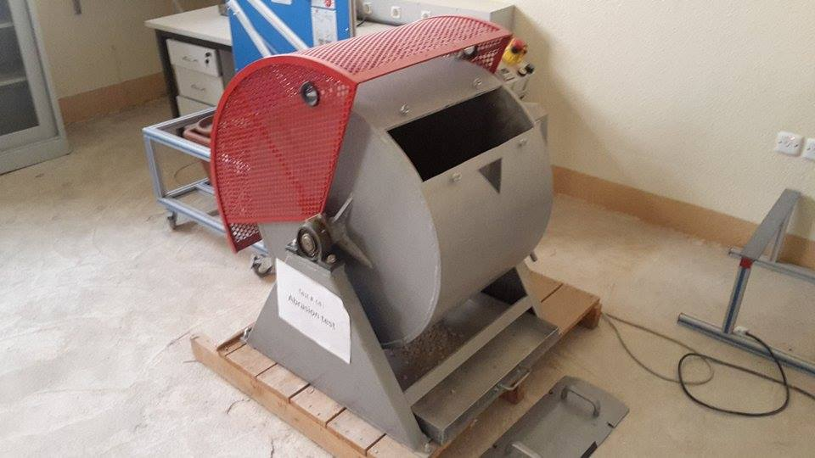
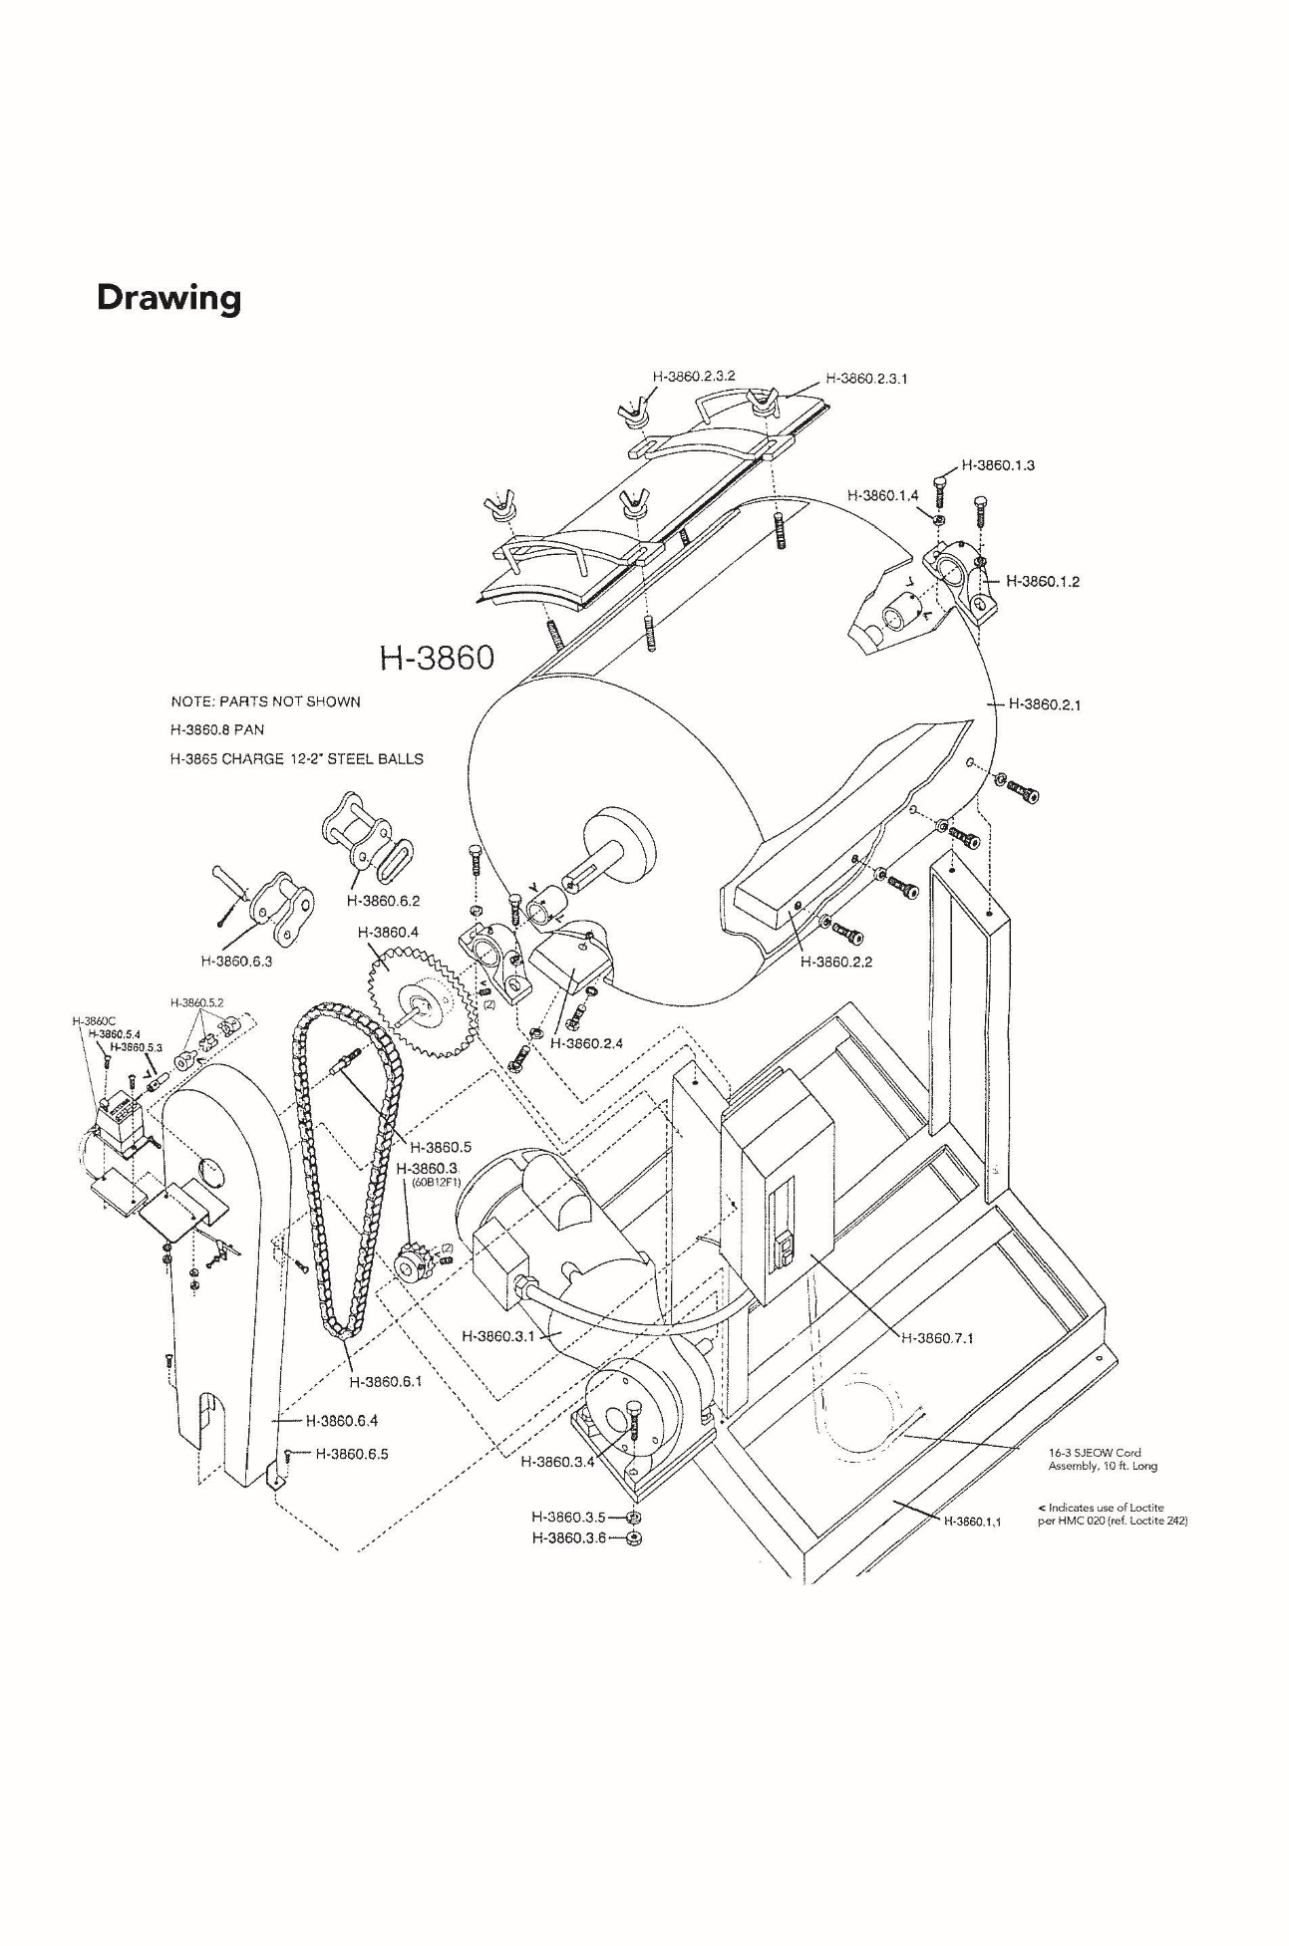
Kingdom of Saudi Arabia
Ministry of Education
Majmaah University
College of Engineering
Department of Civil and Environmental Engineering
Los Angeles Machine
Technical Description
Specification
To measure the degradation of mineral aggregates of standard gradings resulting from a combination of actions including abrasion or attrition, impact, and grinding in a rotating steel drum containing a specified number of steel spheres. The Los Angeles (L.A.) abrasion machine is a common test method used to indicate aggregate toughness and abrasion characteristics. Aggregate abrasion characteristics are important because the constituent aggregate in HMA must resist crushing, degradation and disintegration in order to produce a high quality HMA.
[1] Machine:
The Los Angeles Abrasion Testing Machine consists of a hollow steel cylinder, closed at both ends, having an inside diameter of 28" and inside length of 20". The cylinder is mounted on stub shafts attached the ends of the cylinder but not entering it and mounted in such a manner that it may be rotated about its axis in a horizontal position. An opening in the cylinder is provided for the introduction of the test sample. The opening can be closed dust-tight with the removable cover bolted in place. The cover is so designed as to maintain the cylindrical contour of the interior surface. The shelf is so located that the charge will not fall in the cover or come in contact with it during the test. A removable steel shelf projecting a radial 3- ½" into the cylinder and extending its full length is mounted along one element of the interior surface of the cylinder. The shelf is of such thickness and so mounted by bolts or other approved means to be firm & rigid. The position of the shelf is such that the distance from the shelf to the opening measured along the circumference of the cylinder in the direction of rotation is not less than 50". If the cover stops at the bottom in a difficult to reach location, jog the barrel by pushing the outer weight-plate forward then reverse and pull to jog the barrel to the desired position.
[2] Abrasive charges:
The abrasive charges consist of cast-iron spheres or steel spheres approximately 1-7/8" in diameter and each weighing between 390g and 445g. The abrasive charge depending upon the grading of the test sample as described on page 4 shall be as follows:
[3] Maintenance:
Keep the assembly as clean as possible. Lubricate necessary parts regularly. Use heavy transmission oil-40 weight, for the speed reducer (AGMA lubricant class 8 COMP)
Machine Parts
Grading | Number of Spheres | Weight of Charge, g
A | 12 | 5000 ± 25
B | 11 | 4584 ± 25
C | 8 | 3330 ± 20
D | 6 | 2500 ± 15

