Slide 1

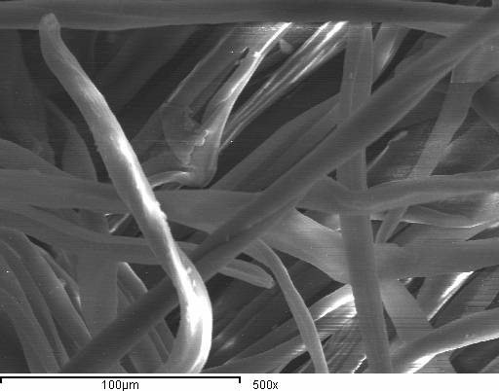
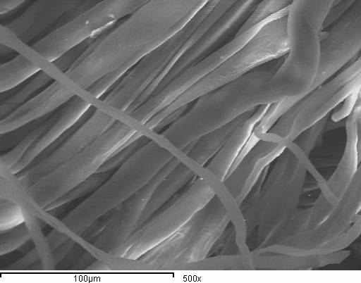
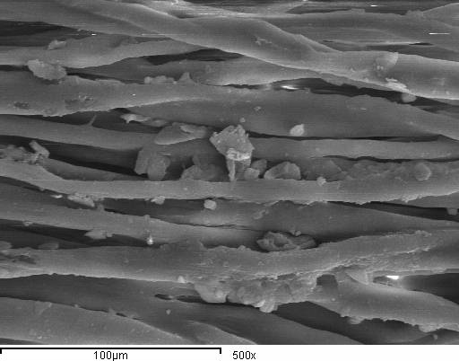
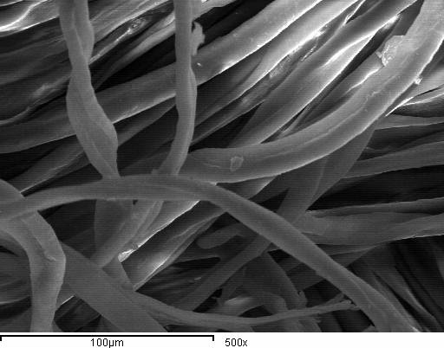
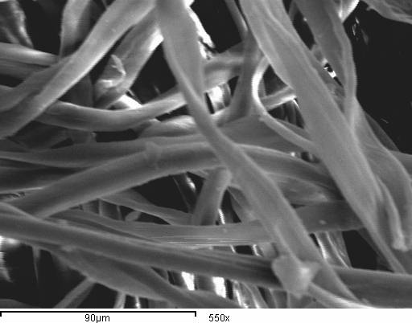
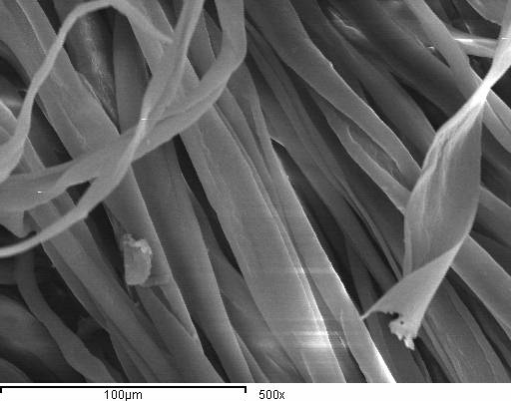
Achieving Optimum Scientific Standards for Producing Fabrics Suitable for Protecting Against Hazardous Chemical Liquids
ABSTRACT
This research aims to produce fabrics suitable for protecting against hazardous liquids (accidental splashes of chemicals). All samples under study were produced cotton and cotton /polyester 50/50 .Three weft sets were used 24, 27 and 30 picks /cm and three fabric structure (plain weave 1/1, twill 2/2 and satin 4). Samples were coated, on one face, with transol F L 20 to make the fabric repellent and a barrier to Protect against hazardous chemical liquids .Their influence on the performance of the end-use fabric and the achieved properties were studied. On the other hand physic-chemical properties including, studying the effect of some hazardous liquids chemicals using Gutter method, tensile strength and elongation, water absorption, roughness, thickness and weight were evaluated according to the final product needs. Some more results were reached concerning structures and materials. Most samples have achieved the expected results
 | Protection characteristic after treatments
 | NaOH (20 %) |  |  | HNO₃ (70 %)
 | Repellency % | Retention % | Penetration % | Repellency % | Retention % | Penetration %
1 | 99.4 | 0.66 | 0.16 | 99.7 | 0.26 | 0.04
2 | 99.5 | 0.59 | 0.09 | 99.4 | 0.49 | 0.11
3 | 99.7 | 0.64 | 0.34 | 99.7 | 0.24 | 0.06
4 | 98.9 | 0.86 | 0.24 | 99.6 | 0.26 | 0.14
5 | 99.2 | 0.65 | 0.15 | 99.8 | 0.21 | 0.01
6 | 99.3 | 0.68 | 0.02 | 99.8 | 0.18 | 0.02
7 | 98.6 | 0.61 | 0.30 | 99.4 | 0.37 | 0.05
8 | 99.1 | 0.64 | 0.09 | 99.5 | 0.25 | 0.07
9 | 99.3 | 0.55 | 0.04 | 99.6 | 0.29 | 0.05
10 | 99.1 | 0.61 | 0.29 | 99.6 | 0.36 | 0.04
11 | 99.3 | 0.63 | 0.07 | 99.7 | 0.23 | 0.07
12 | 99.4 | 0.57 | 0.03 | 99.7 | 0.27 | 0.03
13 | 98.7 | 0.88 | 0.22 | 99.4 | 0.38 | 0.22
14 | 99.1 | 0.60 | 0.3 | 99.6 | 0.35 | 0.05
15 | 99.2 | 0.75 | 0.05 | 99.7 | 0.25 | 0.05
16 | 98.6 | 0.91 | 0.24 | 99.2 | 0.36 | 0.24
17 | 99.0 | 0.65 | 0.5 | 99.5 | 0.33 | 0.06
18 | 99.2 | 0.59 | 0.05 | 99.4 | 0.25 | 0.05
INTRODUCTION
Chemical Protective Clothing (CPC)
Occupational exposure of the skin to toxic chemicals, during both routine and emergency chemical handling, is a recognized health problem, as it is estimated that more than 100.000 chemical products with very different toxicological properties are in use throughout the world Chemical hazards from liquids ( which are the main concern of this research ),gases , or dust occurring in sector such as fertilizers , electroplating, and the pharmaceutical industry, these hazards necessitate the wearing of clothing that is impermeable , is resistant to acids , and provides a tight seal against toxic gases, micro-organisms ,or bacteriological hazards requiring antimicrobial fabrics.
Selection of CPC is a complex task, and the consequence of making wrong selections can vary from a skin rash to a life-threatening situation.
Protection against hazardous liquids
The most common cause of injury among chemical workers in factories, laboratories ….etc. is penetration of liquids chemicals, such as acids and other corrosive chemicals, through their clothing due to spillage, so chemical protective clothing is considered the most important line of defense to the worker who is exposed to these hazardous chemicals
Coated breathable protective clothing
In order to achieve comfort, these fabrics should also be breathable. Breathability is achieved by permitting moisture vapor such as perspiration to pass out through it, by capillary action from interior surface to exterior surface where it evaporates.
Finishing treatment
The produced fabrics were undergoing special treatments before being used as they were treated with transol F L 20 to make the fabric repellent and barrier to some hazardous chemical liquids, as follow: , Samples were treated using solution containing The procedures were 20-50 g/l of transol F L 20 at PH 4-8 and then squeezed to 40 - 70 % wet pick up. The fabric samples were dried at 100 - 120⁰C for 2 sec., and thermo-fixed at 150 -160 ⁰C for polyester and180 ⁰C for cotton for 40 sec.
Results and Discussion
Protection characteristic after treatments (Measuring repellency, retention, and penetration of liquid chemicals)
Before treatment
All Samples showed no protection before treatments as we can notice from results that untreated fabrics did not provide any resistance against hazardous chemical liquids .Treatment of fabrics led to improvement in properties of samples against hazardous chemical liquids.
After treatment
It is clear from the results that the cotton samples had increased protection against hazardous chemical liquids than cotton/polyester blend samples. We can state that cellulous samples have absorbed the treatment material more than the blended samples .It is also obvious from the results that, samples of 24 picks/cm , have achieved the highest rates of protection against hazardous chemical liquids ,whereas samples produced 30 picks/cm has achieved the lowest rates ,this is due to the increases of picks/cm increase fabric compactness leading to decrease in its absorption of the treatment material leading to the decrease in its protection against hazardous chemical liquids used in the research.
It is clear from the diagrams that satin weave have achieved the highest rates of protection against hazardous chemical liquids followed by twill weave and then plain weave
Experimental work
This research concerns with producing fabrics suitable for protective clothing against hazardous chemical liquids. All samples in the research were produced with woven technique with 100% cotton and 50/50 cotton /polyester blend using three woven structures (plain weave 1/1, twill 2/2 and satin 4) and three weft sets were also used (24,27 and 30 picks).
References
1-Hira, M., A.,"Fire- Resistant Clothing and its Performance Testing", The Indian Textile Journal, July, 2003.
2-Gibson, P., Barry, J., and others," Computational Fluid Dynamic Modeling of Protective Clothing System", 43rd International Man-Made Fibers Congress 2004, Dornbirn, Technical Textiles,vol.47, Aug.,2004.
3-Fuchs, H.,and Haase, J., " Overview of Protective Clothing Types Against Thermal and Electric Risks".Technical Textiles, vol.41, Nov., 1998.:60
Raheel, M., "Chemical Protective Clothing", Protective Clothing Systems And Materials, 1st edition, Marcel Dekker, Inc., New York, 1994

Slide 2

Achieving Optimum Scientific Standards for Producing Fabrics Suitable for Protecting Against Hazardous Chemical Liquids
ABSTRACT
 | Protection characteristic after treatments
 | NaOH (20 %) |  |  | HNO₃ (70 %)
 | Repellency % | Retention % | Penetration % | Repellency % | Retention % | Penetration %
1 | 99.4 | 0.66 | 0.16 | 99.7 | 0.26 | 0.04
2 | 99.5 | 0.59 | 0.09 | 99.4 | 0.49 | 0.11
3 | 99.7 | 0.64 | 0.34 | 99.7 | 0.24 | 0.06
4 | 98.9 | 0.86 | 0.24 | 99.6 | 0.26 | 0.14
5 | 99.2 | 0.65 | 0.15 | 99.8 | 0.21 | 0.01
6 | 99.3 | 0.68 | 0.02 | 99.8 | 0.18 | 0.02
7 | 98.6 | 0.61 | 0.30 | 99.4 | 0.37 | 0.05
8 | 99.1 | 0.64 | 0.09 | 99.5 | 0.25 | 0.07
9 | 99.3 | 0.55 | 0.04 | 99.6 | 0.29 | 0.05
10 | 99.1 | 0.61 | 0.29 | 99.6 | 0.36 | 0.04
11 | 99.3 | 0.63 | 0.07 | 99.7 | 0.23 | 0.07
12 | 99.4 | 0.57 | 0.03 | 99.7 | 0.27 | 0.03
13 | 98.7 | 0.88 | 0.22 | 99.4 | 0.38 | 0.22
14 | 99.1 | 0.60 | 0.3 | 99.6 | 0.35 | 0.05
15 | 99.2 | 0.75 | 0.05 | 99.7 | 0.25 | 0.05
16 | 98.6 | 0.91 | 0.24 | 99.2 | 0.36 | 0.24
17 | 99.0 | 0.65 | 0.5 | 99.5 | 0.33 | 0.06
18 | 99.2 | 0.59 | 0.05 | 99.4 | 0.25 | 0.05
This research aims to produce fabrics suitable for protecting against hazardous liquids (accidental splashes of chemicals). All samples under study were produced cotton and cotton /polyester 50/50 .Three weft sets were used 24, 27 and 30 picks /cm and three fabric structure (plain weave 1/1, twill 2/2 and satin 4). Samples were coated, on one face, with transol F L 20 to make the fabric repellent and a barrier to Protect against hazardous chemical liquids .Their influence on the performance of the end-use fabric and the achieved properties were studied. On the other hand physic-chemical properties including, studying the effect of some hazardous liquids chemicals using Gutter method, tensile strength and elongation, water absorption, roughness, thickness and weight were evaluated according to the final product needs. Some more results were reached concerning structures and materials. Most samples have achieved the expected results
INTRODUCTION
Chemical Protective Clothing (CPC)
Occupational exposure of the skin to toxic chemicals, during both routine and emergency chemical handling, is a recognized health problem, as it is estimated that more than 100.000 chemical products with very different toxicological properties are in use throughout the world Chemical hazards from liquids ( which are the main concern of this research ),gases , or dust occurring in sector such as fertilizers , electroplating, and the pharmaceutical industry, these hazards necessitate the wearing of clothing that is impermeable , is resistant to acids , and provides a tight seal against toxic gases, micro-organisms ,or bacteriological hazards requiring antimicrobial fabrics.
Selection of CPC is a complex task, and the consequence of making wrong selections can vary from a skin rash to a life-threatening situation.
Protection against hazardous liquids
The most common cause of injury among chemical workers in factories, laboratories ….etc. is penetration of liquids chemicals, such as acids and other corrosive chemicals, through their clothing due to spillage, so chemical protective clothing is considered the most important line of defense to the worker who is exposed to these hazardous chemicals
Coated breathable protective clothing
In order to achieve comfort, these fabrics should also be breathable. Breathability is achieved by permitting moisture vapor such as perspiration to pass out through it, by capillary action from interior surface to exterior surface where it evaporates.
FINISHING TREATMENT
The produced fabrics were undergoing special treatments before being used as they were treated with transol F L 20 to make the fabric repellent and barrier to some hazardous chemical liquids, as follow: , Samples were treated using solution containing The procedures were 20-50 g/l of transol F L 20 at PH 4-8 and then squeezed to 40 - 70 % wet pick up. The fabric samples were dried at 100 - 1200C for 2 sec., and thermo-fixed at 150 -160 0C for polyester and180 0C for cotton for 40 sec.
RESULTS AND DISCUSSION
Protection characteristic after treatments (Measuring repellency, retention, and penetration of liquid chemicals)
Before treatment
All Samples showed no protection before treatments as we can notice from results that untreated fabrics did not provide any resistance against hazardous chemical liquids .Treatment of fabrics led to improvement in properties of samples against hazardous chemical liquids.
After treatment
It is clear from the results that the cotton samples had increased protection against hazardous chemical liquids than cotton/polyester blend samples. We can state that cellulous samples have absorbed the treatment material more than the blended samples .It is also obvious from the results that, samples of 24 picks/cm , have achieved the highest rates of protection against hazardous chemical liquids ,whereas samples produced 30 picks/cm has achieved the lowest rates ,this is due to the increases of picks/cm increase fabric compactness leading to decrease in its absorption of the treatment material leading to the decrease in its protection against hazardous chemical liquids used in the research.
It is clear from the diagrams that satin weave have achieved the highest rates of protection against hazardous chemical liquids followed by twill weave and then plain weave
EXPERMENTAL WORK
This research concerns with producing fabrics suitable for protective clothing against hazardous chemical liquids. All samples in the research were produced with woven technique with 100% cotton and 50/50 cotton /polyester blend using three woven structures (plain weave 1/1, twill 2/2 and satin 4) and three weft sets were also used (24,27 and 30 picks).
REFERENCES
1-Hira, M., A.,"Fire- Resistant Clothing and its Performance Testing", The Indian Textile Journal, July, 2003.
2-Gibson, P., Barry, J., and others," Computational Fluid Dynamic Modeling of Protective Clothing System", 43rd International Man-Made Fibers Congress 2004, Dornbirn, Technical Textiles,vol.47, Aug.,2004.
3-Raheel, M., "Chemical Protective Clothing", Protective Clothing Systems And Materials, 1st edition, Marcel Dekker, Inc., New York, 1994

