Slide 1

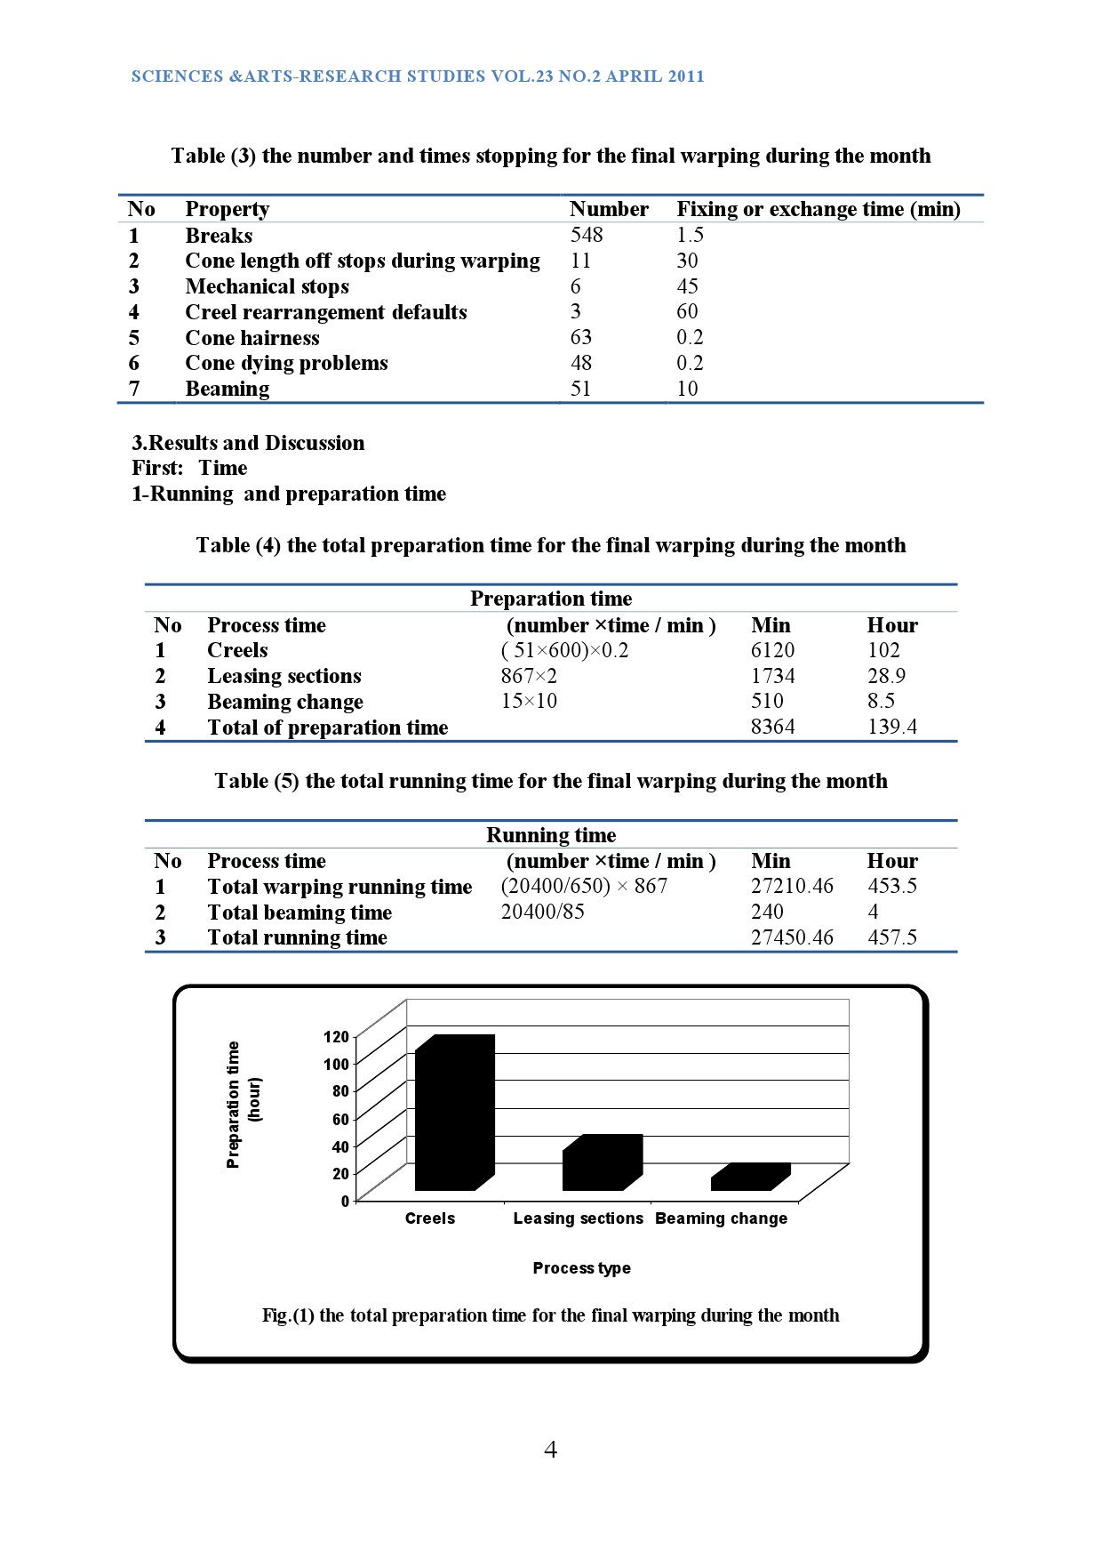
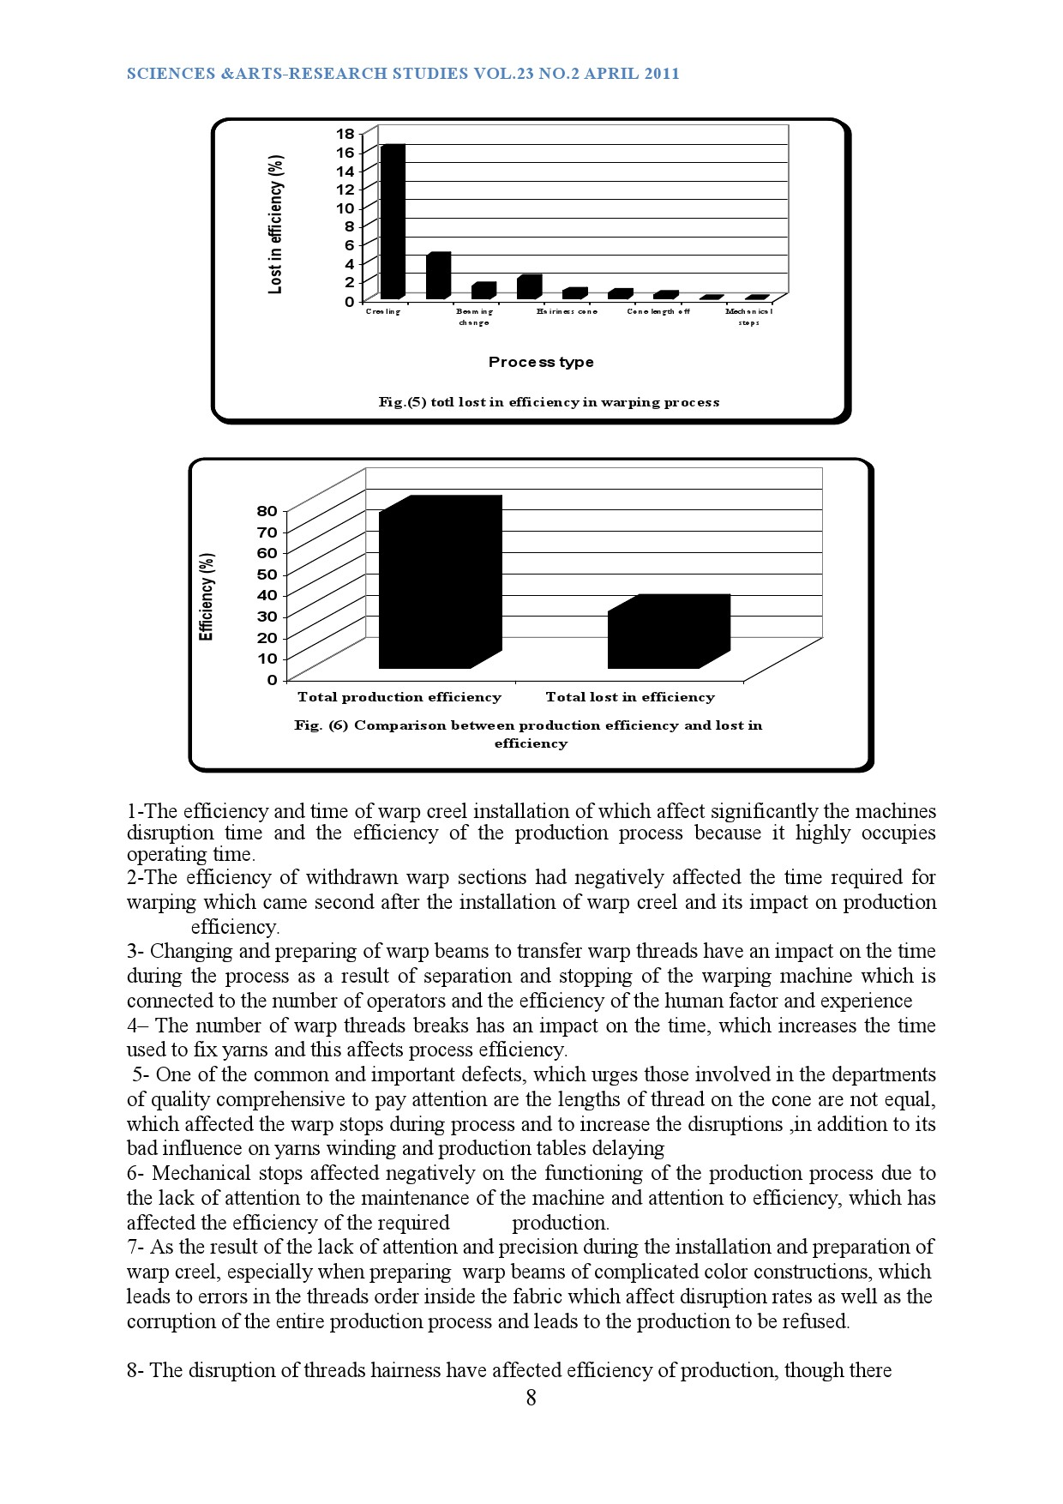
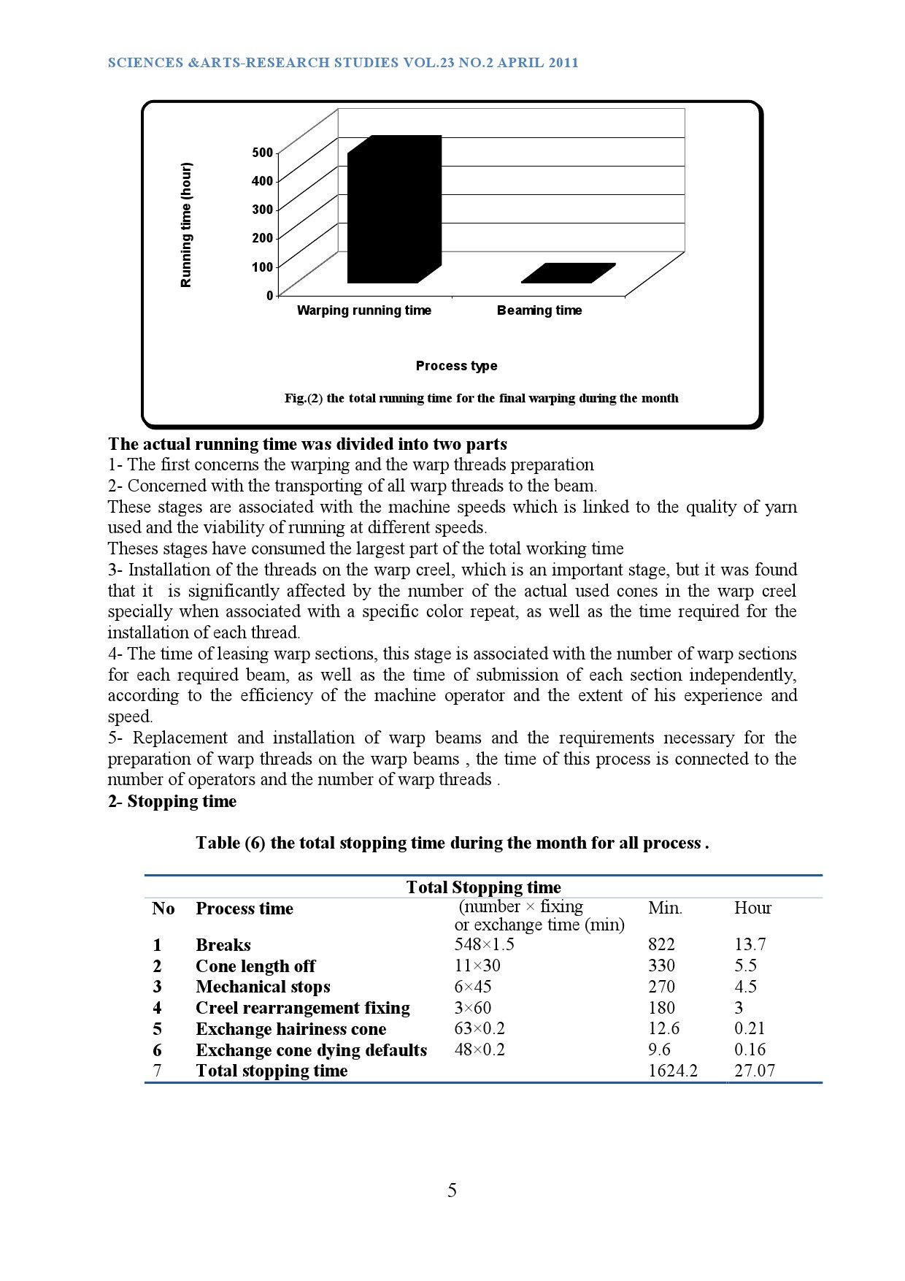
THE ROLE OF QUALITY CONTROL IN THE PREDICITION AND REDUCTION OF PRODUCTION DEFECTS OF SOME TEXTILE PREPARATION STAGES (WARPING )
Ibrahim, G., E., & Dorgham, M.,E.,
SCIENCES &ARTS-RESEARCH STUDIES VOL.23 NO.2 APRIL 2011
Abstract
Results
The aim of this research is to follow up the production lines of warp threads preparations and to find the errors and defects always associated with this phase and identify the causes and quantify and try to minimize them and reduce their appearance and get rid of the obstacles affecting the quality of this stage and treat them which will enhance and not disrupt the following stages in the production process.
The importance of the research is to get to the original points of the defects and identify the causes of these errors and how to treat them to work on avoiding them and make the final product to reach the required quality and not delay the following stages in the production process.
The actual running time was divided into two parts
1- Installation of the threads on the warp creel, which is an important stage, but it was found that it is significantly affected by the number of the actual used cones in the warp creel specially when associated with a specific color repeat, as well as the time required for the installation of each thread.
2- The time of leasing warp sections, this stage is associated with the number of warp sections for each required beam, as well as the time of submission of each section independently, according to the efficiency of the machine operator and the extent of his experience and speed.
The actual warping machine disruption time were measured as time and causes of failures were monitored, and it was found that:
1- The time of submission of fixing each break yarn it is according to the quality and efficiency of the warp threads used which had a profound effect the speed of warp beaming. And clear the increase these number
2-The time taken for the restart and replacement of the cones as a result of unequal yarn lengths on the cones which caused the disruption of warping machine in waiting for dividing of the cones
1- The warping process has reached 73.24% of the overall beaming process according to other external factors affecting the rates of performance in the limited time because it works on a combined image of warp threads on the whole beam.
2-The efficiency of withdrawn warp sections had negatively affected the time required for warping which came second after the installation of warp creel and its impact on production efficiency.
Introduction
Application of ISO 9000 in textile factories in a fast changing world, the importance of quality systems (QSs) in organizations' excellence has been felt more and more demanding, because it ensures consistent and desired product quality. In recent years, ISO 9000 standards have gained considerable attention specially in the textile industry .ISO is important for international trade as well as domestic business The role of quality control and production is mainly in predicting errors and defects that affect the preparatory stages for the manufacture of textiles and so reducing the appearance of defects and errors that affect the quality of the product ISO 9000 has evolved and is being updated continuously to provide necessary conceptual and structural input to the development of such a system. As a consequence, customers demand ISO 9000 certification from their suppliers. Implementation of ISO 9000 standards requires the establishment and development of a documented system, and the involvement of all the employees in adhering to it.
The lost in efficiency
The total stopping time during the month for all process
Lost in efficiency (%) | Property | No
102/623.97×100=16.3 % | Creeling | 1
28.9/623.97×100= 4.6% | Leasing sections | 2
8.5/623.97×100=1.4% | Beaming change | 3
13.7 /623/97 ×100=2.2 % | Breaks | 4
5.5 /623.97×100=0.9% | Cone length off | 5
4.5 /623.97×100=0.7 % | Mechanical stops | 6
3 /623.97×100=0.5% | Creel rearrangement fixing | 7
0.21/623.97 ×100=0.03 % | Hairiness cone | 8
0.16/623.97 ×100=0.02% | Dying defaults | 9
26.65% | Total lost in efficiency | 10
Total Stopping time
Hour | Min. | exchange time (min) | Process time | No
13.7 | 822 | 548×1.5 | Breaks | 1
5.5 | 330 | 11×30 | Cone length off | 2
4.5 | 270 | 6×45 | Mechanical stops | 3
3 | 180 | 3×60 | Creel rearrangement fixing | 4
0.21 | 12.6 | 63×0.2 | Exchange hairiness cone | 5
0.16 | 9.6 | 48×0.2 | Exchange cone dying defaults | 6
27.07 | 1624.2 | Total stopping time |  | 7
Methods and Materials
The experimental work
During the practical work, certain deficiencies were identified. In order to remove these deficiencies, it was felt that executives had to study the problem in details and try to solve it.
A Following-up and monitoring of the full production in fabrics factory was done for month , 24 hours a day, with a truncated of weekend days, and a follow-up certificate has been designed to record all production, stops and problems encountered during the run-time for each warp beam. When the complete study of the warping stages and warp production were finished the results were analyzed. 51 warp beams, 9680 ends for each beam, 20400 m total warp length production, 650 m/min average speed for warping machine and beaming speed 85 m/min .
Conclusions
The research hypothesis that some of the errors in yarn preparation and spinning stages have their impact in influencing the quality of the performance of warping stage, in addition to other errors that may occur as a result of non-compliance and negligence in the order of color repetitions required to produce some warp beamings while preserving the quality of dyeing and the cones that comes from factories.
References
1-Lee, J. H., Warp Breaks Detection in Jacquard Weaving using MEMS, Doctoral Thesis, North Carolina State University, 2005.
2- ISO " Quality Management and Quality Assurance Standards (Geneva, ISO)"
3- SARKAR, A., "Implementation of ISO 9000 in a textile mill" SQC & OR Unit, Indian Statistical Institute, Old CGO Building, 101 Maharshi Karve Road,
4-Bombay 400 020, India, Total Quality Management, Vol. 9, NO. 1, IGQS, 123-131CARFAX

