Slide 1
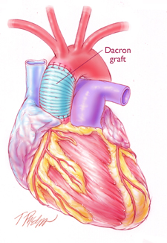
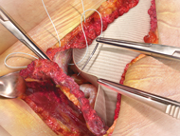
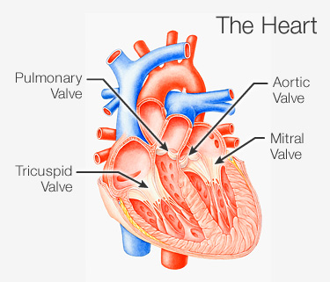
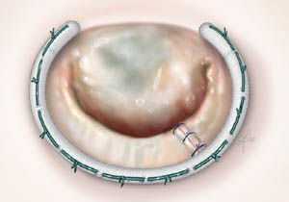
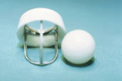
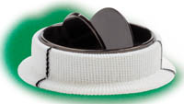
Design And Production Of Fabrics Suitable For Patches And Valves Frames
Sabry, A. M.; El-Bheiry, H.; Mostafa, S. A.; Mahmoud, I. I.; Ibrahim, G. E.
Nature & Science;2014, Vol. 12 Issue 4, p45
Abstract
Results
This research is mainly concerned with designing fabrics used in heart prostheses (patches, valves frames and vasculars). The woven technique was applied to produce fabrics under study, using polyester. Different parameters were studied including, the fabric structure ( regular hopsack 2/2 , satin 4 and twill 1/3), yarn count (50 , 70 and 100 denier), warp set (80, 100 and 120 ends /cm) and weft set (75, 100 and 125 picks /cm) for patches, valves frames. The produced fabrics were treated with Chitosan .Their influence on the performance of the end-use fabric and the achieved properties were studied. On the other hand physical-chemical properties including; air permeability, water permeability, thickness and weight were evaluated according to the final product needs. Some more results were reached concerning structures and materials
Air permeability
-Before treatment
It is clear from the diagrams that regular hopsack 2/2 has obtained the highest rates of air permeability, whereas satin 4 has obtained the lowest rates, and this is for sake of the increase in the number of intersections per unit area for the hopsack 2/2 weave cause increasing of the air spaces in the fabric, so air spaces in the fabric will be increasing causing increasing in the air permeability.
After treatment
All treated samples have prevented blood through them, we can state that the porosity of the samples has been occluded by the Chitosan, and so air was prevented from passing.
Water permeability test
It is obvious from the diagrams, that regular hopsack 2/2 has recorded the highest rates of water permeability, whereas satin 4 has recorded the lowest rates. I can report that because hopsack 2/2 weave have more intersections than satin and twill weave which cause the produced fabric to be less compacted, so spaces in the fabric will be decreased causing decreasing in water permeability.
Introduction
The ideal graft should last a life time and permit blood passage without clotting or infection .The rate should be as close 100% as possible and it should show more compliance . The vessel that is used in replacing. The grafts should be easy to manufacture and store impervious to blood leakage to prevent excessive blood loss and the development of perigraft hematoma , which can interfere with healing and promote infection .Porosity may be essential for fabrics and other biological grafts
Characteristics of the ideal graft
Reasonably priced -readily available – variety of size – easy to store easy to manufacture – durable ( survives repeated sterilization , long life in body) suitable for use in the body (bio compatible – non toxic – non allergic – non thrombogenic, infection resistant easy to handle ( easy to pass suture needle – pliable elastic – does not kink).
Requirements specified for implants with regard to duration of contact with human body where the contact medium and the intended biostability of the material are stricter compatibility than those for operating. Theatre textiles and products which are used in direct contact with the central nervous system or in the immediate vicinity of the heart or those which are deliberately dissolved in the body .The most important general requirement of heart prosthesis is the compatibility of the material to the human body and the ease with it can be sterilized.
Methods and Materials
Experimental work
There are no previous studies about fabrics used in heart prostheses, this research produced fabrics used in patches and valves frames. One textile material used in this research, that is textured polyester denier 50 , 70 and 100 denier . Three different woven structures were used in this research to produce all samples, Regular hopsack 2/2 ,twill weave 1/3 ,and satin weave 4.Three warp set used in produced samples ,theses ,80, 100 and 120 ends /cm and three weft set 75, 100 and 125 picks /cm
The produced fabrics were undergoing special treatments before being used. These treatments as following.
Coating
Prostheses are impregnated with Chitosan, which decrease the permeability. preclotting of coated prostheses have been advocated for many years for their non-porous surface which minimizes blood loss of the patients. The fabric samples were padded in an aqueous solution containing 12% Chitosan, solution then squeezed to a wet pick up 100 %. The fabric samples were dried at 85 ⁰C for 5 min, then thermo-fixed at 140 ⁰C 90 sec.
Sterilization
Heart prostheses fabrics are sterilized by ethylene oxide gas, where sterilization is applied in special autoclaves under carefully controlled conditions of temperature an humidity⁾The gas alters proteins, killing bacteria, fungal spores and viruses .A through cleaning cycle is required before sterilization and a gas removal cycle is needed before use .
Conclusions
From the previous figures, tables and relationship concerns the different fabric properties such as, air permeability, water permeability, thickness, weight and bursting resistance the following conclusions are reached:
All samples have achieved the excepted results for end uses, and the sample produced with lycra (60 detex) covered with polyester for warp and textured polyester denier 70 for weft, 120 ends/cm and 125 picks /cm has achieved the best results
References
1- Anderson ,R., H., “Normal and abnormal development of the heart ”, Glenn thoracic and cardiac vascular surgery, Appleton & Lange, California , 1992,.
2-Majeti,N,V., Kumar, R “A review of Chitin and Chitosan Application ’’ Reactive &Functional polymers ,No,46 2000
3-Adunur, S “ Wellington Sears handbook of Industrial Textiles ”, Wellington sear Company, Technomic Publishing Company,Lancaster,Pennsylvania,1995,
4 – kempczinsk , R.,F., “ Vascular grafts in R.B Rutherfordced ”, vascular surgery , 4th edition, W. B Saunders, Philadelphia ,1995

