Slide 1
Management of hypertension
By Dr. Sajid Hussain

Slide 2
objectives
Recall the etiology of hypertension.
List the major classes of antihypertensive drugs.
Name at least two drugs of each group.
Describe the mechanism of action of these drug groups.
List major adverse effects and contraindications of these drugs.
Discuss the stepped care strategy in hypertension management.

Slide 3
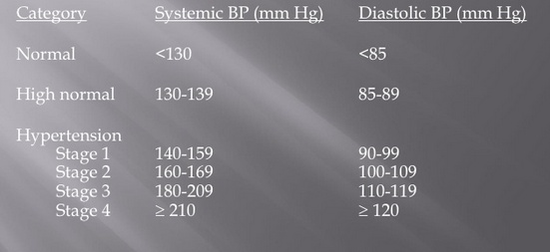
Categories of hypertension

Slide 4
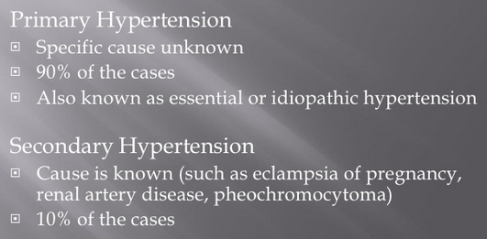
Classification of hypertension

Slide 5
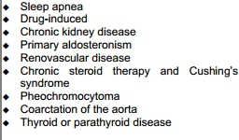
Etiology / causes of hypertension

Slide 6
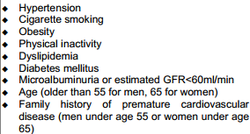
Cardiovascular risk factors

Slide 7
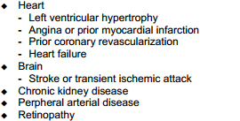
Target organ damage

Slide 8
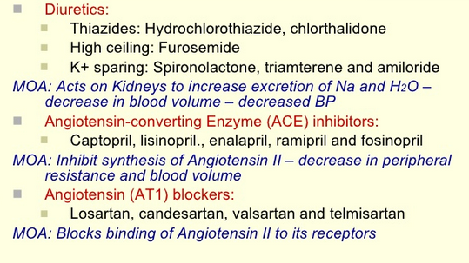
Drugs used to treat hypertension

Slide 9
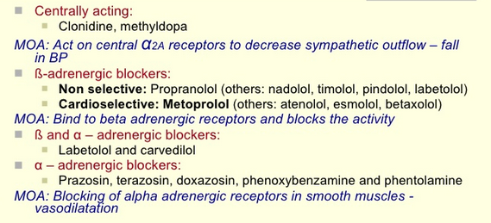
Drugs used to treat hypertension (contd.)

Slide 10
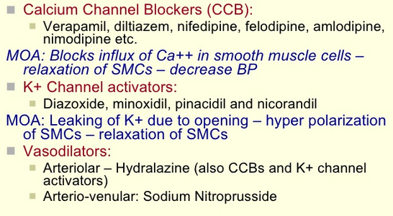
Drugs used to treat hypertension (contd.)

Slide 11
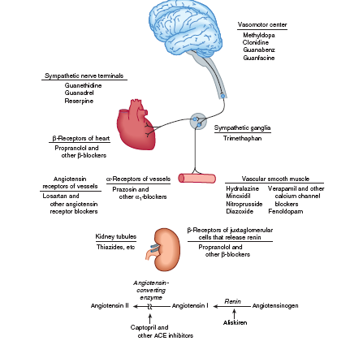

Slide 12
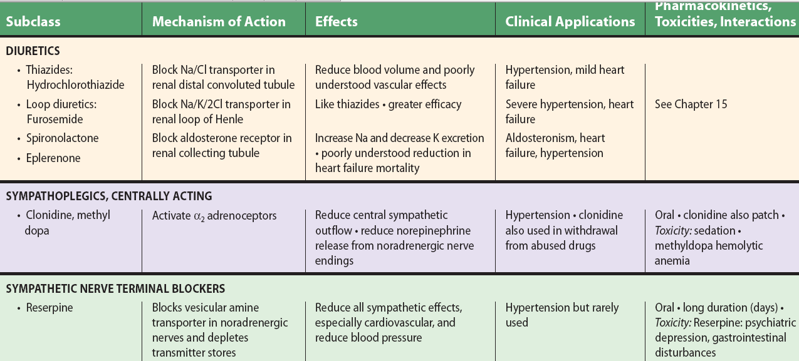
Hypokalemia
Hyperuricemia
hyponatremia

Slide 13
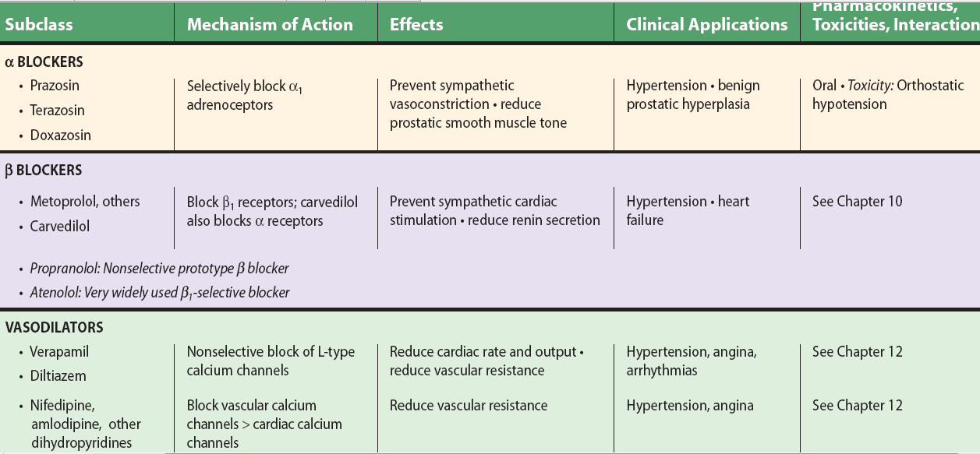
Bradycardia
Impotency
bronchospasm
Flushing
Headache
Reflex tachycardia
Ankle edema

Slide 14
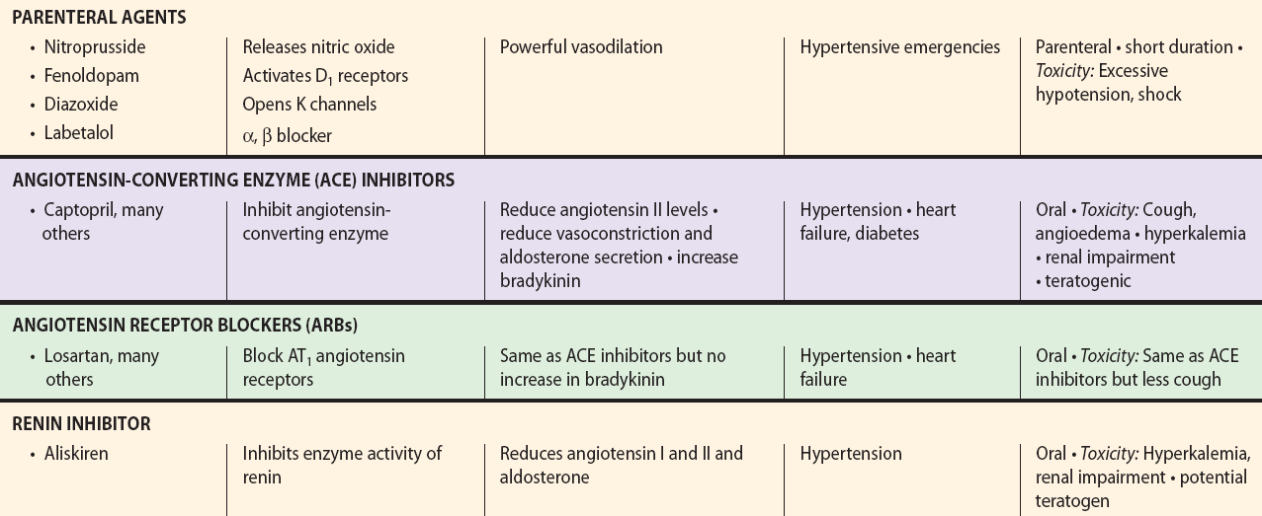
Subclass MOA effecs clinical applications toxicity

Slide 15
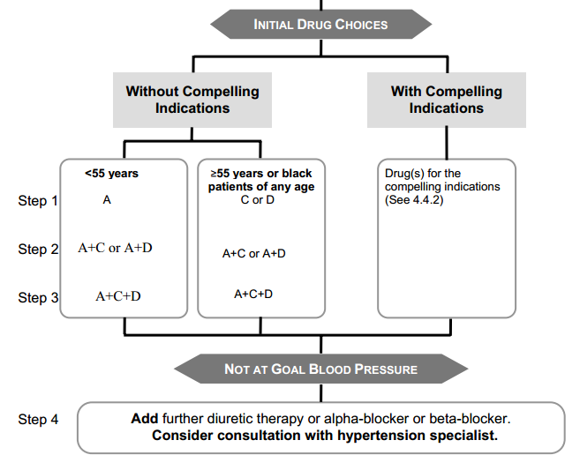
Stepped care strategy for hypertension
A-ACE inhibitors, B-beta blockers, c-calcium channel blocker, D- Diuretics
See next slide

Slide 16
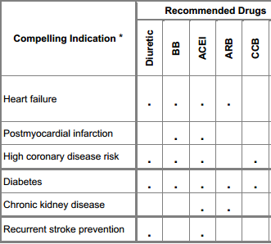
Preferred antihypertensive in secondary hypertension

Slide 17
References:
Katzung’s basic and clinical pharmacology
Harrisons internal medicine-
Internet resource

