Slide 1
Systemic Hypertension
Approach to
Dr ahmed almutairi
Assistant professor
Internal medicine dept

Slide 2
Continents
1- introduction
2- classification/definition
3- classification/etiology
4-etiology in both categories
5- complications
6- clinical finding (symptoms & signs).
7- investigations.
8- how to check blood pressure &measurement strategies
9-Management;
10-Hypertensive emergencies
11-Hypertensive urgencies

Slide 3


Slide 4
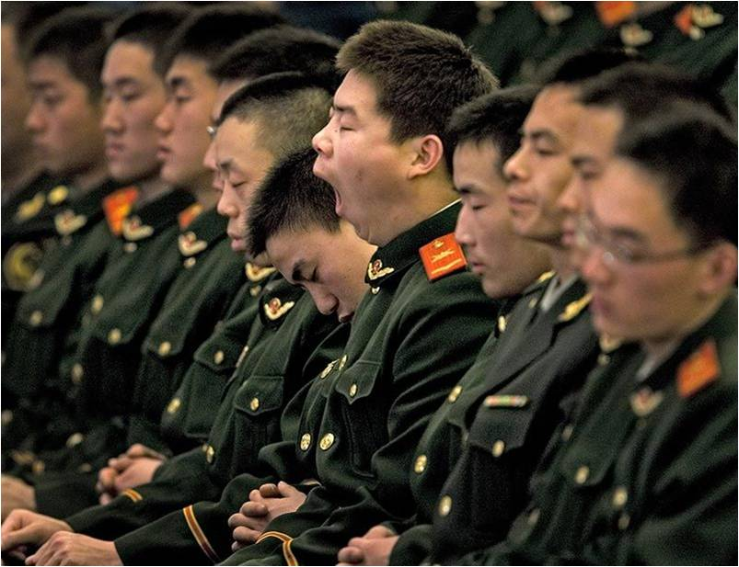

Slide 5
introduction
As of 2000, nearly one billion people or ~26% of the adult population of the world had hypertension.
Is a chronic medical condition in which the blood pressure in the arteries is elevated.^{[1]}
sometimes called arterial hypertension.
This requires the heart to work harder than normal to circulate blood through the blood vessels.
Normal blood pressure at rest is within the range of 100-140mmHg systolic (top reading) and 60-90mmHg diastolic (bottom reading).
High blood pressure is said to be present if it is persistently at or above 140/90 mmHg.

Slide 6
Classification/Definition
Diastolic BP mmHg | Systolic BP mmHg | BP classification
80 | 120 | normal
80-89 | 120-139 | Pre-HTN
90-99 | 140-159 | Stage I
>100 | >160 | Stage II

Slide 7
Classification/Etiology
1- primary (essential) HTN.
.accounting for 90–95%
no cause can be identified.
2- secondary HTN.
5–10% of cases.
conditions that affect the
kidneys, arteries, heart or endocrine system.

Slide 8
Etiology: type I
Onset usually : age (25-55yrs)
1- genetic.??
2- environmental.??
3- sympathetic nervous system hyperactivity.
4- renin-angiotensin system.
Only 10% have high levels while 60% N level , 30% low level
5- defect in natriuresis.
Usual response to high BP, Na/ volume load ----increase Na urine excretion
6- intracellular Na, Ca.
? Na-K channel exchange & other Na transport mechanism;
High Na --- high Ca --- high vascular smooth muscle tone ???
7- exacerbating factors:
– obesity – Na intake – alcohol
– smoking – low exercise
– hematological: polycythemia
– drugs: NSAID – low K.

Slide 9
Etiology: type II
Onset usually : age (<25yrs OR >55yrs)
1- Renal disease.
_Most common cause of 2nd HTN
_May result from: – grumelular disease –tubulointerstitial disease – PCKD .
_mechanism: –fluid over load –rinin-angiotensin-aldosteron activity
_HTN may accelerate progression.
2- Renal Vascular HTN.
A. Renal Artery Stenosis.------ fibromascular hyperplasia.
B. Atherosclerotic Stenosis. ---------- proximal renal artery.
_It can be a single artery stenosis.

Slide 10
Etiology: type II
3- Primary hyperaldesteronism.
_high aldesteron.
_adrenal disease: adenoma/hyperplasia.
4- Cushing Syndrome.
_excess glucocorticoids.
_mechanism:
–direct effect of mineralocorticoid---salt & water retention
–increase secretions of angiotensinogen.
5- Pheochromocytoma.
_uncommon.
_mechanism: excess catecholamine (–alpha-receptor mediated –beta-receptor mediated)

Slide 11
Etiology: type II
6- Coarectation of Aorta.
_ uncommon.
7- HTN associated with pregnancy.
_eclampsia/pre-eclampsia
8- Estrogen use.
_OCP
_mechanism: increase rinin-angiotensin activity.
9- Others.

Slide 12
Complications
_The expected complication are :
–sustained elevated BP with consequent changes
in the vasculature & heart
OR
–atherosclerosis accelerated by long standing.
_The mortality & morbidity related to HTN are linked to both systolic and diastolic BUT risk is approximately double with diastolic HTN.
Complication of HTN in details in next slides ☺☺

Slide 13
Complications
1- HYPERTENSIVE CARDIOVASCULAR DISEASES.
_is the major causes of morbidity & mortality in primary HTN.
_HOW??? LVH →→→ CHF, Ventricular Arrhythmia, MI, … even Sudden Death.
2- HYPERTENSIVE CEREBROVASCULAR DISEASES & DEMENTIA.
_HTN is the major risk factor of stroke /// intracerebral hemorrhage.
_mainly correlate with systolic HTN.
_high incidence of Dementia BOTH → (vascular & Alzheimer dementia).
_effective control → modify risk & rate of progression.
3- HYPERTENSIVE RENAL DISEASES.
_ Nephrosclerosis.
_HTN can accelerate progression of other renal diseases.

Slide 14
Complications
4- AORITIC DISSECTION.
_ Is a contributing factor.
5- ATHEROSCLEROSIS COMPLICATION.

Slide 15
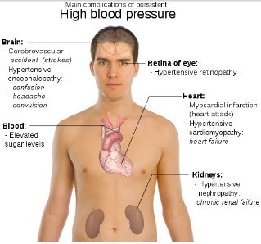
Complications

Slide 16
Clinical Finding;
_Mainly referable to involvement of the target organs (heart, brain, kidney, eyes, peripheral arteries).
SYMPTOMS:
_In mild/moderate primary (essential) HTN, → usually asymptomatic for many years.
_Most frequent symptoms; HEADACH; is also very non-specific.
_Headache (sub-occipital, early morning); BUT any headache can occur.
_Accelerated HTN associated with Somnolence, confusion, visual disturbance, nausea & vomiting → (hypertensive encephalopathy).

Slide 17
Clinical Finding;
SYMPTOMS:
_Pt’s with pheochromocytomas ; may have
episodic HTN; attacks of anxiety;
palpitation; perfuse respiration;
tremors; nausea & vomiting.
_Pt’s with primary aldosteronism ;
muscle weakness; polyuria; nocturia; …etc
_Pt’s with chronic HTN ; may presented with
cardiac complications ; CHF; CAD/IHD; MI.
_In case of cerebral injuries;
stroke (ischemic or hemorrhagic) ; hypertensive encephalopathy.

Slide 18
Clinical Finding;
SIGNS:
_The main goals on the physical examination are to evaluate for signs of end-organ damage and for evidence of a cause of secondary hypertension.
_ like symptoms; depends on the causes; duration; severity; organ involved.
- BLOOD PRESSURE:
_should be taken in both arms +/- legs. (to exclude coarectation of aorta).
_should be taken in different positions (orthostatic drop in Pheochromocytoma).
_?? Think about pesudohypertension with elderly. (Osler's sign).
- RETINAS:
_ do fundoscopy.

Slide 19
Clinical Finding;
SIGNS:
- HEART & ARTERIES:
_ Lf ventricular heave →→→ long standing HTN
_CVS exam →→→ signs of valvulars disease.
- PULSES:
_ check timing of upper & lower limbs ( to exclude coarectation of aorta).

Slide 20
Investigations
Lab test:
CBC, U&E, urine chemistry & microscopy
Plasma aldestron , rinin levels
Blood sugar
Lipids profile
Uric acid level
24hrs urine collection for cortisone level
ECG:
_ highly specific but not very sensitive.
Chest X-Ray:
_not necessary .

Slide 21
Investigations
Echo :
_only if cardiac diseases suspected.
Other Radiological investigations:
_ US
_ CT
_MRI
SINCE MOST HTN CASES ARE PRIMARY (ESSINTIAL) HTN; few investigations are necessary to do unless therapy is unsuccessful OR there is a suspicion of 2ndry HTN , further investigations are required.

Slide 22
how to check blood pressure &measurement strategies
_Three acceptable measurement strategies:
1-Ambulatory blood pressure monitoring (ABPM) 24-48 hrs.
2-Home blood pressure monitoring (one week record)(12-14 times).
3-Office-based blood pressure measurements (at least three visits, spaced over a period of one week or more).
_ A patient with elevated office-based BP but normal 24-hour ambulatory BP is considered to have office hypertension or "white coat" hypertension.

Slide 23
how to check blood pressure &measurement strategies
The proper measurement of office-based BP requires attention to all of the following:
_Time of measurement
_Type of measurement device
_Cuff size
_Patient position
_Cuff placement
_Technique of measurement
_Number of measurements

Slide 24
Management;
1- Life style modification.
_Diet rich in fibers, fruits, low lipids _decrease weight
_decrease alcohol consumptions _ decrease salt intake
_ encourage exercise _smoking cessation.
2- Drug therapy.
_many classes approved
_Diuretics
_Ca channel blockers
_B –blockers
_ACE inhibitors
_ARB
_Others >>>…
3- Treating primary cause if known & possible.

Slide 25
Hypertensive emergencies
_are acute, life-threatening, and usually associated with marked increases in blood pressure (BP), generally ≥180/120 mmHg ; with end organ damage.
_There are two major clinical syndromes induced :
_with eye involvement :
retinal hemorrhages, exudates, or papilledema.
_with brain involvement :
Hypertensive encephalopathy (signs of cerebral edema)
Management:
_The aim of treatment is to lower the diastolic pressure to about 100 to 105 mmHg within 2-6hrs, with the maximum fall in BP over this period of time not exceeding 25 % of the original value; with I.V. anti-HTN Drugs.
_Once the BP is controlled, switched to oral therapy, with the diastolic pressure being gradually reduced to 85 to 90 mmHg over two to three months.

Slide 26
Hypertensive urgencies
_are acute, life-threatening, and usually associated with marked increases in blood pressure (BP), generally ≥180/120 mmHg ; relatively asymptomatic (other than perhaps headache) and have no acute signs of end-organ damage.
Management:
_ We suggest an initial goal of reducing the blood pressure to ≤160/100 mmHg over several hours to days with conventional oral therapy.

Slide 27
That’s enough
Thanks for attention
Have a nice day

