Slide 1
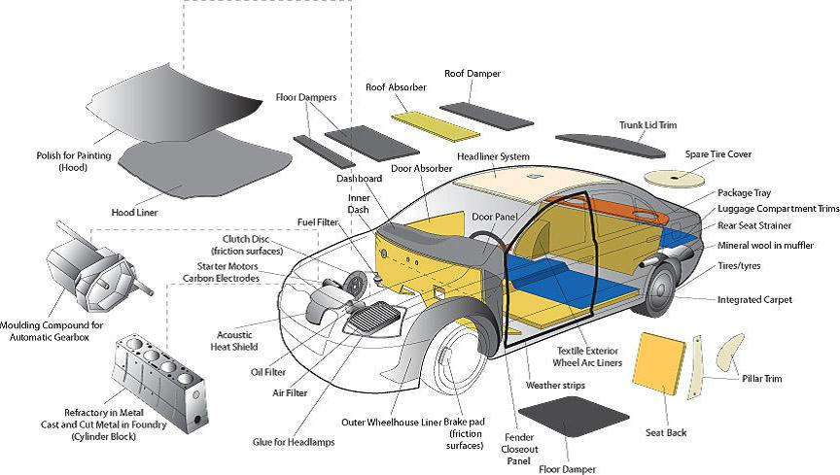

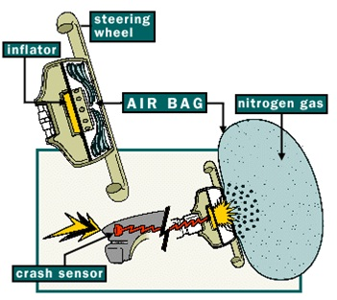

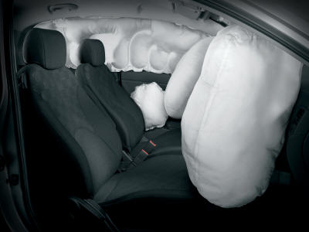

Airbags Fabrics
DR.GHALIA EL-SHENAWY
The airbag and seat belts, used as safety devices, are one of the newest applications for textiles in automobiles and has spurred a huge market for technical textiles. Because frontal collisions are a major cause of accidental death, airbags are being introduced as a standard item in vehicles by legislation to protect the driver and the passengers in case of collision. They are not alternative but supplemental to seat belts because airbags provide protection only against collisions while seat belts provide protection regardless of the crash direction
.
.
panel. Airbags operate by a triggering device, which sets off explosive chemicals when it senses that an accident at a speed greater than about 35km/ hr is about to happen, as upon crash, sensors set off an igniter in the center of the airbag inflator leading to sodium azide pellets in the inflator to ignite and release gases that Primarily consist of nitrogen. The gas the passes through a filter, which removes ash or any particles, into the bag, causing it to inflate. and cushion the human body and prevents it from hitting a harder object. Since almost all collisions occur within 0.125 second, the airbag is designed to inflate and deflate all within a fraction of a second – less than the time to blink an eye.
.
Airbags were first introduced in the late 1960s, but it is only in the 1990s that their use has grown spectacularly and is set to grow even further. An airbag is an automatic safety restrains system built into the steering wheel and instrument

