Slide 1
Pharmacological Management of Congestive Heart Failure
Dr. Naser Ashraf
Department of Basic Medical Sciences
College of Medicine
Majmaah University

Slide 2
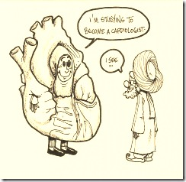
Objectives
List major drug groups used in treatment of heart failure
Explain mechanism of action of digitalis and its major effects
Explain the nature and mechanism of digitalis toxic effects
Describe the clinical implications of diuretics, vasodilators, ACE inhibitors and other drugs that lack positive inotropic effects in heart failure
Describe the strategies used in the treatment of heart failure

Slide 3
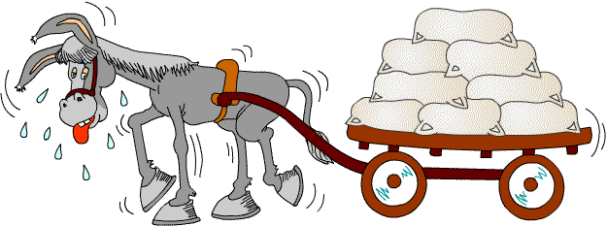
What is heart failure
Notes:
Condition in which heart is unable to pump sufficient amounts of blood to meet the metabolic demands of the body & also unable to receive it back initially during exercise &later at rest
Due to any structural or functional cardiac disorder that impairs the ability of the ventricle to fill with or eject blood.

Slide 4
Compensatory responses during heart failure
Heart failure
↑ Sympathetic discharge
↓ FOC ↓ COP
↓ Renal perfusion
Ventricular dilation
↑ Renin release
↓ GFR
Vasoconstriction
β1 activation
Cardiac remodelling
↑ AT-1
Na & water retention
(Oedema)
↑ preload
↑ afterload
↑ FOC
↑ HR
↑ AT-II
Back pressure
Initially ↑CO Later ↓ CO
↑ Aldosterone
Oedema

Slide 5
Vasodilators
Diuretics
Inotropics
Drugs Used in
Heart Failure
Aldosterone
Antagonists
β-blockers

Slide 6
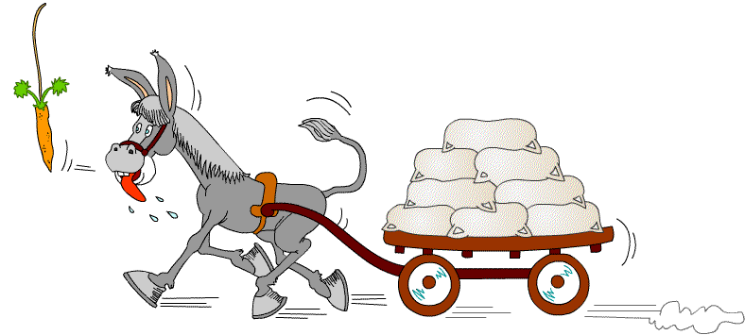
Inotropic drugs
Cardiac glycosides:
  Digoxin, digitoxin
Sympathomimetic amines:
  Dopamine , dobutamine
Phosphodiesterase inhibitors:
  Amrinone , milrinone
Like the carrot placed in front of the donkey

Slide 7
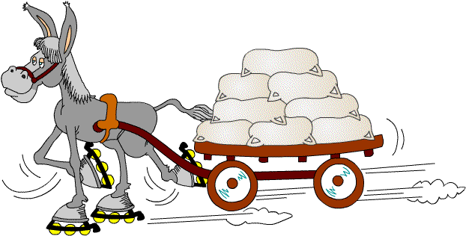
Vasodilators
Arteriolar: hydralazine , minoxidil, nicorandil
Venodilators: nitrates
Arteriolar and venodilators: ACE inhibitors, angiotensin receptor blockers
Increase the donkey’s efficiency

Slide 8
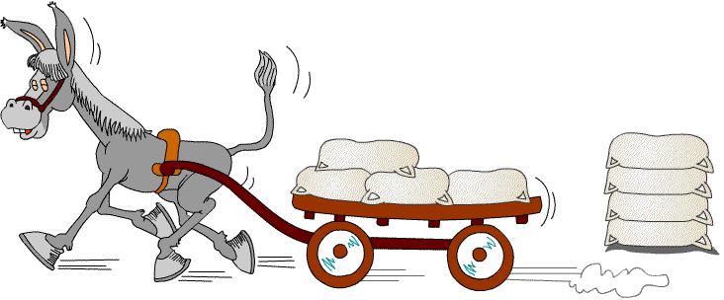
Diuretics
Loop diuretics: furosemide, torsemide
Thiazide diuretics: hydrochlorthiazide
  K+ Sparing diuretics:
    Spironolactone (Also is aldosterone antagonist)
    Amiloride
Reduce the number of sacks on the wagon

Slide 9
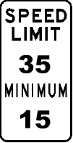
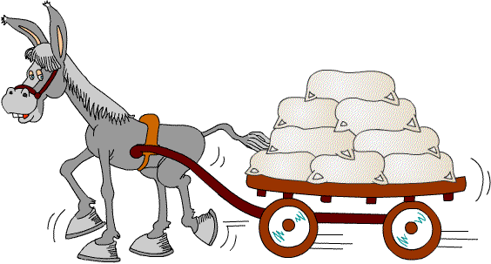
Beta Blockers
  Metoprolol, bisoprolol, carvedilol
Limit the donkey’s speed, thus saving energy

Slide 10
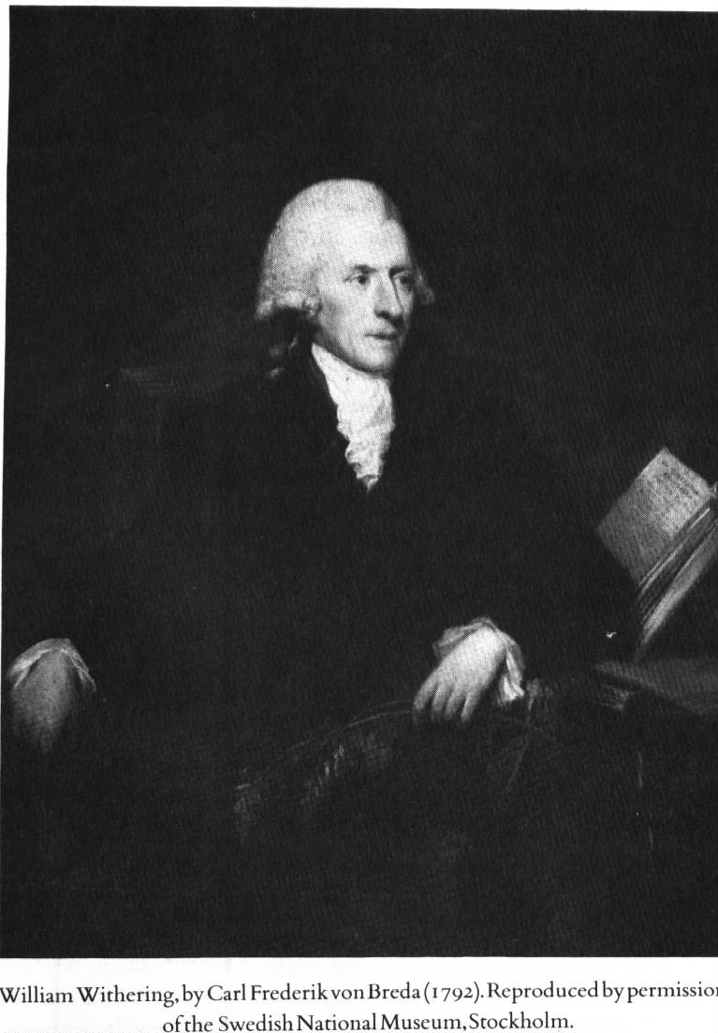
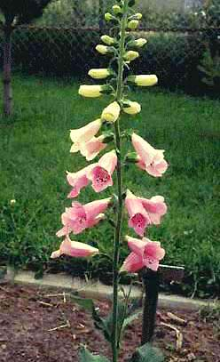
Inotropic Agents
Cardiac glycosides: Digoxin
William Withering 1785
Foxglove plant
Notes:
Cardiac glycosides are inotropic drugs
Cardiotonic drugs: (Digoxin, digitoxin)
Increase myocardial contractility and output in a hypodynamic heart without a proportionate increase in oxygen consumption
Do not increase the heart rate
Have prolonged actions
Thus the efficiency of failing heart is increased
In contrast the cardiac stimulant drugs adrenaline theophylline, increase oxygen consumption rather disproportionately and tend to decrease the myocardial efficiency. i.e is increaase in oxygen consumtion is more than increase in contractility , cardiac stimulants also increase the heart rate and have short lived action ,

Slide 11
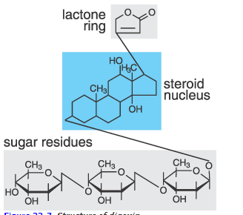
Chemistry of cardiac glycosides
Aglycone
Responsible for pharmacodynamic activity
Sugar influence pharmacokinetics
Notes:
The pharmacologic resides in aglycone but attached sugars modify solubility and cell permeability , in general aglycones have less potent and short living action
Aglycone is consist of CPP steroid ring to which is attached 5 or 6 membered unsatutated lactone ring

Slide 12
Digitalis
Mechanism of the +ve inotropic action:
Digitalis
In therapeutic dose leads to partial inhibition of Na⁺/K⁺ ATPase enzyme
Normally
❶
❷
ca⁺⁺
K⁺
Na⁺
ATPase
Na ⁺ /ca ⁺ ⁺
exchange
ca⁺⁺
Na⁺
ca⁺⁺
ca⁺⁺
ca⁺⁺
ca⁺⁺
ca⁺⁺
Na⁺
Na⁺
ca⁺⁺
ca⁺⁺
ca⁺⁺
Na⁺
troponin
Na⁺
Na⁺
Na⁺
❸
sarcoplasmic reticulum
ca⁺⁺
ca⁺⁺
 intracellular Na⁺ resulting in:
ca⁺⁺
ca⁺⁺
Actin
Myosin
 Force Of Contractility
Notes:
Sarcolemmal membrane structures that regulate calcium entry into the cell slow L type calcium channel
Sodium calcium exchanger and N-K atpase
Prevents extrusion of sodium and hastens entry of sodium into cell during resting phase – diastolic depolarization
Direct action
Indirect: vagal action- SA node, av node, ventricles
Cardfiac glycosides inhibit the enzyme Na – K Atpase also called sodium pump present on the cardiac myocytes, this results in increased intracellular Na and calcium , thus more cvalcium is available for contraction resulting in increased velocity and force of contraction. Inhibiton of sodium pump increases Na this prevents calcium extrusion and also drives more calcium into cell during depolarization through voltage sensitive calcium channels

Slide 13
Pharmacological actions
CARDIAC
EXTRA CARDIAC
↑force of contraction & Cardiac Output
↓ Heart rate
↓ Refractory period (RP) & ↑ Conduction velocity (CV) in atria/ventricles
↑ RP & ↓ CV in AV node
Increased automaticity
ECG: ↑PR interval , ↓ QT interval
Kidney:
  Due to improvement in circulation and renal perfusion
  Retained salt and water is gradually excreted
CNS:
  Nausea, vomiting
Notes:
Decrease heart rate due to
Increased vagal tone
Decreased sympathetic overactivity due improved circulation
By direct action on SA and AV nodes
Systole is shortened, diastole is prolonged
Ventricles more completely emptied due to forceful contractions

Slide 14
Pharmacokinetic properties
Property | Digoxin | Digitoxin
Oral absorption | 60 -80 % | 90 -100 %
Plasma protein binding | 25 % | 95%
Onset of action | 15 -30 min | ½ to 1 hour
Duration of action | 2-6 days | 2-3 weeks
Plasma t ½ | 40 hrs | 5-7 days
Route of elimination | Renal excretion | Hepatic metabolism
Time for digitalization | 5-7 days | 25-30 days
Daily maintainence dose | 0.125 – 0.5 mg | 0.05 -0.2 mg
Administration | Oral / IV | Oral
Notes:
Digitoxin is most lipid soluble and digoxin is relatively polar , bioavailability of digoxin tablets from different manufacturer differs , so stick to one preparation.
Presence of food in stomach delays the absorption of both
Large volume of distribution 6-8 L/kg
All are conc in heart > 20 times than in plasma
Digitoxin is primarily metabolized in liver partly to digoxin and undergoes some enterohepatoc circulation
Cumulative drugs

Slide 15
Cardiac Glycosides (Digitalis)
Two glycosides:
  Short acting Digoxin (t½: 1.5 days)
  Long acting Digitoxin (t½: 5 days)
Used
Severely limited Use

Slide 16
Uses of digoxin
Congestive heart failure
Cardiac arrhythmias
  Atrial fibrillation
  Atrial flutter
  Paroxysmal supraventricular tachycardia

Slide 17
Adverse effects of digoxin
Extra-Cardiac
GIT: Nausea & vomiting
(first to appear)
CNS: Vomiting Restlessness, Disorientation, Visual disturbance
Endocrine: Gynaecomastia
Cardiac
Bradycardia
(first cardiac toxic sign)
Pulsus bigemini
Atrial extra-systole → flutter → fibrillation
Ventricular extra-systole → tachycardia → fibrillation
Partial heart block → complete block
Notes:
GIT adverse events are due to gastric irritation , mesentric vasoconstriction and stimulation of the CTZ
Extra cardiac :
Gastro-intestinal: anorexia, nausea, vomiting and diarrhoea, abdominal pain
Neurotoxicity: vertigo, blurred vision, disturbances of colored vision, headache , confusion, neuralgia, disorientation, delirium, hallucinations and rarely convulsions
Others: allergic skin rashes , gynaecomastia
High
Toxic effect in 25% of patients
Therapeutic index: 1.5 to 3
Discontinuance of drug causes rapid disappearance of toxicity

Slide 18
Treatment of toxicity
Stop digitalis
Oral or parenteral potassium supplements
For ventricular arrhythmias:
  Lidocaine IV drug of choice
For supraventricular arrhythmia:
  Propranolol may be given IV or orally
For AV block and bradycardia
  Atropine 0.6 -1.2 mg IM
Digoxin antibody
Notes:
K contraindicated in presence of hyperkalemia
K tends to antagonize digitalis induced enhanced automaticity and decreases binding of glycosides to sodium potassium ATPase by favouring a conformation of enzyme that has low affinity to digitalis
Mild cases – 5 g daily in divided doses , infusion = 20 m.mol/hr

Slide 19
Phosphodiesterase inhibitors in heart failure
Amrinone & milrinone are selective phosphodiesterase III inhibitors
↑ cAMP levels
The PDE III isoenzyme is specific for intracellular degradation of cAMP in heart, blood vessels and bronchial smooth muscles.
Inodilators
IV administration for short term treatment of severe heart failure
Milrinone is more potent than amrinone and does not produce thrombocytopenia

Slide 20
Preservation
of cAMP
cAMP
Adenylyl cyclase
ATP
Activation of
Protein kinase
Phosphdiesterase III
Milrinone
Myocardial & Vascular
smooth muscles
Phosphorylation
of Ca⁺⁺ Channels
5’AMP
Mechanism of Action
of Inodilators
Increased
Ca⁺⁺ Flow
Positive
inotropism
↑ CO
Elevated
Cytosolic Ca⁺⁺
Inodilatation
↓Pre-load
Relaxation of
Resistance &
Capacitance
vessels
↓After-load
Notes:
In CHF IV amrinone action starts in 5 min lasts 2-3 hrs

Slide 21
Other inotropic drugs
Dopamine
Dobutamine

Slide 22
Role of diuretics in heart failure
Almost all symptomatic Patients treated with a diuretic
High ceiling diuretics (loop diuretics) preferred
  Low dose therapy for maintainence
They increase salt and water excretion & reduce blood volume
  Reduce preload & venous pressure
  Improve cardiac performance & relieve edema

Slide 23
ACE Inhibitors in heart failure
Angiotensin converting enzyme inhibitors
  Captopril, enalapril, ramipril, lisinopril
Act by
  Reduction of after load
  Reduction of preload
  Reversing the compensatory changes
ACE inhibitors are the most preferred drugs for treatment of Congestive cardiac failure
Notes:
Reduction of afterload:
Angiiotensin II is a powerful vasoconstrictor present in the plasma in high concentrations in cardiac failure. ACE inhibitors prevent the conversion of Angiotensin I to Angotensin II and thereby reduce the afterload
Reduction of preload:
Aldosterone causes retention of salt & water and increases the plasma volume (preload)
ACE inhibitor prevent formation of aldosterone and thus decrease the preload
Reversing the compensatory changes:
Angiotensin II responsible for cardiac hypertrophy and remodelling, ACE inhibitors reverse these changes

Slide 24

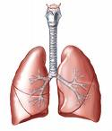
Angiotensinogen
Renin
Synthesis
Blocker
Angiotensin I
ACE inhibitor
Angiotensin Converting Enzyme (ACE)
Angiotensin II
Angiotensin Receptor Blocker
AT2
AT1
Receptor
Blocker
Angiotensin III

Slide 25
Angiotensin receptor blockers in heart failure
Losartan , candesartan, valsartan, telmisartan
Block AT₁ receptor on the heart, peripheral vasculature and kidney
As effective as ACE inhibitors
Used mainly in patients who cannot tolerate ACE inhibitors because of cough, angioedema, neutropenia
Notes:
IV sodium nitroprusside, and nitroglycerine are used fro severe heart failure

Slide 26
Approach to the Patient with Heart Failure
Assessment of LV function (echocardiogram)
EF < 40%
Assessment of
volume status
Signs and symptoms of fluid retention
No signs and symptoms of
fluid retention
Diuretic
(titrate to euvolemic state)
ACE Inhibitor
Digoxin
β-blocker

Slide 27
Drugs used in heart failure
Chronic heart failure
Acute heart failure
Diuretics
Aldosterone receptor antagonist
ACE inhibitors
Angiotensin receptor blockers
Cardiac glycosides
Vasodilators
Diuretics
Vasodilators
Dopamine, dobutamine
Amrinone

Slide 28
Summary
β blockers
Diuretics, ACE inhibitors
Reduce the number of sacks on the wagon
Limit the speed, thus saving energy
Increase the efficiency
Like the carrot placed in front
Vasodilators
Inotrops

