Slide 1
Metabolism of HDL
Dr Abdul Lateef
Assistant professor
Dept of Biochemistry

Slide 2
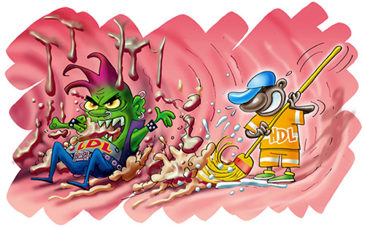
Introduction
HDL transports cholesterol from peripheral tissues to the liver.
The major apoproteins in HDL are Apo A1, Apo A2, Apo C and Apo E.
HDL serves as a plasma reservoir of Apo C and Apo E which can be transferred to VLDL and chylomicrons and back.

Slide 3
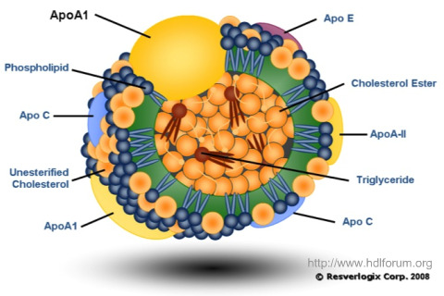
Structure of HDL

Slide 4
Metabolism of HDL
The intestinal cells synthesize components of HDL and release into blood.
The nascent HDL in plasma are discoid in shape.
The free cholesterol derived from peripheral tissues cells are taken up by the HDL.
The apo A1 of HDL activates LCAT present in the plasma.
The LCAT then binds to the HDL disc.

Slide 5
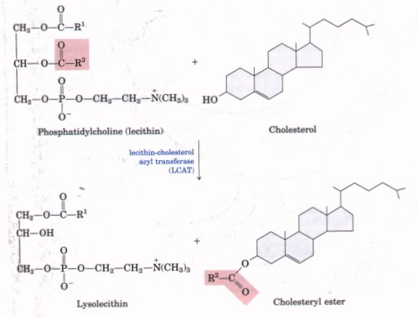
Lecithin is a component of phospholipid bilayer of the HDL disc.
The second carbon of lecithin contains one molecule of PUFA.
It is transferred to the third hydroxyl group of cholesterol to form cholesterol ester.

Slide 6
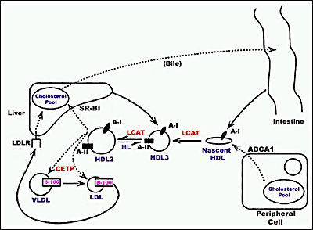
The cholesterol from the cell is transferred to HDL by a cholesterol efflux regulatory protein which is an ABC protein.
The esterified cholesterol which is more hydrophobic, moves into the interior of the HDL disc.
This reaction continues, till HDL becomes spherical with lot of cholesterol esters are formed.
This HDL particle designated as HDL 3.
Mature HDL spheres are taken up by liver cells by apo A1 mediated receptor mechanism.

Slide 7
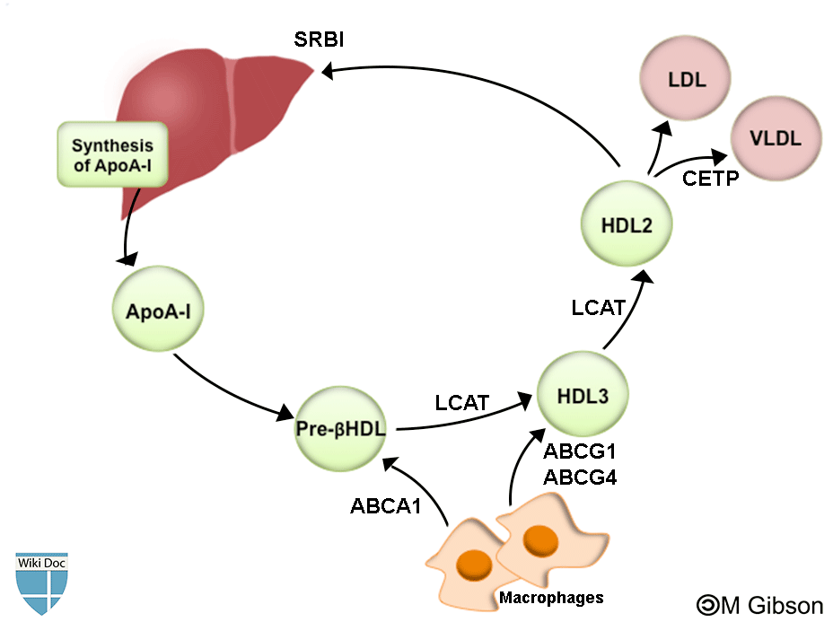
HDL is taken up by hepatic scavenger receptor B1.
Hepatic lipase hydrolyze HDL phospholipid and TAG, and cholesterol esters are released into liver cells.
The cholesterol that reaches the liver is used for synthesis of bile acid or excreted as such in bile.
When HDL remains in circulation, the cholesterol esters from HDL is transferred to VLDL, IDL and LDL by a Cholesterol Ester Transfer Protein (CETP).

Slide 8
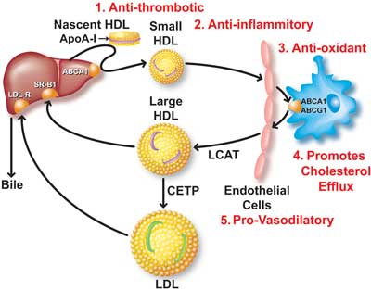
This will help to relieve product inhibition of LCAT so that more cholesterol can be taken up.
TAG from VLDL, IDL, LDL is transferred to HDL in exchange for the cholesterol ester.
The HDL particles that are rich in TG and spherical are called HDL 2.
These particles are first acted upon by hepatic triglyceride lipase (HTGL) before being taken up by scavenger B1 receptor in liver.

Slide 9
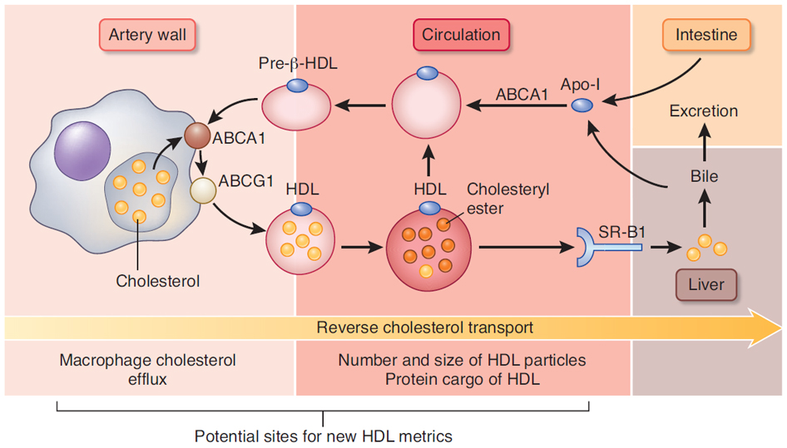

Slide 10
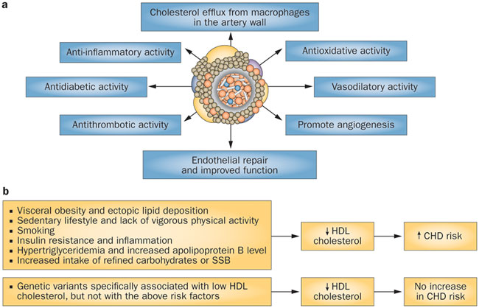
Clinical significance of HDL

Slide 11
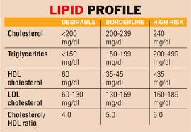

Slide 13
Thank you

