Slide 1
Pharmacological Management of Respiratory tract infections

Slide 2
Objectives
List major respiratory disorders
Describe strategies for management of infection
List the major classes of drug used
Explain the effects, side effects and toxicities of these drugs
Describe pharmacology of anti-tubercular drugs

Slide 3
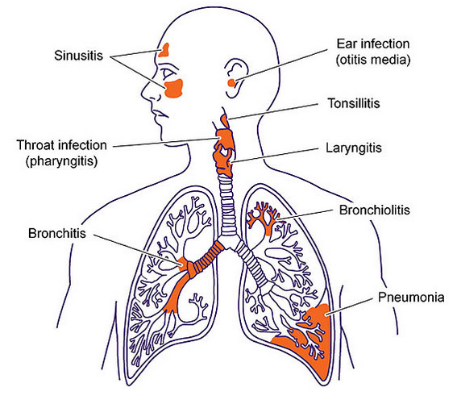
Major respiratory disorders

Slide 4
Strategies for management of infection
Gram positive infections: penicillins
Gram negative infections: aminoglycosides, third generation cephalosporins
Anaerobic infections: metronidazole
Viral infections: anti-virals

Slide 5
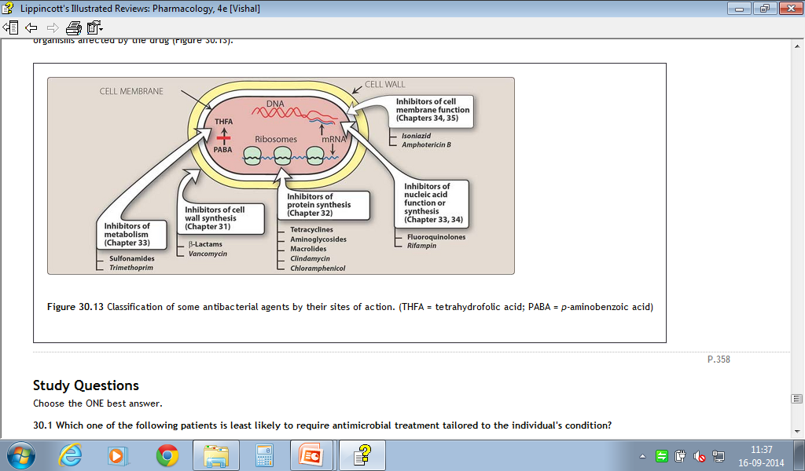
Major classes of drugs used

Slide 6
Inhibitors of cell wall synthesis
Beta Lactum antibiotics
  Penicillins:
    Amoxycillin, piperacillin etc.
  Cephalosporins
    Cefixime, Ceftriaxone etc.
Beta lactamase inhibitors
  Clavulinic acid, sulbactam, tazobactum
Mechanism of action: they inhibit the last step of transpeptidation

Slide 7
Protein synthesis inhibitors
Inhibit 30 S ribosome
  Aminoglycosides: Amikacin, gentamycin
  Tetracyclines: doxycycline
Inhibit 50 S Ribosome
  Macrolides: Azithromycin , erythromycin
  Chloramphenicol

Slide 8
Inhibitors of folic acid metabolism
Cotrimoxazole:
  Combination of sulfamethoxazole and trimethoprim

Slide 9
Mechanism of action
PABA
⊗
Sulfonamides
Dihydrofolate synthetase
Dihydrofolic acid
Trimethoprim
⊗
Dihydrofolate reductase
Tetrahydrofolic acid
RNA
DNA
Proteins

Slide 10
Common side effects and toxicities
Penicillins and cephalosporins: Hypersensitivity
Tetracyclines: Teratogenecity, nephrotoxicity
Cotrimoxazole
  Hypersensitivity, crystalluria
Quinolones :Tendinitis, tendon rupture
Aminoglycosides: ototoxicity, nephrotoxicity

Slide 11
Inhibitors of nucleic acid function
Quinolones
  Ciprofloxacin , ofloxacin
  Mechanism of action
    Inhibit DNA gyrase in bacteria

Slide 12
Antitubercular drugs
First line drugs(standard drugs/primary drugs)
Second line drugs(reserve/secondary drugs)
Other drugs

Slide 13
First line drugs
(high efficacy, low toxicity)
2nd line drugs
Thiacetazone
Paraaminosalicylic acid(PAS)
Ethionamide
Cycloserine
Aminoglycosides:
  Kanamycin(KM)
  Amikacin(AMK)
Isoniazid (H)
Rifampicin(R)
Pyrazinamide(Z)
Ethambutol(E)
Streptomycin(S)

Slide 14
Other DRUGS
Flouroquinolones:
  Ciprofloxacin
  Ofloxacin
Macrolides:
  Clarithromycin
  Azithromycin
Rifabutin
Linezolid

Slide 15
MECHANISM OF ACTION
PROTEIN SYNTHESIS INHIBITION
CELL WALL SYNTHESIS INHIBITION
MYCOLIC ACID SYNTHESIS INHIBITION
ARABINOGYLACTAN SYNTHESIS INHIBITION
Transcriptional level
Translational level
DNA DEPENDENT RNA POLYMERASE
30S Ribosomal inhibition
FATTY ACID SYNTHASE 1 INHIBITOR
FATTY ACID SYNTHASE 2 INHIBITOR
RIFAMPICIN
STREPTOMYCIN
PYRAZINAMIDE
ISONIAZID
ETHAMBUTOL

Slide 16
DRUG RESISTANCE of 1st line drugs
DRUG | Mechanism of resistance
ISONIAZID | Mutation of the catalase peroxidase gene, mutation in the inhA gene.
RIFAMPICIN | Mutation of the rpoB gene
PYRAZINAMIDE | Mutation in gene encoding for the enzyme generating the active metabolite of pyrazinamide
ETHAMBUTOL | Inhibit arabinogalactian synthesis Interfere with mycolic acid incorporation in cell wall
STREPTOMYCIN | One step mutation or by acquisition of plasmid

Slide 17
PHARMACOKINETICS
DRUGS | ABSORPTION | DISTRIBUTION | METABOLISM | EXCRETION
ISONIAZID | WELL ABSORBED | Penetrates all body tissues, placenta and meninges. | Hepatic (acetylation) t½-fast acetylators (1 hr),slow(3 hrs) | urine
RIFAMPICIN | WELL ABSORBED | Penetrates all body tissues, placenta and meninges. | Hepatic t½ -variable (2- 5 hrs) | Mainly in bile and some in urine.
PYRAZINAMIDE | WELL ABSORBED | Widely distributed , good CSF penetration | Hepatic t½ - 6-10 hrs | urine
ETHAMBUTOL | WELL ABSORBED | Widely distributed, penetrates meninges incompletely,temporarily stored in RBC’s | Hepatic t½ ~4 hrs | urine
STREPTOMYCIN | GIT-not absorbed IM-rapid | Penetrates tubercular cavities;does not cross to the CSF | Not metabolised t½ -2-4 hrs. | Urine (unchanged)

Slide 18
ADVERSE REACTIONS of 1st line drugs
DRUG | Adverse effects
ISONIAZID | Peripheral neuropathy Hepatitis
RIFAMPICIN | Hepatitis Orange red secretions and urine
PYRAZINAMIDE | Hepatotoxicity Hyperuricemia:gout
ETHAMBUTOL | Optic neuritis:Loss of Visual acuity/colour vision/field defects hyperuricemia
STREPTOMYCIN | Ototoxicity nephrotoxicity

Slide 19
Recommended doses of Antitubercular drugs
DRUG | DAILY DOSE | 3 × PER WEEK DOSE
mg/kg >50 kg | mg/kg >50 kg
ISONIAZID | 5 | 300 mg | 10 | 600 mg
RIFAMPICIN | 10 | 600 mg | 10 | 600 mg
PYRAZINAMIDE | 25 | 1500 mg | 35 | 2000 mg
ETHAMBUTOL | 15 | 1000 mg | 30 | 1600mg
STREPTOMYCIN | 15 | 1000 mg | 15 | 1000 mg

Slide 20
DOTS
Directly Observed Treatment Short course
Intensive phase
Continuation phase

