Slide 1
LOWER RESPIRATORY TRACT INFECTIONS
Dr. Syed Yousaf Kazmi
Assist Prof Microbiology

Slide 2
LEARNING OBJECTIVES
List microorganisms causing typical and atypical pneumonia
Describe transmission, pathogenicity and lab diagnosis of pneumococcal pneumonia
Briefly discuss etiology, transmission, pathogenicity and lab diagnosis of legionnaires' disease, Mycoplasma pneumonia and Klebsiella pneumonia
Describe the role of vaccination in prevention of lower respiratory tract infections

Slide 3
INTRODUCTION
TYPICAL PNEUMONIA
  Shaking chills
  Purulent sputum
  X-rays abnormalities proportional to physical signs
  Usually bacterial cause e.g. Streptococcus pneumoniae
  ATYPICAL PNEUMONIA
  Insidious onset
  Scant sputum
  X-rays abnormalities greater than physical signs
  Usually viral/atypical bacteria
  e.g. Influenza virus, Mycoplasma pneumoniae

Slide 4
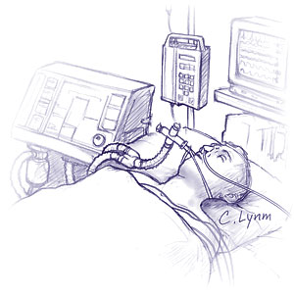
INTRODUCTION
COMMUNITY ACQUIRED PNEUMONIA
From community e.g. S. pneumoniae
HOSPITAL ACQUIRED PNEUMONIA
In hospital setting e.g. Klebsiella pneumoniae
VENTILATOR ASSOCIATED PNEUMONIA
Associated with ventilators
PNEUMONIA IN IMMUNODEFICIENCY
Associated with low immunity e.g. P. jirovecii

Slide 5
LIST OF MICROORGANISMS CAUSING PNEUMONIA
ATYPICAL PNEUMONIA | TYPICAL PNEUMONIA
Mycoplasma pneumoniae | Strep pneumoniae
Legionella pneumophila | Haemophilus influenzae
Coxiella burnetii | Staph aureus
Chlamydophila pneumoniae | Pseudomonas aeruginosa
Respiratory syncytial virus | Klebsiella pneumoniae
Influenza virus
Coronavirus (MERS-CoV)
Parainfluenza virus
VZV
CMV
HSV

Slide 6
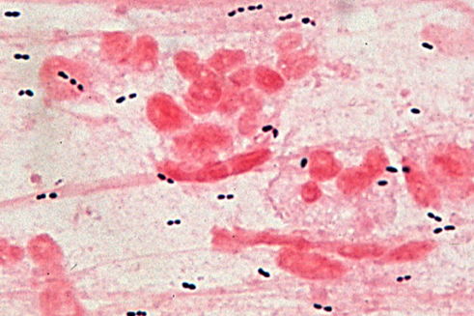
PNEUMOCOCCAL PNEUMONIA
ETIOLOGY
Strep pneumoniae
Gram positive lancet shaped diplococci
Polysaccharide Capsule-virulence factor & anti-phagocytic
90 serotypes based on capsular polysaccharides

Slide 7
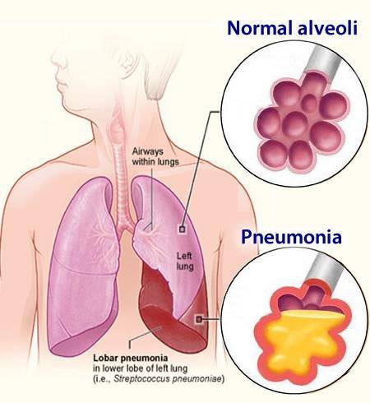
PNEUMOCOCCAL PNEUMONIA
TRANSMISSION
Community acquired
Acquired by aerosolized droplets/ contact
Also part of normal flora of oropharynx
Innate immune system prevent disease

Slide 8
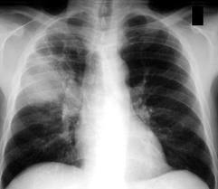
PNEUMOCOCCAL PNEUMONIA
Risk of disease
  Splenectomy
  Malnutrition
  Old /young age
  Smoking, Viral infections
  Immune suppressing drugs
  Alcohol intake
  Pulmonary congestion, heart failure
  Sickle cell anemia
  Complement deficiency

Slide 9
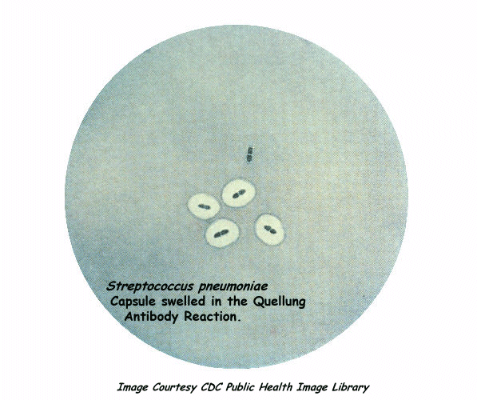
PNEUMOCOCCAL PNEUMONIA
PATHOGENICITY
No toxins/ enzymes
Ability to multiply in tissues
Antiphagocytic capsule most imp
Antibodies against type specific capsule prevent infection
Spleen is crucial in filtering S. pneumoniae from blood born infection
Splenectomized individuals-risk

Slide 10
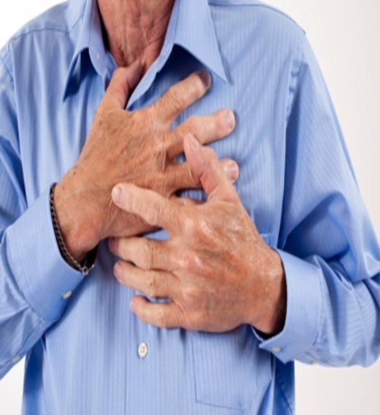
PNEUMOCOCCAL PNEUMONIA
COMPLICATIONS
Sinusitis
Otitis media
Mastoiditis
Bacteremia
Meningitis
Endocarditis
Septic arthritis

Slide 11
PNEUMOCOCCAL PNEUMONIA
LAB DIAGNOSIS
NON SPECIFIC INVESTIGATIONS
CBC
High TLC
Low TLC-severe disease
Thrombocytopenia-increased mortality
SERUM UREA/ ELECTROLYTES
High urea and low Sodium-severe inf
ARTERIAL BLOOD GAS ANALYSIS
PLEURAL FLUID ANALYSIS
If empyema/ effusion +ve

Slide 12
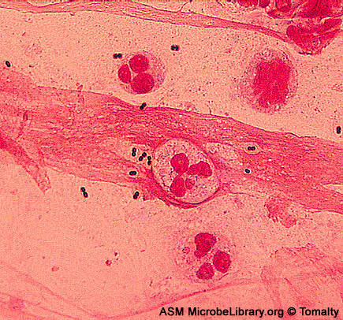
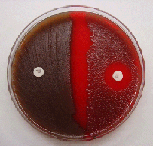
PNEUMOCOCCAL PNEUMONIA
LAB DIAGNOSIS
SPUTUM GRAM STAIN
Neutrophils, RBCs
Gram positive lancet shaped diplococci
SPUTUM C/S
Difficult to differentiate b/w pathogen and flora
Very heavy and pure growth-helps in diagnosis
BLOOD C/S
Very significant
Often positive
URINE ANTIGEN TEST
In very serious infections

Slide 13
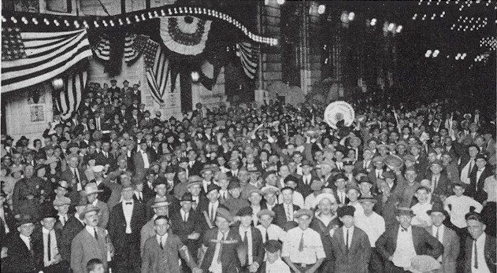
LEGIONNAIRES’ DISEASE
ETIOLOGY
Responsible for outbreak of pneumonia in persons attending American Legion convention in 1976
Legionella pneumophila
Fastidious, Gram neg bacillus
16 serotypes; serotype 1 responsible for >70% of infections
Poorly stained by Gram stain

Slide 14
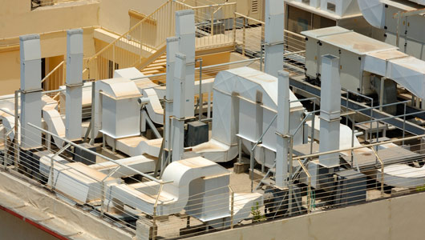
LEGIONNAIRES’ DISEASE
TRANSMISSION
Ubiquitous in warm moist environment
Lakes, streams & other water bodies
Aerosols generated from contaminated AC system, shower head, other sources
Inhalation of aerosols
Person to person transmission does not occur

Slide 15
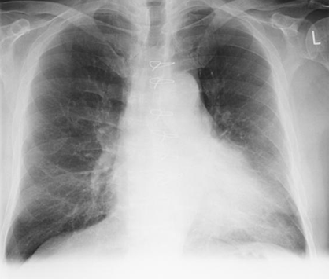
LEGIONNAIRES’ DISEASE
PATHOGENICITY
Usually in individual >55 years
Risk factors:
  Smoking, Chronic bronchitis, Emphysema, Steroids/ other immunosuppressive drugs, Diabetes mellitus
Inhalation of contaminated aerosol
Reach alveolar macrophage
Not efficiently killed
Failure of fusion of phagosome with lysosome
Legionnaire’s disease

Slide 16
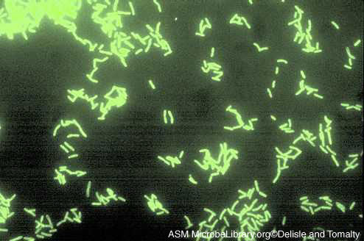
LEGIONNAIRES’ DISEASE
LAB DIAGNOSIS
SMEAR STAIN
Bronchial washings, pleural fluid, lung biopsy
Gram stain not suitable
DIRECT IMMUNO-FLUORESCENT TEST
CULTURE
BCYA-Slow growth
URINE ANTIGEN TEST-only serotype 1
SEROLOGICAL TEST-Serum antibodies to organism by ELISA test

Slide 17
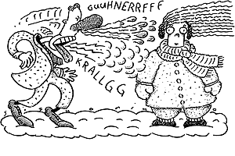
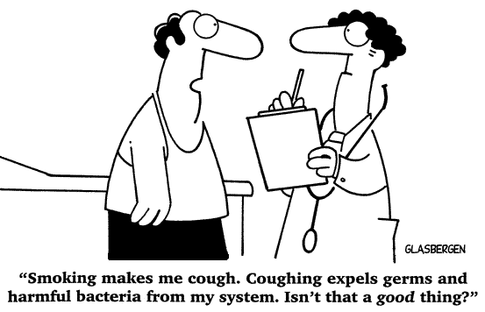
MYCOPLASMA PNEUMONIA
ETIOLOGY & TRANSMISSION
Mycoplasma pneumoniae
No cell wall-No Gram reaction
Person to person transmission
Infected resp secretions
Receptors on respiratory epith
Usually 5-20 years population

Slide 18
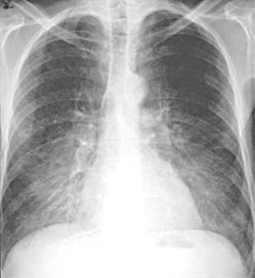
MYCOPLASMA PNEUMONIA
PATHOGENESIS
Primary Atypical pneumonia
Mild disease: Walking pneumonia
Extra-pulmonary involvement frequent
Hemolytic anemia, skin rashes, ear discharge
Consolidation of lungs with minimal symptoms
Death is rare

Slide 19
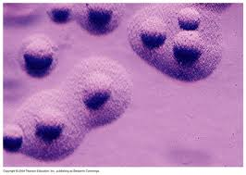
MYCOPLASMA PNEUMONIA
LAB DIAGNOSIS
SPUTUM CULTURE
Only specialized institutes
COLD HEAMAGGLUTININS
In 50% patients
SEROLOGY
ELISA for IgM & IgG very sensitive tests
PCR
On throat swab –sensitive but expensive

Slide 20
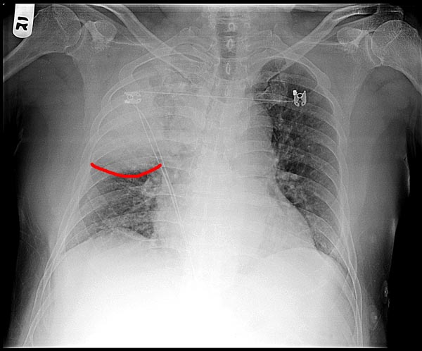
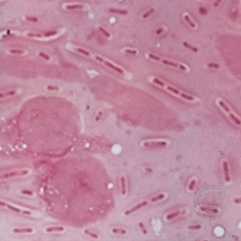
KLEBSIELLA PNEUMONIA
Gram Neg Capsulated Bacillus
Person to person or from environment to person
Rapid extensive hemorrhagic necrotizing consolidation of lungs
In alcoholics/ COPD patients
Gelatinous reddish brown sputum-sticks to container
Gram staining and culture of sputum specimen
Capsulated Klebsiella pneumoniae

Slide 21
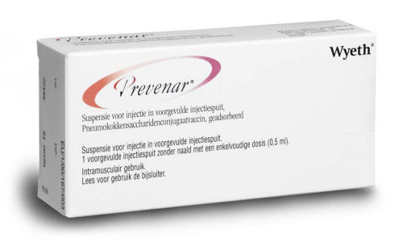
IMMUNIZATION FOR PREVENTION OF PNEUMONIA
Inactivated Polysaccharide vaccine for Strep pneumoniae
23 polysaccharide antigens
90% protection against bacteremic pneumonia
Elderly, debilitated or immuno-suppressed, splenectomized
Pneumococcal Conjugate vaccine with diphtheria protein for children 2-23 months

