Slide 1
Lecture 21Development of respiratory system
Dr. Rehan Asad

Slide 2
At the end of session students should able to
Describe formation of lung buds
Describe development of larynx, trachea and bronchi.
Describe the development of lungs.
Describe the maturation of lungs.
Correlate this knowledge to clinical conditions.

Slide 3
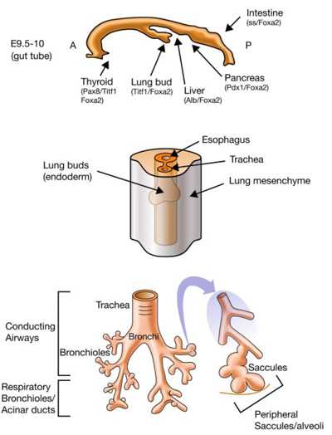
DEVELOPMENT OF THE LUNG BUD
Around 4 weeks of gestation
Respiratory diverticulum (lung bud) appears as an outgrowth from the ventral wall of the foregut
Retinoic acid produced by mesoderm controls its appearance

Slide 4
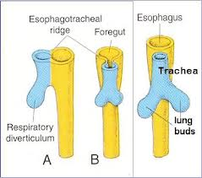
Development of lung Bud
In early stages, the lung bud is in communication with the foregut.
On further growth, two longitudinal ridges termed as tracheoesophageal ridges appears
It separate trachea from the foregut
In later stages, when these ridges fuse to form the tracheoesophageal septum, the foregut is divided into a dorsal portion esophagus and a ventral portion, the trachea and lung buds.

Slide 5
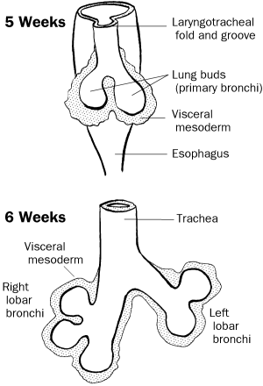
Development of lung buds
Lung bud forms trachea
Its lateral out pockets, known as bronchial buds.
Primary bronchi start forming at beginning of fifth week.
Lobar bronchi appears at sixth week.

Slide 6
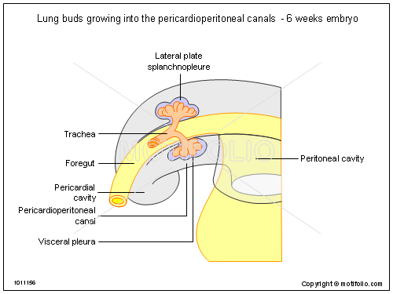
Development of lungs
During further development, lung buds expand in body cavity.
Cavity is known as pericardioperitoneal canal.
Mesoderm of lung form visceral pleura
Space between somatic and visceral pleura forms pleural cavity.

Slide 7
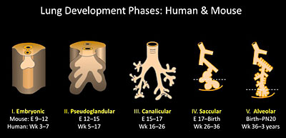
Development of lungs
Divided in four phases:
pseudoglandular
Canalicular
Terminal sac
Alveolar

Slide 8
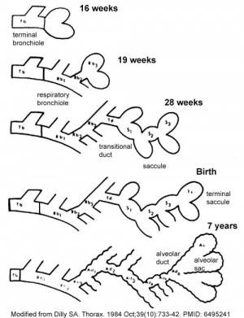
Pseudoglandular phase
Absence of respiratory bronchioles
5 to 16 wks
Branching continues to form terminal bronchiole.

Slide 9
Canalicular phase
16-26 weeks
Terminal bronchiole divide in respiratory bronchiole and formation of alveolar ducts.
Increase in vascularity

Slide 10
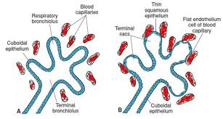
Terminal sac phase
26 weeks to birth.
Formation of primitive alveoli.
Close contact of capillaries.
Formation of blood air barrier.

Slide 11
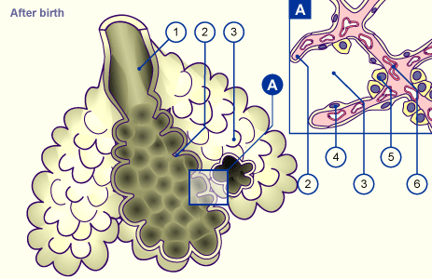
Alveolar phase
Eight months to childhood
Complete development of epithelium
Maturation of endothelial cells of capillaries

Slide 12
Lungs before and after birth
Before birth, lungs half-filled with fluid, little protein, mucus and surfactant
Aeration of lungs at birth is replacement of intra-alveolar fluid by air
During delivery, some fluid expelled via bronchi and trachea
When respiration begins at birth, most of lung fluid absorbed by blood and lymphatic capillaries
surfactant remains deposited as a thin, phospholipid, coating on alveoli

Slide 13
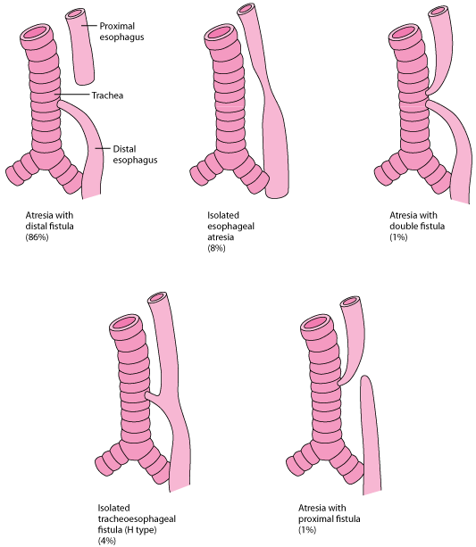
Clinical correlations
Esophageal atresia with tracheo-esophageal fistula
90% present with upper esophageal blind pouch.
33% of the cases are involved with VACTERL association (Vertebral anomalies, Anal atresia, Cardiac defects, Tracheoesophageal fistula, Esophageal atresia, Renal anomalies, and Limb defect).
Complications: Polyhydramnios.

Slide 14
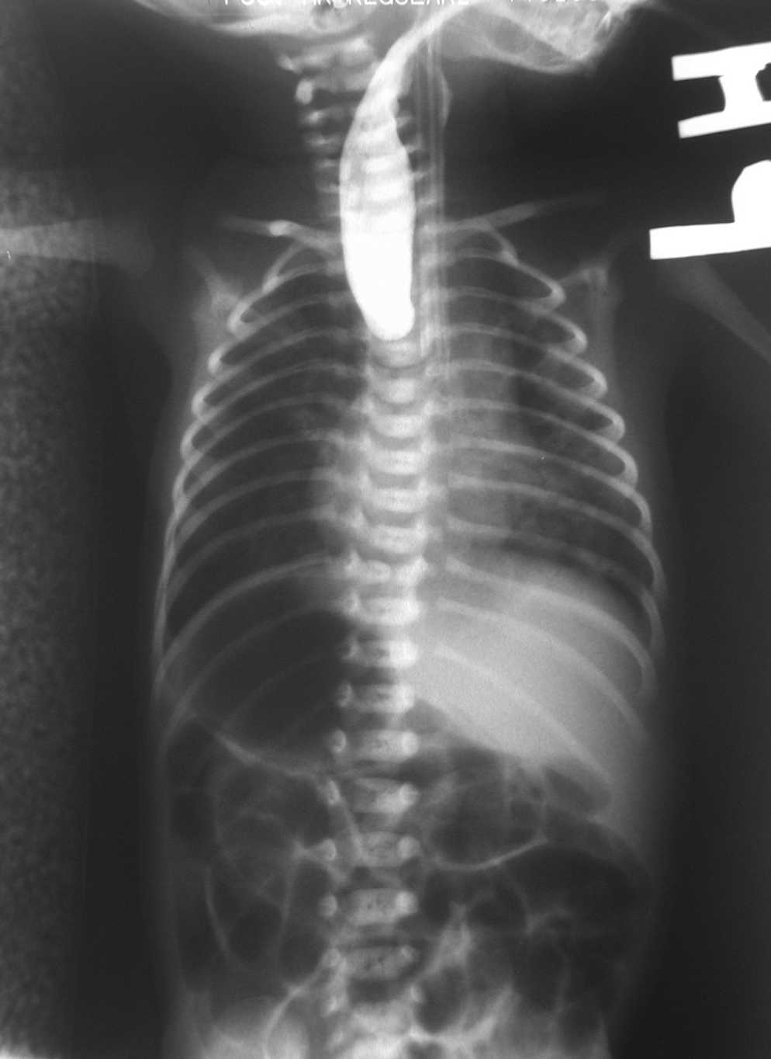
Clinical correlations
At birth, babies having trachesophageal defect need to be carefully monitored for VACTREL defects.

Slide 15
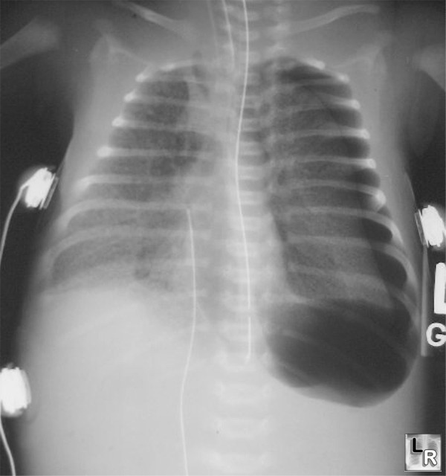
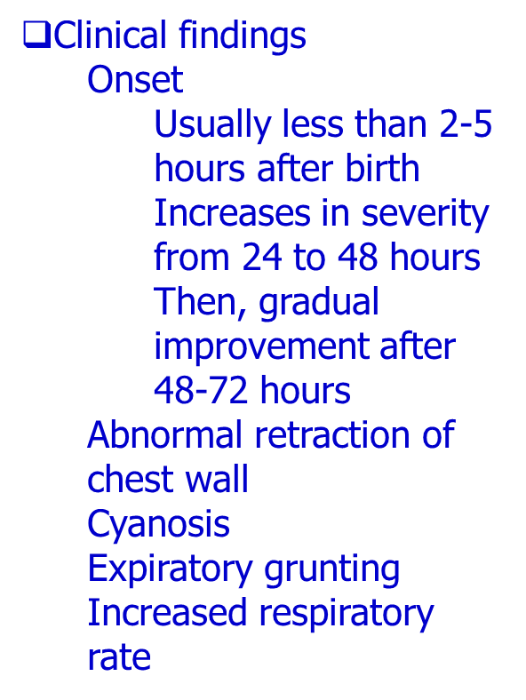
HYALINE MEMBRANE DISEASE
Respiratory Distress Syndrome
Most common in premature babies.
Due to immature type II alveoli
Deficiency of surfactant

Slide 16
Congenital anomalies
Agenesis of lungs
Hypoplasia of lungs
Ectopic lung lobes
Congenital lung cysts due to dilation of terminal bronchi

Slide 17
Summary

Slide 18
References
Langman's Medical Embryology: T.W. Sadler, 12th ed., CH. 14, P. 201-206

