Slide 1
Pulmonary Volumes and Capacities (Spirogram)
DR QAZI IMTIAZ RASOOL

Slide 2
OBJECTIVES
Describe normal spirogram, labeling, defining and mentioning the normal values of lung volumes and capacities.
Discuss and identify volume and capacities that cannot be measured by spirometry and discuss their significance and factors affecting them.
Define dead space, identify its different types and mention its significance.
Describe the changes in these volumes and capacities in obstructive and restrictive pulmonary diseases.

Slide 3
Pulmonary function tests
are group of procedures that are designed to measure (evaluate) the functions of the lung.
Examples include:
Spirometry.
Lung volumes by helium dilution or body plethysmography.
Blood gases.
Exercise tests.
Diffusion capacity.
Bronchial challenge testing.
Pulse oximetry.
Notes:
Before we can proceed, you need to know a little about the Types of Pulmonary Function Tests What exactly are PFTs?
The term means a wide variety of objective methods to assess lung function
Examples include:

Slide 4
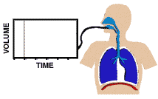
Spirometry Describe the measurement of lung volume
Basic tools to know respiratory status.
In patients with pulmonary disease,
As a first diagnostic test employed
In pre-operative evaluation,
3.In managing patients with pulmonary disease,
4. In quantifying pulmonary disability.
5.In evaluation of allergic status for drug therapy
6.As epidemiological survey to know normal values
7.To assess impact of an occupational exposure
Notes:
John Hutchinson (1811-1861)—inventor of the spirometer and originator of the term vital capacity (VC). Hutchinson thought it could apply to life insurance predictors. Not really used much during his time. 1)Simple, office-based ----Measures flow, volumes Volume vs. Time.
2) Spirogram is the recorded graph on paper
3) Spirometer is the apparatus
Hutchinson moved to Australia and did not pursue any other work on spirometry.
Eventually ended up in Fiji and died (possibly of murder.)

Slide 5
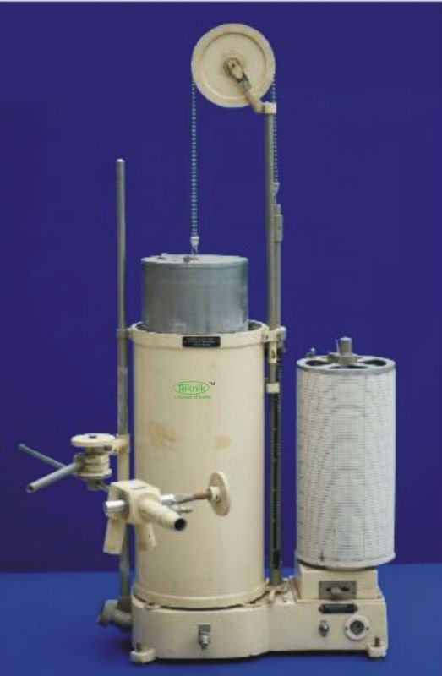

Slide 6
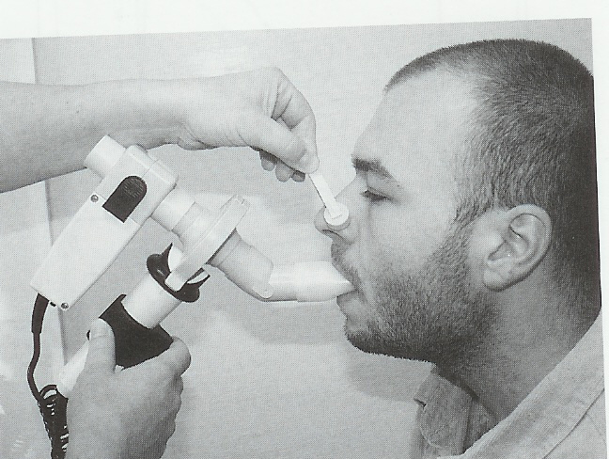
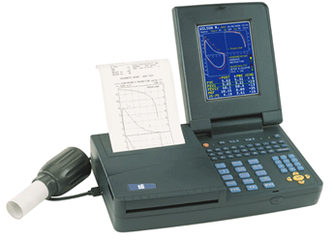
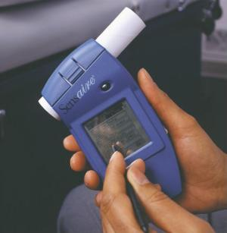

Slide 7
Spirogram
Volumes
Capacities
Tidal Volume (Minute)T.V
Residual Volume R.V
Inspiratory Reserve Volume I.R.V
Expiratory Reserve Volume E.R.V
Vital Capacity V.C
Total Lung Capacity T.L.C
Function Residual Capacity F.R.C
Inspiratory Capacity I.C

Slide 8
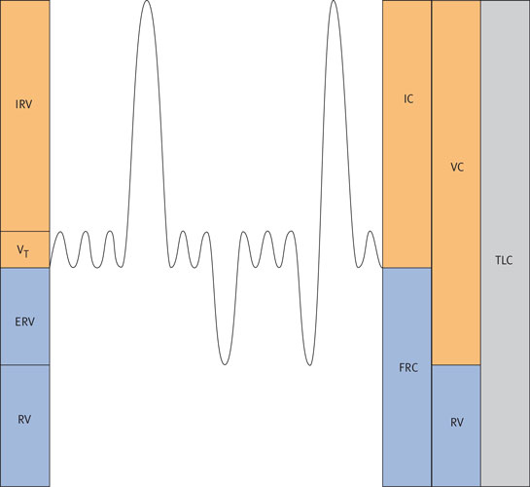
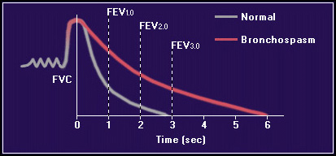
-Lung volume can be measured by;-
1. Changes of the lung volume during one breathing at static conditions, called static/ Primary lung volume
Or
2. Same / unit time called dynamic/ secondary lung volume

Slide 9
Tidal volume = volume of air that can be inhaled or expelled during normal quiet breathing = 500 ml.
Inspiratory reserve volume = Maximum volume of air that can be inspired by forced inspiration after normal inspiration = 3000 ml.
Expiratory reserve volume = Maximum volume of air that can be expired by forced expiration after normal expiration = 1000 ml.
Residual volume = volume of air that remains in the lung after forced expiration = 1200 ml.
1. Can be expelled from the lung unless the thoraxic cavity is opened as in pneumothorax
2. Physiological significance: aerates blood in between respiratory cycle
3. Clinical significance: RV / TLC should by 25-30% . If more
obstruction of airways is diagnosed as in bronchial asthma
4. Not measured by spirometer. It is mesured by helium dilution

Slide 10
Inspiratory capacity = the maximum volume of air that can be inspired by forced inspiration after normal expiration = TV + IRV = 3500 ml.
Functional residual capacity = Volume of air that remains in the lung after normal expiration = RV + ERV = 1200 + 1000 = 2200 ml
Not measured by spirometer.
Total lung capacity = volume of air that is contained in the lung after forced inspiration = IRV + TV+ ERV + RV = 5700 ml.
Not measured by spirometer.

Slide 11
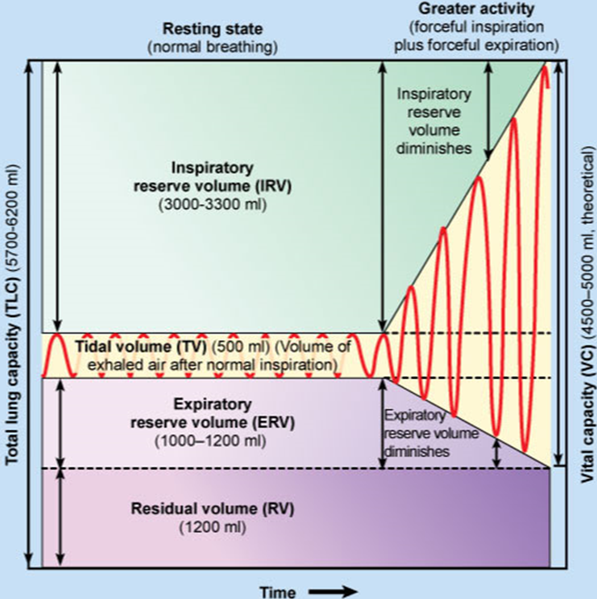

Slide 12
2. Indirect Spirometry Gas dilution Body plethysmography
Gas dilution techniques
All operate on a principle SIMILAR to Boyle’s Law
(P1 V1 = P2 V2),
C1 V1 = C2 V2
NOTE;- 1. Can only measure lung volumes in communication with conducting airways
2. Obstruction or bullous disease can have trapped, noncommunicating air within the lungs
(FRC may be measured is less than its actual volume)

Slide 13
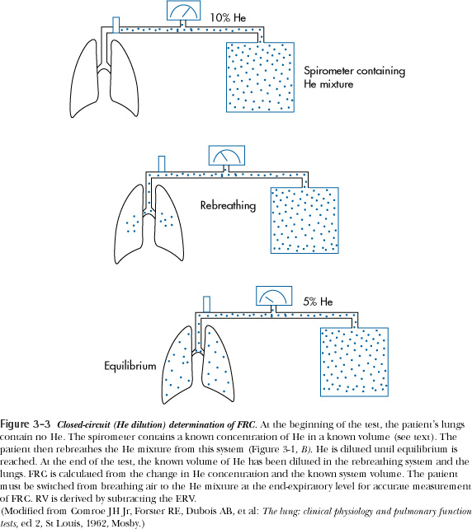
Static lung volumes & capacities,
RV, FRC, & TLC cannot be determined with
direct spirometry.
i.e, Closed-Circuit Helium dilution method for RV, FRC, TLC
Usually first FRC is calculated
1. FRC= ([He]i/([He]f-1)Vi
[He]i=initial concentration of helium in spirometer
[He]f=final concentration of helium in spirometer
Vi=initial volume of air in bell of spirometer
2. RV = FRC- ERV
3. TLC= RV + VC

Slide 14
Vital capacity:
the maximum volume of air that can be expired by forced expiration after forced inspiration = IRV + TV + ERV = 4500 ml.
It is the second best pulmonary function test.
Factors affecting VC:
Posture
Abdominal content
Respiratory muscles
Thoracic wall
Resistance to airflow
Lung elasticity
Pulmonary blood volume

Slide 15
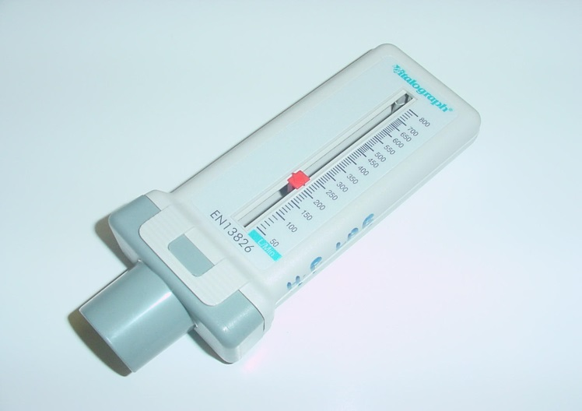
Peak Expiratory Flow Rate (PEFR)
Measuring maximal velocity of expired air after forceful inspiration.
Using peak flow meter.
Values for age, sex, height
Alternative for FEV/FVC.
Reduced in COPD.
Of special importance in asthma for rapid follow up of treatment efficacy.
PEFR (L/min) = [Height (cm) - 80] x 5
Height (cm) | PEFR (L/min)*
120 | 215
130 | 260
140 | 300
150 | 350
160 | 400
170 | 450
180 | 500

Slide 16
Maximal Voluntary Ventilation (MVV) or Maximum Breathing Capacity (MBC):
It is the maximum volume of air that can be breathed in and blown out per minute using the fastest and deepest respiratory effort as ever.
Procedure :Breathing as rapid & as deep as possible for 15 sec then multiply the result x 4.
Equals 80-160 L/min in ♂ and 60-120 L/min in ♀
It is the best pulmonary function test.
Breathing Reserve = MVV-MPV
Equals100 - 8 = 92 L/min
Dyspnoea Index = Breathing Reserve/MBC
Normally = 90% If < 60% , dyspnoea is diagnosed.

Slide 17
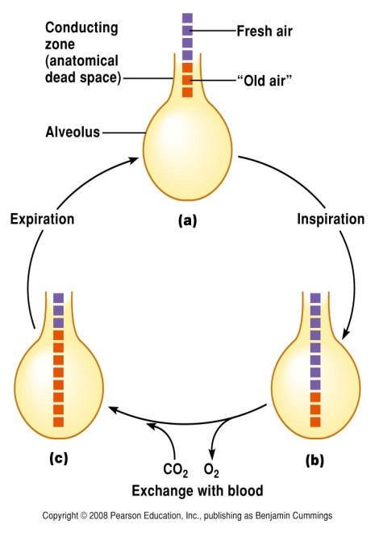
Dead Space
The space that contains the volume of air that dose not undergo gas exchange with the blood in the pulmonary capillaries.
Dead space is filled with inhaled air at the end of inspiration & with alveolar air at the end of expiration.
Volume of air in dead space = 150 ml.
Types of Dead space:
Anatomical; conducting zone of respiratory tract.
Alveolar DS; non-perfused alveoli
Physiological DS = anatomical D.S + alveolar DS
In normal subjects: anatomical dead space = physiological dead space as there is no non-functional alveoli.
In diseased subjects: Physiological dead space > anatomical dead space.

Slide 19
Obstructed Airflow limitation of expiratory airflow so that airways cannot empty as rapidly compared to normal
Narrowing of the airways due to bronchial smooth muscle contraction i.e. Asthma
Narrowing of the airways due to inflammation and swelling of bronchial mucosa and the hypertrophy and hyperplasia of bronchial glands i.e, bronchitis
Material inside the bronchial passageways physically obstructing the flow of air i.e excessive mucus plugging, inhalation of foreign objects or the presence of pushing and invasive tumors
Destruction of lung tissue with the loss of elasticity and hence the loss of the external support of the airways i.e. Emphysema
External compression of the airways i.e.Tumors, trauma

Slide 20
Restricted Airflow Characterized by reduced lung volumes/decreased lung compliance
A. Intrinsic Restrictive Lung Disorders
1. Sarcoidosis 2. Tuberculosis 3. Pnuemonectomy (loss of lung) 4. Pneumonia
B. Extrinsic Restrictive Lung Disorders
1. Scoliosis, Kyphosis 2. Ankylosing Spondylitis 3. Pleural Effusion 4. Pregnancy 5. Gross Obesity 6. Tumors 7. Ascites 8. Pain on inspiration - pleurisy, rib fractures
C. Neuromuscular Restrictive Lung Disorders
1. Generalized Weakness – malnutrition 2. Paralysis of the diaphragm 3. Myasthenia Gravis - in which the nerve impulses fail to induce muscular contraction. 4. Muscular Dystrophy 5. Poliomyelitis 6. Amyotrophic Lateral Sclerosis

Slide 22
Flow/Volume Loops in Obstruction and Restriction
↓ VC, normal shape reduced.
FVC is normal.
concave, scooped appearing
VC is normal.FEV₁ is reduced.
General rule: when flow is ↓→ lesion is obstructive
When volume is↓→it is restrictive

Slide 23
How is a flow-volume loop helpful clinically?
Helpful in evaluation of air flow limitation on inspiration and expiration
In addition to obstructive and restrictive patterns, flow-volume loops can show provide information on upper airway obstruction:
Fixed obstruction: constant airflow limitation on inspiration and expiration—such as in tumor, tracheal stenosis
Variable extrathoracic obstruction: limitation of inspiratory flow, flattened inspiratory loop—such as in vocal cord dysfunction
Variable intrathoracic obstruction: flattening of expiratory limb; as in malignancy or tracheomalacia

Slide 25
Spirometry Interpretation: What do the numbers mean?
FVC
80-120% Normal
70-79% Mild reduction
50%-69% Moderate
<50% Severe
FEV1
>75%
60%-75%
50-59%
<49%

Slide 26
 | Predicted Values | Measured Values | % Predicted
FVC | 6.00 liters | 4.00 liters | 67 %
FEV1 | 5.00 liters | 2.00 liters | 40 %
FEV1/FVC | 38 % | 50 % | 60 %
Decision : This person is obstructed

Slide 27
 | Predicted Values | Measured Values | % Predicted
FVC | 5.68 liters | 4.43 liters | 78 %
FEV1 | 4.90 liters | 3.52 liters | 72 %
FEV1/FVC | 84 % | 79 % | 94 %
Decision : This person is restricted

Slide 28
Classification of Ventilative Function Disorder
obstruction restriction mixed
FEV1/FVC N or
MVV or N
VC N or
RV uncertain
TLC N or N or uncertain

Slide 29
Effects of Aging
VC and MVV ↓
RV and DS ↑
Ability to remove mucus from respiratory passageways ↓
Gas exchange across respiratory membrane ↓

Slide 30
Critical Thinking In the advanced stages of pulmonary emphysema, the FRC and the RV are increased; in addition the VC is often decreased. Why do these changes occur
?
Notes:
Emphysema is characterized by a destruction of elastic tissue in the lung, which causes a lower lung recoil force. When lung recoil forces decrease, as in emphysema, chest wall expansion forces predominate, the chest wall expands outward pulling the lung with it. A new equilibrium occurs at increased lung volume so the FRC is increased. The RV is increased in emphysema because the VC is decreased because of small airway obstruction. When a person with emphysema tries to exhale completely, his or her bronchioles collapse, trapping air in the lungs. Increased FRC = hyperinflation; Increased RV = air trapping

