Slide 1
Respiratory physiology
Pulmonary Ventilation
DR QAZI IMTIAZ RASOOL

Slide 2
OBJECTIVES
Define pulmonary ventilation and differentiate it from alveolar ventilation.
Describe the respiratory cycle and define respiratory rate.
Identify the terms: eupenia, tachy- and bradyapnia, and hyper- and hypoapnia.
Discuss the mechanics (= peripheral mechanism) of normal quiet and forced respiration.
Discuss and illustrate the pressure relations (intrapulmonary, intrapleural, transpulmonary) that affect pulmonary ventilation.
Define intrapleural pressure, mention its values, list causes of its negativity and discuss its significance.

Slide 3
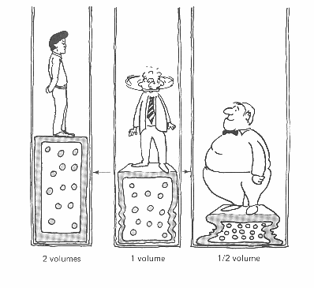
Pulmonary Ventilation
Mechanical process causing gas flow into and out of the lungs according to volume changes in the thoracic cavity. (“Breathing”)
Consists of two phases: Inspiration: Expiration:
NOTE;-
Volume changes lead to pressure changes
Pressure changes lead to flow of gases to
equalize pressure
Boyle’s Law: (when temp constant)
P₁V₁ = P₂V₂
P α 1/V
P = pressure in mm Hg
V = volume in cubic mm

Slide 4
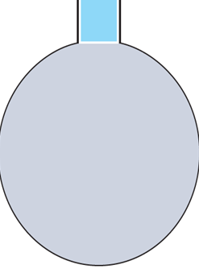
Is the volume of air exchanged between atmosphere and alveoli/min
NOTE;-more important as it represent new air available for
gas exchange with blood. f x (TV- DS)
F = frequency (breaths/min.)
TV = tidal volume
DS = dead space
because of dead space:
It is more advantageous to increase the depth
of breathing
ALVEOLAR VENTILATION
Fresh air
from inspiration
Airway dead-space
volume (150 ml)
.
Alveolar air
Notes:
because of dead space:
It is more advantageous to increase the depth of breathing

Slide 5
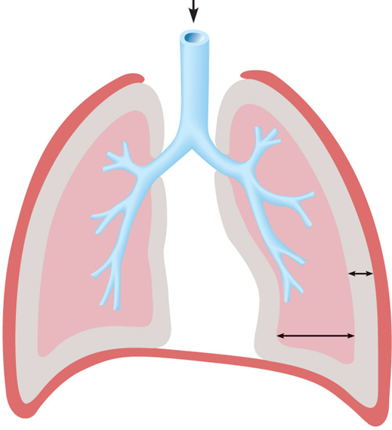
The Pleura Space
1. Between 2 membrane
-Visceral pleura a thin serosal
membrane (LUNGS)
-Parietal pleura lines the inner
surface of the chest wall,
2. Thin layer of mucoid fluid10-20 ml transudate (interstitial fluid + protein) by Parietal layer
A)Acts as a lubricant for lungs to slide against chest wall → facilitates change in size and shape of lungs
B)Also prevents frictional irritation so membranes slide against each other and are difficult to separate apart
C) Excess is removed by lymphatics constant suction on pleura (-5cmH₂O) of Mediastinum,superior - diaphragm,lateral - of parietal pleural
------helps create –ve P_{PL}
D) Protects lungs from external damage
.
Notes:
Parietal pleura lines the inner surface of the chest wall, lateral mediastinum, and most of the diaphragml

Slide 6
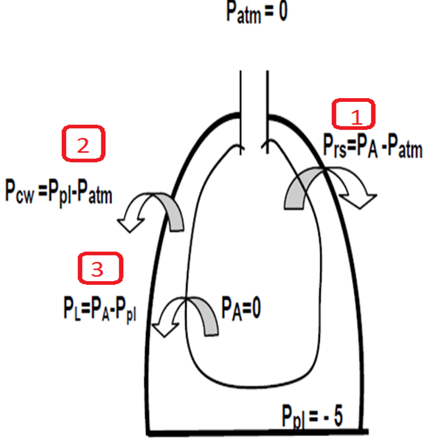
BIOPHYSICS OF BREATHING
1.Transthoracic (P_{tt}) - difference between alveolar pressure and body surface pressure (P_{tt}) = (P_{alv}) - (P_{atml})
2 . Transchest pressure (P_{ta})- tdifference between the alveoli pressure (P_{alv}) and atmospheric pressure
(P_{cw}).= P_{pl}- P_{atm}
3.Transpulmonary pressure (P_{tp}) - difference between the alveolar pressure and the pleural pressure
(P_{tp}) = (P_{alv}) - (P_{pl})
Notes:
P.atm is constant → changes in P.alv drive ventilation

Slide 7
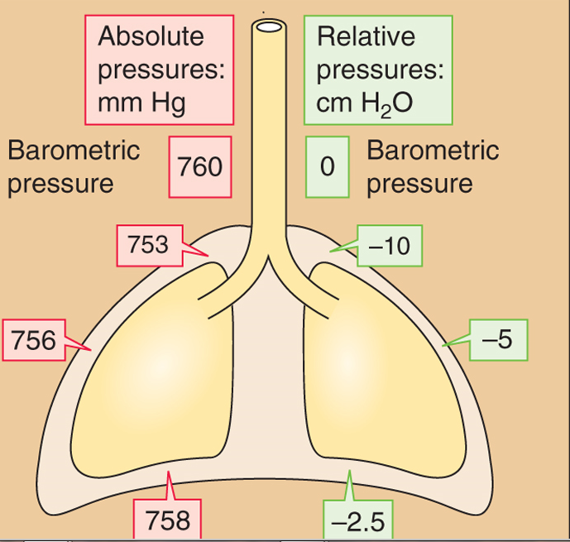
Pleural Pressure
Regional Differences
pressure of the fluid in the pleural space always-ve
Intraoesophageal pressure = intrapleural pressure.
-at rest suction creates a -ve pressure at beginning of inspiration (-5cmH₂0) holds the lungs open
-becomes more -ve during inspiration moving to -7.5cmH₂0 allowing for -ve pressure respiration
APPLIED
If becomes positive the lung will collapse: Pneumothorax, Hemothorax, Chylothorax
Notes:
Intraoesophageal pressure =idered equivalent to intrapleural pressure

Slide 8
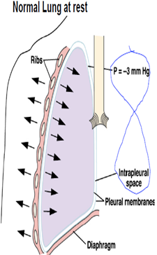
TRANSMURAL PRESSURE pressure inside relative to outside of a compartment. Under static conditions, the transmural pressure = the elastic recoil pressure of the compartment.
Thoracic cavity larger than lungs
Transmural (Across Lung Wall) pressure gradient holds thoracic wall and lungs in close apposition
This pressure gradient is balanced by the elastic forces in the alveoli producing equilibrium

Slide 9
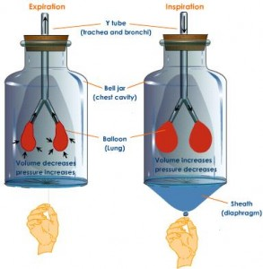
Pressure Relationships in the Thoracic Cavity
1.Intrapulmonary pressure
is the pressure in the alveoli, which rises and falls during respiration, but always eventually equalizes with atmospheric pressure.
2.Intrapleural pressure
is the pressure in the pleural cavity. It also rises and falls during respiration, but is always about 4mm Hg less than intrapulmonary pressure.

Slide 10
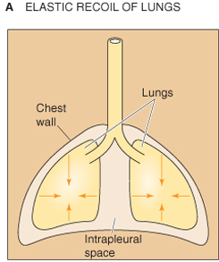
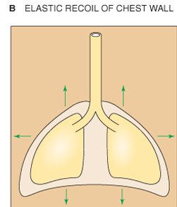
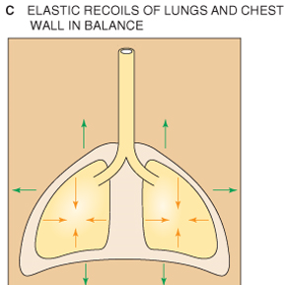
Static Characteristics of Lung
At rest or without air movement.
Lungs have a natural tendency to recoil inward, or to collapse.
2 main static forces :
elastic properties of lung tissue
surface tension by layer of fluid that is inside of t alveoli
Chest wall has a natural tendency to move outward, or to expand.
These two opposing forces tend to cancel each other out, leaving a residual volume of gas in the lungs, known as the FRC.
Notes:
Static lung conditions refer to lung characteristics at rest or without air movement.
lungs have a natural tendency to recoil inward, or to collapse.2 main static forces :
the elastic properties of the lung tissue
the surface tension produced by the layer of fluid that lines the inside of the alveoli
chest wall has a natural tendency to move outward, or to expand.
These two opposing forces tend to cancel each other out leaving a residual volume of gas in the lungs, known as the FRC.

Slide 11
INSPIRATION
Atmosphere
Airways
760 mm Hg
759mm Hg
Pleural Sac
Intrapleural pressure
754 mmHg
Thoracic
Wall
Lungs

Slide 12
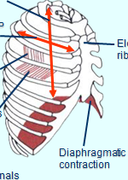
Primary Muscles of Inspiration
Diaphragm
75% of inspiratory effort
Thin dome-shaped muscle attached to
lower ribs, xiphoid process, lumbar vertebra
Innervated by( Phrenic nerveC_{3,4,5})
contraction of diaphragm
Diaphragm moves down 1.5 cm during normal inspiration
During forced inspiration diaphragm can move down 7.5cm
Abdominal contents forced downward & forward causing ↑ in vertically
Rib margins are lifted & moved outward causing ↑ transverse diameter
APPLIED 1. Obesity(moderate to severe),
2. Pregnancy
3.Tight Clothing
Paradoxical movement of diaphragm when paralyzed
Upward movement with inspiratory drop of intrathoracic pressure
Notes:
Main muscle of inspiration
Inflation of lungs is caused by contraction of diaphragm
Contraction of diaphragm expands thoracic cavity in 2 ways –
i) the dome is flattened —abdominal contents pushed downwards –→thoracic cavity enlarges in its rostro-caudal extent— the vertical diameter of thoracic cage ↑s
ii) Contraction of Diaphragm also pushes the ribcage outward that enlarges the thoracic cavity in its antero-posterior n lateral planes
act is –ve pressure ventilation Diaphragm
75% of inspiratory effort
Thin dome-shaped muscle attached to the lower ribs, xiphoid process, lumbar vertebra
Innervated by Phrenic nerve (Cervical segments 3,4,5)
During contraction of diaphragm
Abdominal contents forced downward & forward causing increase in vertical dimension of chest cavity
Rib margins are lifted & moved outward causing increase in the transverse diameter of thorax
Diaphragm moves down 1.5 cm during normal inspiration
During forced inspiration diaphragm can move down 7.5cm
Paradoxical movement of diaphragm when paralyzed
Upward movement with inspiratory drop of intrathoracic pressure
Occurs when the diaphragm muscle is denervated

Slide 13
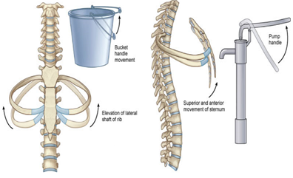
Present obliquely b/w ribs in forward & downward direction.Responsible for 25% of inspiratory effort Intercostal nerves (T 1-11 2 effects—
I) T.S+ A.P ↑by 2 mechanisms—
i) 2–10 rib rotates upwards and outwards by a “bucket-handle movement” → ↑ T.S
ii) upper 4 ribs rotate the sternum in upward n outward (pump-handle movement) → ↑ in vertically
APPLIED;-
Paralysis does not seriously alter inspiration because diaphragm is so effective but sensation of inhalation is de.
Primary Muscles of Inspiration
External intercostals (EIMs)
Notes:
The external intercostal muscles connect to adjacent ribs
Motor neurons to the intercostal muscles originate in the respiratory centers of the brainstem and travel down the spinal cord. The motor nerves leave the spinal cord via the intercostal nerves. These originate from the ventral rami of T1 to T11, they then pass to the chest wall under each rib along with the intercostal veins and arteries.
Contraction of EIM pulls ribs upward & forward
Thorax diameters increase in both lateral & anteroposterior directions
Ribs move outward in “bucket-handle” fashion
transverse & antero-posterior diameters increase by 2 mechanisms—
i) 2nd – 10th rib rotates upwards and outwards by a “bucket-handle movement” → increase in transverse diameter of thoracic cavity
ii) the upper 4 ribs rotate the sternum in upward n outward direction by a movement similar to that of the handle of a water-pump (pump-handle movement) → increase in vertical diameter
Intercostals nerves from spinal cord roots innervate EIMs
Paralysis of EIM does not seriously alter inspiration because diaphragm is so effective but sensation of inhalation is decreased

Slide 14
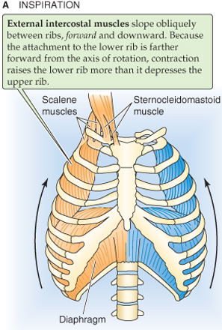
Inspiration,Accessory Muscles
assist with forced inspiration during periods of stress or exercise
1.Scalene Muscle
Attach cervical spine to apical rib
Elevate the first two ribs during forced inspiration
2.Sternocleidomastoid Muscle
Attach base of skull (mastoid process) to top of sternum and clavicle medially
Raise the sternum during forced inspiration
3.Neck and Back muscles(PECTORALIS MINOR)
↑ volume in 2 ways—
1. elevate pectoral girdle— ↑in cross-sectional area of thorax
2. they extend back c ↑ vertical length of the thorax
4. Intrinsic muscles of larynx

Slide 15
Mechanism of Breathing Cycle Normally (Quiet Breathing)
Inspiration active process ,Contraction of Inspiratory muscles →thoracic cavity expands →↓d intrapleural pressure →lungs expand →↓d intrapulmonary pressure to sub-atmospheric level→air from atmos. sucked into lungs

Slide 16
EXPIRATION
Atmosphere
760 mm Hg
Airways
761 mm Hg
Pleural Sac
Intrapleural pressure
756 mmHg
Thoracic
Wall
Lungs

Slide 17
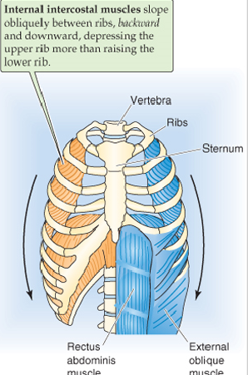
Muscles of Active Expiration
Rectus abdominus/abdominal oblique muscles
Contraction raises intra-abdominal pressure to move diaphragm upward
Intra-thoracic pressure raises and forces air out from lung
Internal intercostals muscles
Assist expiration by pulling ribs downward & inward
Decrease the thoracic volume
Stiffen intercostals spaces to prevent outward bulging during straining
These muscles also contract forcefully during
coughing, vomiting, & defecation

Slide 18
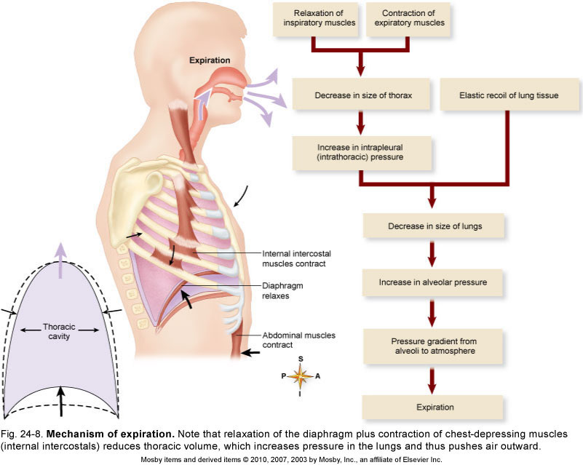
Active during hyperventilation & exercise
Expiration
Passive Phase Of Breathing Cycle
Notes:
The Passive Phase Of Breathing Cycle
Chest muscles & diaphragm relax contraction
Elastic recoil of thorax & lungs return to equilibrium
Pleural & alveolar pressures rise
Gas flows passively out of the lung
Expiration - active during hyperventilation & exercise

Slide 19
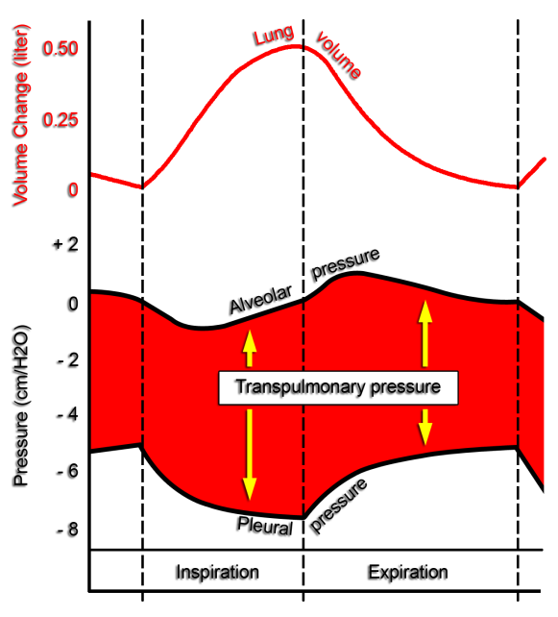
Various pressure in the lungs
(Quiet Breathing)
Notes:
Pleural pressure – is the pressure of fluid in the narrow space between the visceral and parietal pleura, normally slightly negative pressure
The normal pleural pressure at the beginning of inspiration is –5cm of H₂O (it reach about –7.5cm of H₂O due to movement of the chest cage)
The pleural pressure at the beginning of expiration is
–7.5cm of H₂O to reach –5cm of H₂O

Slide 20
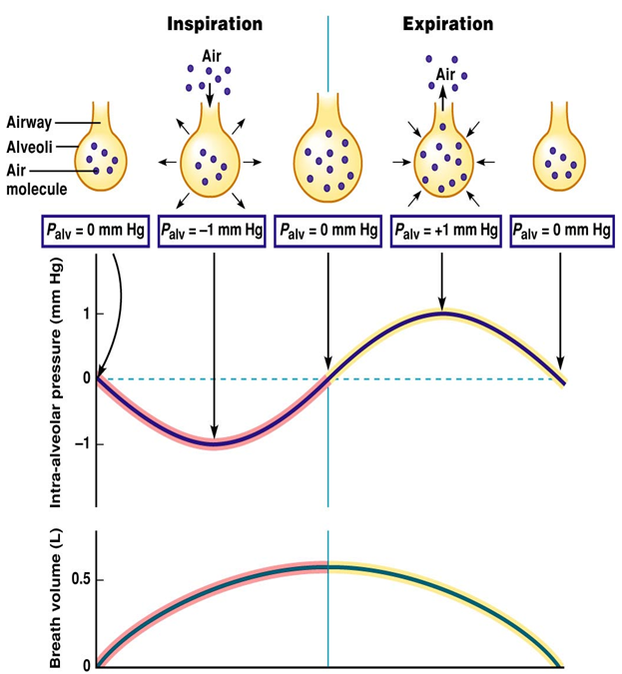
Alveolar pressure
is the pressure inside the lung alveoli
1. During inspiration: ↓ –1cm of H₂O (this slight negative pressure is enough to move about 0.5 liter of air into the lungs in the first 2 second of inspiration)
2. During expiration: it rises to about +1cm of H₂O (this forces 0.5 liter of inspired air out of the lungs during the 2 to 3 seconds of expiration

Slide 21
1.Eupnoea : Rhythmic breathing at rest ,rate of 12 - 20 breaths/ min.
2.Tachypnoea : Rapid breathing, more than 20 breaths / min.
3.Bradypnoea : abnormally slow breathing rate, less than 12 / min.
4.Hyperpnoea : depth of breathing when metabolic demands
4.Hypopnoea : depth of breathing when metabolic demands.
5. Dyspnoea Difficult or labored breathing that creates an “air hunger
6. Apnea A period of breathing cessation, ( sleep apnea).
7. Hyperventilation- above normal rate+ depth of breathing;
8. Hypoventilation Below normal rate; +. depth of breathing
9. Hypocapnia by abnormally low blood pCO2
10.Hypercapnia in blood carbon dioxide). pCO₂ 5 mmHg, V_{AlL} will double.
11. Anoxia severe form/ absence of O₂ deficiency in blood
12. Hypoxia severe form O₂ deficiency in blood
.
Notes:
A period of breathing cessation
Some individuals cease to breathe for short periods during sleep. This is called sleep apnea.
Reduced ability to inhale completely
This condition can occur in some cases due to pregnancy, obesity, poor posture, etc.
Hyperventilation
An above normal rate and depth of breathing; e.g. 25 breaths per minute
Typically due to increases in blood carbon dioxide ( hypercapnia ). If PCO2 increases 5 mmHg, alveolar ventilation will double.
Hypoventilation
Below normal breathing rate; e.g. 6 breaths per minute.
Brought about by abnormally low blood pCO2 ( Hypocapnia ).
Anoxia
A severe form of O2 deficiency (hypoxia)
Occurs during chronic bronchitis, emphysema and other chronic obstructive pulmonary diseases

Slide 22
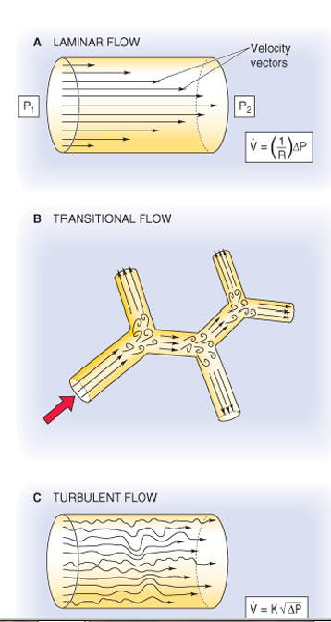
Dynamics of lung mechanics
studies physical states in motion.
As air flows through a tube – a pressure difference exists between the ends of tube
- difference depends on rate & pattern of air flow
at low flow rates is laminar
Turbulence occurs
- at higher flow rates
- changes in air passage way
airway branches
-diameter
-velocity
-direction changes
Notes:
Laminar flow is parallel to airway walls and is present at low flow rates. As the flow rate increases particularly as the airways divide, the flow becomes unsteady. At high flow rates, the flow stream is disorganized and turbulence occurs.
In turbulent flow gas movement occurs both parallel and perpendicular to the axis of the tube.Higher driving pressure is needed to support a given turbulent flow than to support a laminar flow. Much of the flow in airway demonstrate characteristics of both laminar and turbulent flow.
The flow in larger airways is turbulent while that in smaller airways is laminar

Slide 23
Physical nature (types) of flow
flow can be3 types, i.e. laminar, transition and turbulent flow.
Reynolds Number (Re) can be used to characterize these flow.
where ρ = density
μ = dynamic viscosity
ν = kinematic viscosity (ν = μ/ρ)
V = mean velocity
D = pipe diameter
:
Laminar Flow: Re <2000
Transitional Flow : 2000 - <4000
Turbulent Flow : Re >4000

Slide 24
Physical Factors Influencing Pulmonary Ventilation
Inspiratory /Expiratory muscles consume energy to overcome 3 factors that hinder air passage and pulmonary ventilation
Airway resistance
Alveolar surface tension
Lung compliance

Slide 25
Factors affecting pulmonary ventilation
1- Lung compliance: ease with which lungs can be stretched
- Compliance is a measure of the elasticity of lung tissue and the alveolar surface tension
2- Airway resistance: to changes in airway radius (↓radius → ↑resistance)
Pathology
lung disease resulting in stiffness of tissue
no or ↓ surfactant
Asthma
Airway obstruction
COPD

Slide 26
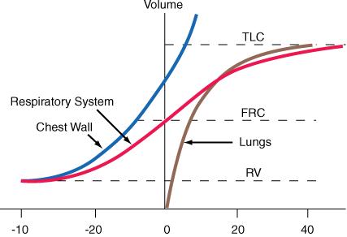

Slide 27
Respiratory adjustments at birth
Most important adjustment is to breath occurs within sec;
stimulated by:
cooling of skin
slightly asphyxiated state (elevated CO₂)
3. 40-60 mmHg of –ve P_{pL} necessary to open alveoli
on 1st breath

Slide 28
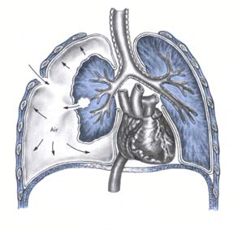
?
Notes:
?

