Slide 1


Slide 2
INTRODUCTION OF
RESPIRATORY SYSTEM
BY DR QAZI IMTIAZ RASOOL

Slide 3
What is
This
Lecture
About?
Define respiration and identify different
levels of respiratory process and the contributing parts of the body.
2. Describe the physiological anatomy of the respiratory system (= List the parts of conductive zone and components of respiratory zone).
3. Discuss its functions of the conducting zone (= respiratory passages).

Slide 4
Adam’s ventilatory apparatus—a rib—gave life to Eve
4th century B.C. writings attributed to Hippocrates depict the cooling of heart as the primary purpose of breathing
Higher animals

Slide 5
Introduction
Respiratio (French)
Re-spiro—to exhale, to breathe
Is a process in living organisms involving the production of energy, typically with the intake of oxygen and the release of carbon dioxide from the oxidation of complex organic substances.
o2
Digested Food
Energy + CO₂
Notes:
done, not by simple ventilation, but rather by respiration, which involves complex chemical and physiologic events at the cell level

Slide 6
Respiration can be classified as:
Aerobic, Anaerobic
External, Internal
Direct, Indirect
Voluntary, Involuntary
Collateral ventilation ,Cellular respiration
Notes:
Respiration, as the term is generally used, includes two processes: external respiration, the absorption of O₂ and removal of CO₂ from the body as a whole; and internal respiration, the utilization of O₂ and production of CO₂ by cells and the gaseous exchanges between the cells and their fluid
medium
Direct respiration through skin and pharyngeal regions
collateral ventilation – airflow between adjacent alveoli (via pores of Kohn)

Slide 7
EXTERNAL AND INTERNAL RESPIRATION
ATMOSPHERE
TISSUE
CELL
O₂ + FOOD
SYSTEMIC
CIRCULATION
HEART
PULMONARY
CIRULATION
LUNGS
CO₂ + H₂O
+ ATP
Notes:
External respiration is gas exchange between the lung alveoli and the blood of the pulmonary circulation. This process depends on gas partial pressure differences, the integrity of lung membranes and blood flow in and out of the lungs.
Internal respiration is the exchange of gas between the blood and the cells of the body.
This process generally depends on the same factors as external respiration

Slide 8
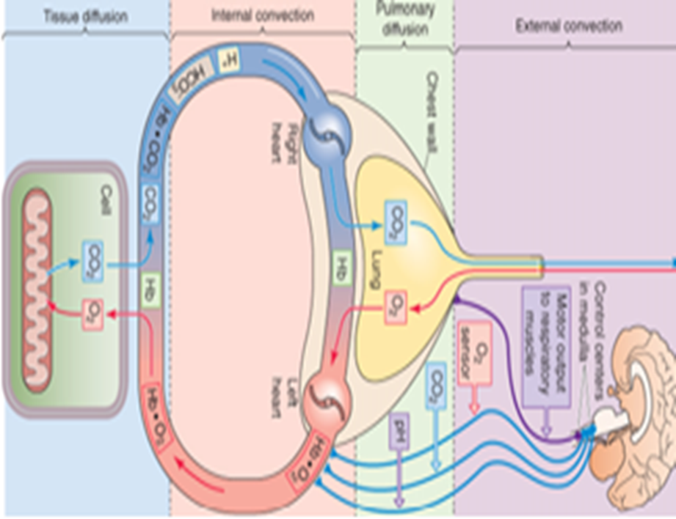
Physiologically, breathing is an activity of the respiratory system
Stages of the Breath:
1. Inhaling Oxygen (Air) INTO the Body:
Inhalation (or inspiration) is active
breathing phase.
2. Gas Exchange in the Lungs:
3. Exhaling Carbon
Notes:
and it is actively
connected circulatory system, nervous system , autonomic nervous
Stages of the Breath:
1. Inhaling Oxygen (Air) INTO the Body: The diaphragm expands into the
abdominal cavity, where the intestines are located. Other muscles cause
the ribs to move up and out, creating room in the chest (thoracic cavity).
The lungs expand with the air that has entered through the nose and
mouth. Inhalation (or inspiration) is the active breathing phase.
2. Gas Exchange in the Lungs: Air enters the lungs through the bronchial
tube that branches into bronchioles which branch into alveoli. The alveoli
are surrounded by the capillaries of the pulmonary arteries and veins.
Oxygen from the inflated lungs moves from the alveoli into the capillaries
as carbon dioxide moves from the capillaries into the alveoli.
3. Exhaling Carbon Dioxide (Air) OUT of the Body: The diaphragm
muscle relaxes and returns to its dome-like position inside the ribcage.
The ribcage muscles also relax. This pressure surrounding the lungs
pushes air out of the body. Carbon dioxide is released from the body by
traveling through the alveoli to the bronchiole to the bronchi, up the
trachea and out through the nose and

Slide 9
Respiratory apparatus
includes
1.Respiratory Tract
2.Thoracic cavity & Muscles of Respiration (PUMP)
3. With their Nervous control
Notes:
The respiratory system is made up of a gas-exchanging organ (the lungs) and a "pump" that ventilates the lungs. The pump consists of the chest wall; the respiratory muscles, which increase and decrease the size of the thoracic cavity; the areas in the brain that control the muscles; and the tracts and nerves that connect the brain to the muscles

Slide 11
Clinically
2 parts
Upper respiratory tract
Lower respiratory tract

Slide 12
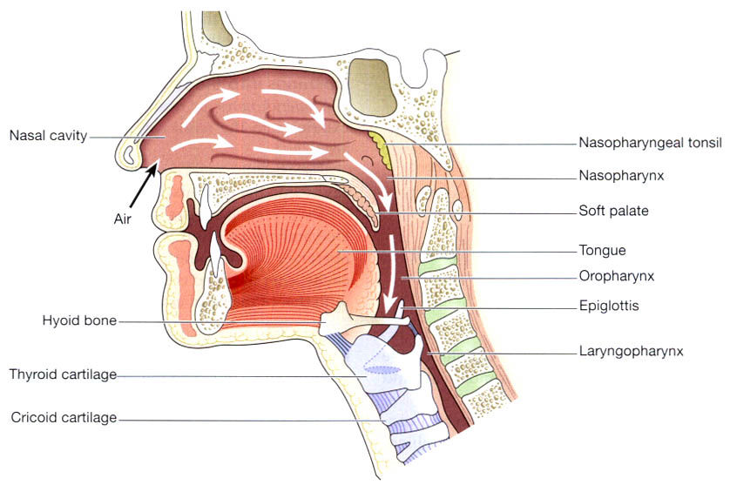
Upper Respiratory Tract
Structures from nose to vocal cords
Nose
Sinuses
Glottis
Pharynx
Larynx
To “Process” the inspired air:-

Slide 13
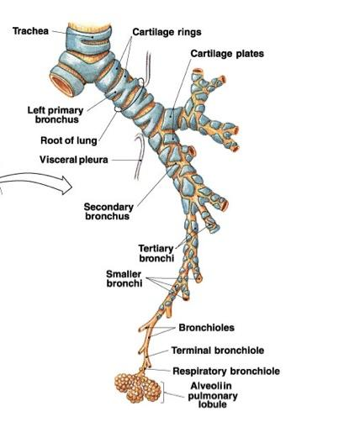
Lower Respiratory Tract
Trachea
Bronchi
Bronchioles
Alveolar ducts
Alveoli

Slide 14
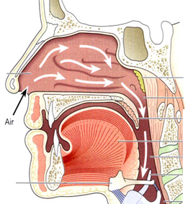
Nose
1. Air conditioning (warming, cooling),
3. Contains Olfactory Epithelium that receives smell n sensation
6. Filters particles > 10 µm
4. Contains Igs & Interferons and mucus production for protection ( bacteria, dust, pollen, etc.).
5. Offers 50% resistance to airflow in the RS
2. Resonating chamber for speech
Notes:
A chamber that transfers air and gases back and forth between the nostrils and the pharynx.
The design of this cavity allows for air filtration, air conditioning (warming, cooling), air monitoring (smelling odors) and mucus production for protection against foreign substances ( bacteria, dust, pollen, etc.).
The cilia facilitate the flow of mucus from the upper airways and clear the main nasal passages approximately every 15 minutes

Slide 15
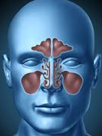
Paranasal Sinuses
Around the nasal cavity4 sinuses,
Maxillary, frontal, sphenoid, ethmoid
3 functions
1.Offer resonance to voice
2. Lighten the skull –→ upright posture becomes easier
3. Provide protection to brain during facial trauma
Notes:
The sinuses have two major functions-they lighten the skull, which makes upright posture easier, and they offer resonance to the voice

Slide 16
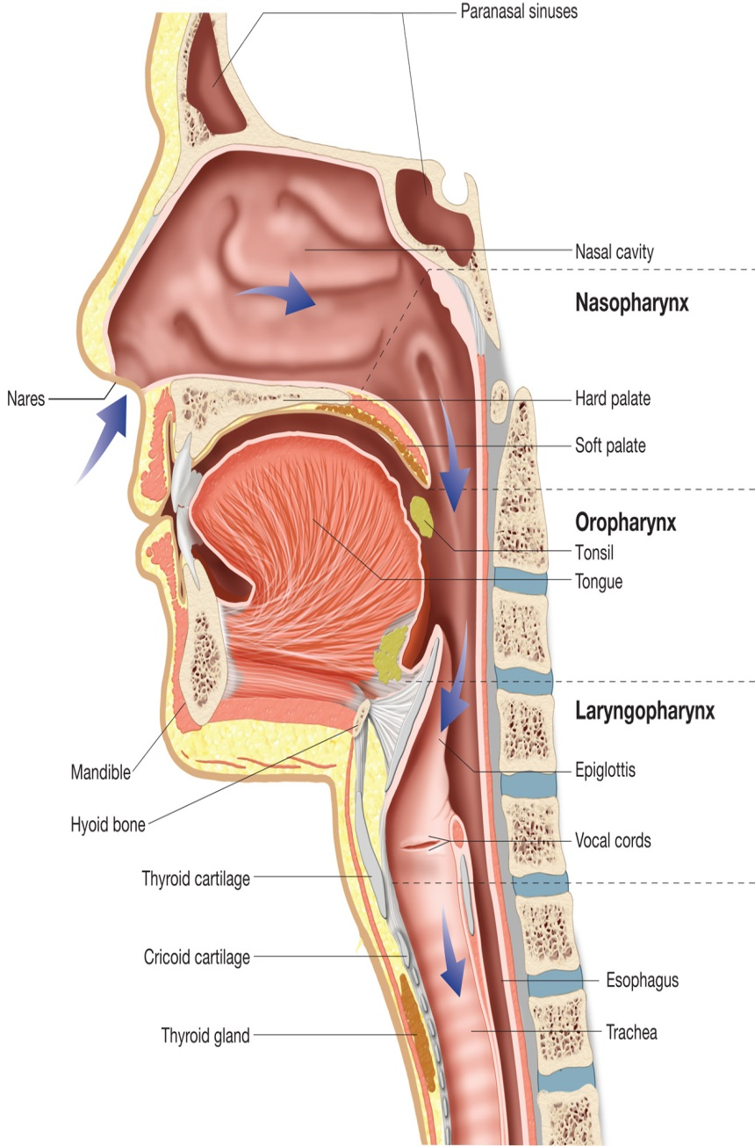
Pharynx
- is a tube 12 to 14 cm long
Nasopharynxsituated behind nose posterior nares to soft palate
Oropharynx situated behind mouth soft palate—hyoid bone level
Laryngopharynx hyoid bone to esophagus
Function—
Passageway for air and food.
Warming and humidifying.
Taste. .
Hearing.
Protection.
Speech.
Notes:
Passageway for air and food. The pharynx is an organ
involved in both the respiratory and the digestive
systems: air passes through the nasal and oral parts, and
food through the oral and laryngeal parts.
Warming and humidifying. By the same methods as in
the nose, the air is further warmed and moistened as it
passes through the pharynx.
Taste. There are olfactory nerve endings of the sense of
taste in the epithelium of the oral and pharyngeal parts.
Hearing. The auditory tube, extending from the nasal
part to each middle ear, allows air to enter the middle ear.
Satisfactory hearing depends on the presence of air at
atmospheric pressure on each side of the tympanic
membrane (ear drum) (p. 193).
Protection. The lymphatic tissue of the pharyngeal and
laryngeal tonsils produces antibodies in response to antigens,
e.g. microbes (Ch. 15). The tonsils are larger in
children and tend to atrophy in adults.
Speech. The pharynx functions in speech; by acting as a
resonating chamber for the sound ascending from the
larynx, it helps (together with the sinuses) to give the
voice its individual characteristics.

Slide 17
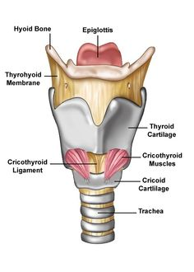
Larynx
  9 cartilages connected by membranes and ligaments
  Thyroid cartilage with laryngeal prominence (Adam’s apple) anteriorly
Consists of Epiglottis, Arytenoids, Vocal cords
Epiglottis n arytenoids cover the vocal cords during
deglutition n prevent aspiration of food during respiration
Vocal cords are for production n modification of voice
Function:
  Produces vocalizations (speech)
  Provides an open airway (breathing)
  Switching mechanism to route air and food into proper channels
    Closed during swallowing
    Open during breathing
Notes:
Functions
Production of sound. Sound has the properties of pitch,
volume and resonance.
• Pitch of the voice depends upon the length and
tightness of the cords. At puberty, the male vocal cords
begin to grow longer, hence the lower pitch of the
adult male voice.
• Volume of the voice depends upon the force with
which the cords vibrate. The greater the force of
expired air the more the cords vibrate and the louder
the sound emitted.
• Resonance, or tone, is dependent upon the shape of
the mouth, the position of the tongue and the lips, the
facial muscles and the air in the paranasal sinuses.
Speech. This occurs during expiration when the sounds
produced by the vocal cords are manipulated by the
tongue, cheeks and lips.
Protection of the lower respiratory tract. During
swallowing (deglutition) the larynx moves upwards,
occluding the opening into it from the pharynx and the
Passageway for air. This is between the pharynx and
trachea.
Humidifying, filtering and warming. These continue as
inspired air travels through the larynx

Slide 18
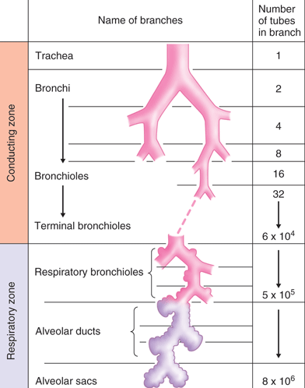
Lower Respiratory Tract
(Tracheo-Bronchiolar tree)
WEIBEL (1963)
1.Trachea
R+L main bronchi
2.lobar bronchi
3.segmental bronchi
4.bronchioles
5. TERMINAL BRONCHIOLES
1.RESPIRATORY BRONCHIOLEs
2.alveolar ducts
3.atria
4. alveolar sacs
conducting
zone
generations
1-16
respiratory
zone
primary lobule /
or acinus
generations
17-23
Notes:
The progressively bifurcating airways designated by their generation numbers
Trachea is the zero generation
Left n right main bronchi – 1st generation
Twenty three generations of airways
2 categories— conducting airways – [0-16] move air by convection into gas exchange area (Conducting zone)
respiratory airways – [17-23] participate in gas exchange (Respiratory zone)

Slide 19
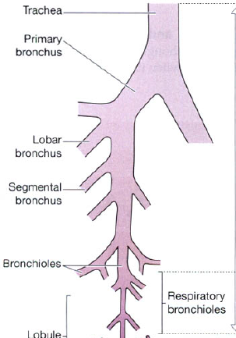
Generation Modifications
As the generation number ↑s :
1. Airways become smaller, shorter and narrower
2. The amount of cartilage in the wall ↓s
3. The no. of submucosal glands ↓s
4. The no. of mucous-secreting cells ↓s
5. The no. of cilia ↓s
6. The total cross-sectional area ↑s (2.5 cm² in the trachea thru 180 cm² in terminal bronchioles to 11,800 cm² in the alveoli; about are in contact with capillaries7000cm² )

Slide 20
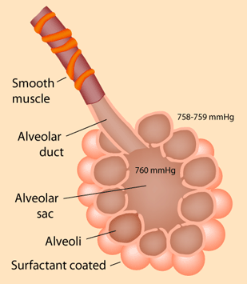
Conducting Zone
Some amount of cartilage present up to 10th generation(prevent collapse of airways ) and absent in bronchioles
Bronchioles Suspended by elastic tissue of lung parenchyma
First 16 airway generations lack alveoli and form the anatomical dead space.
Portion of the lung supplied by primary respiratory bronchiole is acinus

Slide 21
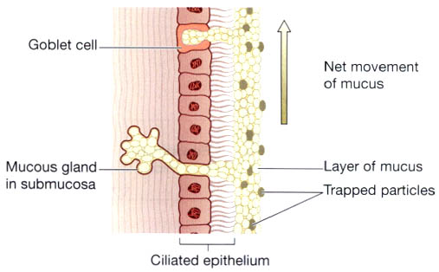
Functions of Conducting zone
Support and patency They distribute air evenly to deeper parts of lungs
They serve as part of Non-specific Defense System of body by removing dust, bacteria and harmful gases from resp. tract
Mucociliary escalator Mucous lines the inner wall of airways like carpet & traps small foreign particles
Provides a low-resistance pathway for air flow; resistance is physiologically regulated by changes in contraction of
airway smooth muscle and by physical forces acting upon
the airways.
Warming, humidifying and filtering of air.
Phonates (vocal cords).
Cough reflex
Notes:
Support and patency. The arrangement of cartilage and
elastic tissue prevents kinking and obstruction of the
airway as the head and neck move. The absence of cartilage
posteriorly allows the trachea to dilate and constrict
in response to nerve stimulation, and for indentation as
the oesophagus distends during swallowing. The cartilages
prevent collapse of the tube when the internal pressure
is less than intrathoracic pressure, i.e. at the end of
forced expiration.
Mucociliary escalator. This is the synchronous and
regular beating of the cilia of the mucous membrane
lining that wafts mucus with adherent particles upwards
towards the larynx where it is swallowed or expectorated
(Fig. 10.12).
Cough reflex. Nerve endings in the larynx, trachea and
bronchi are sensitive to irritation that generates nerve
impulses which are conducted by the vagus nerves to
the respiratory centre in the brain stem (p. 256). The
reflex motor response is deep inspiration followed by
closure of the glottis. The abdominal and respiratory
muscles then contract and suddenly the air is released
under pressure expelling mucus and/or foreign material
from the mouth.
Warming, humidifying and filtering of air. These
continue as in the nose, although air is normally saturated
and at body temperature when it reaches the trachea.

Slide 22
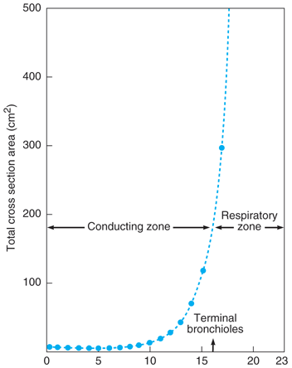

Slide 23
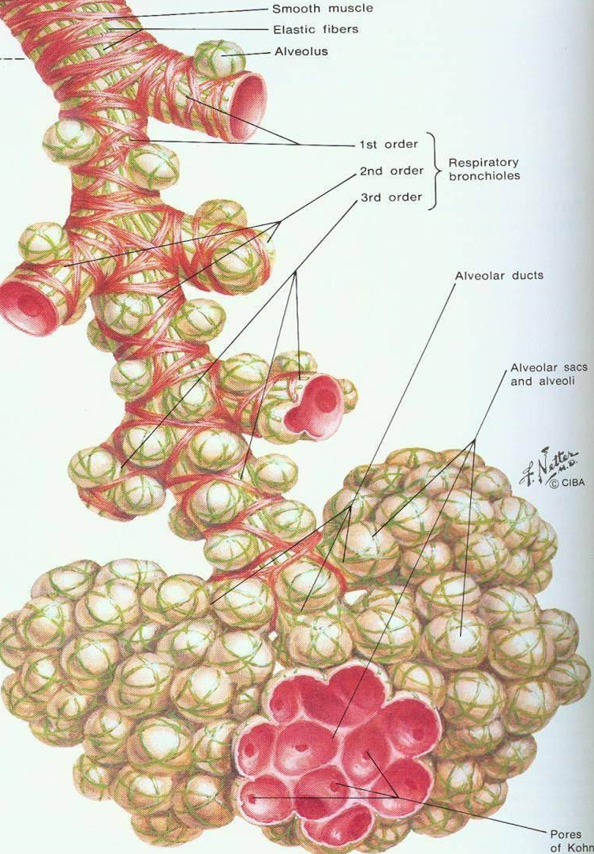
Respiratory Zone
site of gas exchange
Last 7 generations of airways
17-19 generation respiratory bronchioles
20-22 generation alveolar ducts
23 alveolar sac
This region is only approximately 5 mm long
Alveoli start budding off from 17 gen (~ 300 million)
All airways of a single terminal bronchiole (resp. bronchioles, alveolar ducts ‘n’ sacs) with associated blood and lymphatic vessels constitute a primary lobule (terminal resp. unit)
Resp zone supplied by pulmonary circulation
Extensive capillary network occupies 80% of alveolar surface area
Perialveolar capillaries proximate blood to alveolar air—easy diffusion of gases

Slide 24
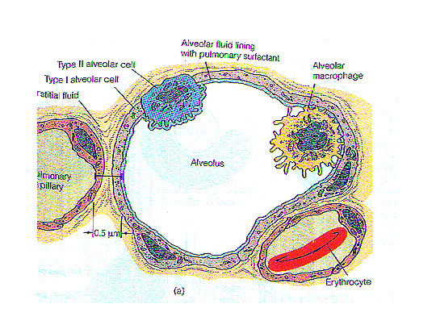
Alveolus
75-300 µm diameter
Total alveolar area in contact with capillaries in both lungs approx. 70m²
Type I-flat cells, primary lining cells of alveoli, covering 95% alveolar epithelial surface area
Type II (granular pneumocytes)— → thicker, contain numerous lamellar inclusion bodies → secrete surfactant
→ imp. in alveolar repair
→ make up 5% surface area
→ represent 60% epithelial cells in alveoli

Slide 25
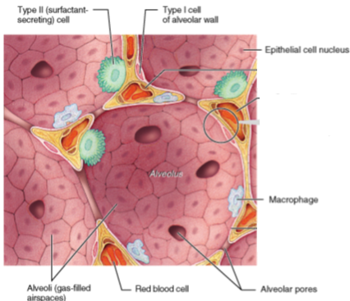
Other cells of alveolus
Pulmonary alveolar macrophages
Lymphocytes
Plasma cells
Mast cells containing
APUD cells
heparin, histamine, lipids &
proteases that participate in allergic
Notes:
APUD=AMINE PRECURSOR UPTAKE DECARBOXYLATION

Slide 26
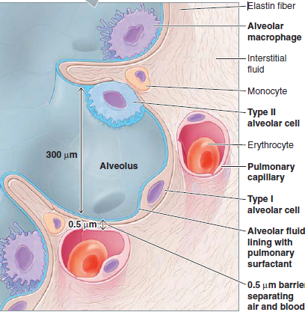
Respiratory membrane (air-blood barrier) or (Alveolar-capillary membrane) is composed of:
Primary function is gas exchange
Notes:
simple squamous epithelial cells (Type I cells)
-cobweb of pulmonary capillaries
-Type II cells (cuboidal)
surfactant
-elastic fibers
-alveolar pores allow for
pressure equalization
between alveoli
9.alveolar macrophages
(dust cells)

Slide 27
Functions of respiratory bronchioles and alveoli
1.External respiration
2. Defence against microbes
1.lymphocytes
2. plasma cells,
3. macrophages
3. Warming and humidifying
Notes:
External respiration
Defence against microbes. At this level, ciliated epithelium,
goblet cells and mucus are no longer present.
Defence relies on protective cells present within the lung
tissue. These include lymphocytes and plasma cells,
which produce antibodies in the presence of antigens,
and macrophages and polymorphonuclear lymphocytes,
which are phagocytic. These cells are most active in the
distal air passages where ciliated epithelium has been
replaced by flattened cells.
Warming and humidifying. These continue as in the
upper airways. Inhalation of dry or inadequately humidified
air over a period of time causes irritation of the
mucosa and facilitates the establishment of pathogenic
microbes.

Slide 28
II. Non-respiratory functions
a) Left ventricular reservoir= 0.5 L of blood
b) Filtering small emboli = Clots, fat or air bubbles:
c) Biochemical functions= → chemical substances removed PGE₂, PGF_{2a}, leukotriens, serotonin and bradykinin; → 250 volatile substances removed i.e methane(from intestines), alcohol, acetone, etc.
d) Olfactory function
e) Coughing and sneezing
f) Processing of inhaled air –filtration of toxic substances & organisms
g) Endocrine function—converts ANG₁ to ANG₂
h) Defense functions=→ alveolar & interstitial macrophages remove particles < 2µm → IgA, collectins (including Surfactant A and D),
→ defensins and proteases, reactive oxygen PGE2
→ chemokines and cytokines secrete (immune cells)
i) Metabolic functions— synthesis of surfactant lyse clot (local fibrinolytic system)
synthesis of local hormones like histamine, kallikrein, PGs
j) Temperature control=panting
Notes:
a) Left ventricular reservoir—pulmonary accommodates 0.5 L of blood at any given time
b) filtering small emboli from blood— venous blood contains microemboli of blood clots, fat or air bubbles:
c) Biochemical functions— → many chemical substances are removed in the lungs: PGE₂, PGF_{2a}, leukotriens, serotonin and bradykinin; → almost 250 volatile substances are also removed including methane(from intestines), alcohol, acetone, etc.
d) Olfactory function—breathing is essential for delivering odorants from the environment to the olfactory epithelium. Olfaction is required for many physiological activities including limbic functions
e) Coughing and sneezing
Irritation of nerves within the nasal passages or airways →coughing and sneezing →
air expelled forcefully from the trachea or nose, respectively.
Irritants caught in the mucus which lines the respiratory tract are expelled or moved to the mouth where they can be swallowed.
f) Processing of inhaled air –filtration prevents entry of toxic substances & some organisms into body
g) Endocrine function—ACE in pulmonary endothelium converts ANG₁ to ANG₂
h) Defense functions—
→ alveolar & interstitial macrophages remove particles < 2µm in diam
→ IgA, collectins (including Surfactant A and D), defensins and other peptides and proteases, reactive oxygen species, and reactive nitrogen species are all generated by airway epithelial cells, in bronchial secretions provide resistance to infection & maintain mucosal lining
→ epithelial protease activated receptors release PGE2 c protects pulm epith cells
→ Airway epithelial cells also secrete a variety of chemokines and cytokines that recruit the traditional immune cells and others to site of infections.
) Metabolic functions—
synthesis of surfactant
lyse clot (local fibrinolytic system)
synthesis of local hormones like histamine, kallikrein, PGs

Slide 29
INTERESTING FACTS
Lungs are in a space with a volume of approximately 4 L, and surface area for gas exchange is the size of a tennis court (∼70-85 m²).
Adults, the lung weighs = 1 kg, with lung tissue accounting for 60%
Volume of the nose in an adult is 20 mL
Lymphatic channels are more abundant in the lungs than in any other organ
Circulation to the lung is unique in its dual circulation and ability to accommodate large volumes of blood at low pressure.

