Slide 1
L58: Development of venous system
DR. Rehan

Slide 2
By the end of this session, the student should be able to:
Describe formation of vitelline veins.
Describe formation of umblical veins.
Describe formation of cardinal veins.
Correlate this knowledge to clinical conditions.

Slide 3
Development of venous system
Around 5th week, three pairs of the major vein appears.
Vitelline vein
Umbilical vein
Cardinal vein

Slide 4
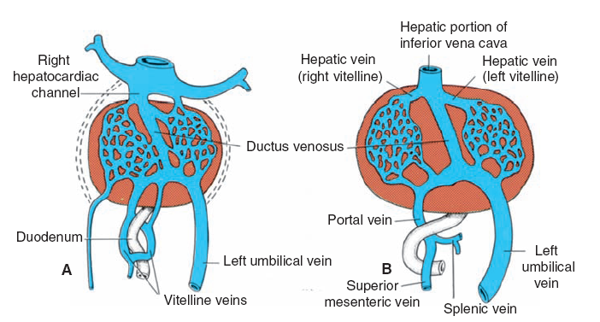
Development of Vitelline vein
Before entering in the sinus venosus, vitelline vein form plexus around duodenum and pass by septum transversum
The developing liver form sinusoids in septum.
With regression of left sinus horn, right portion of vitelline vein enlarges.

Slide 5
Development of vitelline vein
Right hepatocardiac channel form hepatocardiac portion of inferior vena cava.
Proximal part of left vitelline vein disappears.
Anastomotic network forms portal vein
Sup. Mesenteric vein derives from right vitelline vein.
Distal portion of vitelline vein disappears.

Slide 6
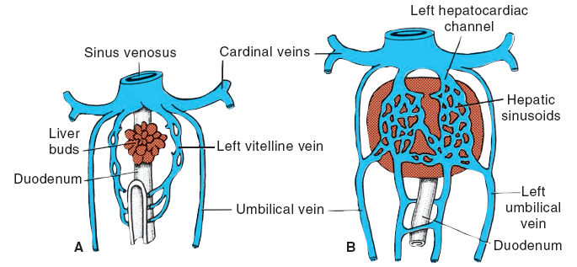
Development of umbilical vein
During fourth week, umbilical vein on both sides passes by the side of liver.
The proximal part will disappear from both sides
Distal part of right also disappears.
Only left umbilical vein persist up to 12 wks

Slide 7
Development of umbilical vein
With increase in placental circulation, the direct connection will form hepatocardiac channel and left umbilical vein
After birth, left umbilical vein form ligamentum teres
Ductus venosus form ligamentum venosum.

Slide 8
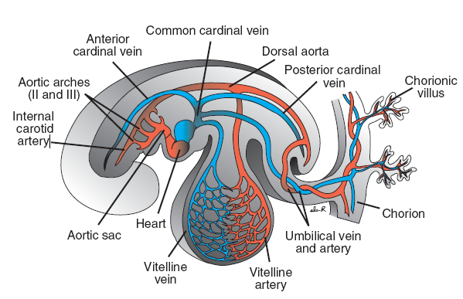
Development of cardinal vein
Up to 4th week of gestation, cardinal vein form main venous drainage.
Anterior cardinal vein drain cephalic part of embryo.
Posterior cardinal vein drain the remaining
Common cardinal vein

Slide 9
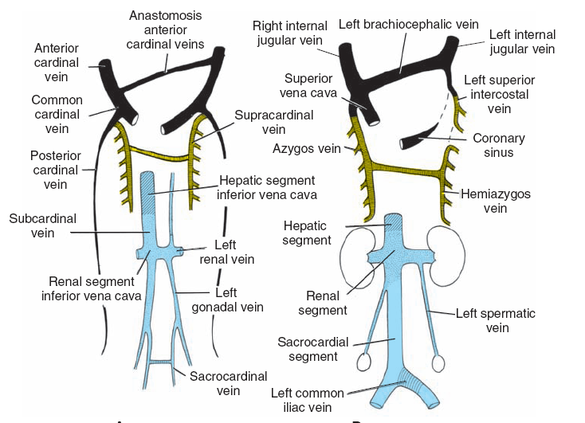
Development of cardinal vein
From 5th to 7th week, number of additional veins are formed.
Sub cardinal veins
Sacricardinal veins
Supracardinal veins

Slide 10
Development of venous system
Anastomosis between anterior cardinal vein will form future left brachiocephalic vein
This will channelize blood from left side of head and neck to right
Terminal part of left post. Cardinal vein will retained as left sup. Intercostal vein

Slide 11
Development of venous system
Formation of Sup. Vena cava
Formation of internal jugular vein
Extenal jugular derives from venous plexus in face
Left renal vein formed b anastomosis of subcardinal vein
Distal part of left subcardinal vein persist as left gonadal vein.
Renal segment of inferior vena cava

Slide 12
Development of venous system
Left common iliac vein
Sacrocardinal segment of inferior vena cava
Body wall is drained by supracardinal vein after 7th week
Its is drained by 4th to 11th right intercostal vein
Formation of azygos vein
4th to 7th left intercostal vein drained in left supracardinal vein

Slide 13
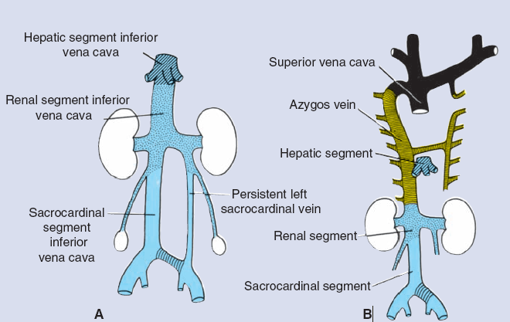
Clinical correlations
Double inferior vena cava: persistence of the connection between sacrocardinal and subcardinal vein
Absence of inferior vena cava: failure in the connection between right subcardinal vein with hepatic segment

Slide 14
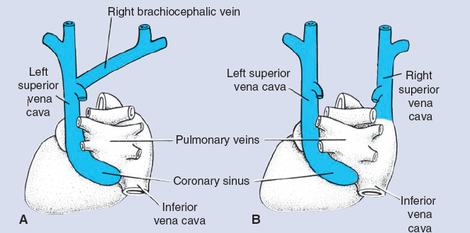
Clinical correlations
Left superior vena cava: persistence of left anterior cardinal vein
Double superior vena cava: persistence of left anterior cardinal vein and failure of the formation of left brachiocephalic vein.

Slide 15
Summary

Slide 16
References
Langman’s medical embryology, 12 edition.
http://www.uco.es/organiza/departamentos/anatomia-y-anat-patologica/embriologia/T8_SistemaCirculatorio/eng/development_of_the_venous_system.html

