Slide 1
Physiological Response to Hypovolemic Shock
Dr Khwaja Mohammed Amir
MD
Assistant Professor(Physiology)

Slide 2
Objectives
At the end of the session the students should be able to:
List causes of shock including hypovolemic shock
Describe compensatory mechanism of shock
Describe mechanism of non progressive shock
Describe mechanism of irreversible shock
Correlate this knowledge to the management of shock.

Slide 3
Definition of shock
Circulatory shock means generalized inadequate blood flow through the body; to the extent that the body tissues are damaged, especially because of too little oxygen and other nutrient delivery to the tissues (Guyton)
Inadequate perfusion (oxygen supply) of tissues, resulting in:
Organ dysfunction
Cellular and organ damage
And if not quickly corrected…
Death

Slide 4
Shock is a process that causes the eventual shutdown of all body systems in a systematic order
Amount of time for shock to progress varies from patient to patient
Is related to the body’s overall health and ability to compensate for it’s deficiencies
As the syndrome progresses, the process speeds up
The circulatory system fails to provide adequate blood to the tissues, resulting in cellular hypoxia and death

Slide 5
Types of Shock
Hypovolemic
Cardiogenic
Obstructive
Distributive
Notes:
Distributive = not the loss of blood
but excessive dilation of blood vessels causing the blood to be improperly distributed
5 ml of blood in a test tube or 5 ml of blood in a mixing bowl
fluid pools in the dependent areas and is not returned to the arterial circulation
Neurogenic = may occur after a spinal or head injury and drugs or anesthesia
blood vessels dilate and pools in the peripheral vessels
causes the cardiac output and venous return to drop
body cannot compensate due to the failure of the nervous system

Slide 6
Causes of Hypovolemic Shock
Bleeding (hemorrhage)
Loss of plasma
burns
exfoliative dermatitis
Intestinal obstruction
Loss of fluid and electrolytes
diarrhoea
vomiting
polyuria
excessive sweating

Slide 7
Hypovolemic Shock
Signs and symptoms:
Mental status: lethargy, sleepy,
Skin: cold and pale.
Blood pressure: begins to fall.
Pulse: rapid and weak
Respirations: rapid and shallow
Other: decreased urination

Slide 8
Cardiogenic Shock
Heart pump failure
Myocardial infarction
Cardiac trauma
Cardiomyopathy
Congestive heart failure
Cardiac arrhythmias

Slide 9
Obstructive Shock
It occurs when cardiac output is decreased as a result of mechanical obstruction of left or right ventricular filling
Causes
Tension pneumothorax with kinking of the great veins
Massive pulmonary emboli
Cardiac tamponade (bleeding into the pericardium with external pressure on heart)

Slide 10
Distributive Shock
Also known as vasogenic shock , low resistance shock or warm shock
It itself includes three types of shock
Neurogenic shock
Anaphylactic shock
Septic shock

Slide 11
Neurogenic shock
the vascular capacity increases so much that even the normal amount of blood becomes incapable of filling the circulatory system adequately.
One of the major causes of this is sudden loss of vasomotor tone throughout the body, resulting especially in massive dilation of the veins.
Causes
Deep general or spinal anaesthesia
Brain damage
Vasovagal syncope

Slide 12
Anaphylactic shock
It is a rapidly developing severe allergic reaction.
It occurs when an individual who has previously been sensitive to an antigen is re-exposed to it.
One of the principal effects is to cause the basophils in the blood and mast cells in the pericapillary tissues to release histamine or a histamine-like substance

Slide 13
The histamine causes
(1) an increase in vascular capacity
(2) dilation of the arterioles
(3) greatly increased capillary permeability,

Slide 14
Septic shock
This refers to a bacterial infection widely disseminated to many areas of the body, with the infection being borne through the blood from one tissue to another and causing extensive damage
Most of the effects are brought about by endotxins released by gram negative bacteria.

Slide 15
Stages of Shock
Non progressive/Compensated shock ---- body is able to compensate and maintain tissue perfusion
Progressive shock---- body begins to lose its ability to compensate---inadequate perfusion begins
Irreversible shock---cell and tissue damage result in multi-system organ failure
Notes:
Compensated
begins with a fall in BP
baroreceptors in the carotid arteries stimulate the sympathetic nervous system
increases heart rate, constricts blood vessels
activates the renin-angiotensin system
aldosterone promotes retention of Na
ADH results in retention of H2O
blood pH falls which stimulates the respiratory system to increase the rate and depth to eliminate excess CO2
Assessment
irritable
decreased BP
^ pulse
^ respiratory rate and depth
UOP decreased
skin- pale, cool
decreased bowel sounds
increased blood sugar
thirst
Progressive
metabolic acidosis
listlessness
confusion
decreased BP
tachycardia
^ respirations
temperature subnormal
UOP decreased with possible renal failure
skin cool, pale, clammy
dry mouth, thirst, muscle weakness, sluggish pupils
ischemic heart, lungs, liver
Irreversible
death is imminent
patients who are resuscitated may die within a week
fluid shifts into tissue
MODS
loss of consciousness
BP falls
pulse slow and irregular
respirations shallow
UOP minimal
skin clammy, cold, cyanotic

Slide 16
Nonprogressive/Compensated shock
Sympathetic reflexes and other factors compensate enough to prevent further deterioration of circulation
The factors that cause a person to recover from moderate degree of shock are all negative feedback control mechanisms of circulation. These include the following
Baroreceptor reflex
CNS ischemic response
Reverse stress-relaxation of the circulatory system

Slide 17
Increased secretion of renin by the kidneys and formation of angiotensin II(constriction of peripheral arteries, and decreased output of salt and water)
Increased secretion by posterior pituitary gland of vasopressin(ADH) :it constricts the peripheral arteries and veins and greatly increases the water retention by the kidneys.
Increased secretion by adrenal medulla of epinephrine and norepinephrine
Compensatory mechanism that return the blood volume back towards normal

Slide 18
Sympathetic reflexes and increased secretion of catecholamine by adrenal medulla get maximally activated within 30 seconds to a few minutes after hemorrhages.
The angiotensin - vasopressin mechanisms and reverse stress relaxation require 10minutes to 1 hour to respond completely.
Readjustment of blood volume may require 1 to 48 hours.

Slide 19
Sympathetic reflex compensations in shock
Especially important in maintaining Arterial Pressure
Powerful sympathetic reflexes initiated mainly by arterial baroreceptors and other vascular stretch receptors.
Three important effects
Constriction of arterioles in most of systemic circulation thereby increasing TPR
Constriction of venous reservoir increases venous return despite reduced blood loss.
Increase in heart rate

Slide 20
Value of the sympathetic nervous reflexes
In absence of sympathetic reflexes the body can tolerate only 15-20% of blood loss in contrast to 30-40% when the sympathetic system is intact.
Sympathetic reflexes are geared more for maintaining arterial pressure than for maintaining cardiac output.

Slide 21
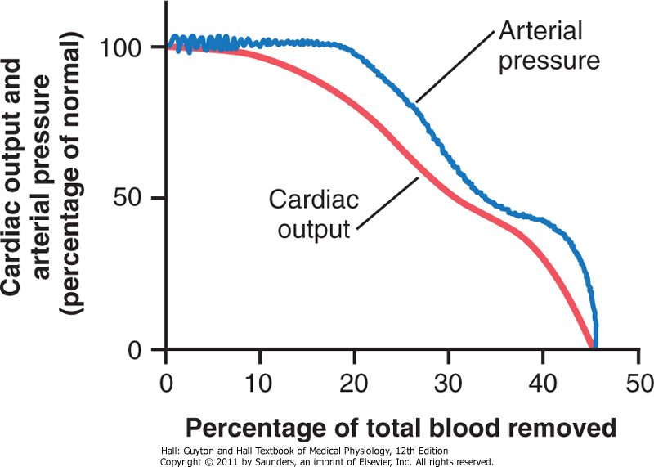
Figure 24-1 Effect of hemorrhage on cardiac output and arterial pressure.
Downloaded from: StudentConsult (on 11 October 2012 06:23 PM)
© 2005 Elsevier
Notes:
MAB=CO * TPR

Slide 22
Sympathetic reflexes is brought about by increase of TPR and constriction of veins to keep venous return and cardiac output from falling too low.
The second plateau phase of is due to CNS ischemic response. This leads to extreme stimulation of sympathetic nervous system. This can also be called last ditch stand of the sympathetic nervous reflexes to keep arterial pressure from falling too low.

Slide 23
Protection of coronary and cerebral blood flow by reflexes
The sympathetic nervous reflexes do not cause significant constriction of either the cerebral or cardiac blood vessel. In addition in these areas local blood flow autoregulation is excellent.
In these areas blood flow is maintained until arterial blood pressure falls below 70mmHg.

Slide 24
Progressive shock –vicious circle of cardiovascular deterioration
There are some positive feedbacks that cause shock to become progressive. Some of these are mechanisms are
Cardiac depression: when arterial blood pressure falls low enough, the myocardium itself gets damaged due to reduced blood supply in the coronaries. This weak heart muscle leads to further reduction in cardiac output.

Slide 25
Blockage of very small blood vessels-Sludged Blood:
Since tissue metabolism continues to occur despite the sluggish blood flow, large amount of acids like carbonic acid and lactic acid are dumped in to the blood. This along with products from ischemic tissue cause blockage of small blood vessels.
Increased capillary permeability.
Caused by capillary hypoxia.
Release of toxins by ischemic tissues
Histamine, serotonin, tissue enzymes .
Cardiac depression caused by endotoxins:
Released from dead gram negative bacteria in the intestines. This causes increased cellular metabolism despite inadequate nutrition. Major role in septic shock

Slide 26
Generalised cellular deterioration:
Occurs throughout the body but the organ worst effected is the liver because of its exposure to vascular toxins. The major effects occurring are:
Na+/K+ transport is diminished. Sodium chloride accumulates inside the cell and potassium is lost. The cell begins to swell.
Mitochondrial activity is depressed
Lysosomes release hydrolases causing intracellular deterioration.

Slide 27
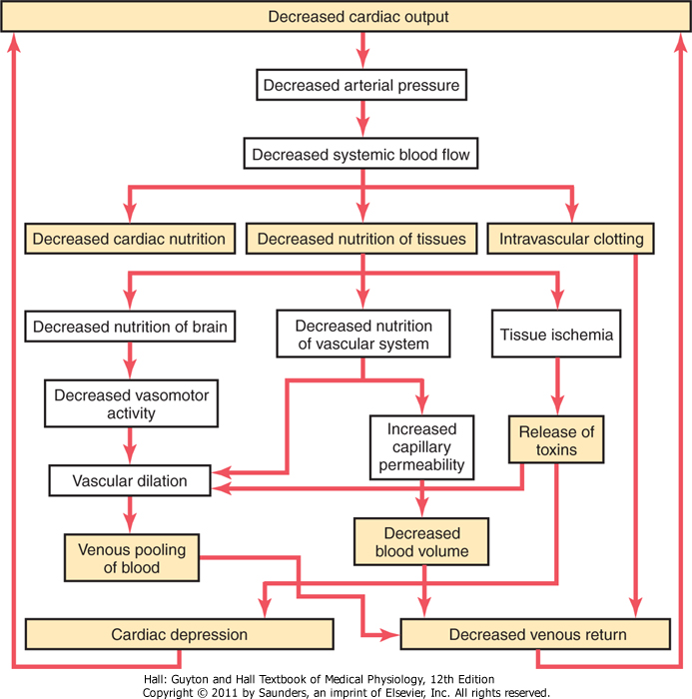
Downloaded from: StudentConsult (on 11 October 2012 06:47 PM)
© 2005 Elsevier

Slide 28
Tissue necrosis in severe shock-patchy areas of necrosis
Acidosis in shock-
due to excess lactic acid and retention of carbon dioxide in tissues
All positive feedback does not necessarily lead to vicious cycle. Whether a vicious cycle develops depends on intensity of the positive feedback.

Slide 29
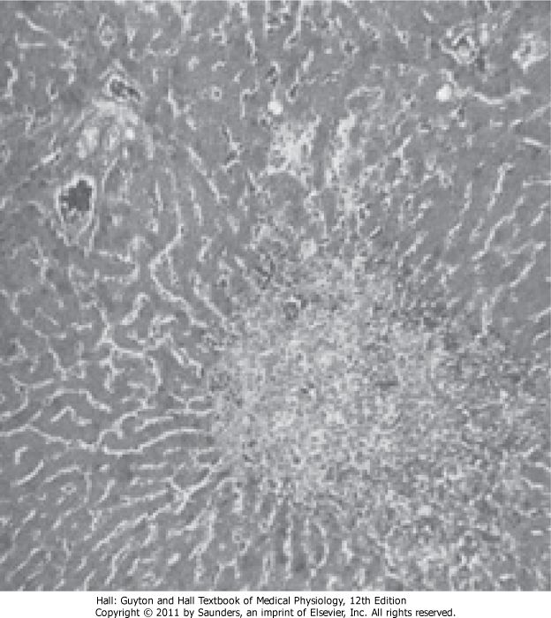
Necrosis of the central portion of a liver lobule in severe circulatory shock.

Slide 30
Irreversible shock
At this stage of shock, transfusion or any other form of therapy is incapable of saving the person’s life.
Also known as refractory shock.
Depletion of the cellular high energy phosphate reserves.

Slide 31
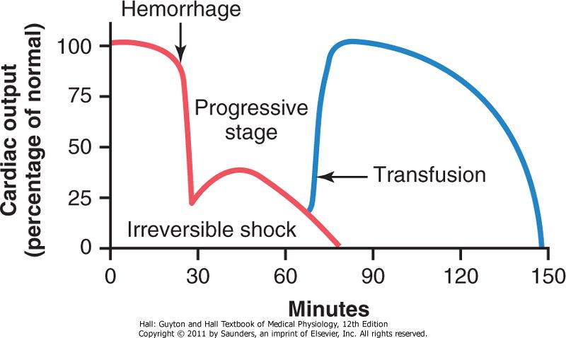
Failure of transfusion to prevent death in irreversible shock

Slide 32
Physiology of Treatment in Shock
Replacement Therapy
Blood and Plasma Transfusion
Dextran Solution as a Plasma Substitute
Treatment of Shock with Sympathomimetic Drugs-
Sometimes Useful, Sometimes Not
Useful in neurogenic and anaphylactic shock.
Sympathomimetic drugs have not proved to be very valuable in hemorrhagic shock

Slide 33
Other Therapy
Treatment by the Head-Down Position
Oxygen Therapy
Treatment with Glucocorticoids
Glucocorticoids frequently increase the strength of the heart in the late stages of shock;
Glucocorticoids stabilize lysosomes in tissue cells
Glucocorticoids might aid in the metabolism of glucose by the severely damaged cells.

Slide 34
Summary
List causes of shock including hypovolemic shock
Describe compensatory mechanism of shock
Describe mechanism of non progressive shock
Describe mechanism of irreversible shock
Correlate this knowledge to the management of shock.

Slide 35
Thanks………..

