Slide 1
Cardiovascular system
By:
Dr Hossam El-deen Salem

Slide 2
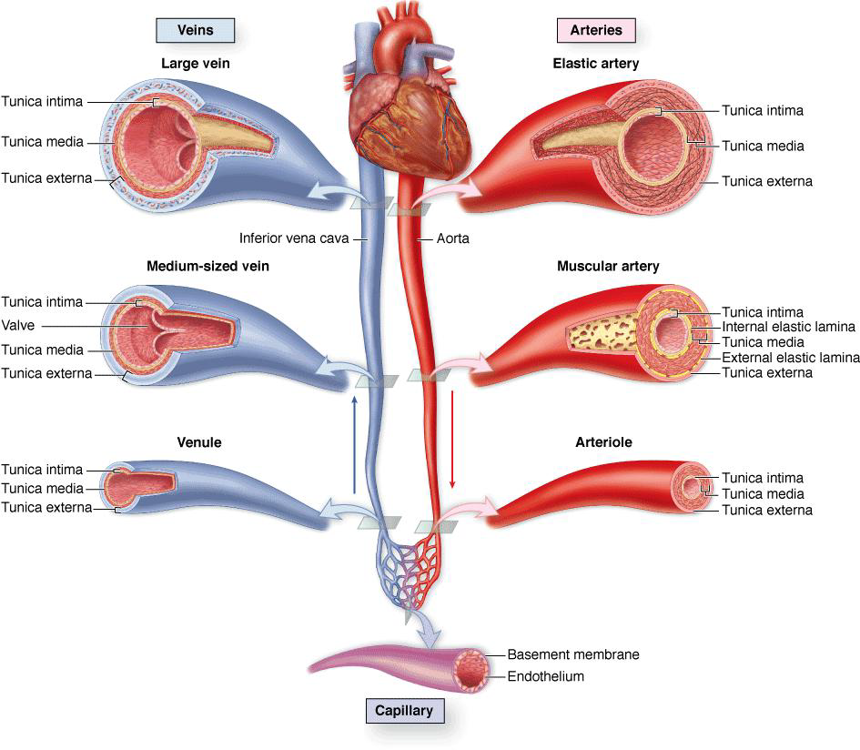

Slide 3
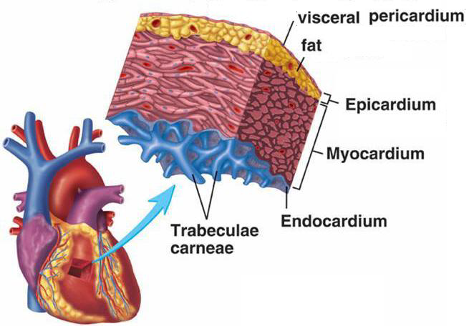
Heart

Slide 4
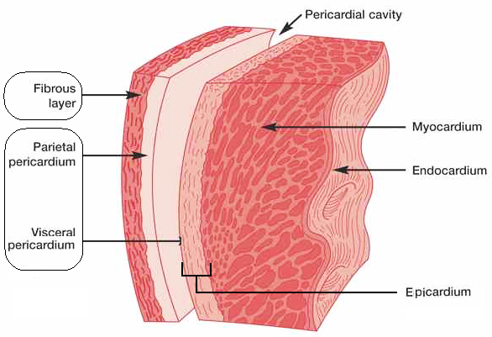

Slide 5
Structure of the heart
I. Endocardium
Endothelium of simple squamous epithelium
Subendothelial layer of loose connective tissue
II. Myocardium (the thickest layer of the heart).
The contractile cardiac muscle fibers are arranged as sheets in a complex and spiral manner
Impulse-conducting system [S-A node, A-V node, A-V bundle, and Purkinje fibers] is formed of specialized (conducting) noncontractile cardiac muscle fibers
III. Epicardium
layer of connective tissue (rich in fat) and contains blood vessels, lymphatic and nerve fibers.
The visceral layer of pericardium

Slide 6
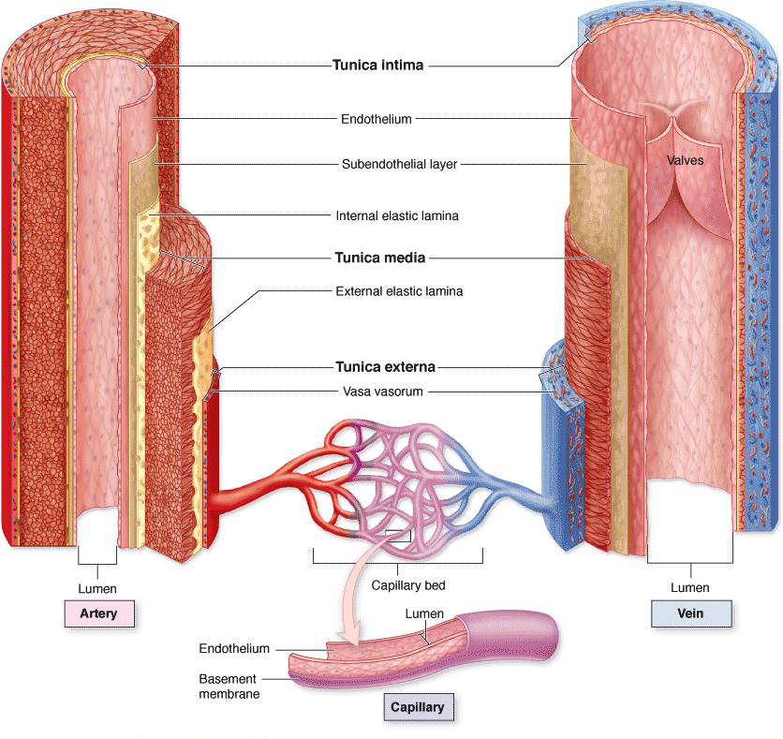
Blood vessels

Slide 7
General Structure Blood vessels
I. Tunica intima
Endothelium of simple squamous epithelium
Subendothelial layer of loose connective tissue
Internal elastic lamina: elastic fibers (may be absent)
II. Tunica media
Circular smooth muscle fibers.
External elastic lamina: elastic fibers (may be present)
III. Tunica adventitia
Loose connective tissue
Small blood vessels of the blood vessels (called vasa vasorum) are present in this coat. [because in larger vessels the wall is too thick to be nourished only from diffusion from the blood in the lumen]

Slide 8
Differences between types of blood vessels
Walls of both arteries and veins have a tunica intima, tunica media, and tunica adventitia, which correspond roughly to the heart's endocardium, myocardium and epicardium.
An artery has a thick tunica media and relatively narrow lumen. A vein has a thick tunica adventitia and a larger lumen
The tunica intima of veins is often folded to form valves.
Capillaries have only an endothelium, with no subendothelial layer or other tunics.

Slide 9
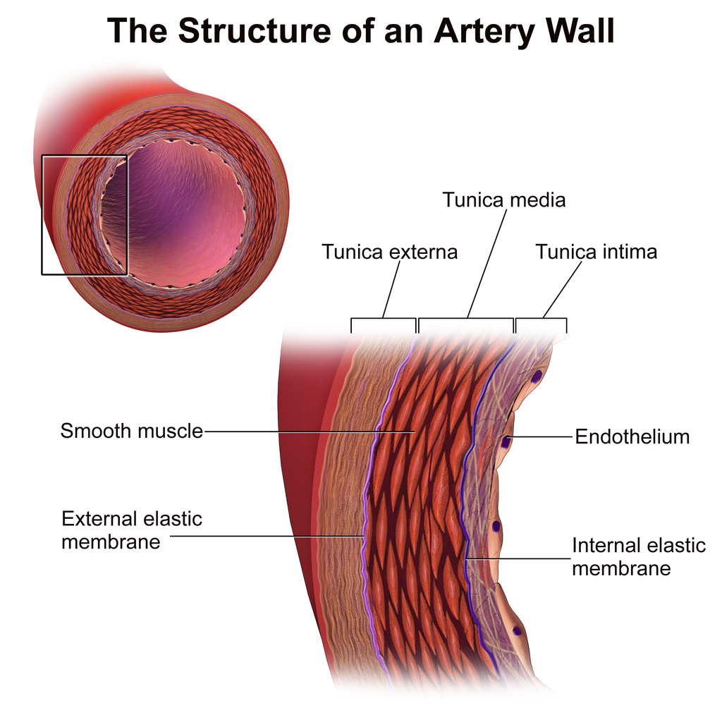
Arteries
Large (elastic) arteries
Need to be elastic to accommodate systole and diastole
Tunica media is rich in elastic fibers
Internal and external elastic laminas are present but not easily distinct (because the media is rich in elastic fibers)
Medium (muscular) arteries
Thick tunica media (well developed muscular wall)
Control blood flow to organs by contracting or relaxing the smooth muscle cells of the tunica media
Prominent internal elastic lamina
Arteriole
Narrow lumen (about 0.5 mm)
No internal or external elastic laminas

Slide 10
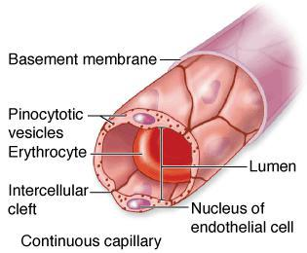
Capillaries

Slide 11
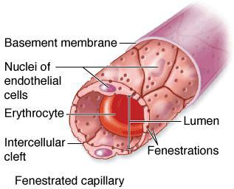

Slide 12
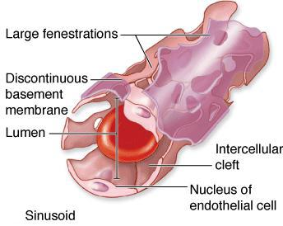

Slide 13
Continuous capillary
The most common type of capillary
Numerous pinocytotic vesicles are responsible for transfer of macromolecules in both directions across the endothelial cytoplasm.
Fenestrated capillary
Characterized by the presence of small fenestrae (=perforations) , covered by a diaphragm, and the basal lamina is continuous, covering the fenestrae.
They are found in tissues where rapid interchange of substances occurs between the tissues and the blood, as in the kidney, the intestine, and the endocrine glands.
sinusoid
Endothelial cells have large fenestrae without diaphragms, and the basal lamina is discontinuous.
So they are discontinuous capillaries that permit maximal exchange of macromolecules and even cells
Sinusoids are irregularly shaped and wide (much greater than those of other capillaries) . Both causes slow blood flow
They found in the liver, spleen, and bone marrow

