Slide 1

Refer to deanship of libraries affairs in the new university building if you want to get a printout

Slide 2

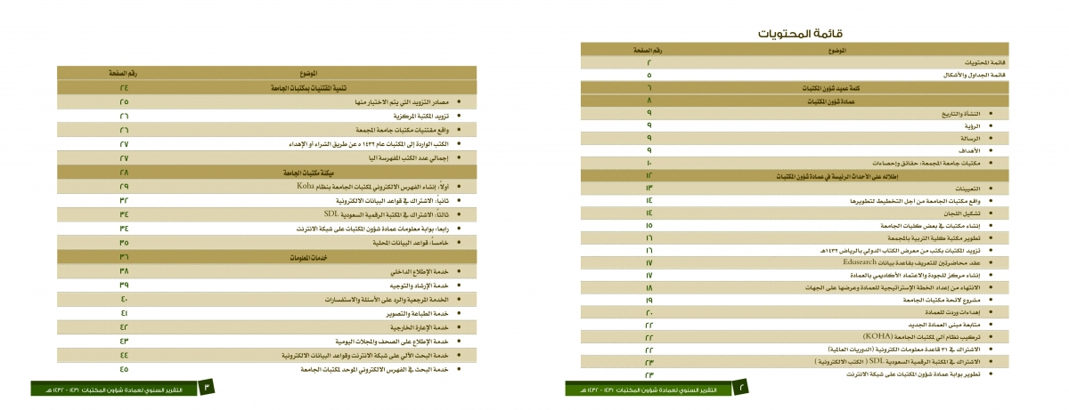

Slide 3
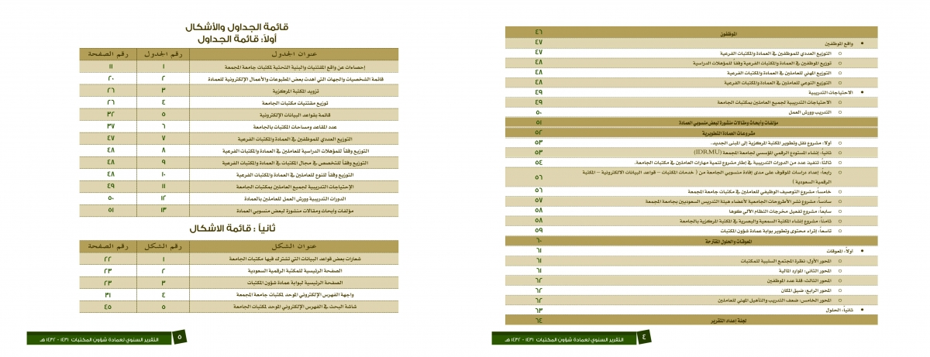


Slide 4


