Slide 2
Acute Abdomen-1
Prof.Pervez Iqbal
Professor of surgery

Slide 3
OBjectives
1. Define acute abdomen
2. Link acute abdomen presentations to abdominal quadrants
3. List the investigations that can help in diagnosis of acute abdomen

Slide 4
Acute abdomen
Acute Abdomen is a Non- traumatic condition where patient presents with Acute Abdominal symptoms, that require urgent Surgical Attention, SURGICAL INTEVENTION may or may not be REQUIRED.

Slide 5
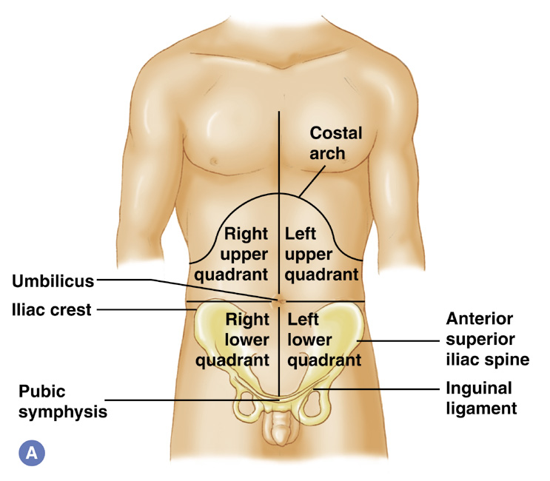
The Abdominal Quadrants

Slide 6
Right Upper Quadrant (RUQ)
Acute Cholecystitis
Cholangitis
Hepatitis
Peptic Ulcer

Slide 7
Right Lower Quadrant (RLQ)
Appendicitis
Ovarian cyst
Ectopic pregnancy
Pelvic inflammatory disease
Meckel’s diverticulum
Mesenteric adenitis
Ureteric colic
Rectus sheath haematoma
Right-sided lobar pneumonia

Slide 8
Left Lower Quadrant (LLQ)
Sigmoid diverticular disease
Ovarian cyst
Ectopic pregnancy
Pelvic inflammatory disease
Ureteric colic
Rectus sheath haematoma
Left-sided lobar pneumonia

Slide 9
Left Upper Quadrant (LUQ)
Peptic ulceration
Pancreatitis
Splenic infarct

Slide 10
Radiating Pain
Radiating pain to Back
Peptic ulcer
Pancreatitis
Aortic aneurysm
Acute aortic dissection
Radiating Pain to Groin
Ureteric colic
Testicular torsion

Slide 11
Investigation for diagnosis of acute abdomen
Amylase: a high amylase confirms the diagnosis of pancreatitis; a mildly raised amylase is also seen in ectopic pregnancy, perforated viscus, intestinal obstruction and intestinal ischaemia
b-hCG: pregnancy/ectopic pregnancy – must be performed in all females of childbearing age with iliac fossa pain
CRP: inflammatory marker generally raised within 8 h of an inflammatory process – can be useful in difficult cases, e.g. suspected appendicitis of 12 h duration with a normal WCC and CRP is unlikely to be acute appendicitis
ABG: generally only indicated in severely ill patients; it can give useful information on tissue perfusion, pH and lactate levels; PaO2 and PaCO2 can give important information for the anaesthetist prior to surgery

Slide 12
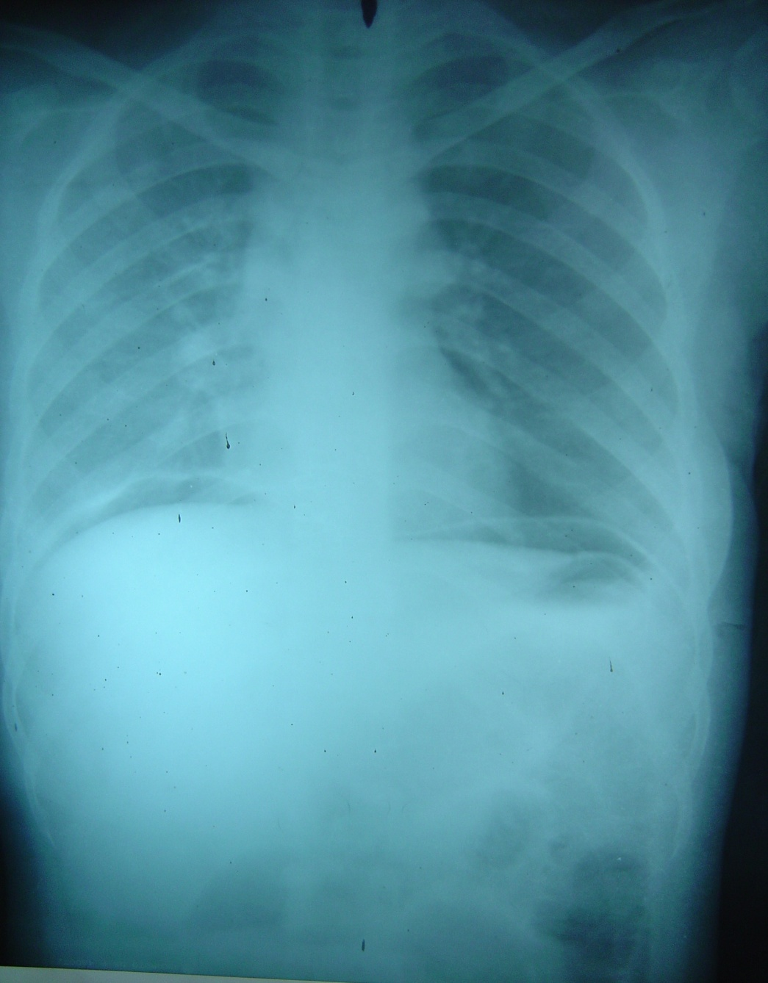
Investigations
CXR: exclude referred lesion, gas under diaphragm.

Slide 13
Investigations
AXR: distended bowel with air/fluid levels, gallstones (10% are radio-opaque); calcified aorta, e.g. aneurysm; air in biliary tree (cholecystoduodenal fistula with gallstone ileus)
USS: e.g. ovarian cyst, ectopic pregnancy, gallstones
CT: useful in difficult cases – able to demonstrate free fluid, air, dilated bowel, pancreatitis
KUB & IVU for stones
Angiography: e.g. acute GI haemorrhage of obscure cause, superior mesenteric embolus or thrombosis (duplex scanning may also be appropriate).

