Slide 1


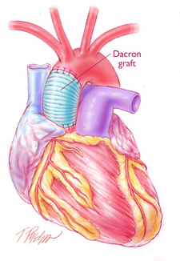
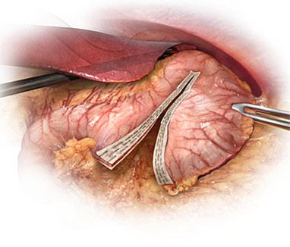


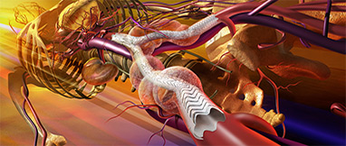
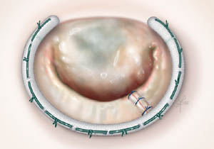
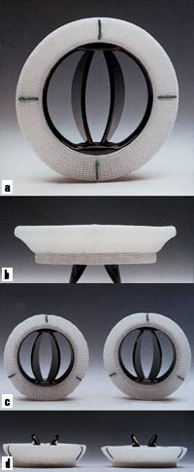
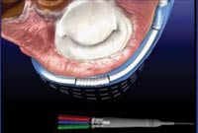
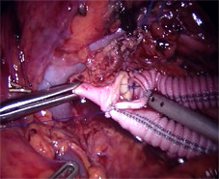
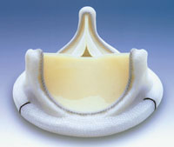

PRODUCTAION FABRICS USED IN HEART PROSTHESES
Abdel-Monem Sabry, Sherif Abdel-Hady, * Hassan El-Bheiry, ** Ismail Ibrahim & Ghalia El-Shennawy
PATENT FEBRUARY 2013
ABSTRACT
RESULTS
This patent is mainly concerned with designing fabrics used in heart prostheses (vascular ,patches and valves frames). The woven , nonwoven and knitted technique were applied to produce these fabrics, using polyester denier. The produced fabrics were treated with Chitosan. Different parameters were studied including, the fabric structure (regular hopsack 2/2,twill ,satin 4 and twill 1/3), yarn count (50 , 70 and 100 denier), Their influence on the performance of the end-use fabric and the achieved properties were studied. On the other hand physical-chemical properties including; air permeability, water permeability, thickness and weight were evaluated according to the finial product needs. Some more results were reached concerns structures and materials .
1-The more densities the warp &the weft get , the lower air and water permeability the samples become.
2-The more densities the warp &the weft get , the higher thickness and weight the samples become
3-The regular hopsack 2/2 have obtained the highest rates of air and water permeability , followed by twill 1/3 and then satin weave
4-The more denier the yarns get , the lower air and water permeability the samples become.
5-Samples produced of polyester have recorded the highest rates of water permeability and air permeability ,whereas samples produced of lycra yarns has recorded the lowest rates .
6- Samples produced of lycra have recorded the highest rates of thickness and weight ,whereas Samples produced of polyester have recorded the highest rates , but difference had an insignificant .
7-The random web have recorded the lowest rates of air and water permeability compared with cross-laid samples .
8-The random web have recorded the highest rates of thickness compared with cross-laid samples .
9-The random web have recorded the highest rates of bursting resistance compared with cross-laid samples
10-The more courses and wales the samples get , the lower air and water permeability the samples become .
INDTRODUCTION
Heart prosthesis, prosthesis is a device used to overcome surgically some deficiency in the body. The most common prostheses are vasculars, prosthetic heart valves and patches…etc
Classification of prostheses, each prosthesis can be classified as indicated below
synthetic textile
A-knitted B-woven
2-synthetic non-textile
A-extruded /expanded polymers
3-Biological
A-Allografts B- Homografts ⁽²⁾
Patches ,patches are used to close gaps in the septal wall of the heart . Prosthetic patch has become a widely accept technique for the repair of coarctation .⁽³⁾
Patches may be either autogenous or synthetic. Synthetic patches may be made from polyester or Teflon mesh or tightly woven polyester .The size of the patch is determined by the length of the arteriotomy , and the patch is made large enough to ensure that sutures can be placed in an area of the heart that is free of disease . ⁽⁴⁾ patch has been laminated on to the surface of a cardiac pumping diaphragm to maintain a totally biolized surface.⁽⁵⁾
Prosthetic heart valve , prosthetic heart valves, whether mechanical or biological , are caged ball valves with metal struts , mounted on a frame called a stent that is, of necessity rigid . when fitted , the stent is surrounded by tissue that pulses with the beating of the heart ⁽⁶⁾ stents are therefore fitted with the beating with a sewing ring made from woven polyester to provide a means of suturing the valve to the surrounding tissues . The fabric is also used to develop tissue ingrowth into the struts .Stents perform three functions : first it provides a secur anchorage for the valve in position , second ,it seals the valve against leakage ,and third , it acts as a cushion between the rigid stent and the flexible tissue , spreading the stresses caused by the sutures more evenly .
The vasculature
The Vasculature consists of arteries , arterioles capillaries and veins . Arteries carry blood away from the heart to all parts of the body, ⁽³⁸⁾ where arteries are made up of layers of smooth muscle fibers and elastic membrane tissue. Arterioles carry blood into capillary tissues , capillaries , the smallest vessels , through which exchange take place between the blood and the tissues, whereas veins carry blood back to the heart
Characteristics of fabric used in heart prostheses
Biological properties such as Non-toxicity (non – pyrogenicity, non allergenic respond, non carcinogenesis) the ability to be sterilized, biocompatibility (bioinert, bioactive) , in vivo stability ( chemistry ,size ,shape ) good flexibility ,tenacity , softness ,absorbency as well as the material should be non antigenic, mutagenicity ,tumorigenicity, antignicity and blood compatibility (hemolysis, coagulation ) .Mechanical properties such as elasticity, durability, tensile strength, torsional strength, impact strength, ductility, brittleness, creep, and stress propagation .Physiological properties such as formability, wetability, electrical nature (charge, zeta potential, critical surface tension, crystallinity, thermal history and surface structure.
Fig .(1) application textiles in heart prostheses
Fig .(2) Determination of ideal samples for woven patches and valves frames by radar method
METHODS AND MATERIALS
There are no previous studies about fabrics used in heart prostheses, this research produced fabrics used in vascular ,patches and valves frames .Two textile material used in this research, that is textured and flat polyester denier 50,70 and 100
Three different woven structures were used in this research to produce all samples
regular hopsack 2/2,twill ,satin 4 and twill 1/3))
Finishing treatment
The produced fabrics were undergoing special treatments before being used. These treatments include coating with Chitosan, and then sterilization as following.
Coating
Prostheses are impregnated with Chitosan, which decrease the permeability. Preclotting of coated prostheses have been advocated for many years for their non-porous surface which minimizes blood loss of the patients .The fabric samples were padded in an aqueous solution containing 12% Chitosan, solution then squeezed to a wet pick up 100 %. The fabric samples were dried at 85 ⁰C for 5 min, then thermofixed at 140 ⁰C 90 sec.
Sterilization
The fabric samples were sterilized by ethylene oxide gas, where ethylene oxide gas is a colorless gas. It applied in special autoclaves under carefully controlled condition of temperature and humidity .The gas alters proteins, killing bacteria, fungi spores and viruses. A through cleaning cycle is required before sterilization and a gas removal cycle is needed before use.
Fig. (3)Determination of the ideal sample for the warp knitted patches and valves frames by radar method
.
Fig .(4) Determination of ideal samples for nonwoven patches and valves frames
REFERENCES
1-Adunur, S., “ Wellington sears handbook of industrial textiles ”, Wellington sear company, Technomic publishing company,Inc.,Lancaster,Pennsylvania,1995
2-Brody, H., “ Synthetic fiber materials ”, Longman group UK,limited,London,1994
3-Blanck., H., “ Textile in medicine”, International Textile Bulletin ,4th quarter, vol. 41,1995
4-Rigby, A.,T., “ Textiles materials in medicine and surgery”, Textile Horizon, vol. 13, No.6, 1993
5-Ellis,J., G., “ Perspective on textile artificial ligaments”, Ellis developments limited, UK , Melliand textile berichte, January, 1992
6-Anon, “Warp-knitted anti-thrombosis stocking from karl Mayer ” , Medical Textiles, July ,1998
7-Anderson ,R., H., “Normal and abnormal development of the heart ”, Glenn thoracic and cardiac vascular surgery, Appleton & Lange, California , 1992
8-Rick, J.,T., “Cardio vascular reactivity and stress patterns of physiological response ”, Plenum press, New York, 1995

