Slide 1

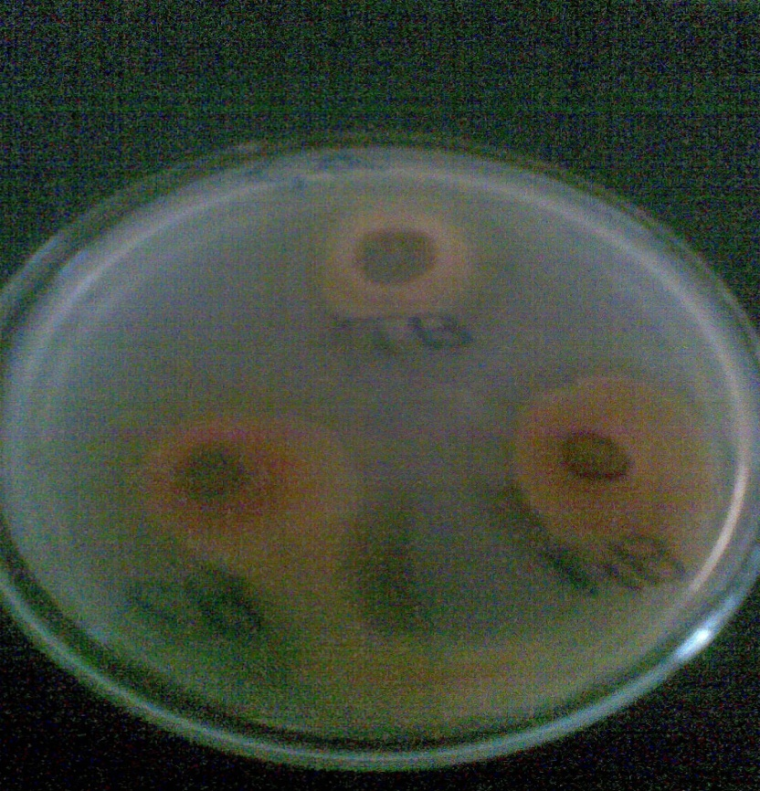
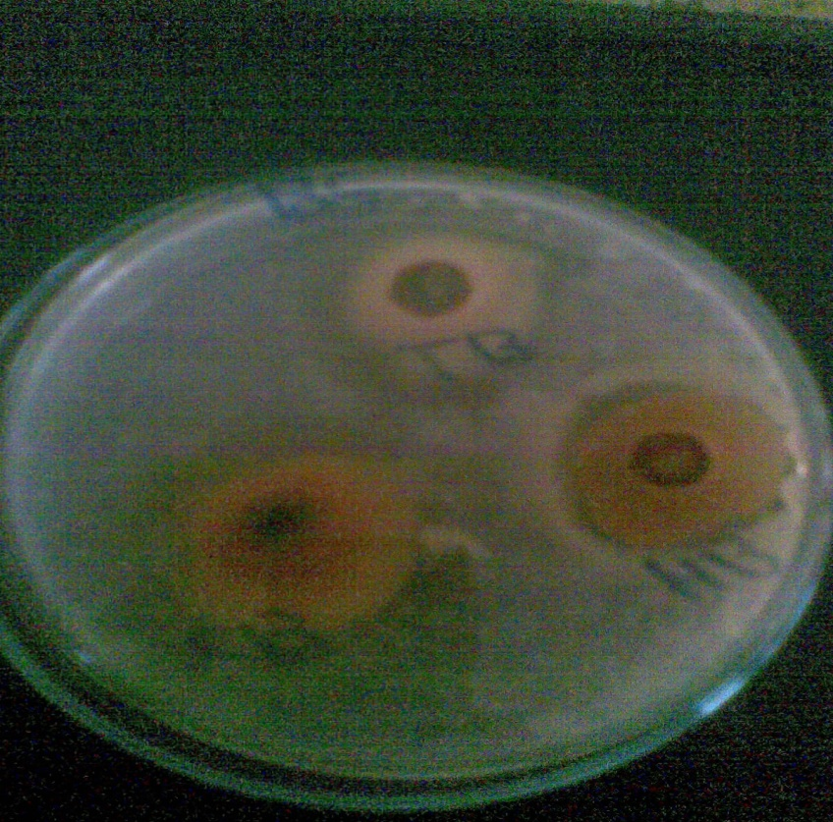
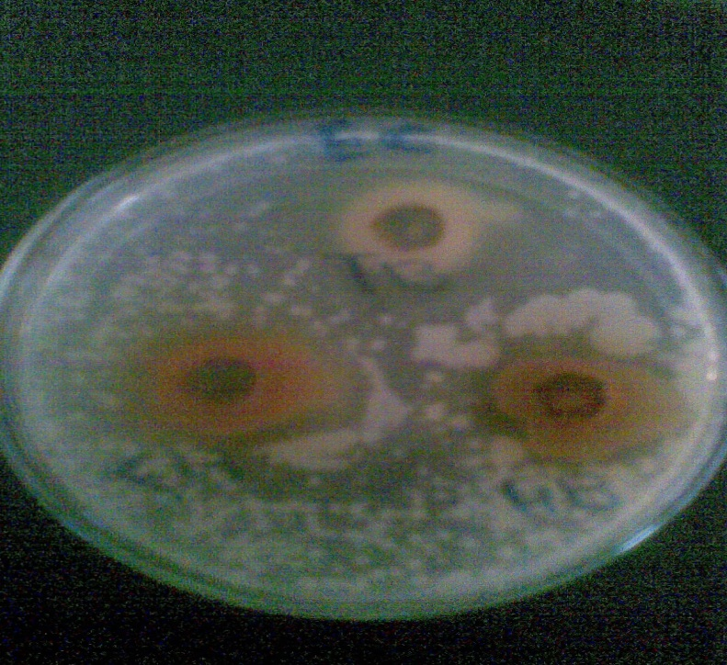
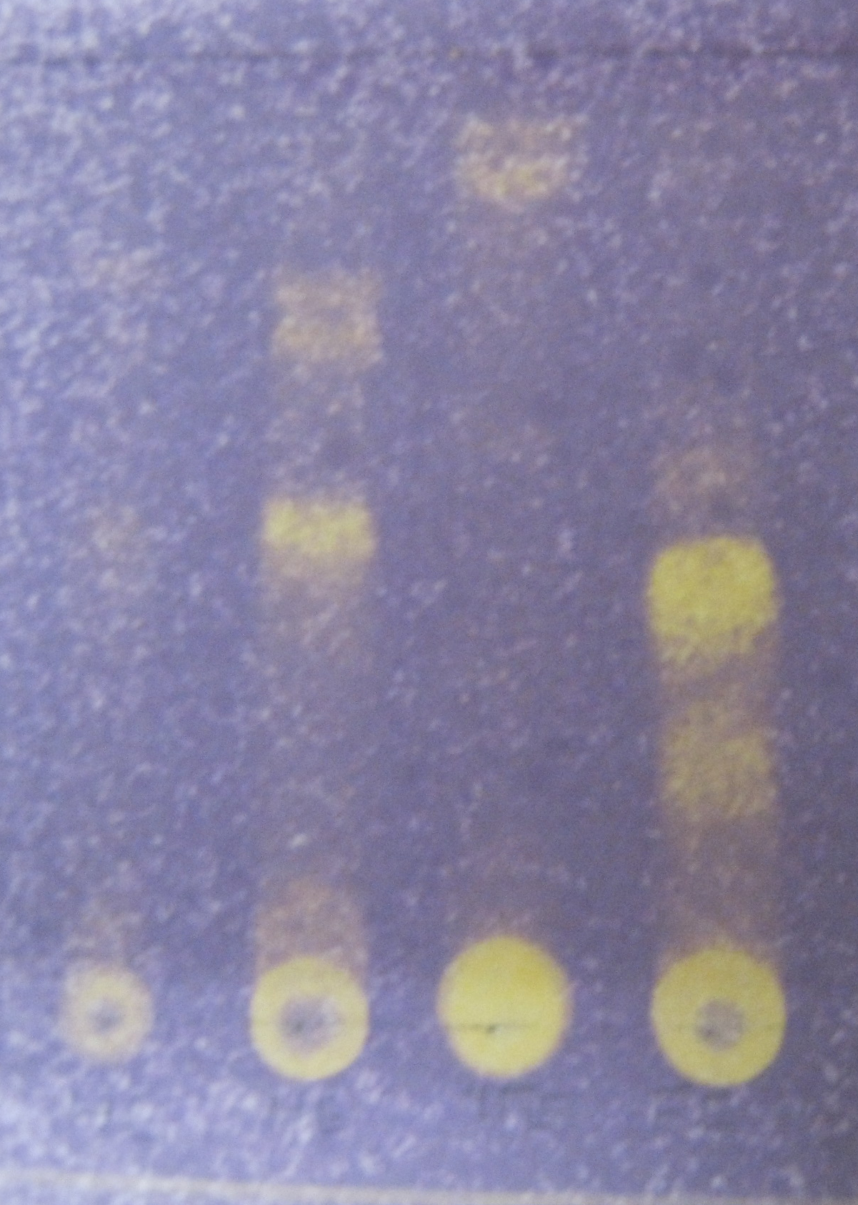
Antimicrobial activity and Antioxidant activity
of fruits Hyphaene thebaica and leaves of Tamarix nilotica
By
Dr.Amani Hassan Ahmed
Department of chemistry
Faculty of Education
Majmaah University
Part of Ph.D. research 2012
LOGO
Research Problem مشكلة البحث
Results and Dissection النتائج والمناقشة
The herbal products today symbolise safety in contrast to the synthetics that are regarded as unsafe to human and environment.However, the blind dependence on
synthetics is over and people are returning to the naturals with hope of safety and security.(1)
Over three-quarters of the world population relies mainly on plants and plant extracts
for health care.(1)
Natural, mainly plant-derived constituents have long been sources of drugs, and a large proportion (30–40%) of the pharmaceuticals available in modern medicine is directly or indirectly derived from natural sources.
Resistance to antimicrobial agents has become an increasingly important and pressing global problem.(2)
Substantial investment and research in the field of anti-infectives are now desperately needed if apublic health crisis is to be averted(2)
Antimicrobial activities
Table 1 : inhibition zone of the plant extracts against bacteria
(Ratio of diameters mm)
Inhibition zone (mm) Extracts |  |  |  | Organism (Bacteria)
B.H | B.T | E.H | E.T
29 | 27 | 20 | 24 | Staphylococcus aureus
28 | 32 | 17 | 25 | Bacillus subtilis
24 | 30 | 16 | 16 | Salmonella typhi
29 | 33 | 21 | 27 | Escherichia coli
Purpose الهدف
E.T :ethylacetate extract from Tamarix nilotica
E.H:- Ethyl acetate extract from Hyphaene thebaica
B.T -:butanol extract from Tamarix nilotica
B.H :-butanol extract from Hyphaene thebaica
Extraction of phytochamicals components from plant species.
Evaluation of the antimicrobial activity of different extracts.
Evaluation of the antioxidante activity of different extracts
Methods أسلوب/منهج البحث
Extraction ofphytochemical componenter from Hyphaene thebaica
The air dried ground plant (1.00 Kg) was exhaustively percolated with 80% methanol (5L) at ambient temperature for 72hr . The solvent was evaporated under reduced pressure leaving 50 g residue.[3]
Residue of methanolic extract was suspended in 500 ml of distilled
water and successively extracted with dichloromethane , ethyl acetate and butanol . Removal of the solvent under reduced pressure gave crude products which were manipulated further by different chromatographic techniques.[3]
The above mentioned experiments were performed for Tamarix nilotica
The ethyl acetate and butanol fractions of Hyphaene thebaica and Tamarix nilotica, were screened for their antimicrobial activity against six stander human pathoens (Bacillus subtilis,Staphylococcus aureus, Sallmonela typhi, gEscherichia coli , Aspergillums niger,candida albicans). The cup-plate agar diffusion method was adopted with some minor modification, [4]to assess the antibacterial activity . (20ml) Aliquots of the incubated nutrient agar were distributed into sterile petri dishes ,the agar was left to settle in each of these plates which were divided into two halves. Two cups in each half (10 mm in diameter ) were cut using sterile cork borer (No. 4) .Each of the halves was designed for one of test compounds. Separate petri dishes were designed for standard antibacterial chemotherapeutic agents.
The agar discs were removed ,a hamates cup were filled with 0.1ml sample of each extracts and pure compounds using adjustable volume microtiter pipette and allowed do diffuse at room temperature for two hours .The plates were then incubated in the upright position at 37^{ο}c for 24 hours.
The above procedure was repeated for different concentration of the isolated compounds and standard antibacterial chemotherapeutics .After incubation the diameters of the resulting growth inhibition zones were measured.[4]
CHART or
PICTURE
CHART or
PICTURE
Fig.1 : Inhibition zones induced by butanol extract from Tamarix nilotica and butanol extract from Hyphaene thebaica on Staphylococcus aureus
Fig. 2 : Inhibition zones induced by butanol extract from Tamarix nilotica& butanol extract from Hyphaene thebaica on Bacillus subtilis
Fig. 3: Inhibition zones induced by butanol extract from Tamarix nilotica& butanol extract from Hyphaene thebaica on Escherichia coli
Free radical scavenging assay with DPPH ⁵
The stable radical :1,1-diphenyl-2-picrylhydrazyle (DPPH) was used in this assay. The assay is based on the decolouration of the compound when reduced by a free radical scavenger. The test is performed on TLC.
A solution of 0.2% DPPH in methanol was sprayed on the developed TLC. After about 30 minutes, the active compounds appeared as clear spots on the purple background. 100μ g of plant extracts and 10 μg of pure compounds were spotted on the plates.(5)
BH EH TB TE
Antioxidant Activity
E.T :ethylacetate extract from Tamarix nilotica
E.H:- Ethyl acetate extract from Hyphaene thebaica
B.T -:butanol extract from Tamarix nilotica
B.H :-butanol extract from Hyphaene thebaica
Results and Dissection النتائج والمناقشة
Conclusions الخلاصة
Antimicrobial activity
The antimicrobial activities of four extracts obtained from fruits Hyphaene
thebaica and leaves of Tamarix nilotica against four bacteria and two fungi species, measured by the diameter of the zone of inhibition and using the disc agar diffusion assay, are shown in tables 1. The r extracts were showed moderate to weak inhibition on fungi (Aspergillus niger& Candidas albicans).
The significant antibacterial activity related to butanol extract from Tamarix nilotica showed: 27mm against Staphylococcus aureus, 32mm against Bacillus subtilis,30mm against Salmonella typhi and 33 against Escherichia coli. The significant antibacterial activity related to butanol extract from Tamarix nilotica leaves was shown in Fig.(1,2,3).
Antioxidant activity
Initial Screening of antioxidant potential of ethyl acetate extract from
Hyphaene thebaica fruits and butanol extract of Tamarix nilotica leave was
conducted by DPPH assay on TLC.Purple colour of DPPH reagent bleached by yellow spots is an indication of a positive antioxidant activity.
The significant antioxidant activity related to butanol extract from Tamarix nilotica leaves and ethyl acetate extract from Hyphaene thebaica fruits is shown in Fig.4.
This study showed that butanol leaves extract of Tamarix nilotica is a potential candidate for antimicrobial activity. and Antioxidant Activity.
The presence of flavonoids could significantly contribute to its antimicrobial activities.
References المراجع
[1] Indumon,S,S. Victoria,mP,K. Medicinal plants .Kepala Agticalural university .Aromatic and medicinal plants research station 1998.
[2] Infectious Diseases Society of America. Statement of the IDSA
concerning ‘Bioshield II: Responding to an ever-changing threat’.
Alexandria, VA: IDSA; 2004
[3] Harbome. J. B. "Phytochemical Methods" (2" ddition) Chapman and Hall New York (1988).
[4] Bauer, A. W., Kirby, W. M., Sherris, J. C., Jurck, M.
Antibiotic susceptibility testing by a standard single disc method. Am J Clin Patho.; 451,493-496 (1996).
(5)Cuendet, M., Hostettmann, K., Potterat, O. and Dyatmiko, W. Iridoid glucosides with free radical scavenging properties from Fagraea blumei. Helvetica Chimica Acta ;80, 1144-1152(1997

