Slide 1

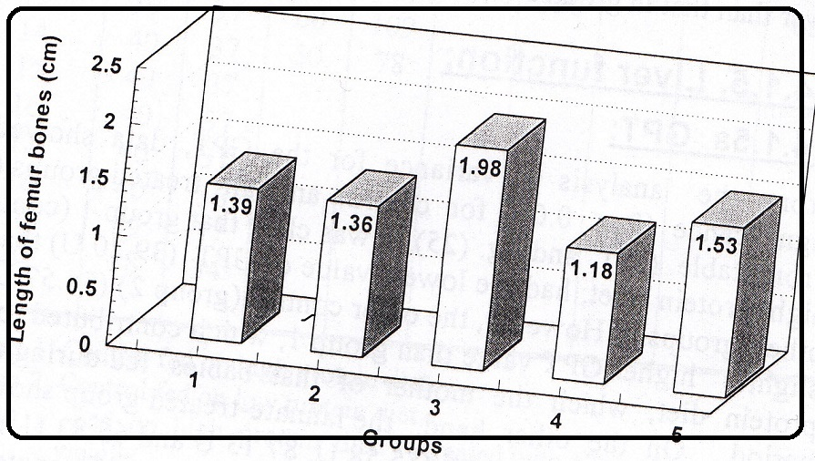
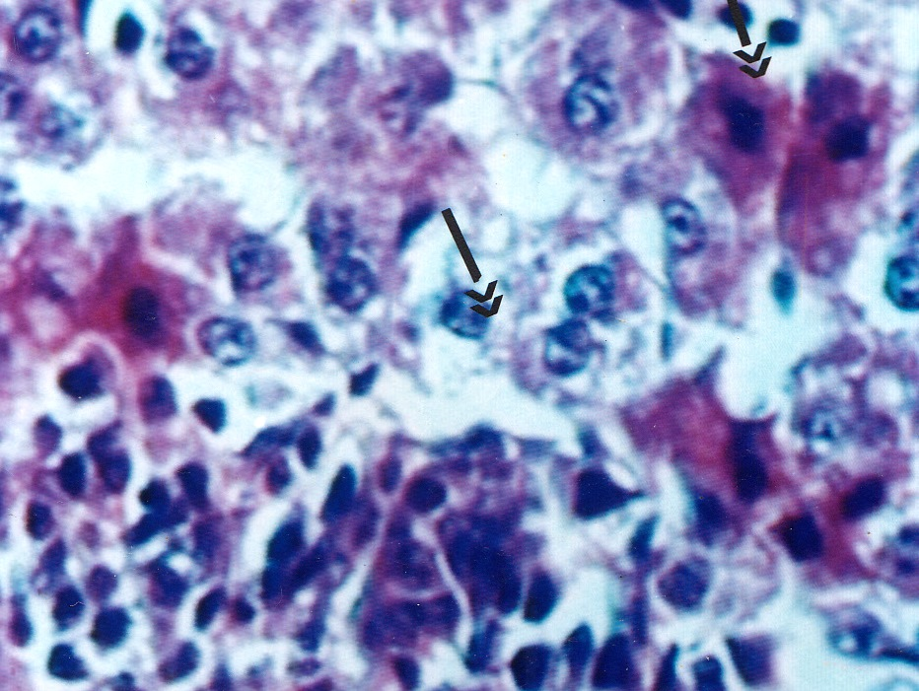
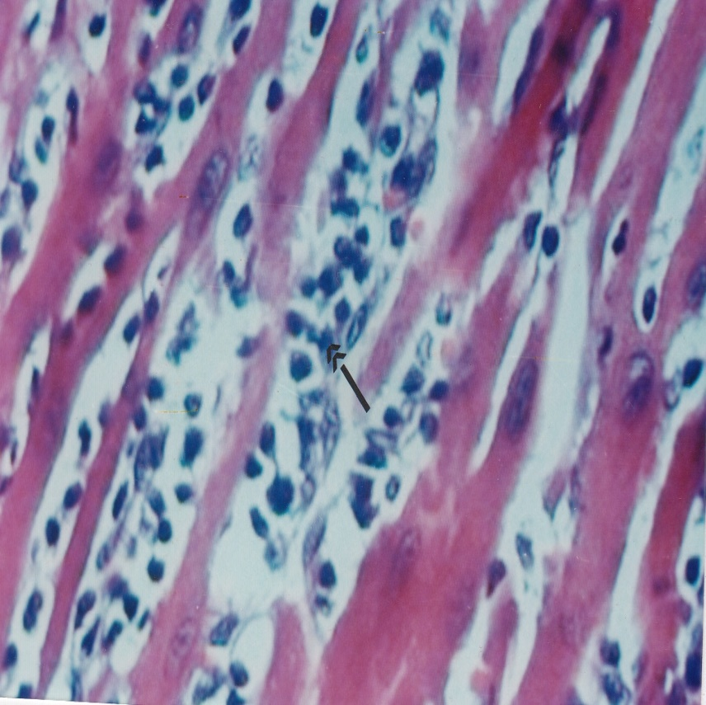
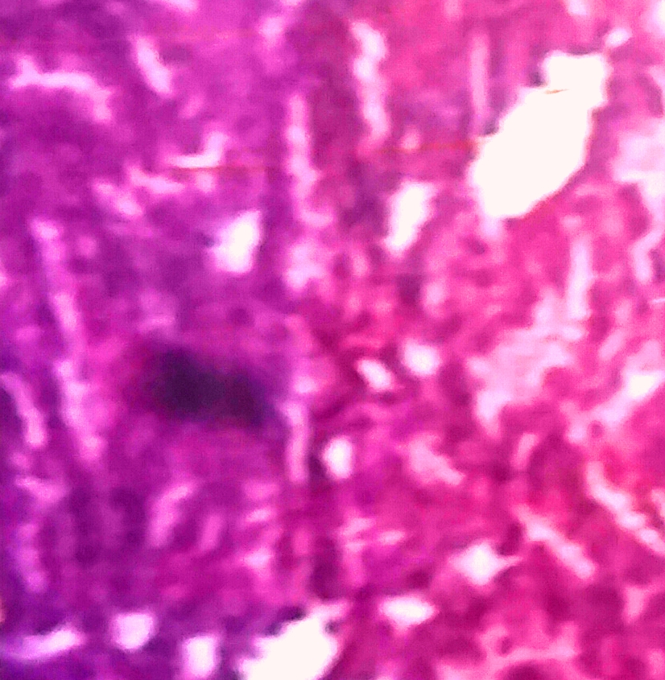
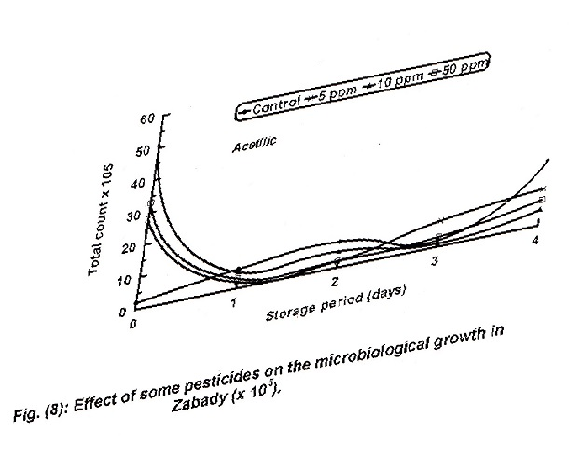
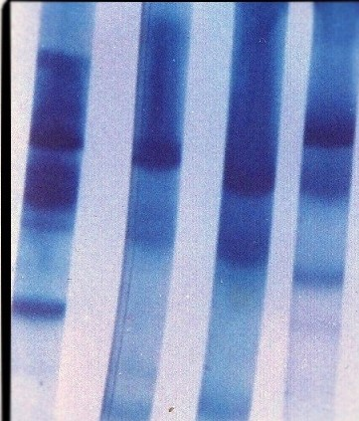
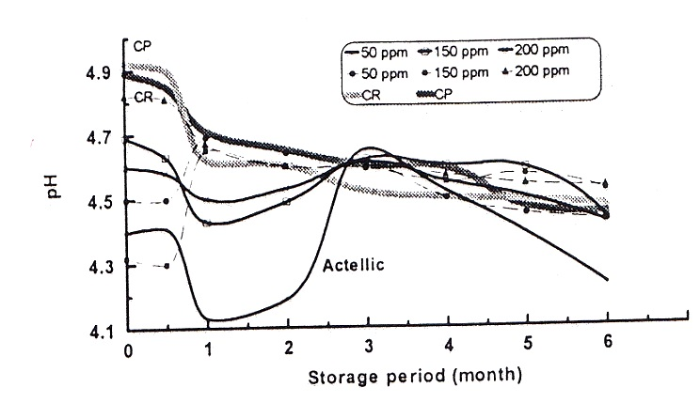
Mansoura university
Chemical and techenological studies on rouquefort cheese
Manal samy gouida
Faculty of agriculture
Food science
Abstract
Results
Recent years have witnessed a marked increase in milk pollution with both pesticides and heavy metals . This pollution may be attributable to the use of large quantities of pesticides for crop production.
The present work was limited with respect o achieve the board objectives of furthering the knowledge of occurrence of pesticides and heavy metals in buffalos milk , graining information concerning the pesticides residues in processed dairy product and throwing some lights on the harmful effect of pesticides containing milks on public health
*The presence of some pesticides residues in buffaloes milk in Dakahlia governorate from 9centersrevealed that malathion ,actellic and lannate were detected in 30,2,and 10%resp.in the investigated samples.the reidual limits of samples were 0.25-313,0.07-2.15 and0.02-0.6resp.
*The Ph of zabady samples wich treated with pests were higher than that of control sample also the same samples had nearly the same percent of TN and NPN AS MAXIMUM WITH atelic pest
*The occurrence of pesticides in milks resulted in slight change incheese Ph. Reversible relationship was noticed between pesticide level in milk and pH value of Domiatti cheese
*Lead , cadmium and Iron was higher in all samples of milk but Copper doesn't show any increase in milk along the two years of investigation
*The overall Risks of Lannate and lead show shortage in progeny numbers of rats also body weight and length of femur bones in suckling rat babies were less in treatments
*Synthesis of both GOT and GPT enzymes increased significantly in suckling babies fed on feeds containing either lannate and lead
Introduction
The pollution of milk and dairy products is considered one of the main dangerous aspects of the last few years . All the nations in the world are suffering from pollution if milk ,but the degree of pollution varies from one nation to another. As a direct result of using the pesticides for controlling plant pests and diseases; the residues which ,transferred to milk renders it unsuitable for human consumption. The problem is increased with the more kinds of pesticides with high concentrations and at short intervals ,such as chlorinated hydrocarbons ,organo phosphorus ,carbamates and pyrithriod.(fouzy,1991) Respect of these compounds to toxicity ,some of the organophosphours and carbamates have amuch higher acute toxicity than the common organochlorine pesticides such as DDT and HCH ( lindane)
Materials: sample selection– milk– rennet– zabady starter– salts– organic solvents-- pesticides( lannate- actellic—mallation) albino rats
METHODS:
1- detection of trace elements in milk and its products ( lead –cadmium- copper) method by Antlia and ANTILA (1971)
2-Chemichal analysis(Ts- fat- NPN- TN) godinho and fox (1982) –Kjldahel method described by Ling (1963)
3- detection of pesticides residues by EL-Nabaraway et.al ( 1988)
4- Scanning electron microscope for cheese samples by Ayyad (1996)
5- electrophoretic pattern of total protein by El-Shibiny and Abd El- Salam (1976)
6-Biological experiments : a- Analytical methods
b- Histopathology detected
CHART or
PICTURE
CHART or
PICTURE
CHART or
PICTURE
Methods and Materials
Figure_1.length of femur bones (cm)
Figure_1.the effect of actionof lannate and lead on the kidney of suckling babies ratsxxxxxxxxx
Figure_1.the effect of actionof lannate and lead on the heart of suckling babies ratsxxxxxxxxx
CHART or
PICTURE
CHART or
PICTURE
CHART or
PICTURE
The kidney of suckling babies rats
Conclusions
Shortage in progeny numbers of rats was found in all treatments received lannate or lannate pus lead . The nutrition level had an important role in the protection from the possible harm of such pollutants.
Body weight and length of femur bones in suckling rat babies were less in treatment ,which received lannate or lannate plus lead.
Synthesis of both GOT and GPT enzymes increased signifcantly in suckling rat babies containing either lannate or lannate plus lead .
Effect of some pesticides on the microbiological growth in zabady (x10)
Electrophoretic patterns of milk total protien
Effect of pesticides on the pH in zabady during incubation period
References
x
Abd- El- Salam ,M.H. asker.L.F .Hamzawi,h..f.EL- DIEN and A.farrag (1992)
Clayden ,E.C (1971) histopathological techniques .5th ed n. J.huchill livingstone, Edinburg .
EZZAT,N.(1990) ACCELERATION OF Domiati cheese ripening using commercial enzymes.egyptian.J.Sci. ,18:435-445
FOUTS,J.(1970) Some effects of insecticides on hepatic microsomal enzymes in various animal species . Rev. Can.Biol., 29 (4) : 377-389.

