Slide 1




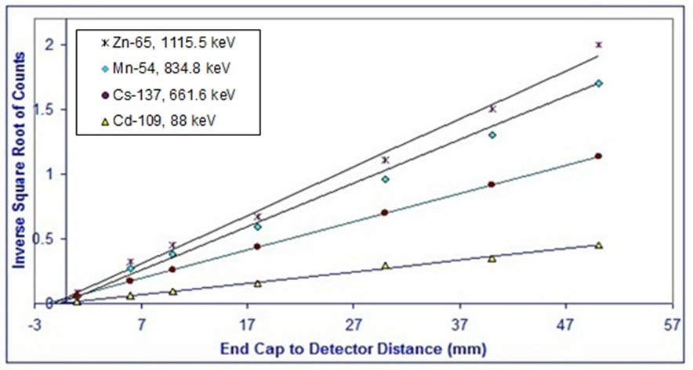
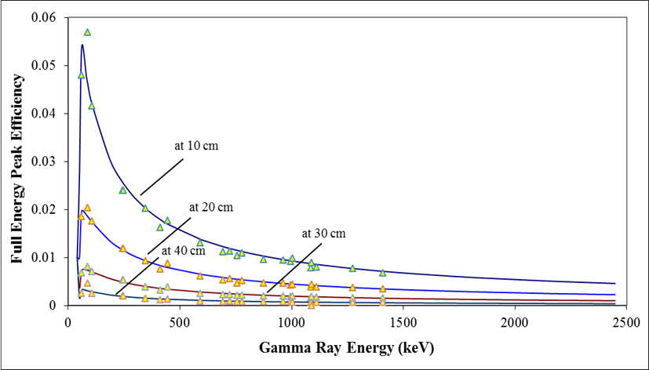
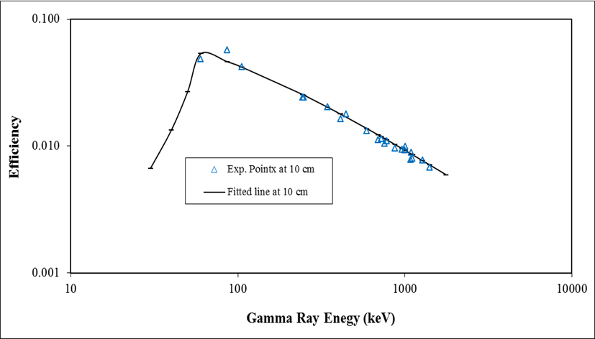

Gamma-ray efficiency of a HPGe detector as a function
of energy and geometry
Mohsen B. Challan
Physics Department, Faculty of Education in Zulfi, Majmaah University, P. O. Box. 66, Al-Zulfi 11932, Kingdom of Saudi Arabia.
Abstract
Results
The concept of a double point detector model (DPDM) approach is developed as a procedure to find the full energy peak efficiency of the coaxial 120 cm3 closed HPGe detectors. Usually in the experimental work that involves using gamma-ray spectrometry the full energy peak efficiency (FEPE) function must represents adequately the HPGe detector response. In the current work the gamma-ray energy in the range from 59.5 to 1332.5 keV and gamma-ray intensity changes by changing source to detector distance from 10 to 800 mm. The detector was characterized using a number of point–like standard sources. The calculated efficiencies obtained by (DPDM) are in good agreement with experimental data.
Double Points Model Approach
In the present work a procedure is suggested to solve the above mentioned difficulties. In ⁽³⁾ a point-detector approximation was first proposed, in this point-detector approximation, the detector is considered to act as a point located along the detector axis at an effective distance behind the external window several authors latter ⁽⁴⁻⁷⁾ used techniques to calculate efficiencies at different distances. In the double points approximation, the detector is considered to act as a point of a definite active volume, the standard source as a point of infinitesimal size as well, both are located along the detector axis at an effective distance separate them. Then, the solid angle subtended by detector will equal to unit Steradian (Sr), if the distance increase than the solid angle will be less than unity, if the distance decreased than the solid angle will be more than unity. We then multiply the intrinsic detector efficiency by a factor to complete the whole solid angle surrounding the point source.
We could write down the absolute efficiency as:
(1) and Substituting from eq. (1)
(2)
The function which adequately represents the efficiencies between 59.5-1332.5 keV and distances between 10-800 mm has the form:
(3)
Introduction
The quantitative γ-ray spectrometry at different geometries is a commonly encountered problem. Accurate relative intensity calibration of photon emitted is usually performed by counting a sample and standard sources in the same geometry. It is therefore important to have available method to correct measurement taken with HPGe detectors from the effects of geometry change, hearing in mind that HPGe detector efficiency curves are most often and conveniently determined using point-like standards. In general, one or two efficiency curves are obtained at different distances. This is usually done in order to minimize the detector’s dead time and to maximize the area under full energy peak, a higher uncertainty in the photo-peak area is found due to the spectral distortion. Hence, changing counting geometry is a mandatory for comparison between measurements, introduces a need for solid angle geometry corrections as well as for coincidence summing if applicable. Many authors commented of the importance of measurement geometries^{(1, 2)}.
Methods and Materials
1. Experimental Set-up:
The detector used in these measurements was ORTEC hyper pure Germanium Detector. The germanium crystal was nominally 55 mm in diameter and 60 mm long. It was mounted inside a protective aluminum end, with its axis vertical, on a liquid nitrogen Dewar, with an energy resolution of 2.0 keV for a -ray energy of 1332.5 keV. The source holder was made of cylindrical hard paper with seven slots to accommodate the point sources which are at the center of a polyethylene dish. The detector active volume was estimated to be (120 6) cm³. The detector was biased to + 4500 V using an ORTEC-459 power supply. Pulses from the pre-amplifier were amplified and shaped by Canberra 2021 spectroscopy Amplifier before being fed into a Trumf 8192 buffered analog-to-digital converter controlled by an IBM-Compatible computer.
Fig. 2: Typical plots for determining using a coaxial close-ended HPGe detector.
Fig.3: Shows the absolute full energy peak detection efficiency of the HPGe detector for point sources on axis as a function of γ–ray energy and separation, this functions fitted to the experimental points.
Conclusions
Fig.1: Full Energy Peak Efficiency of the HPGe Detector vs Energy
The full energy peak efficiencies were calculated in the energy range from 59.5 to 1332.5 keV and in distance between 10 and 800 mm. A new theoretical function has been proposed which adequately represents the experimental points. The advantage of using a function of this type is that it is possible to determine the efficiency at point where experimental measurements do not exist. It is worthwhile mentioning that the coincidence summing effects must be taken into account while carrying out measurements at short distances from detector window, using radioisotopes emitting gamma-rays in cascades.
2. The gamma-ray Sources
For the point-like sources we used -ray reference standard sources from the Oak-Ridge, The Tennessee, U.S.A. These take the form of ion-exchange beads 2 mm in diameter held in clear plastics cases fitted with polyethylene windows 0.5 mm thick. The radionuclides used were ²⁴¹Am, ¹³⁷Cs, ⁵⁴Mn, ⁶⁵Zn, ⁶⁰Co and ¹⁰⁹Cd these span the energy range from 59.5-1332.5 keV.
3. Efficiency calculation
Once the full energy peak area is obtained the intrinsic efficiency can be calculated by the following equation:
(1)
Where:
is the intrinsic peak efficiency, is defined as the probability that a photo striking the detector will produce a pulse residing in the full energy peak of the spectrum.
is the corrected net peak area in counts/s
is the activity of the source at the time of standardization in (Bq),
is the absolute -ray emission probability
is the decay constant. (lamda)
t is the elapsed time since standardization
is the duration of the count (sec).
References
1. J. M. Maia, J. M. F. Dos Santos and C. A. N. Conde, Applied Radiation and Isotopes 48 (10-12), 1649-1656 (1997).
2. P. M. Grant, Nuclear Instruments and Methods 127 (3), 371-372 (1975).
3. P. R. Bevington and D. K. Robinson, Data reduction and error analysis for the physical sciences. McGraw-Hill, Boston, (2010).
4. M. B. Challan, M. N. H. Comsan, and M. A. Abou-Zeid, Thin target yields and Empire-II predictions on accelerator production of Technetium-99m, Journal of Nuclear and Radiation Physics, 2(1), 1-13 (2007).
5. K. Debertin and R. G. Helmer, Gamma- and x-ray spectrometry with semiconductor detectors. North-Holland, Amsterdam; Oxford, (2001).
6. A. Sanchezreyes, M. Febrian, J. Baro and J. Tejada, Nuclear Instruments and Methods in Physics Research Section B: Beam Interactions with Materials and Atoms Nuclear Instruments and Methods in Physics Research Section B: Beam Interactions with Materials and Atoms 28 (1), 123-127 (1987).
7. M. A. Hammed, P. W. Gray, A. H. Naboulsi and T. C. Mac Mahon, Nuclear Instruments and Methods in Physics Research Section A: Accelerators, Spectrometers, Detectors and Associated Equipment 334 (2–3), 543-550 (1993).

