Slide 1

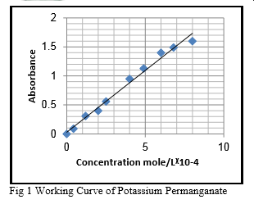
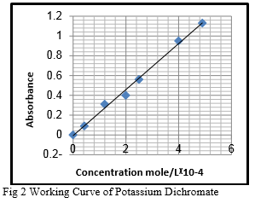
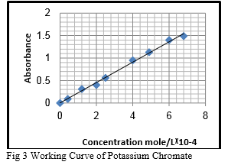
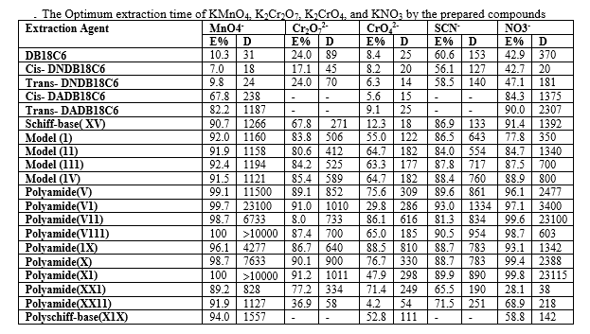
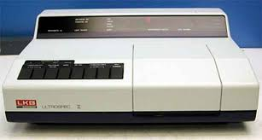
LOGO
Uses of some monomers and polyamides of aminodibenzo-18- crown-6 in solid-liquid extraction of potassium permanganate, dichromate, chromate, thiocyanate and nitrate
Nawal Mahgoub Suleman
Chemistry Department Zilfi Faculty of Education Majmaah University, KSA
Sudan Journal of Science (SJS) ,5(1),1-12,2012
Abstract
Results
Crown ethers are very important compounds in the extraction of alkali, alkaline earth, and transition metal ions that by formation of complexes with these ions .Crown ether polymers may have more ability of extraction compared with their monomers .In addition these polymers may be less poison, expensive, and can be used as catalysts. This study had been aimed for using of some monomers and polymers contains dibenzo-18-crown-6 in solid – liquid extraction of potassium permanganate, dichromate, chromate and thiocyanate. The value of E% (D) was found to be increased with time in the case of extraction of KNO3, K2Cr2O7 and KMnO4 for all compounds expect in the case ofDB18C6, cis-DNDB18C6 and trans-DNDB18C6 when were used for KNO3 and KMnO4 extraction. In case of K2CrO4, a decrease was observed in the values of E% (D) after 15-30 minutes.
Working curves for the determination of concentrations of KMnO4, K2Cr2O7, K2CrO4 were constructed as in Figures (1-3) respectively. In general, long equilibrium periods are required for the extraction of these ions .This can be due to the steric hindrance of the groups attached to the prepared compounds, and the size of anions which are involved in the extraction process. It is evident that the values of E% obtained by the usage of crown compounds in the solid-liquid extraction system are almost in accordance with those obtained from liquid-liquid extraction systems. With regard to change of the anion, most of the compounds show a marked selectivity for the monovalent anions; MnO4-, SCN- and NO3- compared to Cr2O72- and CrO42-. With respect to the effect of the chemical nature of the synthesized compounds. Generally speaking; as can be seen the polyamides DADB18C6 (V1) possess better ability for extraction than the polyamides of diaza18C6 (XX11).Cis- and trans-isomers of DNDB18C6 have lower ability than those of other product under study (see table).
The polyamide of diaza18C6 (XX11) reflected lower extraction power compared with the polyamides of DADB18C6 (V1).This may be attributed to that the polyamide of diaza18C6 which contains nitrogen atoms, has softer basic properties than oxygen atoms, consequently higher affinity towards cations such some of the transition or heavy metal ions, while crown ethers
have affinity for hard cations such as alkali or alkaline – earth metal ions. Also this is to be expected because the ion-dipole interaction between the Donor atoms and the cations declines with decreasing of the electronegativity of the donor atoms, and thus the complexation ability reduced.
Introduction
The extraction of picrate ion with alkali metal ions, by some crown ethers was reported{ 1, 2-4}. The extraction of KMnO4{5}, K2Cr2O7{6}, by dibenzo-18 crown-6 was reported. Feigenbaum and Michel {7} prepared 4,4'- diaminodibenzo-18-crown-6 . Polyamides were prepared using cis-4,4'-diaminodibenzo-18-crown- 616,{8}. The mobility of Na+ and Rb+ in poly (dibenzo- 18-crown-6) has been studied {9}. The first example of main chain liquid-crystalline polymers containing dibenzo-18-crown-6 was reported by Percec and Rodenhouse {10}. The EDTA dianhydride was used in the
reaction with diazacrown ethers to obtain the water- soluble EDTA-diazacrown ether polymers{11}.
CHART or
PICTURE
CHART or
PICTURE
CHART or
PICTURE
Methods and Materials
2.1 Chemicals and Techniques
All chemical used are of high purity (98 % or more). UV-Visible Spectrophotometer 4050 LKB Biochrom Ultra spec 11, with two matched quartz cells was used.
2.2 Extraction of Potassium Permanganate
From stock solution of KMnO4 (10-2M), various concentrations were prepared by accurate dilution. A calibration curve was elaborated for KMnO4 determination at 552 nm .For extraction of KMnO4(10- 4M) solution, the experiments were performed by shaking the mixture of o.o36 g ofDB18C6 and 10 ml of the extracted solution (10-4 M) for 5,10,15,….60 minutes and overnight, then the absorbance of the permanganate solution was measured at each time, (represent the absorbance of the un-reacted ion).The percentage of the extracted permanganate ion was determined by difference between the absorbance of permanganate ion at zero time and that at appropriate time of extraction .Similar procedure was repeated for DNDB18C6(0.045 g),DADB18C6(0.039 g),Schiff- base of DAD18C6(XV) (0.077), polyamide of DADB18C6(V1)(0.1 g),and polyamide of diaza18C6(XX11)(0.1g) .
2.3 Extraction of Potassium Dichromate
A calibration curve for K2Cr2O7was built at 320 nm .The same procedure was followed as in potassium permanganate. Solutions of K2Cr2O7 were prepared in 3, 5 N sulphuric acid.
CHART or
PICTURE
Conclusions
-Generally there was increase in the values of E% (or D) with time for the extraction of potassium permanganate, dichromate and nitrate, while there was decrease in these values in the extraction of potassium chromate by the prepared compounds.
-Most of the compounds, show a remark selectivity for the monovalent anions MnO4-,SCN- and NO3- compared with divalent ones Cr2O72- and CrO42-.
-The sequence of extraction of KMnO4, K2Cr2O7, K2CrO4, KSCN and KNO3 by the prepared compounds is as follows: polyamides of DADB18C6 give higher value of extraction, while the cis-DNDB18C6 gives the lowest value. Polyamide of diaza18C6 has less ability than that of DADB18C6 ..
CHART or
PICTURE
UV-Visible Spectrophotometer
References
2.4 Extraction of Potassium Chromate
Solutions of K2CrO4were prepared in (0.05N) potassium hydroxide solution. The absorbance of K2CrO4 was measured at 372 nm (Fig. 2.1). For extraction of this compound the same procedure was followed as in potassium permanganate.
2.5Extraction of Potassium Thiocyanate
Stock solution of 0.1 M of KSCN in deionized water was prepared. Other concentrations were prepared by dilution .To each solution 10 ml of ferric chloride was added .The latter was prepared by dissolving (33.3 g) of FeCl3.6H2O in 10 ml concentrated HCl, and then diluted to 100ml21 . The absorbance was obtained at 480 nm. For extraction of KSCN the same procedure was followed as in potassium permanganate, except that the contact time was 60 minutes only.
3. Pedersen, C.J., J.Am.Chem.Soc. 91,386(1970).
Pedersen, C.J., J.Org.Chem. 36,254(1971).
Danesi, P.R., Meider-gorican, H., Chiarizia, R.and Scibona, G. Int.Solvent.Extr.Conf., 2, 1761(1974).
Tusek, L., Danesi, and Chiarizia, R., J.Inorg.Nucl.Chem. 37, 1538(1975).
Jalhoom, M.G., and Al-haidery A.C., Iraqi J. Sci.35 (3), 653(1994). 13.
Al-haidery A.C., Iraqi J. Sci.37 (1), 455(1996).
Feigenbaum W.H. and Mickel R.H. J. Polymer Sci., A1, 9,817(1971). 16.
Shchori E. and Jagur-Grodzinski J., J.App.Polymer Sci.20, 1665, (1976).
Angely L.Rault-Berthelot J.and Simonet, J.Chem.Soc. Farady Trans., 87(9), 1393(1991).
. Pecec, V.and Rodenhouse, R.Macromolcules, 22, 2043, (1989).
Jian Z. L., Chun H. H., and Sheng Y. Q., Chinese Chem. Letters 16, No. 1, 27-30, (2005)

