Slide 1
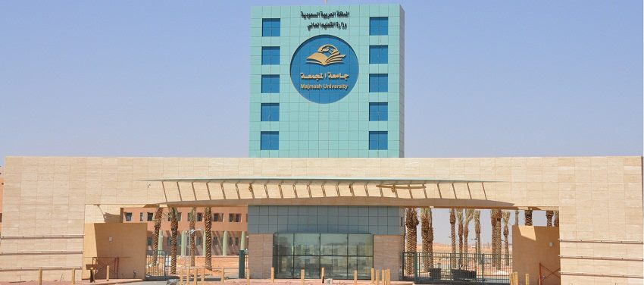
Vice Rector for Graduate Studies and Scientific Research

Slide 2
Overview of University
With the launch of the University in 1431, started and Vice President for Graduate Studies and scientific research activities and tasks of scientific and research, and formulated its all in the pursuit of accuracy:
• provide a stimulating environment for scientific production for all employees of the university.
• promote a culture of scientific research and mainstreaming their issues inside and outside of academia and work to attract qualified and genuine national contribution to the development of society.
• community partnership with all sectors of society

Slide 3

Vission :
Distinguished academic environment for research and graduate programs.
Mission :
Conducting a distinguished research and rendering competitive graduate programs in a stimulating environment, characterized by responsibility, professionalism and effective social partnership.

Slide 4

Values
· Objectivity
· Perfection
· Teamwork
· Justice
· Academic Freedom

Slide 5

Objectives
· Preparing a cohort of distinguished faculty members for the university through encouragement of external scholarships.
· Recruitment of distinguished Saudis scholars who have studied abroad to work in the university.
· Inauguration of postgraduate programs to meet the growing needs of research.
· Supporting academic research that addresses social issues and realizes scientific development.
· Availing knowledge and information resources for the students of Majmaah University.
· Supporting translation and scientific publication in the university.
· Founding research chairs for studying current scientific and social issues.
· Adoption of inventors and innovators, providing a supportive environment for their inventions.
· Opening channels for international cooperation with local and international universities.
· Activating the by-laws and systems for the promotion of faculty members and their assistants.
· Organizing the participation of faculty members and their assistants in local and international conferences.

