Slide 1
Regulations of Scientific Research Chairs in Almajma'ah University

Slide 2
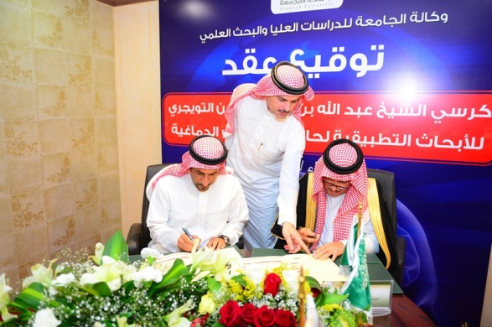

Slide 3
Overview
The universities that are listed under the system of higher education institutions are considered the primary incubators for supporting and developing the scientific research. Undoubtedly, the benefits and positive effects of the scientific research reach all the society classes. This is part of "Societal Partnership" which through all society members and institutions contribute effectively to support the scientific research and other sciences that help achieve the development and advancement to the society, resolve its problems and reinforce its potentials and capabilities.
The research chairs are believed to be the most fundamental resources in developing the scientific knowledge, modern technology and achieving societal development. They are important in knowledge excellence in societal, economic and scientific fields. Also, they contribute to improving innovation and creativity that aims to achieve the societal partnership with both humanitarian and financial aspects. In fact, these research chairs can help the university gain more benefits from technologies and other potentials available at the university that could be of help for the society and its problems and enrich knowledge.
According to what has been said earlier and based on the system of higher education and universities council and the relevant regulations, a new set of regulations has been created for research chairs in Almajma'ah University. This set of regulations include thirteen articles.

Slide 4

Fundamental Definitions
Research Chairs Program: This program is concerned with establishing research chairs, managing them and achieving their goals
Research Chairs Committee: This committee is concerned with designing policies and strategies that to do with keeping the research chairs programs going properly and supervise them
Research Chairs Management: This is an administrative unit that executes all the financial, administrative and technical missions that are to do with research chairs program
Research Chair: This is a university unit with financial and administrative flexibility. Its missions are encouraging extrinsic sectors to contribute to establish a research and consultation environment, and facilitating its job in this area
Research Chair Supervisor: He is a teaching staff that has distinguished research and scientific production. He gets elected and hired to supervise and be responsible for the financial, administrative and scientific issues of the chair
Chair Professor: a distinguished researcher in the field of the chair; he holds a doctorate degree or any other equivalent qualification; he has some unique research interests; and he has a key role in supporting the scientific issues of the chair
Management Committee of Research Chari Issues: This committee is responsible for supervising the scientific and technical aspects of the research chair

Slide 5

Objectives of the Research Chair
The scientific research chairs aim to achieve the following goals:
1. Providing the appropriate environment for research and development in all various fields of science and knowledge
2. Attracting excellent researchers and scientists around the world in order to benefit from their experience of supporting the programs and scientific research outputs
3. Providing alternatives and financial sources for supporting the scientific research programs
4. Strengthening the relationship and partnership between the university and other private, public and non-profit sectors and institutions at the local and international level.
5. Linking the scientific research output with the society needs in the way of achieving the constant development

Slide 6

Research Chairs Fields
The scientific research chairs cover all the fields of science and knowledge that serve the message of the university, the society needs, scientific research and the national economy that depends on knowledge. Also, they satisfy the needs of financers

