Slide 1
Springer
Part of the Saudi Digital Library eResources Training Program
Majma’ahUniversity
12th December 2011
Ismael Touq, Training Specialist

Slide 2
Introduction: How To Access Springer Databases

Slide 3
SDL Portal
Majma’ah
University
University IP
Springer
Username/password

Slide 4
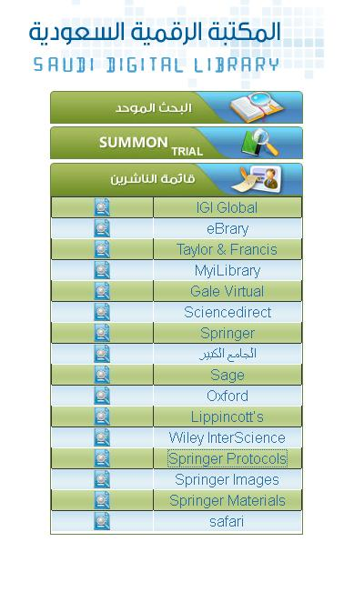
SDL Portal

Slide 5
Username/password
SpringerImages
SpringerMaterials
Username: SaudiDigital
Password: sdl1357

Slide 6
1. SpringerLink.com 2. SpringerProtocols.com 3. SpringerImages.com* 4. SpringerMaterials.com* 5. SpringerReferences.com 6. Z MATH
*Username: SaudiDigital
Password: sdl1357

Slide 7
1. SpringerLink.com - Homepage and Search Functions - Other Search / Browse Options - The Search Results - The new ‘Look Inside’ functionality - Personalization and Other Functionalities

Slide 8
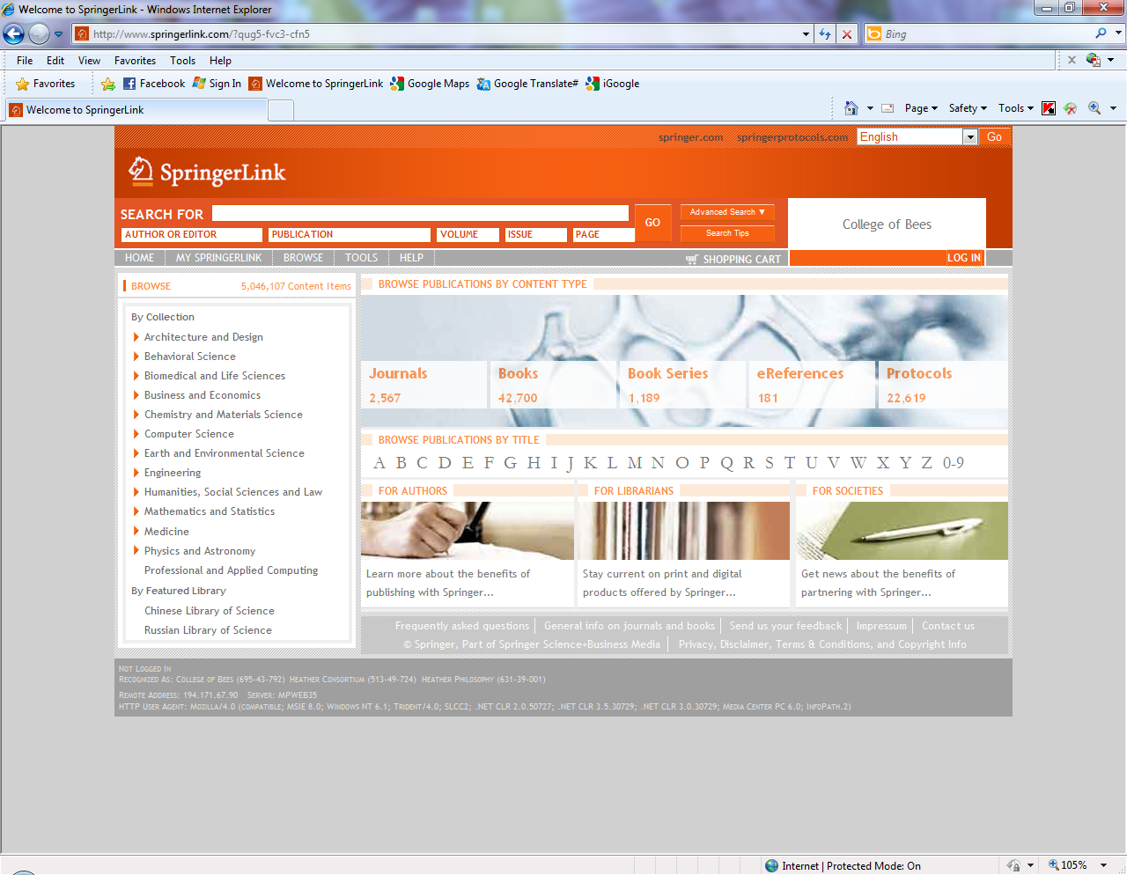
Homepage consists of three parts
Notes:
The Homepage.
The new SpringerLink interface has been designed based on the results of one of the largest usability studies. Features have been added and revisions done to best match the requests of users world wide.
The homepage consists of three parts; The top bar, the cockpit on the left, both which will stay with you on every page and in the middle, main part where the content will be displayed.

Slide 9
❶
More language interfaces to be released.
Institutional branding appears in the top right corner of every page.
Administrators can upload their institutions’ logo.
❷
❸
❸
In the grey bar, on every page, the user can see how he or she is being recognized and whether or not the user is logged in.
In case the user needs assistance from customer service, the Metapress ID and the IP address can be found here as well.
Notes:
Some additional remarks about the homepage:
1. Further interface languages to be released soon
2. Institutional branding now appears in the top right corner of every page. Here branding can also be included for societies. The administrator can add the institutional logo to the account and it will be displayed here instead of the written name.
3. The grey bar at the bottom displays useful information on how you are being recognized.

Slide 10
There are 4 different ways to search or browse content
Notes:
There are 4 different ways to search or browse the content
Search by keywords, author, DOI, etc in the search box at the top
Browse subjects in the cockpit on the left
Browse content type; journals, books, book series, reference works, protocols
Or, finally, alphabetical by publication title
The homepage also allows easy access to Services for Authors, Librarians and Societies. These three links (the pictures) take the user back to springer.com, our information platform. SpringerLink is our content platform.
We will continue to look at the search box on top as this has the most different options. The other three search or browse functions are pretty straight forward.

Slide 11
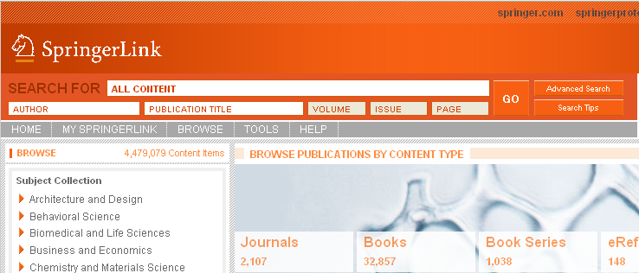
Quick Search on SpringerLink
Quick Search Box is now in the same location on EVERY page of the site. Users no longer have to go looking for it!
Notes:
Placement of the Quick Search box in the same location on every page makes the site easier to use. The user does not have to go back to the homepage to start a new search.

Slide 12
Advanced Search on SpringerLink
Clicking on “Advance Search” will unfold the numerous options for an advanced search.
Notes:
That same search bar ‘unfolds’ to the Advanced Search box by clicking on the button “advance search”. The search box now shows many more options, like search in full text or title only, search only books, show results alphabetical, most relevant or most recent.
Let us use an example..

Slide 13
Advanced Search by Keywords, without “”
- In this example the key words protein methods are used, WITHOUT quotation marks.
Key words should be in the title only (of the Book, the Book Chapter, the Book Series, the Journal, the Journal Article, the Protocol, or the Reference Entry
Category in this case is Only Books
And the results should be displayed as most recent publication first
Notes:
In this example we search on “protein methods” without the quotation marks.
We search in the “Title Only” (Chapter, Article or Publication)
Under Category we select “Only Books”
And we would like to see the most recently published first

Slide 14
Search Results
The results show publications with ‘protein’ AND ‘methods’. The results can be narrowed down further by using the filters in the cockpit on the left.
Notes:
The results come back with publications having Protein AND Methods in the title of the book, book chapter, book series etc.
The results can be narrowed down further by using the filters in the cockpit on the left. Do make sure however that you can see the filters as shown on the next slide.

Slide 15
Access Indicators can be switched off or on (default is ‘on’)
Notes:
Or to switch the Access Indicators on or off.
The green square means you have access.

Slide 16
SpringerLink.com Other Search / Browse Options
Notes:
Let’s discuss the other three browse/search options

Slide 17
Browse by Subject Collection
Subject Collections expand to show detailed subfields.
Notes:
One other browse or search function from the homepage is to select the Subject Collection in the cockpit on the left.
Clicking on the orange arrow next to the subject collections now expands them to show the sub-fields. This allows the user to browse easily for their specific field of interest. Clicking on the subject collection name takes you directly to that subject collection, with all available books, articles, reference work entries, etc.

Slide 18
Browse by Title - Browse Alphabetically
Browse content by content type
Or alphabetical by title
Notes:
The third option is to search only by content type; like books, or book series.
The fourth and last option is to browse the alphabetical list of Springer’s publications, the new A-Z List reduces the need for scrolling through long lists.

Slide 19
.. Then by Keyword, Collection or Alphabetical order
When the user has selected a content type, the user can search within that content type by keyword, by subject collection or alphabetical
Notes:
Whichever option you choose, you can use the “search within”.
For example, on the homepage we select “content type: Books”, on this second page you can search alphabetically within books, OR use the keyword search on the top left OR use the cockpit on the left to narrow down the results further (make sure the filters are shown!).

Slide 20
SpringerLink.com The Search Results

Slide 21
New Search
To show the different options available in the search results, we will start a new search.
Notes:
Let’s start a new search, for example within “books” containing the work “Autism” in the book or chapter title.

Slide 22
❶
❶
❷
❶
The user can easily see whether the result is a book, a book chapter, or an entry in a reference .
The user can click on “Show Summary” to read the abstract.
❷
Notes:
On the result page it is stated whether the result concerns a book chapter or an entire book.
With the “Show Summary” button the user does not have to leave the page, but read the abstract here.

Slide 23
The user can click on “Show Summary” to unfold the book chapter abstract.
The user can unfold many summaries at the same time, thus enabling him or her to compare chapters without having to leave the search result page.
Notes:
The user can open as many summary / abstract pages as needed, thus enabling him or her to compare chapters without having to leave the search result page.

Slide 24
Flexible Filters
Again, the user can narrow down the results by using the filters in the cockpit on the left hand side
Any of the filters used can be easily removed again by clicking on the X in front of it
Notes:
Result can be broadened again by simply deleting one of the parameters, for example, here we filtered on:
Content Type “Books”
Subject Collection “Behavioral Science”
Copyright Year “2011”
Any of these filters can be removed without losing the search results / without having to start over again.

Slide 25
Contents vs Look Inside
The user can also opt for the ‘contents’ tab. The contents appear in the main screen, where, again the download and “Show Summary” options are available.
Notes:
Back to SpringerLink, back to the “Book” tab in the cockpit, the user can choose between the “Look Inside” and the “old-fashioned” display with a list of the chapters.
Here, again, the user can read the chapter summary, download the PDF, view the HTML or switch back to the Look Inside.

Slide 26
Related Documents on the abstract page
Notes:
When the user selects a book chapter or journal article, the user will be taken to the so called abstract page.
In the cockpit on the left, now the 10 most closely “Related Documents” appear, which can be any content type.
80% of SpringerLink users begin their experience on an abstract page, coming for example from Google. From the abstract page, the user can see which documents are most closely related to the journal article or book chapter. This is done through semantic linking. Results are not limited to books or journals, but rather open to all content on SpringerLink.
Springer worked with semantic experts at a company called Temis to create a “digital fingerprint” for each document on SpringerLink (over 5 million!). Using content level analysis, semantic indexing recommends up to ten related documents for each abstract on SpringerLink. Interdisciplinary researchers will find this feature extremely useful.

Slide 27
Related Documents
Hovering over the title with the mouse will show the user a separate window with the suggested documents’ abstract.
Notes:
“Mousing” over a related document causes a mini-abstract page to pop-up. Researchers do not need to navigate away from their article or book chapter to find out more information. Related documents can be downloaded directly from this mini-abstract page!

Slide 28
More options on the Abstract page
Notes:
There are several more options on the abstract page
Here the user can:
read the abstract (or summary), which is the default setting
find the references used in the journal article or book chapter (References)
see which article or chapter has cited this article or chapter (Cited By) (will show in another slide)
export citations
read more about this publication (authors, affiliations, SpringerLink date, etc)

Slide 29
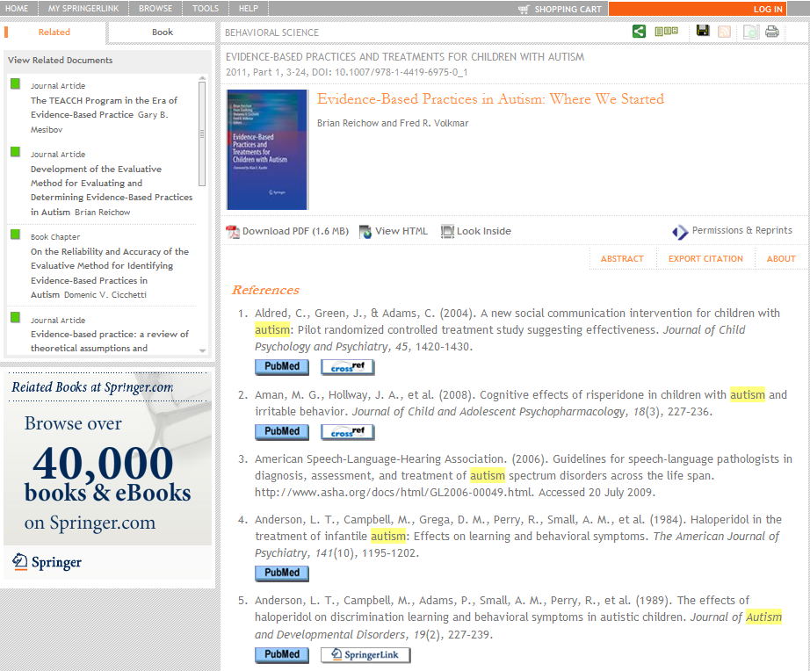
References
The buttons, under the references, take the user to PubMed, or to the original article either through crossref or directly to SpringerLink if the referred source was published with Springer.
Notes:
When the user selects “References”, a list of references is shown with links to the original articles where available.
With this functionality, researchers can link to any publication which submits article DOIs to CrossRef.

Slide 30
Cited By
When an article or chapter is cited by another publication, this will be listed here, on the article or chapter level.
Notes:
For articles or chapter that have been cited in other publications, the orange text “cited by” will be visible on the abstract page. Similarly this will link to the article that has cited the article of chapter.

Slide 31
Export Citation
A citation is very easily exported.
The user can choose from the most commonly used Citation Managers.
Notes:
Citations can be easily exported in the most popular citation managers:
ProCite
BibTex
EndNote
Reference Manager
PubMed (NLM)
RefWorks
BookEnds
Text Only

Slide 32
SpringerLink.com The new ‘Look Inside’ functionality

Slide 33
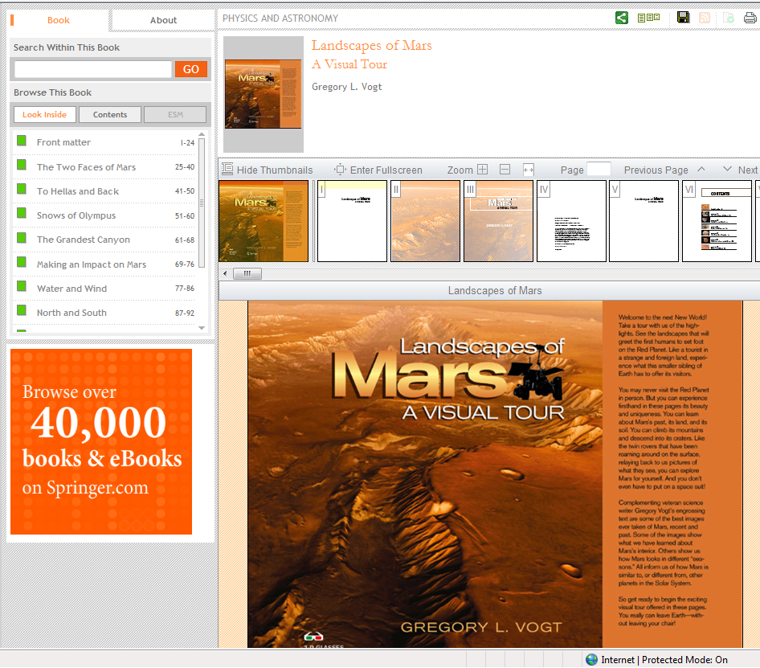
Look Inside
‘Look Inside’ puts the PDFs for all chapters back together so the user can browse the entire book, bringing the “book” experience back into eBooks. No special software is required.
Notes:
To demonstrate all the features associated with the ‘Look Inside’ functionality, we will look at the beautifully illustrated book “Landscapes of Mars”.
The “Look Inside” PDF Preview feature allows users to scan the PDFs for the Springer eBooks and Protocols without having to downloading them or with the need for special software.
Through the “Look Inside” functionality non-subscribers have access to the front matter and back matter, and to 10% or 5 pages from each chapter, whichever is more.
Subscribers of course have access to the entire book and can use the Look Inside function to browse the entire book, quickly scanning illustrations, charts, tables, and equations.
Look Inside puts the “book” experience back into eBooks.

Slide 34
Look Inside - Navigation
The user will always know where he or she is in the eBook.
Additionally, the bar at the to shows the title of the chapter the user is in.
Notes:
The user will always know where he or she is in the eBook.
The bar at the top of the
To browse the eBook, users can:
-‘slide’ through the book horizontally and browse the thumbnail of the pages
-scroll through the pages vertically by scrolling down on the preview screen
-use the table of Content in the cockpit on the left to jump to a certain chapter.
content area always shows the chapter title.

Slide 35
Options in ‘Look Inside’
Here the user can
Show or hide thumbnails
Enter and exit the full screen mode
Zoom in and out
Directly select a page number and jump to that page
Select next or previous page
Notes:
The bar just above the thumbnails shows several options.
Here the user can
Show or hide thumbnails
Enter and exit the full screen mode
Zoom in and out
Directly select a page number and jump to that page
Select next or previous page

Slide 36
View Details or Download the PDF
Select “View Details” to see references and related documents for each chapter
Select “Download PDF” to download the PDF file if the user is a subscriber
Notes:
In the bar just above the preview page the user can:
-View Details which will take the user to the Abstract page
-Immediately download the complete PDF

Slide 37
SpringerLink.com Personalization and Other Functionalities

Slide 38
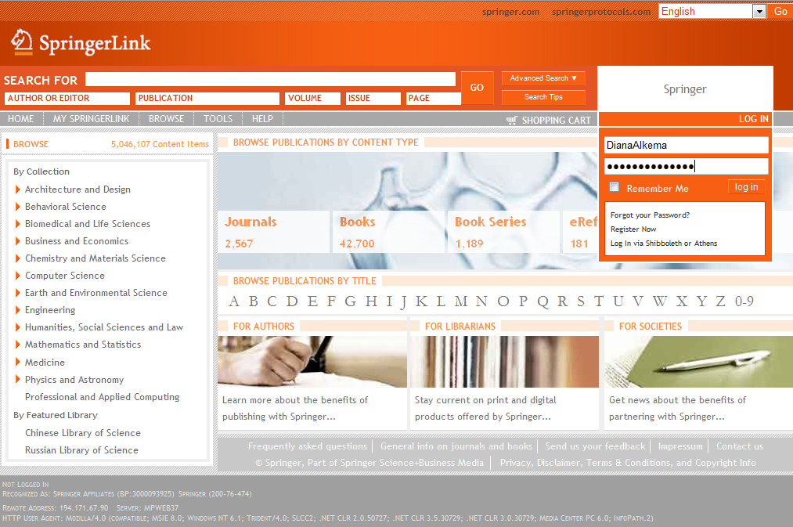
Users can log in to their own account
Users can log in to their own, personal account as well.
A login box is available from every page.
Notes:
Visitors to SpringerLink are recognized as being at an institution when they are at the institution.
Additionally, users can create their own personal account and save some personal preferences here.
The log in for SpringerLink is available from every page by clicking on the log in button which will expand the log in screen.

Slide 39
Save a search
Once logged in, the user can benefit from features such as “saved searches” and “saved items”. To save a search or an item, the user can simply click on the disk icon.
Notes:
In a personal account users can save searches, favorite articles or books.
To save a search or an item, the user can simply click on the ‘save’ icon in the top right corner.

Slide 40
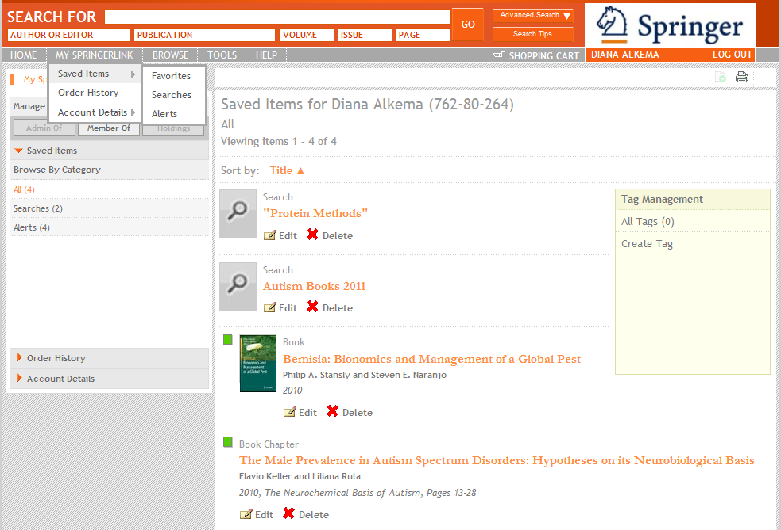
Saved Searches
Notes:
To go back to the favorites, the user selects “My SpringerLink” in the menu bar.

Slide 41
Other options are RSS Feeds and Print view
The other three icons are to:
- Create RSS Feeds
- Items / List management (currently under development )
- Enable the print view
Notes:
Create RSS Feed
Items / List management is currently under development and will be made available soon
Last icon is to enable the print view

Slide 42
Sharing Results
On the title, chapter or article level, the results can be shared with peers through email or bookmarking services like: CiteULike, Connotea and Delicious
Notes:
On the title, chapter or article level, the results can be shared with peers through Email or bookmarking services like:
CiteULike
Connotea
Delicious

Slide 43
Frequently Asked Questions under Help in the Menu bar
Makes sure to browse the Frequently Asked Questions section and send us your feedback.
Notes:
Last but not least: please refer to the Frequently Asked Questions sections in the Help menu.
Here you can also send us your feedback and find our contact details.

Slide 44
2. SpringerProtocols
Comprehensive database of peer reviewed, reproducible procedures for scientific experiments
Tested. Trusted.

Slide 45
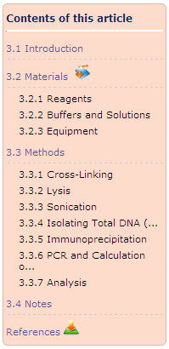
What are protocols?
SpringerProtocols | Saudi Arabia | March 2011
Step-by-step instructions, in a standardized format, that help researchers conduct experiments
Protocols are “recipes” that researchers use to recreate experiments in their laboratory, including: Bias, Safety, Equipment, Statistical methods, Reporting and Troubleshooting
Peer-reviewed
SpringerProtocols
The largest database with close to 23,000 protocols
Notes:
Protocols are step-by-step instructions, in a standardized format, that allow researchers to recreate an experiment
They are predefined methods in the design and implementation of experiments, including Bias, Safety, Equipment, etc.
All protocols are peer-reviewed and have been gathered from several book series, journals and handbooks.
Sources:
Book Series (by Humana Press)
Methods in Molecular Biology
Editor: Dr. John M. Walker
Methods in Molecular Medicine
Methods in Biotechnology
Methods in Pharmacology and Toxicology
NeuroMethods
Journals
Hand Books
The Protein Protocols Handbook
Molecular Biomethods Handbook
And many more….

Slide 46
SpringerProtocols | Saudi Arabia | March 2011
Notes:
On SpringerLink the user can choose to only search the protocols.
In a general search on SpringerLink the protocols will be displayed in the search results just like chapters and journal articles are.
SpringerProtocols is the largest database with close to 23,000 protocols.
About 2,000 new protocols are added each year, the updates are made continuously.

Slide 47
PLATFORM SpringerProtocols.com
SpringerProtocols | Saudi Arabia | March 2011
Notes:
There are two options to use the protocols
Through SpringerLink
Through the separate platform SpringerProtocols

Slide 48
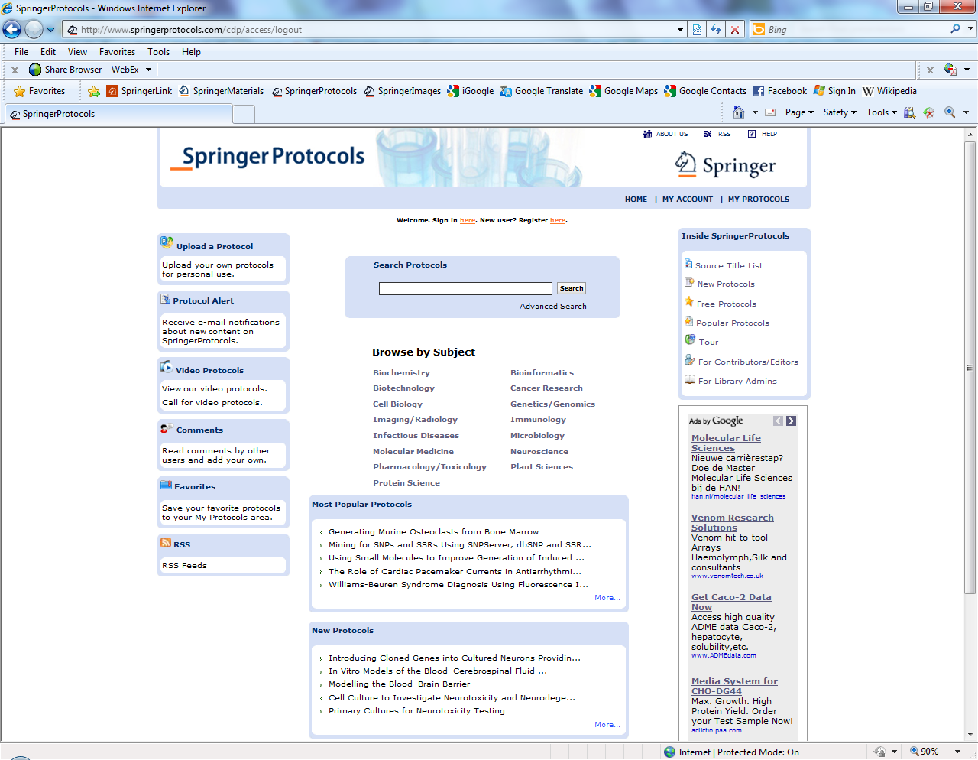
SpringerProtocols | Saudi Arabia | March 2011
Notes:
The SpringerProtocols homepage offers;
Browse per Subject
Quick Search, plus a link to the Advanced Search
Browse most popular Protocols or New protocols

Slide 49
SpringerProtocols | Saudi Arabia | March 2011
Notes:
Plus:
Web 2.0 features, such as:
Upload your own protocols
Sign up for Alerts
Select Video Protocols or request one
Read or leave comments
Save the protocol to your favorites
Sign up for RSS Feeds
Personalized features, such as:
MyProtocols
Saved Searches
Useful Tools, such as:
Source Title List
Browse FREE protocols
Take a Tour

Slide 50
SpringerProtocols | Saudi Arabia | March 2011
Notes:
Search for example on “DNA Cloning”
Results can be sorted by e.g. relevance or title
Search box has moved to the top bar and is available there from every page
The user can search with the results, or
Drill down by subject or publication year

Slide 51
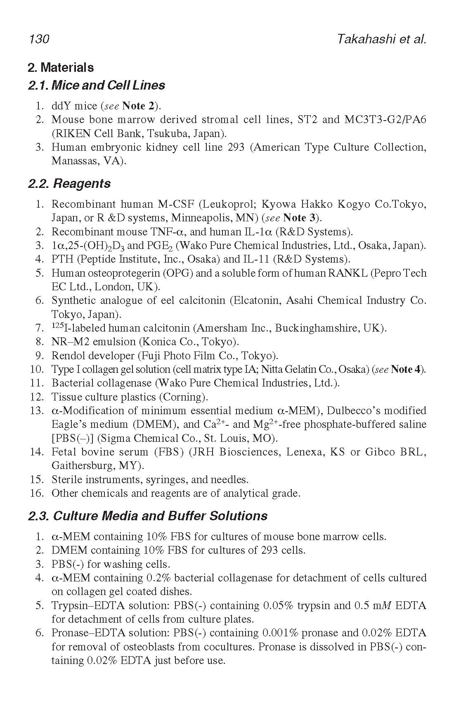
Example of the actual Protocol / PDF File
SpringerProtocols | Saudi Arabia | March 2011
Notes:
And finally, here is an of the actual Protocol, PDF file

Slide 52
3. SpringerImages
Simplify
Research

Slide 53
About SpringerImages
Springer Images | Saudi Arabia | March 2011
2
2.8 million+ scientific, technical and medical images
Images: photos, graphs, histograms, figures and tables
Constantly growing database
Variety of sources: SpringerLink, SpringerProtocols, images.MD, and more
Peer-reviewed, trusted sources
Unlimited concurrent users
Permission to use images for personal, non-commercial use
Notes:
When to use SpringerImages?
When you are looking to:
Use images to quickly update lectures or presentations.
Get a refined and relevant list of results quickly when searching for pertinent pieces of information in a vast quantity.
Use easily customized searches tailored to individual needs, such as comparison of research results or sharing keywords with other users to optimize the search
Quickly understand the context of an image, dramatically reducing the time needed to review literature
Easily jump to the source to confirm the context and retrieve further information

Slide 54
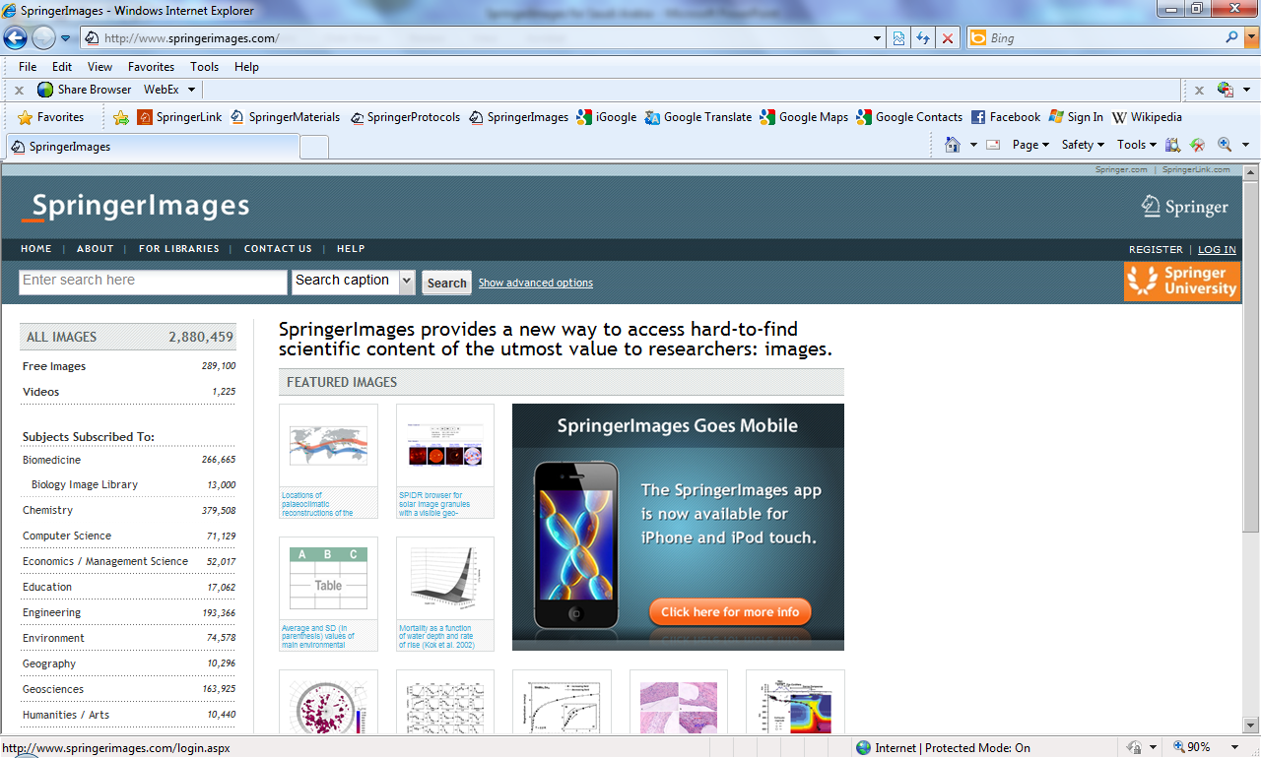
Personalization of SpringerImages
Springer Images | Saudi Arabia | March 2011
3
Notes:
To use SpringerImages to its full potential, one should create a personal account and log-in.

Slide 55
Image sets – Drag and Drop
Springer Images | Saudi Arabia | March 2011
4
Notes:
Once the account is created, users can manage their account at My Account, accessed from the link on the top of each page.
Here users can manage Image Sets and save searches.

Slide 56
Springer Images | Saudi Arabia | March 2011
5
Notes:
Let’s start with the homepage.
Here the user can:
Browse all images by subject field
Do a simple search
Do an advanced search
To perform an Advanced Search, a user clicks on the link by the search bar at the top of the screen.
With an advanced search, the user is able to search with a number of advanced options:
Subject (select from list)
DOI
Source Publication (select from list)
Publication date
Image provider
Image type
Image color
Institution (select from list)
Author
Keyword

Slide 57
Springer Images | Saudi Arabia | March 2011
6
Notes:
Here we searched on “brain tumor” and MRI.
The 28 results can be sorted by Relevance or Publication Date.
The search can be refined by
-Search within results
-Image type
-Subject
-Source (e.g. journal title)
-Publication Year
When you are logged in, you can:
-Save you search
-Create an image set

Slide 58
Springer Images | Saudi Arabia | March 2011
7
Notes:
The saved Image Sets can then be exported directly to a PDF file of A PowerPoint.

Slide 59
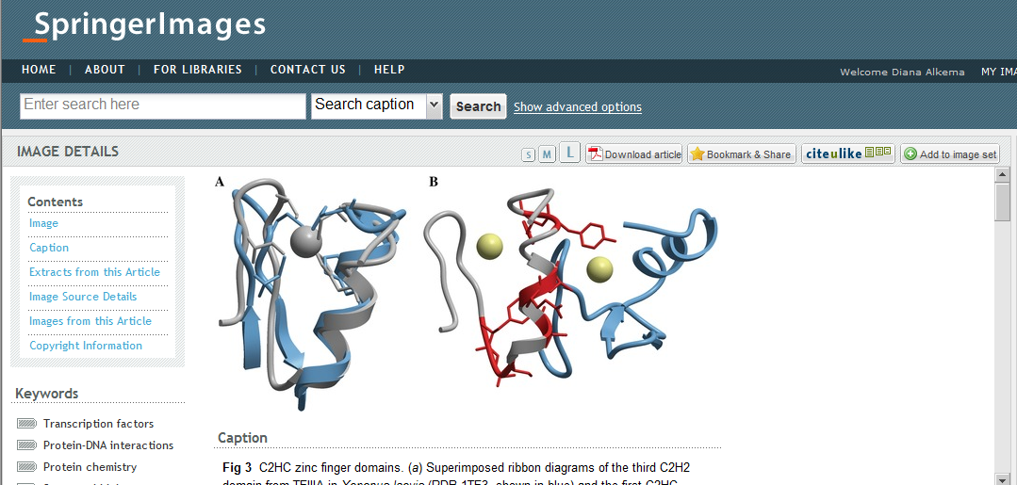
Springer Images | Saudi Arabia | March 2011
8
Notes:
One the Image page we have
-the actual Image
-the caption that goes with the Image
-extracts from the article
-image source details (including the abstract of the article)
-other images from this article
-license details

Slide 60
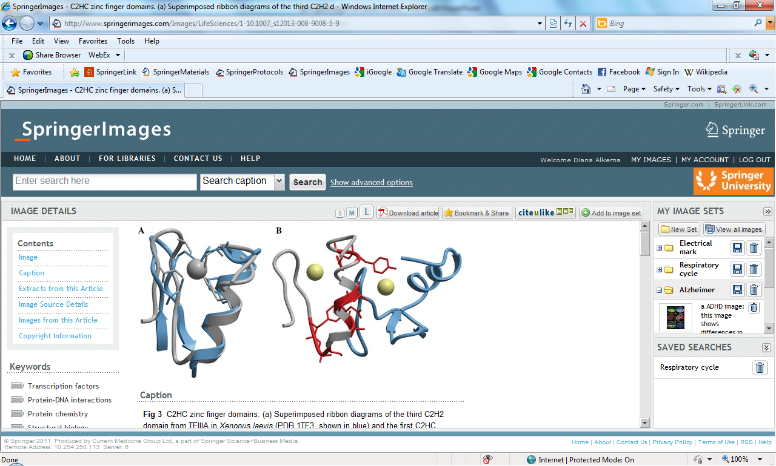
Springer Images | Saudi Arabia | March 2011
9
Notes:
Other option available here are:
- Change the display size of the image
- Download the PDF of the original article
- Bookmark and Share
- Add to an Image Set
Another feature is that you can add your own keywords to the Image!

Slide 61
Name
Title
Date
www.springermaterials.com

Slide 62
What‘s in SpringerMaterials?
Landolt-Börnstein
Databases: – Inorganic Solid Phases – Thermophysical Properties
Chemical Safety: – REACH – GHS – RoHS, WEEE
More to come … (Quarterly Updates)
2

Slide 63
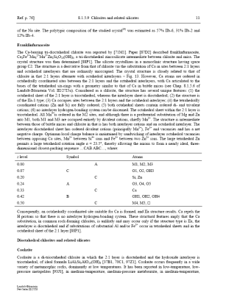
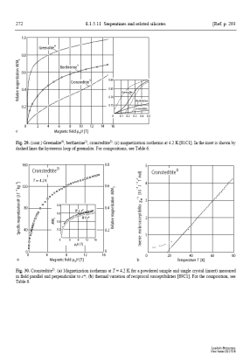
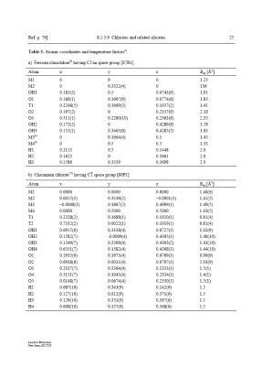
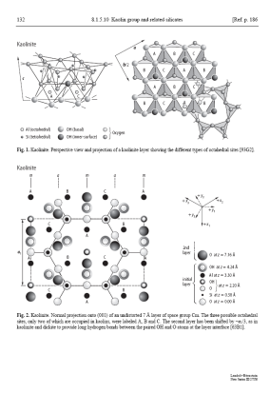
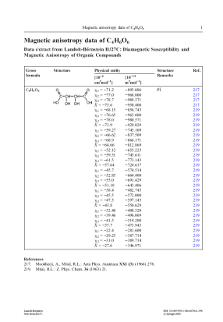
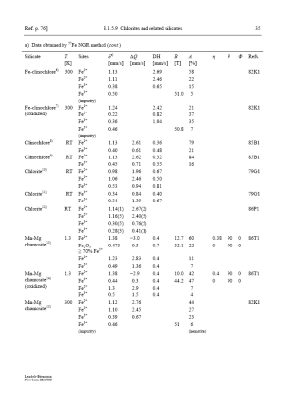
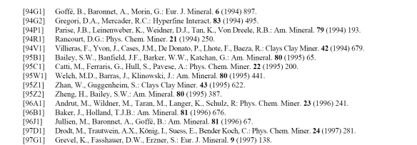
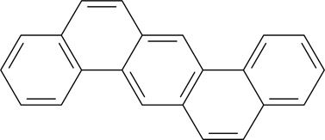
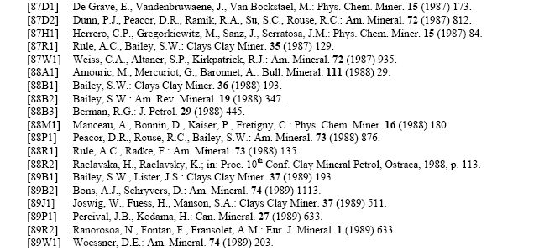
What is Landolt-Börnstein?
> 200,000 pages | > 100,000 online documents | > 150,000 figures
> 250,000 chemical substances | > 1,200,000 literature references
Systematic and comprehensive evaluation of data by renowned authors and editors (… since 1883)
3

Slide 64
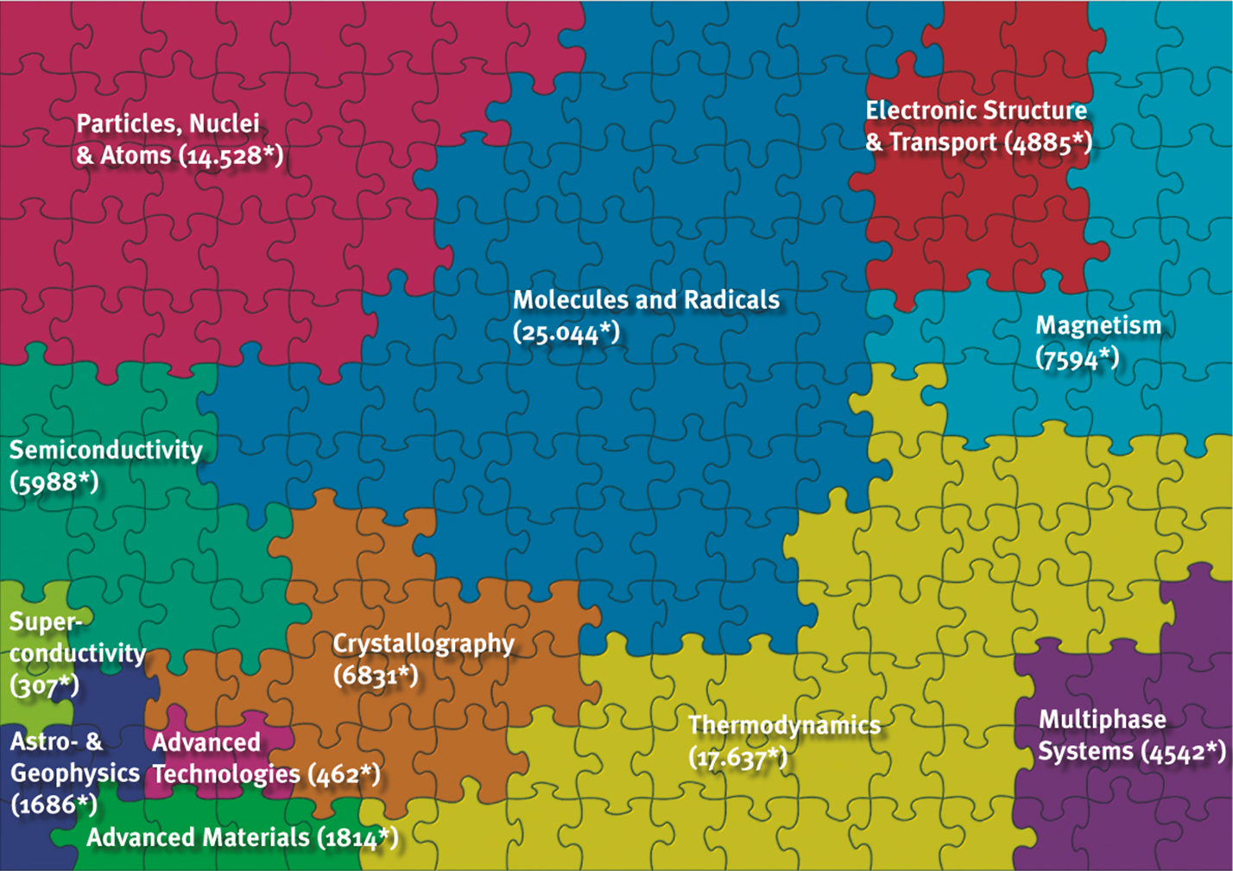
ca. 100,000 online documents from “Landolt-Börnstein”
4

Slide 65
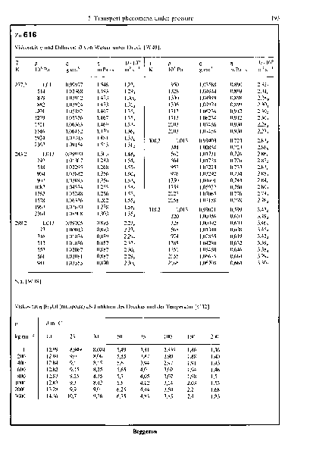
What does “critically evaluated” mean?
Temperature measurements
Best results
Journal article cited
in SpringerMaterials.
Now more than
1,200,000 citations
Included!
Editors & Authors
Pick best results
Describe optimal
experimental set-up
Pick best results
Describe optimal
experimental set-up
Explain best practise
Give physico-chemical
background information
Paper 1,
published by
Paper 2,
published by
Paper 3,
published by
Paper 4,
published by
5

Slide 66
Info Documents
PDF Documents
6

Slide 67
Free-access Info Documents
7

Slide 68
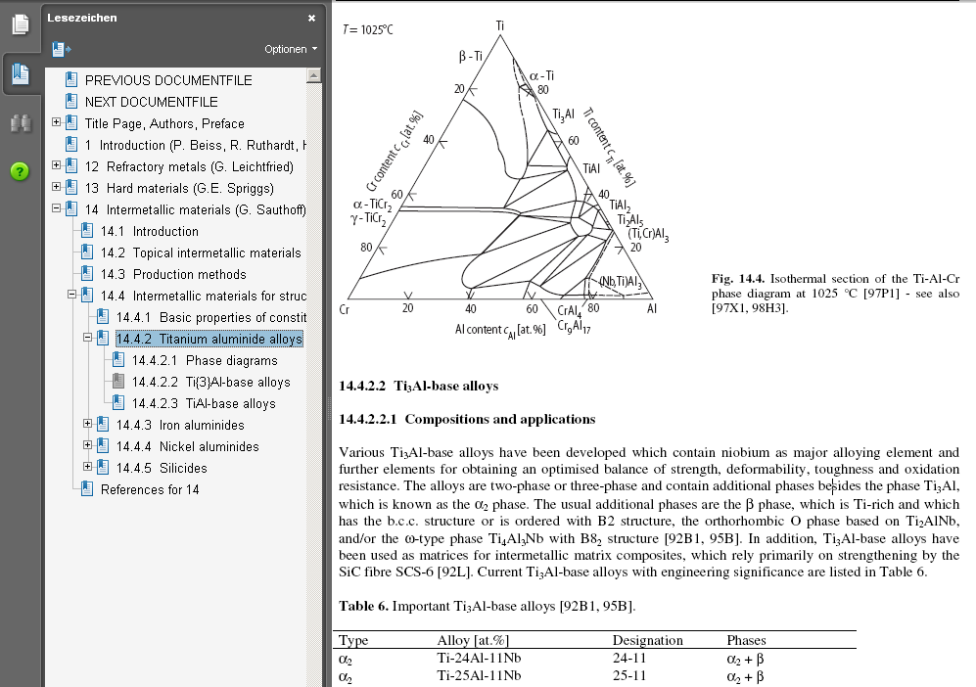
Actual Documents Subscription Required
Figures
Text
Tables
8

Slide 69
Database on Inorganic Solid Phases “Linus Pauling File”
Physical Properties (44,000 Data Sheets)
Structure/Diffraction Data (123,000 Data Sheets)
Phase Diagrams (23,000 Data Sheets)
9

Slide 70
„Inorganic Solid Phases“:
Overview of Relevant Data Sheets
10

Slide 71
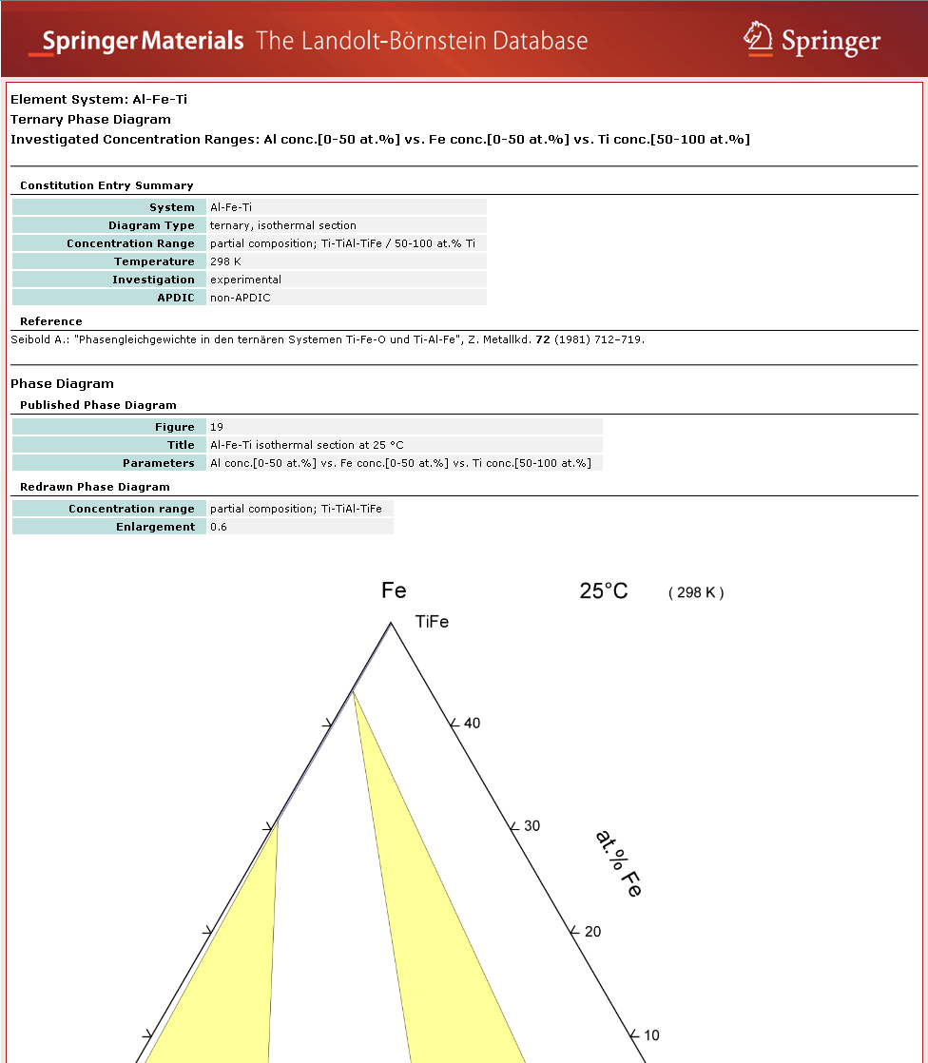
Actual Data Sheet
11

Slide 72
Database on Thermophysical Properties Subset of the DDBST / Dortmund Data Bank Software & Separation Technology
Thermophysical Properties of 50 Organic Liquids + Water and their 1225 Binary Mixtures
12

Slide 73
„Thermophysical Properties“: Overview of Available Data
13

Slide 74
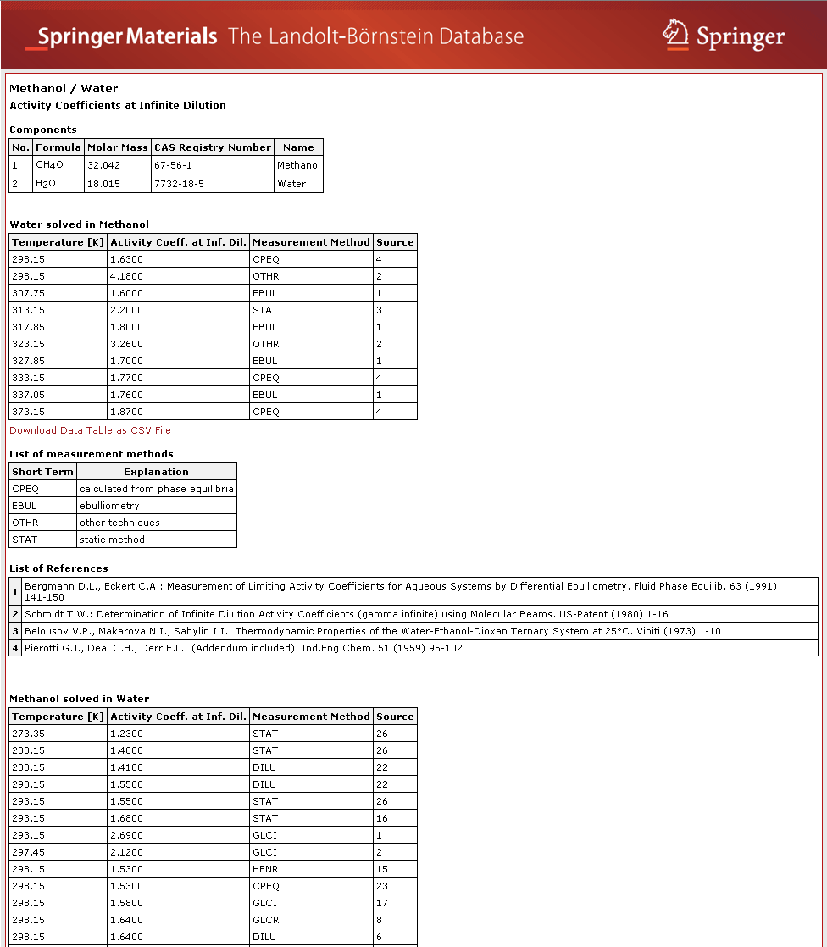
Actual Data Sheet
Data available as CSV File
14

Slide 75
Chemical Safety Data (44,000 Documents)
REACH (Registration, Evaluation, Authorization and Restriction of Chemicals)
GHS (Globally Harmonized System)
RoHS (Restriction of Hazardous Substances)
WEEE (Waste from Electrical and Electronic Equipment)
15

Slide 76
Chemical Safety Data
44,000 documents on REACH | GHS | RoHS | WEEE
Identifies recognized potential dangers of a substance
Standardized classification and labeling
European Union Regulation requires all companies manufacturing or importing /exporting chemical substances to/from the European Union in quantities of > 1 t/a to register at European Chemicals Agency (ECHA)
SpringerMaterials has been official identified as a REACH compliant provider by the European Chemicals Agency (ECHA)
Information instantly available under one source – one-stop shopping
16

Slide 77
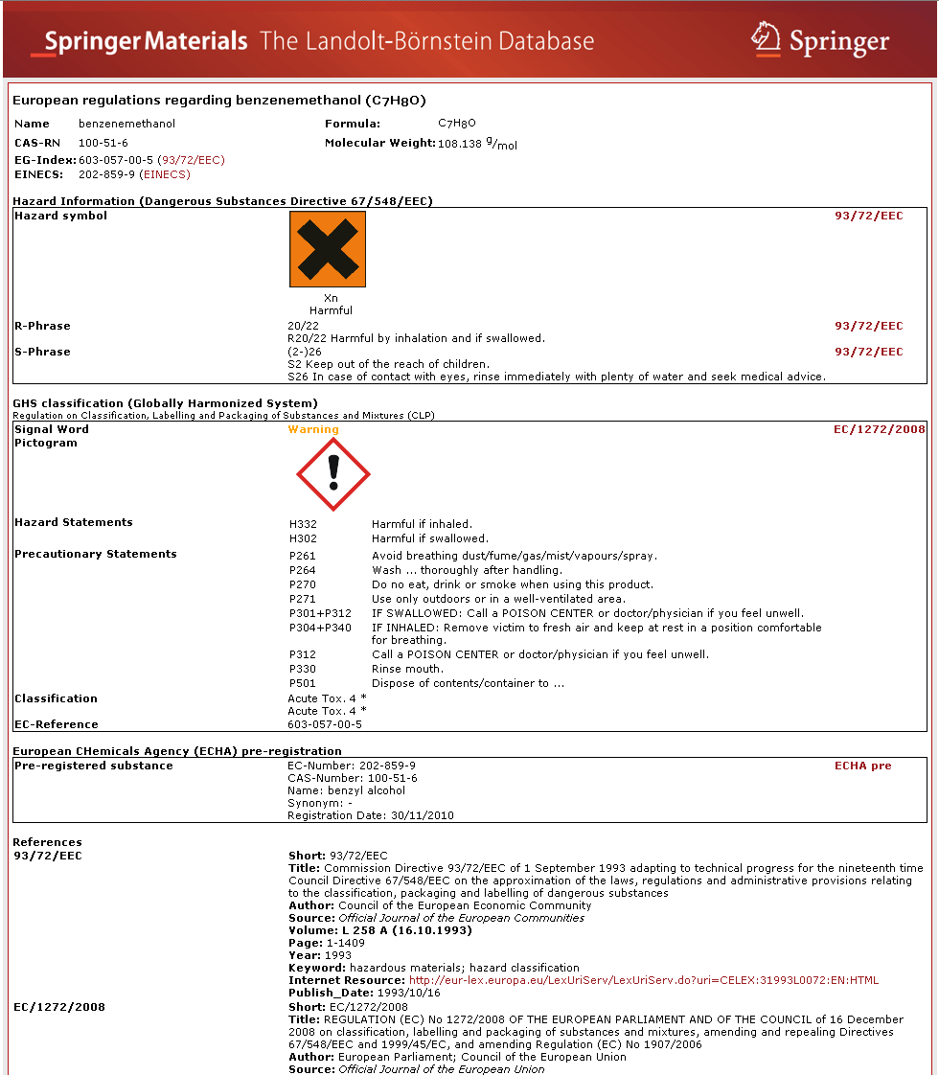
Actual Safety Document
17

Slide 78
Available Content
43

Slide 79
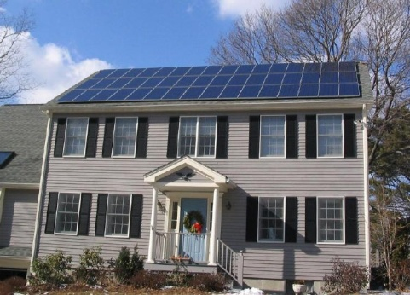
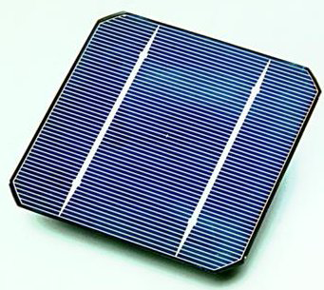
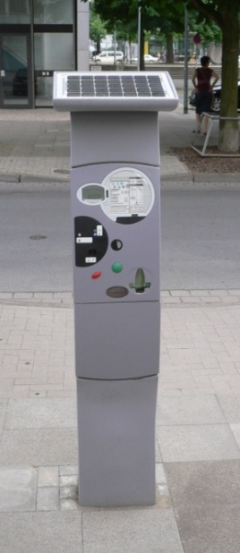
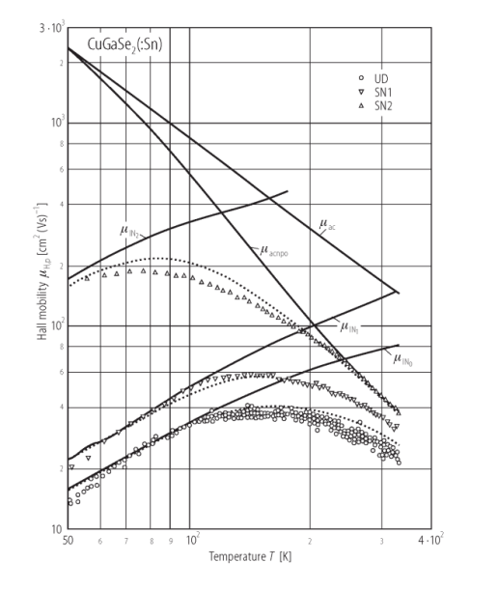
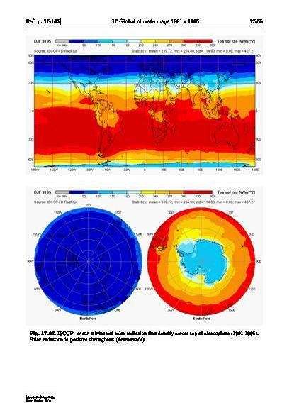
Engineer develops
improved solar cell
SpringerMaterials
Typical Usage Situation
Search for the carrier mobility of CuGaSe2
Get an overview of the climate conditions in the area of interest
52

Slide 80
Aircraft engineer needs
new alloy for construction
of stronger winglets:
e.g., Al-Fe-Ti
SpringerMaterials
Typical Usage Situation
1. Selects components by clicking on elements in periodic table
2. Available content shown
53

Slide 81
SpringerReference.com

Slide 82
www.zentralblatt-math.org/zbmath/

Slide 84
Thank you for your time! Any questions? Ismael.touq@springer.com

