Slide 1
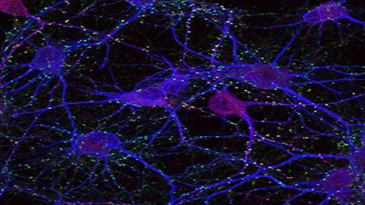

Organization of
Somatic Nervous system
Spinal nerve and Reflex arc
Dr. Qazi Imtiaz Rasool
Notes:
Where nerve impulses convert to neurotransmitters
Transmission of impulses Inhibition of impulses Integration of impulses Modification of impulses Learning and memory

Slide 2
OBJECTIVES
Recall various components of somatic nervous system.
Explain structure of typical spinal nerve.
Describe reflex arc.
Identify clinical application.

Slide 3
Nervous System
1.CNS 2.PNS
  1. SOMATIC 2. AUTONOMIC
  1. Brain 2. Spinal Cord

Slide 4
Somatic nervous system (SNS)
All parts of the nervous system outside of the brain and spinal cord
  Somatic System: Links spinal cord with body and sense organs; controls voluntary behavior
  Autonomic System: Serves internal organs and glands; controls automatic functions such as heart rate and blood pressure
  Enteric System

Slide 5
Functional Classification
BRAIN
SPINAL CORD
(CNS)
AFFERENT
NERVES
EFFERENT
NERVES
PNS
EXTERO-
RECEPTORS
INTERO-
RECEPTORS
SOMATIC
AUTONOMIC
EFFECTOR
ORGANS
SKELETAL
MUSCLES
SMOOTH AND
CARDIAC MUSCLES
AND GLANDS
Notes:
The ANS is one of the most sophisticated control systems known to man. It is primarily involved in maintaining the homeostatic state of the organism while allowing adaptation to changes in conditions, sometimes even severe changes.
Contrary to the somatic division of the CNS is it a totally unconscious activity. It also involves a sophisticated interplay of chemical and neural signals (see previous lecture).

Slide 6
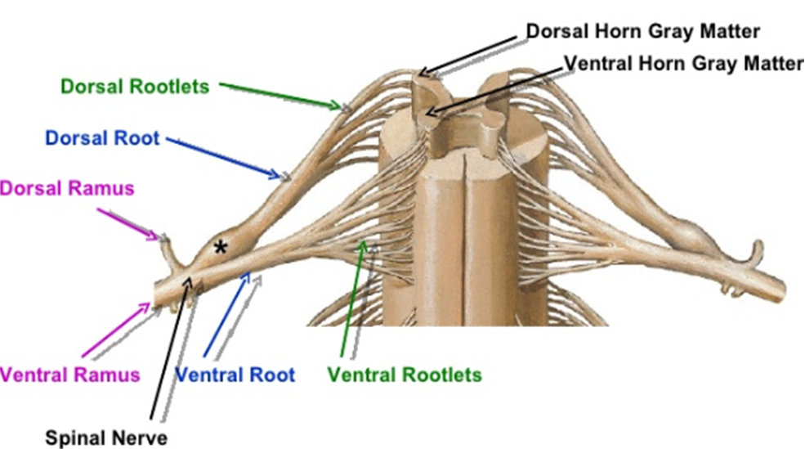
Notes:
Spinal Nerve
Each side of spine Dorsal and ventral roots join
To form a spinal nerve
Mixed Nerves
Carry both afferent (sensory)
and efferent (motor) fibers
Two branches of spinal nerves
Ventral root
Contains axons of motor neurons
Dorsal root
1. Contains axons of sensory neurons
2. Dorsal root ganglia

Slide 7
Peripheral Distribution of Spinal nerve
Nerves Spinal nerves
    Form lateral to intervertebral foramen
    Where dorsal and ventral roots unite
    Then branch and form pathways to destination
  Motor nerves
    first branch
      White ramus Carries visceral motor fibers to sympathetic ganglion of autonomic nervous system
      Gray ramus Unmyelinated nerves , Return from sympathetic ganglion to rejoin spinal nerve
Notes:
• Spinal nerve are the path of communication between the spinal cord and the specific region of the body
Cervical and thoracic spinal nerves arise and leave at corresponding vertebra .• Because the spinal cord are shorter than vertebra column, nerve that arise from lumbar, sacral and coccyx region of spinal cord do not leave the vertebra column at the same level where they exit the cord.• The root of these spinal nerves angle inferiorly in the vertebral canal from the end of spinal cord like wisps of hair.

Slide 8
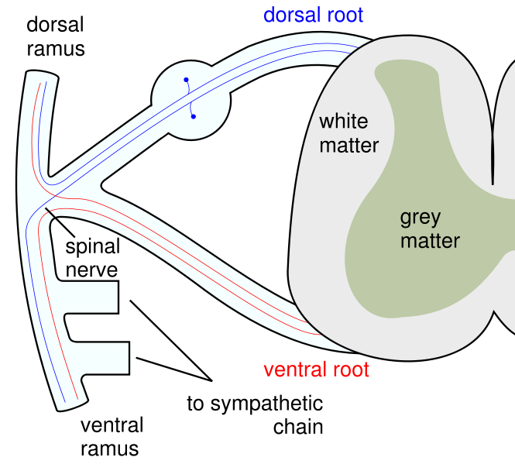
Afferent fiber
DRG
Efferent fiber
Notes:
.

Slide 9
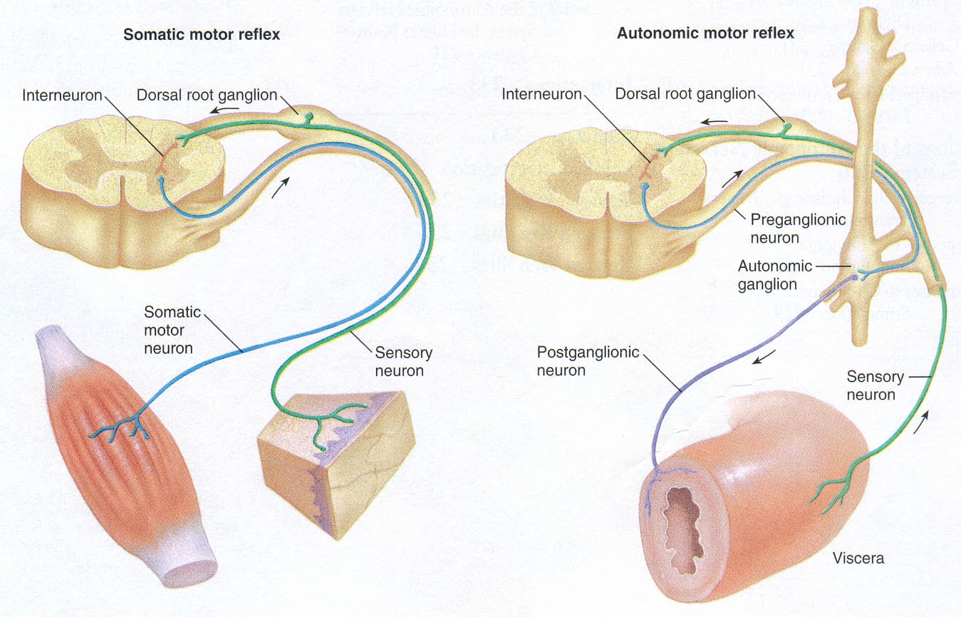
Notes:
The 2 neuron usually relays through a ganglia

Slide 10
Spinal Nerves
.
  Based on vertebrae where spinal nerves originate
  Positions of spinal segment and vertebrae change with age
    Cervical nerves
      Are named for inferior vertebra
    All other nerves
      Are named for superior vertebra

Slide 11
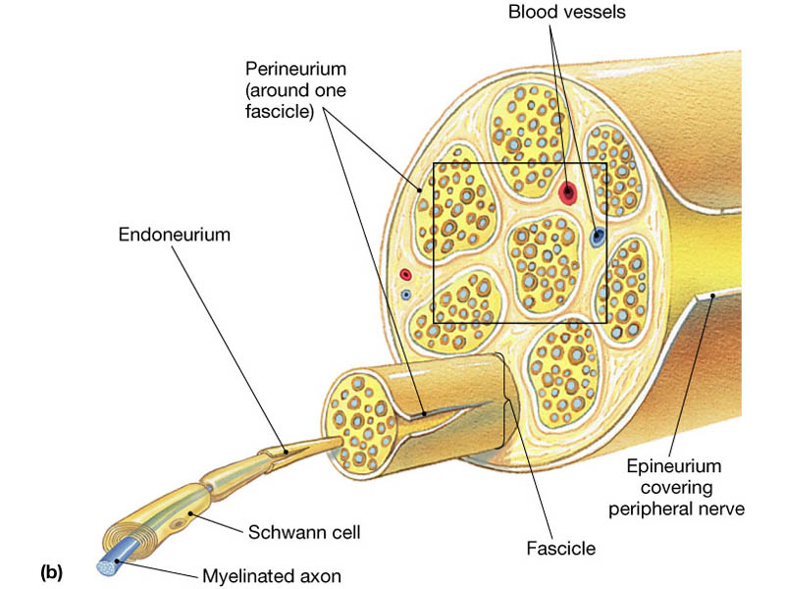
Peripheral Nerves
Epineurium wraps entire nerve
Perineurium wraps fascicles of tracts
Endoneurium wraps individual axons

Slide 12
Nerve structure
Nerves are only in the periphery
Cable-like organs in PNS = cranial and spinal nerves
Consists of 100-100,000 of myelinated + unmyelinated axons (nerve fibers)+ connective tissue + blood vessels
Support Cells of the PNS
Satellite cells ---Protect neuron cell bodies
Schwann cells---Form myelin sheath

Slide 13
Morphology of neuron
1.membrane
2.perikaryon
Cell body (soma)
3.nucleus
Two parts
Dendrites
Processes
Axon
  Presynaptic terminals.
  terminal (bouton / button)
Notes:
Terminal branches (telodendria)
End in knobs called axon terminals (aka synaptic terminals, end bulbs, boutons, synaptic knobs)

Slide 14
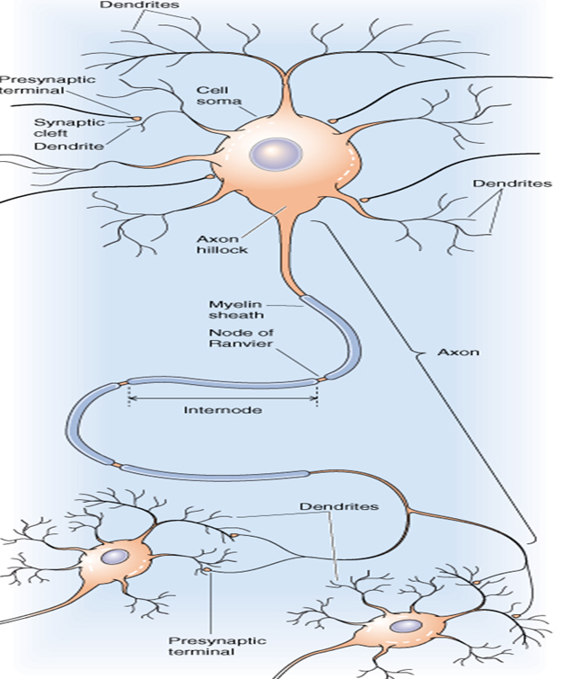
AXON
1.Plasmalemma--axolemma
2.Cytoplasm--axoplasm
(mitochondria,microtubues,
Neurofilaments,)
3, Axon hillock;Origin
4. No rough ER--No protein synthesis
5. Axon terminal
6. Chromatophilic-----
no Nissl body
Notes:
Often branch sparsely, forming collaterals.
Each collateral may split into telodendria which end in a synaptic knob, which contains synaptic vesicles – membranous bags of NTs
refer to the end points of an axon responsible for releasing chemicals to communicate with other neurons
Surrounded by a myelin sheath, a wrapping of lipid which:
Protects the axon and electrically isolates it
Increases the rate of AP transmission
The myelin sheath is made by ________ in the CNS and by _________ in the PNS.
This wrapping is never complete. Interspersed along the axon are gaps where there is no myelin – these are nodes of Ranvier.
In the PNS, the exterior of the Schwann cell surrounding an axon is the neurilemma
In life: soft, elastic, homogeneous (jelly)
Unspecialized cytoplasm (neuroplasm) = axoplasm

Slide 15
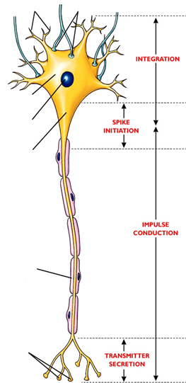
FUNCTIONAL PARTS OF AXON
  1. Processes
  Integration zone
  2.Axon hillock
    1ST portion of the axon plus the region of the cell body fro m which the axon leaves
    Neuron’s trigger zone
    3.Nerve fiber
  Single, elongated tubular extension
  that conducts AP away from the cell
    Conducting zone of the neuron
  4..Collaterals
      Side branches of axon
  5.Axon terminals
    Release chemical messengers other cells with which they come into close
    Output zone of the neuron

Slide 16
REFLEX = reflection
is an involuntary, immediate, automatic and
stereotyped response to a specific sensory stimulation.

Slide 17
Classification
CLINICAL
PHYSIOLOGICAL
NUMBER OF SYNAPSES
SITE
ANATOMICAL
DEVELOPMENT
FUNCTIONAL
ON PURPOSES
RESPONSE IS CONFINED
DEPENDING ON THE PART INVOLVED
CHARACTER OF THE RESPONSE
OTHER REFLEXES
Notes:
1. CLINICAL
SUPERFICAL REFLEX
2. DEEP REFLEX
3. VISERAL REFLEX
4. PATHOLOGICAL REFLEX
2.PHYSIOLOGICAL
1. FLEXORS REFLEXES
2. EXTENSORS REFLEXES
3.ANATOMICAL/ACCORDING TO DESTINATION OF INTERNEURON IN THE SPINAL CORD
1.segmental reflex
2.Intrasegmental reflex -
3.Intersegmental reflex-
4. Supra-segmental reflex
According to the Location of the Receptor
(1) Superficial Reflexes :
The receptor is in the skin ( cutaneous receptor)
(2) Deep reflexes : The receptor is located in muscle or tendon
a) Stretch Reflexes (Tendon jerks)
b) Inverse Stretch Reflex ( Golgi Tendon Organ)
5.NUMBER OF SYNAPSES 1.MONOSYNAPTIC QUICKER
2 .POLYSYNAPTIC SLOWER
3. A SYNAPTIC REFLEX
( AXON REFLEX)
6.DEVELOPMENT
INBORN (INTRINSIC) REFLEX –
unlearned, unpremeditated, and involuntary;
LEARNED (ACQUIRED) REFLEX –
7.FUNCTIONAL
. Motor reflexes
2. Sensory reflexes
8.ON PURPOSES
PROTECTIVE OR FLEXOR REFLEXES
2.ANTIGRAVITY REFLEXES
3. RIGHTENING REFLEXES
4. CONDITIONAL REFLEXES
5. LOCOMOTOR REFLEXES
9.RESPONSE IS CONFINED TO ONE MUSCLE R MORE
1.SIMPLE RFEFLEXES
2. CO-ORDINATEDE REFLEXES
3. CONVULSIVE REFLEXES
10.DEPENDING ON SITE OF PROCESSING SITE
SPINAL REFLEXES
2. BIULBAR REFLEXES
3. CORTICAL REFLEXES
4. MESENCEPHALIC REFLEXES
DI-ENCEPHALIC REFLEXES
11.CHARACTER OF THE RESPONSE
1.MOTOR REFLEXES
2. SECERTORY REFLEXES
3.VASOMOTOR REFLEXES
PRESENTATION REFLEXES
CROSSED FLEXION REFLEXES
CROSSED EXTENSION REFLEXES
WALKING REFLEXES
HOPPING REFLEXES
GALLOPING REFLEXES.

Slide 18
SIGNIFICANCE
HOMEOSTASIS (autonomic reflexes)
TONE DURING RESTING STATE
TONE DURING TENSE MOTOR ACTIVITY
3. POSTURE
4. EQUILIBRIM
5. EXECUTION OF MOVEMENTS
6. SMOOTHNESS
7. DAMPNESS during resting , walking, running, states
8. ROLE AS PROPRIOCEPTOR( unconcouscious+ concious kinaesthetic sensations)
Notes:
Reflexes maintain homeotasis–
heart rate, breathing rate, bp, digestion.
b. Reflexes also carry out the automatic actions of
swallowing, sneezing, coughing, vomiting.

Slide 19
R-SIM Reflex arc pathway
R
receptor neuron receives the stimuli
2. S
sensory neuron passes the impulse on
3. I
interneuron at the spinal cord processes
4. M
motor neuron acts

Slide 20
Simplified reflex arc
stimulus

Slide 21
Simplified reflex arc
stimulus
receptor

Slide 22
Simplified reflex arc
sensory neurone
stimulus
receptor

Slide 23
Simplified reflex arc
stimulus
sensory neurone
receptor
spinal cord of central nervous system

Slide 24
Simplified reflex arc
stimulus
sensory neurone
receptor
spinal cord of central nervous system
relay neurone

Slide 25
Simplified reflex arc
stimulus
sensory neurone
receptor
spinal cord of central nervous system
relay neurone
motor neurone

Slide 26
Simplified reflex arc
stimulus
sensory neurone
receptor
spinal cord of central nervous system
relay neurone
effector
motor neurone

Slide 27
Simplified reflex arc
stimulus
sensory neurone
receptor
spinal cord of central nervous system
relay neurone
effector
response
motor neurone

Slide 28
Spinal Reflexes
Somatic reflexes mediated by the spinal cord are called spinal reflexes
These reflexes may occur without the involvement of higher brain centers
Additionally, the brain can facilitate or inhibit them

Slide 29
R 3 Inputs to Alpha
Motor Neurons
DRG
(1) Afferent (sensory) neuron
(2) Upper
motor
neurons
(3) Spinal interneuron

Slide 30
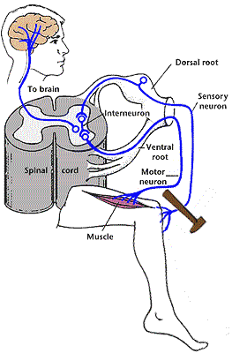
Monosynaptic Reflexes

Slide 31

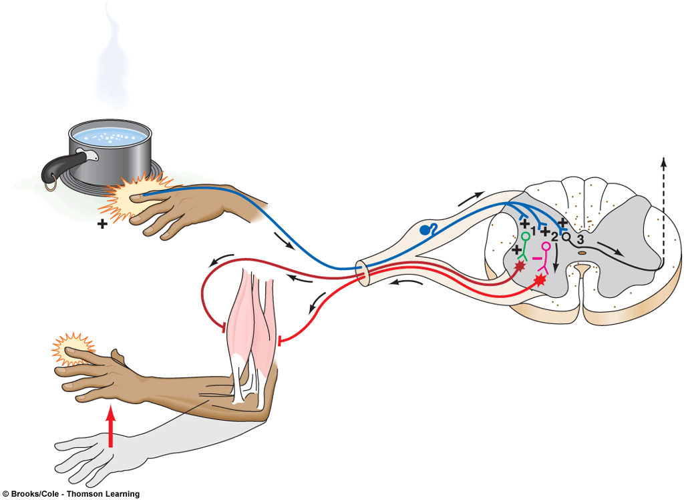
= Inhibitory interneuron
= Excitatory interneuron
= Synapse
= Inhibits
= Stimulates
Thermal
pain receptor
in finger
Ascending pathway
to brain
Afferent
Pathway
Stimulus
Biceps
(flexor)
contracts
Efferent pathway
Triceps
(extensor)
relaxes
Integrating center
(spinal cord)
Hand
withdrawn
Effector
organs
Response

Slide 32
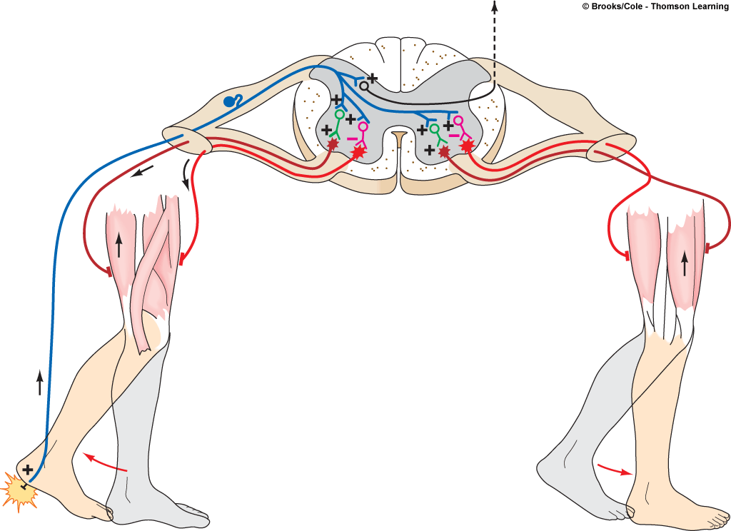
Afferent
pathway
Efferent
pathway
Efferent
pathway
Integrating center
(spinal cord)
Flexor
muscle
contracts
Extensor
muscle
relaxes
Flexor
muscle
relaxes
Extensor
muscle
contracts
Injured
extremity
(effector
organ)
Pain
receptor
in heel
Opposite
extremity
(effector
organ)
Response
Stimulus
Response

Slide 33
UMN lesions
Weakness, paralysis
Spasticity
tendon reflexes
+ve Babinski sign
Little,if muscle atrophy
No fasiculation
LMN lesions
weakness, paralysis
flaccidity, hypotonia
tendon reflexes
-ve Babinski sign
Muscle atrophy
Fasiculation of muscle

Slide 34
UMN v LMN
Cortex
UMN
LMN
Muscle
Flaccidity
Spasticity

Slide 35
Reflex testing
0 = ABSENT
1+ = HYPOREFLEXIA
2+ = NORMAL
3+ = HYPERREFLEXIA
4+ = HYPERREFLEXIA & CLONUS

Slide 36
SPINAL SHOCK
Spinal shock is a state of transient physiological (rather than anatomical) reflex depression of cord function below the level of injury with associated loss of all sensorimotor functions.
An initial increase in blood pressure is noted due to the release of catecholamines, followed by hypotension.

Slide 37
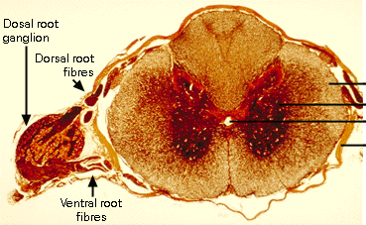
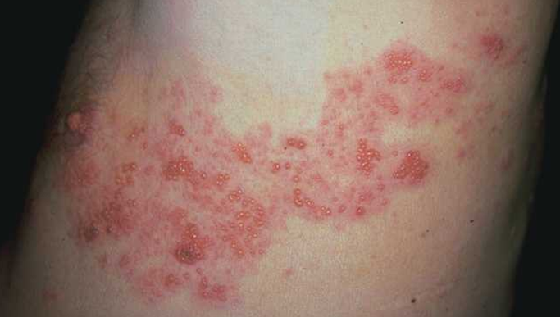
Shingles ( of the herpes family) In dorsal root ganglia and cranial nerves
Initial infection: chicken pox virus
Peripheral Neuropathy
  Regional loss of sensory or motor function
  Due to trauma or compression R metabolic causes

