Slide 1

Copyright © 2012 Pearson Education, Inc. or its affiliate(s). All rights reserved. 800 837 8969

Slide 2
Psychometric Services
Dr. Stefan Bondorowicz
1st April 2014

Slide 3
Agenda
Psychometric Analysis
  Exam-level Analysis
  Item-level Analysis
Standard Setting
Test Administration
Score Reporting

Slide 4
Psychometric Analysis
Exam-level Analysis

Slide 5
Classical Test Theory
Origins in early 20th century individual difference testing
CTT introduces 3 basic measurement concepts:
  Observed score
  True score
  Error score
CTT provides a number of statistics:
  Test reliability
  Item difficulty & discrimination
  Distracter analysis

Slide 6
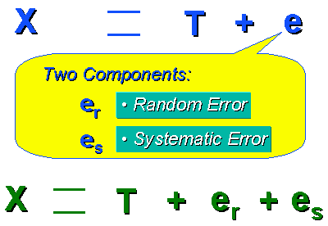
True Score Theory

Slide 7
Test Reliability
Reliability is the extent to which:
  Scores are dependable
  Scores are repeatable for an individual test taker
  Scores are free from error
Reliability coefficients:
  A statistic that reflects the degree to which scores are free of measurement error (Cronbach’s Alpha)
  Ranges from 0 to 1.0
  Good reliability is >.80
Reliability depends on a number of factors:
  Test length
  Test difficulty

Slide 8
Standard Error of Measurement
SEM is an estimate of error to use in interpreting a candidates test score
SEM = s √( 1 – r )
Consider
  Test mean = 100, SD = 12, r = 0.9, cut score 70
  Candidate 1 raw score = 66, 68% CI = 62-70, 95% CI = 58-74
  Candidate 2 raw score = 74, 68% CI = 70-78, 95% CI = 66-82
The higher a tests reliability the smaller the SEM and, therefore, the more confidence can be placed in the candidates observed score

Slide 9
Test Validity
Validity is the extent to which:
  A test measures what it is supposed to measure
  The inferences made from the test scores are meaningful and useful
  The content of the test reflects critical aspects of the job or the profession

Slide 10
Questions?

Slide 11
Psychometric Analysis
Item-level Analysis

Slide 12
Item Analysis
Why analyse items?
Statistical behaviour of ‘bad’ items is fundamentally different from that of ‘good’ items
Provides quality control indicating items which should be reviewed by content experts
Items are good to the extent they ‘discriminate’ amongst candidates
Item scores should correlate positively with overall exam score
High test scorers should choose the correct answer more than low scorers

Slide 13
P-Value, Item Difficulty, Facility Value
Item difficulty is the percentage of the total sample getting item correct
Index ranges between 0 to 1.0
Important because it reveals whether item is too difficult or easy
Optimal average item difficulty depends on examination use and number of distracters
Often recommend to be between 0.6 – 0.75
Below 0.10 and higher than 0.90 item is problematic

Slide 14
Item Difficulty Diagnostics
If difficulty level is too low
  Key is incorrect
  There is more than one correct answer
  Contents is rare or trivial
  Question not clearly stated

Slide 15
Point-biserial, Item-total Correlation
Represented by a correlation coefficient which indicates degree of relationship between performance on the item and performance on the test as a whole.
Point-Biserial correlation most often used
Index range is -1.0 to +1.0
Should be positive indicating that candidates answering correctly tend to have higher scores
Items that are below 0.20 should be reviewed since they are not providing sufficient information about people who do well on the test

Slide 16
Point-biserial Diagnostics
Key is incorrect
More than one key
Item is too difficult and guessing is being used
Item is ambiguous
Item is testing something different from the other items

Slide 17
Index of Discrimination
Difference between the percentage of high scoring students getting item correct and percentage of low scoring students getting it right
Range of values depends on item difficulty
The higher the discrimination index D the better
High group top 27%, low group bottom 27%
 | A | B | C
HG | 30% | 96% | 80%
LG | 10% | 84% | 20%
D | 20 | 12 | 60

Slide 18
Distracter Analysis
High scoring candidates should select the correct option
Low scoring candidates should select randomly from distracters
Look at facility values for each of the distracters

Slide 19
Questions?

Slide 20
Standard Setting

Slide 21
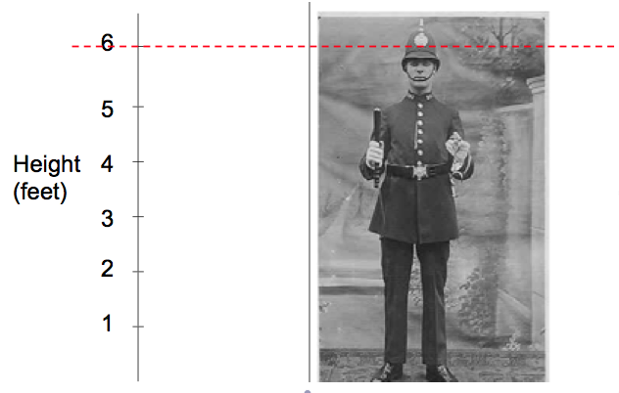
Standard Setting Overview

Slide 22
Standards
Norm-Referenced
  Standard based on group performance
  Fixed: Pass mark is 60
  Relative: 60% of candidates pass
  Arbitrary, subjective, indefensible
Criterion-Referenced
  Standard defined by measure of acceptable performance
  What is acceptable performance is defined by expert judgment
  Content/knowledge based standard
  Leniency/severity of judges affects the standard
  Methodical, objective, defensible

Slide 23
Standards
Licensure/Certification examinations enable the assessment of the knowledge a candidate possesses in a specific content area
A pass/fail decision on an examination enables the separation of competent and incompetent candidates
  Protecting the public
  Passing suitable candidates through to next phase
An understanding of minimal competence is necessary in order to set a standard
A standard is a cut point along a scale ranging from not competent to fully competent

Slide 24
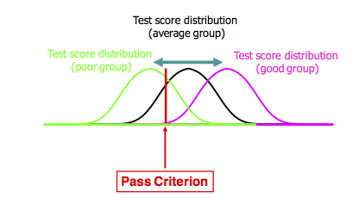

Slide 25
Minimally Competent Candidate
Most criterion-based methods have the concept of a ‘Borderline Candidate’
The MCC is:
  Just barely passing
  Borderline pass
  Minimally competent
  Just over the hypothetical borderline between acceptable and unacceptable performance
Judges need to agree the characteristics of this candidate
Judges need to understand this concept

Slide 26
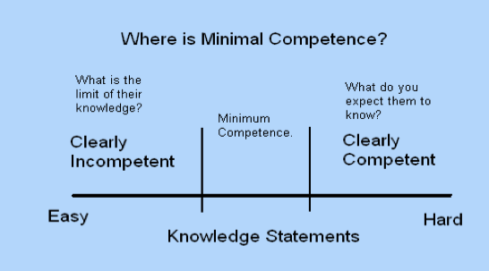

Slide 27
Training for Standard Setting
Select judges
  Must be qualified to decide what level of knowledge measured by the examination is necessary
  All important points of view should be represented on the panel
  Minimum 5+ judges needed
Panel meeting to define borderline knowledge
  Judges must understand what the test measures and how test scores will be used
  Judges describe a person whose knowledge would represent the borderline
  Try to achieve an agreed definition of borderline performance
A statement, with examples, of the standard that the passing score is supposed to represent

Slide 28
Training Reduces Inconsistency
Can be argued that all standard setting is arbitrary
  Standards reflect learning objectives based on value judgments
Need to avoid capricious standard setting in which learning objectives are inconsistently translated into the cut-off score
Three main sources of inconsistency
  Due to different conceptions of mastery
  Inter-judge inconsistency due to different interpretations of learning objectives
  Intra-judge inconsistency with judge using different standards for different items – due to items being perceived differently from the way they actually function

Slide 29
Standard Setting Methods
More than 3 dozen methods
Amongst the better known methods are:
  Angoff
  Bookmark
  Nedelsky
  Ebel
  Jaeger
The “Industry Standards” currently are the Angoff and Bookmark methods

Slide 30
Angoff Procedure
Estimate the percentage of minimally competent candidates who would answer each test item correctly
Two types of judgment are common:
  Probability that any single MCC will answer correctly
  Number out of 100 MCC’s who will answer correctly
The judgment is will a MCC answer correctly not should
Ratings are averaged across judges and the average of these ratings is the cut-score

Slide 31
Angoff Procedure
Typically Angoff judgments are made over multiple rounds
Iterative process allows increasing refinement of judgments
Between rounds information can be provided to judges:
  Consistency of judges ratings
  Impact data -% pass rate with current cut-score
  Difficulty of each item
The passing score arrived at in the final round is the standard for this examination

Slide 32
 | J1 | J2 | J3 | J4
I1 | 40 | 30 | 40 | 50 | 40
I2 | 60 | 40 | 70 | 50 | 55
I3 | 80 | 60 | 70 | 80 | 72.5
I4 | 20 | 40 | 30 | 20 | 27.5
I5 | 40 | 60 | 60 | 50 | 52.5
I6 | 20 | 40 | 40 | 40 | 35
I7 | 70 | 80 | 60 | 60 | 67.5
I8 | 80 | 70 | 60 | 80 | 72.5
I9 | 20 | 20 | 30 | 30 | 25
I10 | 50 | 50 | 60 | 50 | 52.5
 |  |  |  |  | 50

Slide 33
Bookmark Procedure
Item Response Theory analysis is used to position the items on a scale of increasing difficulty
Judges are provided with a booklet consisting of the items arranged from easiest to most difficult
Judge selects the point in the set of items at which they think a MCC will go from getting the items correct to getting the items incorrect

Slide 34
Bookmark Procedure
1st round judges read through the items deciding whether MCC would answer correctly or not and then selects initial bookmark
In subsequent rounds discussion regarding the discrepancies between judges takes place
Through facilitated group discussion the differences between raters is discussed in terms of the knowledge candidates ought to have and the justification for individual bookmark placements
Actual candidate data can be provided
After the final round the cut-score is the average of the bookmark judgments

Slide 35
Standard Setting
Standard Setting is easy
  Fairly mechanical process which most SME’s should be able to understand and master
Standard Setting is hard
  Success depends on training
  Needs an investment of time and resources
Standard Setting is essential
  Vital part of the test development process

Slide 36
Questions?

Slide 37
Test Administration

Slide 38
Test Administration Models
Examination Windows
Administration
  Fixed Form (Linear)
  Linear-on-the-Fly Testing (LOFT)
  Computer Adaptive Testing (CAT)

Slide 39
Examination Windows & Continuous Testing
Single Examination Window
  Candidates can sit examination once a year during a very limited period
Multiple Examination Windows
  Candidates can sit the examination a number of times during the year
Continuous Testing
  Candidates can sit the examination whenever they like

Slide 40
Fixed-Forms (Linear)
Similar to paper test forms.
Same set of test items is administered to candidates receiving same form
Items can be administered randomly
Requires the construction of a limited number of parallel forms containing non-overlapping or partially overlapping item sets
Construction of test forms requires satisfying content and psychometric constraints for each form

Slide 41
Computer-Adaptive Multistage Testing (MST)
MST administers sets of items in modules or testlets
Test taker performance on previous module determines which module is seen next
Test takers receive a tailored examination allowing for increased reliability and decreased test length

Slide 42
Linear-on-the-Fly Testing (LOFT)
LOFT is designed to address item security issues with Linear Forms
Increases security by limiting the exposure of all items
Requires a large, calibrated, item bank to construct individual test forms for each candidate
A fixed-length test is constructed for each candidate at the beginning of the testing session
Items are selected to satisfy both content and psychometric constraints

Slide 43
Computer Adaptive Testing (CAT)
Items which are too easy/difficult contribute little information about ability
As candidate takes a CAT an estimate of ability is continually estimated based on response to all previous items
An algorithm selects the next ‘best’ item given test specification and current estimate of candidate ability
Items too hard or too easy will not be seen
CAT enables shorter tests, greater reliability, and greater test security

Slide 44
Questions?

Slide 45
Score Reporting

Slide 46
Raw Score
The number of correct answers or the sum of the points earned on each item
Are of limited value on all but the simplest of examinations
Raw scores cannot be compared across examinations
Slight differences in the difficulty of exam forms means raw scores can not be used to compare performance across forms

Slide 47
Percent-Correct Scores
Raw score divided by the number of points possible on the examination
Expresses exam performance on a scale which is independent of the number of questions
Equivalent percent-correct scores across different examination forms probably don’t represent equivalent levels of ability

Slide 48
Scale Scores
Raw scores are normally scaled
  Compare scores of candidates across forms
  Compare scores across years
  Given score indicates same level of knowledge no matter which form or year
  Scale scores are adjusted to compensate for differences in question difficulty
  The easier the questions the more correct answers needed to achieve a particular scale score
  Each test form has its own raw-to-scale score conversion

Slide 49
Score Reporting
Scale used is a fairly arbitrary decision
  Should be clear that score is not number correct
  Should be clear that score is not percent correct
  Minimum score should not be 0
  Scale should not be 0 – 100
If there is a passing standard then scale can be chosen so that the cut score is a particular number
  This number will be consistent across forms and time
  Interpretation of exam performance can be made from the score no matter when the exam was taken or which exam form was administered

Slide 50
Test Equating
It should be a matter of indifference to candidates of every ability level as to which form they are administered
Test equating is the statistical process of determining comparable scores on different forms of an exam
Establishing equivalent scores on different forms of a test is called horizontal equating
To determine equivalent scores on different levels of a test is called vertical equating

Slide 51
Approaches To Equating
Mean Equating
  adjusts the distribution of scores so that the mean of one form is comparable to the mean of the other form
Linear Equating
  adjusts so that two forms have comparable means and standard deviations
Equipercentile Equating
  The equating relationship is one where a score on one form is equal to a score on another form when they have an equivalent percentile on either form

Slide 52
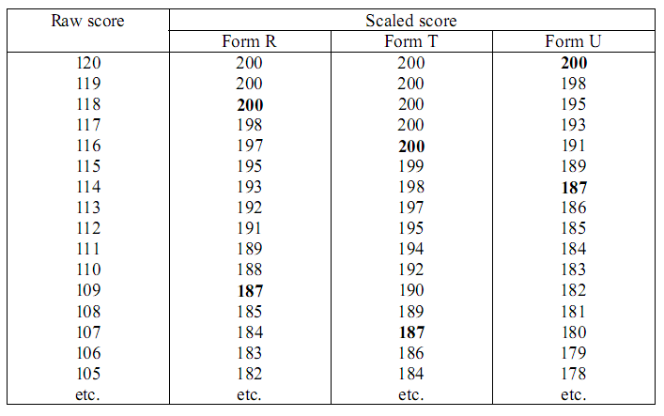
Raw-to-Scale Conversion Table

Slide 53
Questions?

