Slide 2
Presynaptic
Axon Terminal
Postsynaptic
Membrane
Terminal
Button
Dendritic
Spine

Slide 3
(1) Precursor
Transport

Slide 4
(2) Synthesis
enzymes/cofactors
_
_
_
NT

Slide 5
(3) Storage
in vesicles

Slide 6
NT
Terminal
Button
Dendritic
Spine
Synapse
Vesicles

Slide 7
(4) Release
Terminal
Button
Dendritic
Spine
Synapse
Receptors

Slide 8
Terminal
Button
Dendritic
Spine
AP
Synapse

Slide 9
Exocytosis
Ca²⁺

Slide 10
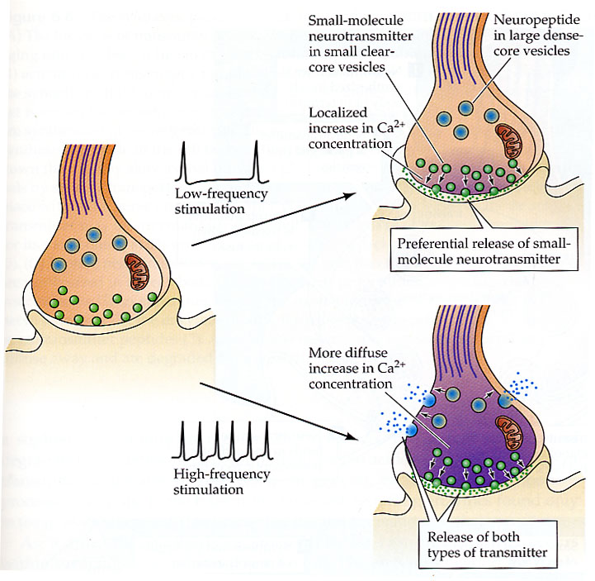

Slide 11
(5) Activation

Slide 12
Quantum release
Each vesicle contains one quanta of neurotransmitter (approximately 5000 molecules) – quanta release
Notes:
Each vesicle contains one quanta of neurotransmitter (approximately 5000 molecules) – quanta release

Slide 13
(3) Transmitter Inactivation
Reuptake by presynaptic terminal
Uptake by glial cells
Enzymatic degradation
Presynaptic receptor
Diffusion
Combination of above

Slide 14
(6) Termination

Slide 15
(1) Termination by...
Diffusion

Slide 16
(2) Termination by...
Enzymatic degradation

Slide 17
(3) Termination by...
Reuptake by presynaptic terminal
Uptake by glial cells

Slide 18
(4) Termination by...
Autoreceptors
A

Slide 19
2. Receptor Activation
NS uses 40 families , act on 100 types of receptors; cause EPSPs and IPSPs,
Neuromodulators cause, via 2nd messengers, more complex metabolic effects in the PSM.
Ionotropic channel
directly controls channel
fast
Metabotropic channel
second messenger systems
receptor indirectly controls channel ~
Notes:
The mammalian nervous system uses dozens of different neurotransmitters that act on more than 100 types of receptors; these receptors stimulate numerous second-messenger systems, which in turn regulate several dozen ion channels and enzymes
Synapse is excitatory or inhibitory
NE is excitatory at some synapses, inhibitory at others
Transmitter binding activates ion channel directly or indirectly.
Directly
ionotropic receptors
fast
Indirectly
metabotropic receptors
G-protein coupled
Slow
In general, neurotransmitters cause EPSPs and IPSPs,
and neuromodulators cause, via second messengers,
more complex metabolic effects in the postsynaptic
cell.

Slide 20
(1) Ionotropic Channels
Channel
NT
neurotransmitter

Slide 21
Ionotropic Channels
NT
Pore

Slide 22
Ionotropic Channels
NT

Slide 23
Ionotropic Channels
NT

Slide 24
G protein: Protein Phosphorylation
external signal: nt
external signal: NT
norepinephrine
Receptor
Receptor
β adrenergic -R
trans-
ducer
trans-
ducer
primary
effector
primary
effector
G_{S}
adenylyl
cyclase
2d messenger
2d messenger
cAMP
secondary effector
secondary effector
protein kinase

Slide 25
G protein: Protein Phosphorylation
A
C
R
G
GDP
PK

Slide 26
G protein: Protein Phosphorylation
A
C
R
G
ATP
GTP
cAMP
PK

Slide 27
G protein: Protein Phosphorylation
A
C
R
G
ATP
GTP
P
cAMP
PK
Pore

