Slide 1
ADRENERGIC SYSTEM
BY DR QAZI

Slide 2
OBJECTIVES
1. Know anatomical organization of ANS.
2. Discuss the synthesis, storage, release,
actions and degradation of adrenergic
3. Explain adrenergic transmission
4. Discuss adrenergic receptors

Slide 3
Division
divided and viewed 3 different ways:
1 . Anatomically/Morphological
2. Chemically/Pharmacolgical
3.Functional/physiological
Notes:
The Adrenergic NS derives it’s name form the word adrenalin

Slide 4
ADRENERGIC
1. THORACO-LUMBAR
2.ADRENERGIC,NON-ADRENERGIC
3.NERVOUS SYSTEM OF TODAY
4.CATABOLIC SYSTEM
5.ERGOTROPIC SYSTEM
6. “E” division exercise,excitement, emergency,embarrassment
Notes:
ERGO= WORK, HENCE ENERGY TROPIC =RELEASING, CANNON 1920 ,

Slide 5
Cell-bodies
Preganglionic neurons originate in thoracic + lumbar levels of the spinal cord (T1-L2).
inter­mediolateral horn
5000 cell bodies
(lamina VII)
Tracts Desend From Above
Notes:
5000 cell bodies in lateral horn INTERMEDIOLATERAL HORN, C 8,T1 to L2. fibers which comprise the sympathetic system originate in the inter­mediolateral horn (lamina VII)

Slide 6
Sympathetic Pathways
Axons leave the sympathetic trunk in 5 possible ways:
spinal nerves
Perivascular plexus i.e along blood vessel, e.g. internal carotid artery.
3. sympathetic nerves straight to the target organ.e.g.e heart.
4. splanchnic nerves
5. Adrenal Medulla Pathway
Notes:
Travel along the spinal nerves.
2.Travel along the blood vessel, e.g. internal carotid artery.
3.Travel straight to the target organ.e.g. fibers to the heart.
Perivascular plexus
- Sympathetic : postganglionic
sympathetic fibers AS SYM; NERVES—VISERAL ORGANS, SPINAL NERVE PARTS GO TO VISERAL EFFECTOR PARTS
-Parasympathetic : preganglionic
parasympathetic fibers
- Sensory fibers

Slide 7
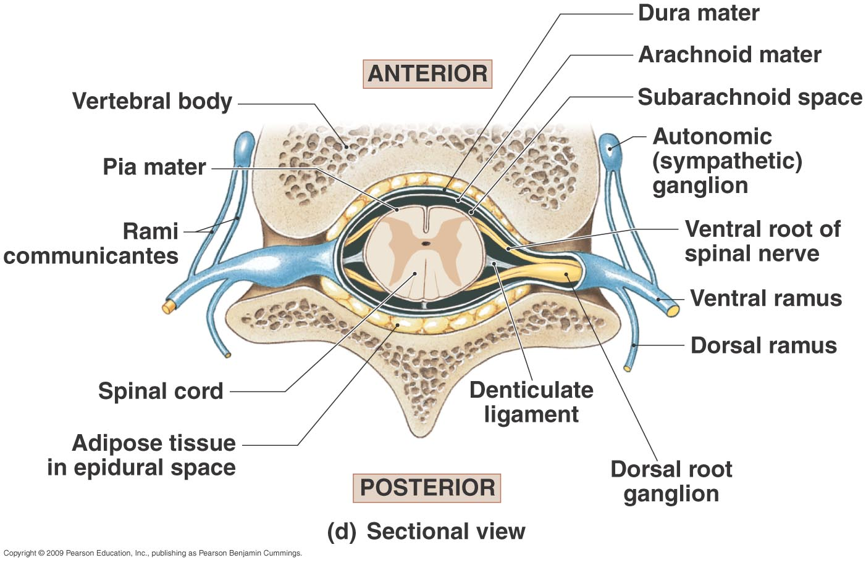
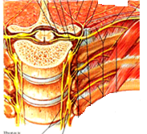
Notes:
SPINAL NERVE Dorsal rami serves post; trunk ---muscles and skin
Ventral rami servs as plexuses to the anterior

Slide 8
Notes:
Sympathetic trunk ganglia: 3 cervical, 11 or 12 thoracic, 4 or 5 lumbar, 4 or 5 sacral and 1 coccygeal.
Postganglionic neurons from the
superior cervical region-head and heart.
middle cervical ganglion and the inferior cervical ganglion-heart.
Thoracic sympathetic trunk- heart, lungs, and bronchi.

Slide 9
Sympathetic Pathways
Axons leave the sympathetic trunk in 5 possible ways:
spinal nerves
Perivascular plexus i.e along blood vessel, e.g. internal carotid artery.
3. sympathetic nerves straight to the target organ.e.g.e heart.
4. splanchnic nerves
5. Adrenal Medulla Pathway
Notes:
Travel along the spinal nerves.
2.Travel along the blood vessel, e.g. internal carotid artery.
3.Travel straight to the target organ.e.g. fibers to the heart.
Perivascular plexus
- Sympathetic : postganglionic
sympathetic fibers AS SYM; NERVES—VISERAL ORGANS, SPINAL NERVE PARTS GO TO VISERAL EFFECTOR PARTS
-Parasympathetic : preganglionic
parasympathetic fibers
- Sensory fibers

Slide 10
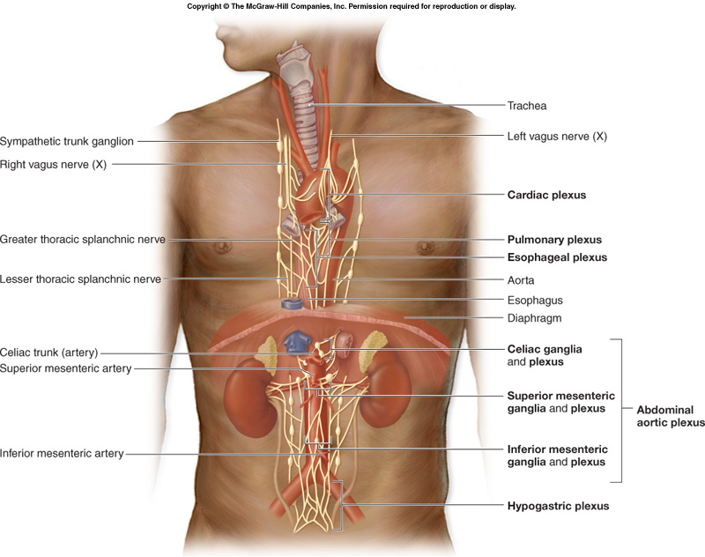
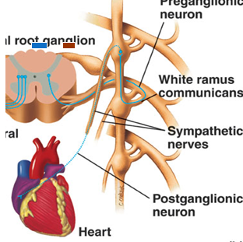

Slide 11
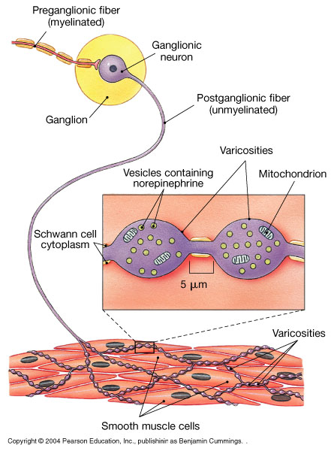
Sympathetic Variosities are long 1:25,000 effector cells; cleft ∼50 nm across
Notes:
Synapses of the ANS are specialized for their function. Rather than possessing synaptic terminals that are typical of somatic motor axons, many postganglionic autonomic neurons have bulbous expansions, or varicosities, that are distributed along their axons within their target organ It was once believed that these varicosities indicated that neurotransmitter release sites of the ANS did not form close contact with end organs and that neurotransmitters needed to diffuse long distances across the extracellular space to reach their targets. However, we now recognize that many varicosities form synapses with their targets, with a synaptic cleft extending ∼50 nm across. At each varicosity, autonomic axons form an "en passant" synapse with their end-organ target. This arrangement results in an increase in the number of targets that a single axonal branch can influence, with wider distribution of autonomic output

Slide 12
CATECHOLAMINES
1. Norepinephrine (ne) 1904
2. Dopamine
3. Epinephrine (e)
4.Indolamines = histamine + serotonin
all contain a catechol ring 6 carbon ring with 2 OH groups
+an amine group;
Resting rate secretion
– E: 0.2ug/kg/min,– NE: 0.05ug/kg/min
SMOOTH+CARDIAC MUSCLE+ GLANDS i.e SWEAT GLANDS, NEURONES =N.S
Notes:
Low level of ne/e no pathelogical effect
Adrenal ne/e non-essential for life
High --- high bp
Tumours release both ne/e. may also dopamine
Produce*x500 times E
CAN BE FOUND ANY WERE—
Ratio of ne to e
Human10;1
Cats it is equal
Whalees it is 90to100% ne; ratio changes with age----no E at early evelopment
1year equal amounts of NE & E
E/NE INCREASE thereafter ne levels r>28% day,75% night the aging effect of age may be related with sympathetic activity,

Slide 13
BIOSYNTHESIS
Phenylalanine (amino acid from diet)
phenylalanine hydroxylase
Tyrosine
tyrosine hydroxylase (RLS)
3,4 Dihydroxyphenylalanine (L-DOPA)
aromatic-L-Amino Acid decarboxylase
Dopamine
dopamine β hydroxylase
Norepinephrine
Phenylethanol-amine N-methyl-transferase
adrenal gland
Epinephrine
Notes:
Precursors of catecholamines
Phenylalanine – essential amino acid Must be obtained from diet Phenylalanine hydroxylase –􀂄 Found in liver and nerves Phenylketonuria – deficiency of the enzyme found in 1 out of 200 humans
Tyrosine – amino acid Not essential because most people can synthesize this from phenylalanine regulated by preggl. neurons and intracellular catecholamine levels:
- acute ↑ in the activity of preexisting enzyme by PKA, PKC and CaM-kinases - long-term stimulation by upregulating TH expression catecholamines suppress TH
Activity Tyrosine hydroxylase
Present in adrenal medulla, brain, and all sympathetically innervated tissues, WITHEN MITOCHONDRIA Rate-limiting enzyme
Activated by phosphorylation Converts tyrosine into 3,4-dihydroxyphenylalanine (DOPA)
DOPA decarboxylase ( CYTOPLASM)

Slide 14
BIOSYNTHETIC PATHWAY FOR NE
CH₂
CH
NH₂
PHENYLALANINE
COOH
PHENYLALANINE HYDROXYLASE
HO
CH₂
CH
NH₂
TYROSINE
COOH
TYROSINE HYDROXYLASE I t is irreversible reaction.
HO
HO
CH₂
CH
NH₂
3,4-DYHYDROXYPHENYLALANINE (L-DOPA)
COOH
AROMATIC-L- AMINO ACID DECARBOXYLASE
deficiency of this enzyme can cause Parkinson’s disease
HO
DOPAMINE (DIHYDROXYPHENYL-ETHYLAMINE)
HO
CH₂
CH₂
NH₂
dopamine β- hydroxylase. O₂ and vit C
Notes:
1) First Step: Hydroxylation:
In this step: the reaction involves the conversion of tyrosine, oxygen and tetrahydrobiopterin to dopa & dihydrobiopterin. This reaction is catalyzed by the enzyme tyrosine hydroxylase. It is irreversible reaction.
2) Second step: Decarboxylation:
In this step: the dopa decaboxylase will catalyze the decaoxylation of dopa to produce dopamine. The deficiency of this enzyme can cause Parkinson’s disease. It is irreversible reaction. The cofactor in this reaction is the PLP (pyridoxal phosphate). In the nerve cells that secrete dopamine as neurotransmitter the pathway ends at this step.
3) Third step: Hydroxylation:
This reaction is catalyzed by the enzyme dopamine β- hydroxylase. The reactants include dopamine, O₂ and ascorbate (vitamin C). The products are norepinephrine, water and dehydroascorbate. It is an irreversible reaction). The end product in noradrenergic cells is norepinephrine and the pathway ends her.
4) Forth step: Methylation:
This reaction is catalyzed by phenylethanolamine N-methyltransferase. Norepinephrine and S-adenosylmethionin (ado-Met) form epinephrine and S-adenosyl homocysteine (ado-Hcy).

Slide 15
Metabolism of catecholamines
1. Synaptic cleft:
reuptake into the axon terminals
re-enter secretory vesicles
degraded by MAO
2. Degradation by the target cells: by COMT
3. Degradation by the liver: by COMT and/or MAO
4. major metabolites excreted in urine is VMA (Vanillyl mandelic acid)(2-10%)
Notes:
METABOLISM : by two enzyme systems – MAO and COMT.
NE after uptake -1 into the axoplasm is acted upon by MAO.
NE which diffuses into the circulation is acted upon by COMT, mainly in the liver
The major metabolites excreted in urine is VMA (Vanillyl mandelic acid)

Slide 16
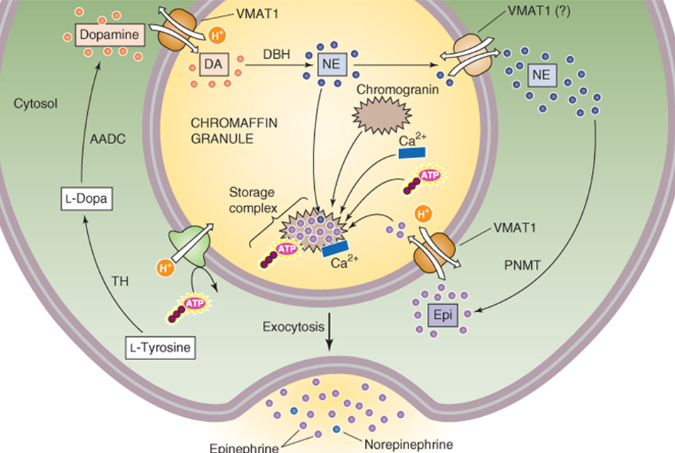
Notes:
CA are stored+fills in vesicles prior to release by VMAT: vesicle monoamine transporter protein
2. Active transport processes keep high concentrations of CA inside the vesicles,inhibited by reserpine
3. vesicles contain CA bound to ATP and chromogranin A (49-kD protein), Dopamine β-hydroxylase
4 in some neurons,VMAT can secrete small amounts of CA from neurons

Slide 17
ADRENERGIC TRANSMISSION
RELEASE :
The release of CA takes by exocytosis .
Indirectly acting amines (tyramine and amphetamine) induce the release of NE by displacing it from the nerve endings.

Slide 18
Levels of Adrenaline
Basal Level — 25-50 pg/mL
Hypoglycemia — 250 pg/mL
Diabetic Ketoacidosis — 500 pg/mL
Severe Hypoglycemia — 1500 pg/mL

Slide 19
Catecholamines
autoreceptor: cell surface receptor on the same
neuron secreting the
CA (autocrine signaling pathway) stimulated at the same time as the paracrine receptor
During initiation of release—NE Low; conc. in cleft ↑s release process (+ive feedback) whereas conc. of NE presynaptically stimulates α-receptors which terminate its secretion(-ive feedback)
Notes:
Uptake 1 is an active energy requiring temperature dependent process that can be inhibited.
Extraneuronal uptake (uptake 2) is a minor pathway for inactivation of NE and NE that is taken up by the extraneuronal tissue is metabolized by MAO and COMT to form VMA.
The importance of uptake 1 & uptake 2 is diminished when sympathomimetics are given exogenously, uptake 3 is the predominant pathway for catecholamines given exogenously and is clinically important. The uptake 3 is slow metabolism.

Slide 20
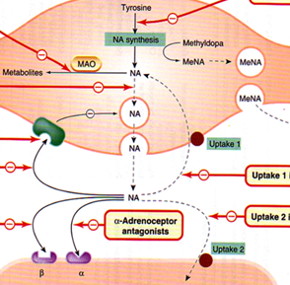

Slide 21
Adrenergic System
MAO
MAO –A present in the nerves /intestine/ liver or Anywhere
Metabolizes NE, 5-HT and tyramine
MAO – B
Present mainly in the Brain
Metabolizes preferentially dopamine

Slide 22
Termination
Terminated by reuptake into neurons or glia (50%-80%) ,breakdown by monoamine oxidase (MAO)
By-products are metabolized and excreted (not recycled)
NE is broken down into vanillylmandelic acid (VMA)+MHPG(methoxy-4-hydroxyphenylglycol )–
index of NE activity
DA broken into homovanillic acid (HVA) – index of DA activity
Notes:
Activity terminated primarily by reuptake into neurons or glia
Following reuptake, breakdown inside neurons (or glia) is by monoamine oxidase (MAO)
By-products are metabolized and excreted (not recycled)
NE is broken down into vanillylmandelic acid (VMA) and MHPG – index of NE activity
DA broken into homovanillic acid (HVA) – index of DA activity
Also some NE and DA broken down in synaptic space by catechol-o-methyl-transferease (COMT)
Axonal uptake (Uptake 1 ) : Transports NE at a higher rate than E.
Cocaine, Imipramine inhibits this uptake 1.
UPTAKE 2 (extra neuronal uptake) : CA are taken into other tissues.

Slide 23
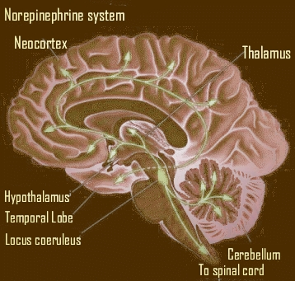
Notes:
Most NE releasing neurons are unmyelinated 2 pathways from brainstem
1. From locus coeruleus to multiple subcortical and cortical sites
Locus coeruleus – large cluster of neurons at core of pons – 12000 on each side that send axons over broad network
Project to hippocampus, thalamus, hypothalamus, olfactory bulb, cerebellum, cerebral cortex Mostly act at beta adrenergic receptors – inhibitory
Inhibit background discharge rates of multiple neurons in above areas, especially cortex – causes global orientation to stimuli; positive feelings of emotion; involved in basic drive states (hunger (suppression); thirst; sex)

Slide 24
Epinephrine
Role in brain is poorly understood
E appears to modulate NE in certain locations
Adrenal medulla secretes E+ NE during stress or emotional arousal (fear; anger)
E+ NE act as hormones (travel in blood to sites of action)
E important in blood pressure regulation, coordination of eating and visceral activities
Notes:
Low level of ne/e no pathelogical effect Adrenal ne/e non-essential for life
High --- high bp Tumours release both ne/e. may also dopamine
Produce*x500 times E CAN BE FOUND ANY WERE—Ratio of ne to e Human10;1
Cats it is equal Whales it is 90to100% ne; ratio changes with age----no E at early Development 1year equal amounts of NE & E
E/NE INCREASE thereafter ne levels r>28% day,75% night the aging effect of age may be related with sympathetic activity,

Slide 25
use more than a 1 NT.=COTRANSMISSION common in synapses -the ANS.
As many as 8 different NT may be found within some
neurons, known as co-localization
NT are controlled by neuronal firing frequency: medullary
raphe neurons project lateral horn( spinal cord), where
they co-release 5-HT, TRH, and substance P onto SNS
at low firing rates, 5-HT is released alone;
at intermediate firing rates, TRH is also released;
at high firing rates, all 3 NT released.
enhancing the versatility of the ANS.
Notes:
More recently, it has become evident that some neurotransmission in the ANS involves neither adrenergic nor cholinergic pathways. Moreover, many neuronal synapses use more than a single neurotransmitter. Such cotransmission is now known to be common in the ANS. As many as eight different neurotransmitters may be found within some neurons, a phenomenon known as co-localization (see Table 13-1). Thus, ACh and norepinephrine play important but not exclusive roles in autonomic control. Sir Henry H. Dale Body_ID: P014046 The distribution and function of nonadrenergic, noncholinergic transmitters are only partially understood. However, these transmitters are found at every level of autonomic control (Table 14-3), where they can cause a wide range of postsynaptic responses. These nonclassic transmitters may cause slow synaptic potentials or may modulate the response to other inputs (as in the case of the M current) without having obvious direct effects. In other cases, nonclassic transmitters have no known effects and may be acting in ways that have not been determined. Body_ID: P014047 Although co-localization of neurotransmitters is recognized as a common property of neurons, it is not clear what controls the release of each of the many neurotransmitters. In some cases, the proportion of neurotransmitters released depends on the level of neuronal activity (see Chapter 13). For example, medullary raphe neurons project to the intermediolateral cell column in the spinal cord, where they co-release serotonin, thyrotropin-releasing hormone, and substance P onto sympathetic preganglionic neurons. The proportions of released neurotransmitters are controlled by neuronal firing frequency: at low firing rates, 5-hydroxytryptamine is released alone; at intermediate firing rates, thyrotropin-releasing hormone is also released; and at high firing rates, all three neurotransmitters are released. This frequency-dependent modulation of synaptic transmission provides a mechanism for enhancing the versatility of the ANS. Body_ID: P014048 Two of the Most Unusual Nonclassic Neurotransmitters, Adenosine Triphosphate and Nitric Oxide, Were First Identified in the Autonomic Nervous System Body_ID: HC014021 page 361 page 362 Body_ID: P0362 Body_ID: P014050 Body_ID: F014009 Figure 14-9 Dual nicotinic and muscarinic neurotransmission between sympathetic preganglionic and postganglionic neurons. A, Stimulation of a frog preganglionic sympathetic neuron releases ACh, which triggers a fast EPSP (due to activation of nicotinic receptors on the postganglionic sympathetic neuron), followed by a slow EPSP (due to activation of muscarinic receptors on the postganglionic neuron). B, The M current (mediated by a K⁺ channel) normally hyperpolarizes this rat sympathetic postganglionic neuron, thereby inhibiting trains of action potentials. Thus, injection of current elicits only a single action potential. C, In the same experiment as that in B, the addition of muscarine stimulates a muscarinic receptor (i.e., GPCR) and triggers a signal transduction cascade that blocks the M current. One result is a steady-state depolarization of the cell. In addition, injection of current now elicits a train of action potentials.It was not until the 1970s that a nonadrenergic, noncholinergic class of sympathetic or parasympathetic neurons was first proposed by Geoffrey Burnstock and colleagues, who suggested that adenosine triphosphate (ATP) might act as the neurotransmitter. This idea, that a molecule used as an intracellular energy substrate could also be a synaptic transmitter, was initially difficult to prove. However, it is now clear that neurons use a variety of classes of molecules for intercellular communication (see Chapter 13). Two of the most surprising examples of nonclassic transmitters, nitric oxide (NO) and ATP, were first identified and studied as neurotransmitters in the ANS, but they are now known to be more widely used throughout the nervous system CNS Neurons Preganglionic Autonomic Postganglionic Autonomic Visceral Afferent Ganglion Interneurons Enteric Neurons Body_ID: T014003.50 Acetylcholine X X Body_ID: T014003.100 Monoamines Body_ID: T014003.150 Norepinephrine X X X Body_ID: T014003.200 Epinephrine Body_ID: T014003.250 5-Hydroxytryptamine X X Body_ID: T014003.300 Dopamine X X Body_ID: T014003.350 Amino acids Body_ID: T014003.400 Glutamate X Body_ID: T014003.450 Glycine X Body_ID: T014003.500 GABA X Body_ID: T014003.550 Neuropeptides Body_ID: T014003.600 Substance P X X X X X Body_ID: T014003.650 Thyrotropin-releasing hormone X X X Body_ID: T014003.700 Enkephalins X X Body_ID: T014003.750 Neuropeptide Y X X X Body_ID: T014003.800 Neurotensin X X Body_ID: T014003.850 Neurophysin II X X Body_ID: T014003.900 Oxytocin X X Body_ID: T014003.950 Somatostatin X X X Body_ID: T014003.1000 Calcitonin gene-related peptide X Body_ID: T014003.1050 Galanin X X X Body_ID: T014003.1100 Vasoactive intestinal polypeptide X X Body_ID: T014003.1150 Opioids? X X Body_ID: T014003.1200 Tachykinins (substance P, neurokinin A, neuropeptide K, neuropeptide γ) Body_ID: T014003.1250 Cholecystokinin Body_ID: T014003.1300 Gastrin-releasing peptide Body_ID: T014003.1350 Dynorphin Body_ID: T014003.1400 Nonclassical X X Body_ID: T014003.1450 Nitric oxide X X Body_ID: T014003.1500 ATP None ATP is co-localized with norepinephrine in postganglionic sympathetic vasoconstrictor neurons. It is contained in synaptic vesicles, is released on electrical stimulation, and induces vascular constriction when it is applied directly to vascular smooth muscle. The effect of ATP results from activation of P₂ purinoceptors on smooth muscle, which include ligand-gated ion channels (P_{2X}) and GPCRs (P_{2Y} and P_{2U}). P_{2X} receptors are present on autonomic neurons and smooth muscle cells of blood vessels, the urinary bladder, and other visceral targets. P_{2X} receptor channels have a relatively high Ca²⁺ permeability (see Chapter 13). In smooth muscle, ATP-induced depolarization can also activate voltage-gated Ca²⁺ channels (see Chapter 7) and thus lead to an elevation in [Ca²⁺]_{i} and a rapid phase of contraction (Fig. 14-10). Norepinephrine, by binding to α₁-adrenergic receptors, acts through a heterotrimeric G protein (see Chapter 3) to facilitate the release of Ca²⁺ from intracellular stores and thereby produce a slower phase of contraction. Finally, the release of neuropeptide Y may, after prolonged and intense stimulation, elicit a third component of contraction. Body_ID: P014051 Nitric Oxide Body_ID: HC014023 In the 1970s, it was also discovered that the vascular endothelium produces a substance that induces relaxation of vascular smooth muscle. First called endothelium-derived relaxation factor, it was identified as the free radical NO in 1987. NO is an unusual molecule for intercellular communication because it is a short-lived gas. It is produced locally from l-arginine by the enzyme nitric oxide synthase (NOS; see Chapter 3). The NO then diffuses a short distance to a neighboring cell, where its effects are primarily mediated by the activation of guanylyl cyclase. Body_ID: P014052 NOS is found in the preganglionic and postganglionic neurons of both the sympathetic and parasympathetic divisions as well as in vascular endothelial cells. It is not specific for any type of neuron inasmuch as it is found in both norepinephrine- and ACh-containing cells as well as in neurons containing a variety of neuropeptides. Figure 14-11 shows how a parasympathetic neuron may simultaneously release NO, ACh, and vasoactive intestinal polypeptide, each acting in concert to lower [Ca²⁺]_{i} and to relax vascular smooth muscle. Why NO is so ubiquitous and when its release is important are not known. However, evidence now indicates that abnormalities of the NO system are involved in the pathophysiological processes of adult respiratory distress syndrome, high-altitude pulmonary edema, stroke, and other diseases. Understanding of its physiological and pathophysiological roles has led to the introduction of clinical treatments that modulate the NO system. Examples

Slide 26
Co-localization NT Peptides
1.Acetylcholine
Enkephalin
VIP
CGRP
Substance P
Somatostatin
GRH
Neurotensin
Galanin
Notes:
ID: T013001.100 Body_ID: T013001.150 Body_ID: T013001.200 GABA Cholecystokinin Enkephalin Somatostatin Neuropeptide Y Substance P Vasoactive intestinal polypeptide Body_ID: T013001.250 Glutamate Substance P Body_ID: T013001.300 Glycine Neurotensin Body_ID: T013001.350 Body_ID: T013001.400 Serotonin Cholecystokinin Enkephalin

Slide 27
2.Dopamine 1. Cholecystokinin 2.Enkephalin 3. Neurotensin
3.Epinephrine
4.Norepinephrine
1. Enkephalin 2.Neuropeptide Y 3.Neurotensin 4.Substance P
1. Enkephalin 2.Neuropeptide Y 3.Neurotensin 4.Somatostatin 5.Vasopressin

Slide 28
Exceptions in the SNS:
Skin;-Postganglionic neurons involved with stress-related excretion release norepinephrine (“sweaty palms”)
2. Hypothalamus;-Postganglionic neurons involved with thermoregulation release acetylcholine
3. Kidney Postganglionic neurons to the smooth muscle of the renal vascular bed release dopamine
4. Adrenal gland:Preganglionic neurons synapse directly on the adrenal gland, release acetylcholine, and activate nicotinic receptors on the adrenal gland
Notes:
Sweat glands:
Postganglionic neurons involved with stress-related excretion release norepinephrine (“sweaty palms”)
Postganglionic neurons involved with thermoregulation release acetylcholine
Kidneys:
Postganglionic neurons to the smooth muscle of the renal vascular bed release dopamine
Adrenal gland:
Preganglionic neurons do not synapse in the paraverterbral sympathetic ganglion
Preganglionic neurons synapse directly on the adrenal gland, release acetylcholine, and activate nicotinic receptors on the adrenal gland
Adrenal glands release epinephrine into systemic circulation

Slide 29
Basal ganglia
Rapne nuclei
Neocortex
Neocortex,
Hypothalamus,
Cerebellum,
Locus coeruleus
Amygdala
thalamus
Prefrontal area
Ventral tegmental area
Substantia nigra
Basal ganlia
Notes:
Neocortex,
Hypothalamus,
Cerebellum,
Locus cere

Slide 30
Drugs mostly act on the nervous system by interacting with NT.
cause the same effect as a transmitter: agonism
block a receptor site: antagonism
decreasing activity of enzymes that destroy a NT.
block reuptake mechanisms
blocking ion channels
altering release of transmitter altering the action of NT

Slide 31
NEUROTRANSMITTERS & DISEASE
Ach mysthesia Gravia, Alzheimer’s disease
Dopamine Parkinson’s Disease
Serotonin Depression
Glutamate stroke

Slide 32
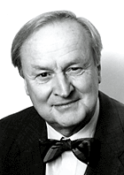
Arvid Carlsson
Nobel Prize
(2000)
Dopamine–
basal ganglia,
limbic system,
CTZ and anterior pituitary
D1, D2, D3, D4, D5
Receptors
Notes:
Dopaminergic synapses:
Striatum: Motor behavior (PD)
Nucleus Accumbuns: Reward-Pleasure
Mesolimbic/mesocortical: affect, emotions, motivation
(Schizophrenia)
Hypothalamus: Release of hormones

Slide 33
CLASSIFICATION of Adrenergic Receptors
α+ β
Each type has two or three subclasses α₁,A, B ,D
α₂, A,B,C
β₁,
β₂ ,
β_{3,}

Slide 34
SNS Receptors
1. α1 - contraction smooth muscle,
2. α2 - ↓ secretions (salivary glands)+ Regulating NT release in SNS+CNS
3. β1 - Increases cardiac output+ Renin release from juxtaglomerular cells.
4. β2 - eye, bronchi ,uterus. Bladder arteries to skeletal muscle GIT, Mnemonic: 1, 2 lungs
5. β3 - lipolysis in adipose tissue. +CNS effects
α1 + β1 ARE USUALLY EXICITATORY
α2 +β2 ARE USUALLY INHIBITATORY
Notes:
Specific actions of the β2 receptor include:
Smooth muscle relaxation, e.g. in bronchi.
Relax non-pregnant uterus.
Relax detrusor urinae muscle‎ of bladder wall
Dilate arteries to skeletal muscle
Glycogenolysis and gluconeogenesis
Contract sphincters of GI tract
Thickened secretions from salivary glands.
Inhibit histamine-release from mast cells
Increase renin secretion from kidney

Slide 35
Effector organ | Adrenergic response | Receptor | Cholinergic response | Receptor
Gastro-Intestinal tract
Glands | Increase secretion | α1 | Increased secretion | M3
Smooth muscle Walls Sphincters | Relaxation Contraction | α2β2 α1 | Contraction Relaxation | M3 M3
Secretions |  |  | Increase secretion | M3

Slide 36
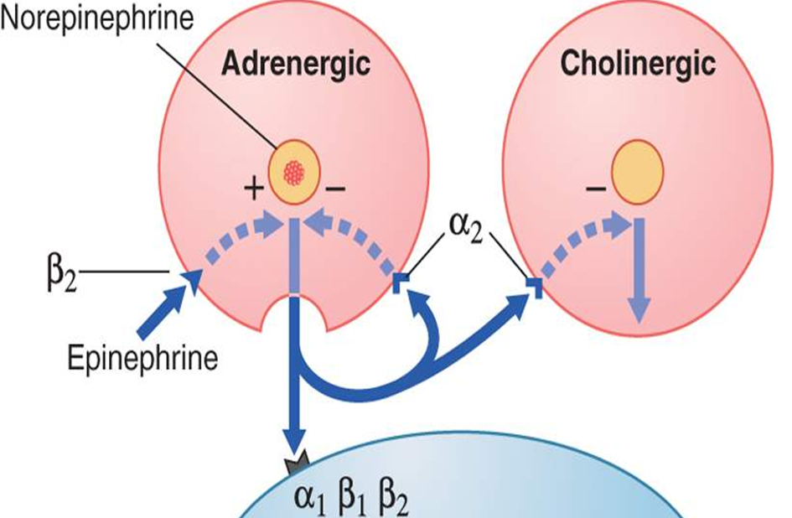

Slide 37
CNS
DA in the hypothalamus cause prolactin release.
2. basal ganglia coordinate motor function.
3. smooth muscle of UGIT → ↑ secretion, production & ↓ intestinal motility.
is to stimulate the CTZ of medulla producing vomiting.
natriuresis and diuresis
Notes:
DA1 receptors are located on renal tubules which inhibits sodium reabsorption with subsequent natriuresis and diuresis. It reduces afterload via dilatation of the renal and mesenteric arterial beds.
The natriuresis may be the result of combined renal vasodilatation, improved cardiac output and tubular action of DA1 receptors.
JG cells also contain DA2 receptors which increases renin release when activated. This action modulates the diuresis produced by DA1 activation of tubules.

Slide 38
Agonists and Antagonists
Pro-SNS Effects
Isoprotenerol - β agonist
Belladonna and Atropine - mACh antagonist
Anti-ANS (both PNS and SNS)
Hexamethonium - nACh antagonist (ganglia)
Anti-Skeletal Muscle Contraction
Curare - nACh antagonist (NMJ)

Slide 39
Adrenergic System
AGENTS ACTING AT DIFFERENT SITES
INTERFERE WITH THE SYNTHESIS : Metyrosine
BLOCKADE OF UPTAKE 1 AT NERVE TERMINAL : Cocaine, Imipramine
BLOCKADE OF STORAGE IN GRANULE OR GRANULAR UPTAKE : Reserpine
PROMOTION OF RELEASE : Amphetamine
PREVENTION OF RELEASE: Bretylium, Guanethidine

