Slide 1
Developing KPIs & Annual reports in a professional way [1]
Dr. Mohammed TingarY
H.O. Scientific Affaires Unit

Slide 2
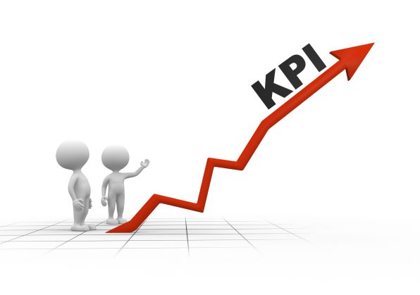
What are KPIs?
Simply defined, KPIs are measures that an organization uses to define success and track progress in meeting its strategic goals.
Key Performance Indicators (KPIs) are quantitative and qualitative measures used to review an organization's progress against its goals.

Slide 3
Characteristics of good KPIs
People often use the acronym “SMART” to refer to the characteristics of good performance indicators.
Specific
Measurable
Achievable
Relevant:
Time-bound

Slide 4
Development of KPIs
A number of factors should to be considered when developing and evaluating KPIs:
Define the use for measurement.
Consult with stakeholders and advisory group.
Choose the area to measure.
Achieve a balance in measurement.
Determine selection criteria.
Define the indicator
Identify the target population
Identify the Benchmarks (internal & external)
Define the target to be achieved
Threshold for action (weaknesses & recommendations)
Action

Slide 5
Determine Selection Criteria
Validity
Does the KPI measure what it is supposed to measure?
Reliability
Does the KPI provide a consistent measure?
Explicit evidence base
Is the KPI supported by scientific evidence or the consensus of experts?
Acceptability
Are the KPIs acceptable?

Slide 6
Determine Selection Criteria
Feasibility
Is it possible to collect the required data and is it worth the resources?
Sensitivity
Are small changes reflected in the results?
Relevance
What useful decisions can be made from the KPI?

Slide 7
Determine Selection Criteria
Balance
Do we have a set of KPIs that measure different aspects of the service?
Tested
Have national and international KPIs been considered?
Timeliness
Is the information available within an acceptable period of time to inform decision-makers?

Slide 8
To Be Continued ,,,
FINALLY
THANKS FOR LISTINING

