Slide 1
Course improvement plan
خطة التحسين المقرر
Dr. Ayman Algohary
Assistant professor
Chemistry department
College of science

Slide 2
After finish this lecture the participant will be able to:
1- List the positive features of the current course
2- List any features needing improvement,
3- List the factors which you consider may have influenced student learning outcomes or student feedback
4- Indicate the types or sources of data that were considered in evaluating this course offering
5- Describe the improvements you plan for the next offering

Slide 3
Statistic for improvement plan
50 % of course report miss improvement plan
20 % of improved plans is not clear

Slide 4
Content
Course review
Course improvement plans
Appling in course report

Slide 5
COURSE REVIEW
What worked well? (strength points)
What areas need improvement? (Weakness points)
What comments, if any, would you like to make about the above summary?
What data were collected?

Slide 6
What is the improvement plan?
How can you select the items of improvement plan?

Slide 7
COURSE REVIEW
What worked well?
What are positive features aspects of your current course?
1-
2-
3-
4-
5-

Slide 8
COURSE REVIEW
1- What worked well?
2- What areas need improvement?
May be all or some of the following
1
Design
2
Content
3
Delivery
4
Assessment
5
Student outcomes

Slide 9
COURSE REVIEW
3- What comments, if any, would you like to make about the above summary?
comment on any factors which you consider may have influenced student learning outcomes or student feedback

Slide 10
COURSE REVIEW
4- What data were collected?
Indicate the types or sources of data that were considered in evaluating this course offering
A-
B-
C-
D-
E-

Slide 11
COURSE REVIEW
4- What data were collected?
Indicate the types or sources of data that were considered in evaluating this course offering
Student Perceptions (student survey and exam quality survey)
Staff Perceptions (Peer review )
Evaluation Student Engagement (behaviour, attendance and online participation, assignment, Homework's)
Analysis of learning Outcomes (direct assessment sheet)
Benchmarks and Standards (Comparisons with internal and external)

Slide 12
COURSE IMPROVEMENT PLANS
Try to describe the improvements you plan for the next offering course.
What are the items of improvement plan?

Slide 13
COURSE IMPROVEMENT PLANS
Try to describe the improvements you plan for the next offering course.
What is the items of improvement plan?
Design
Content
Delivery
Assessment
Student outcomes

Slide 14
Improvement of course design
Review course | Data sources | Worked well/ Need to improvement | comments
Completion and updating of course specification. | Instructor
Formulated of Outcomes | Instructor
Improvement plan of last semester was available | Instructor

Slide 15
Improvement of course content
Review course |  | Data sources | Worked well/ Need to improvement | comments
Content | All Course content was covered | Student survey Q5
 | Course content match with what has already been taught. | Peer reviewer
 | Reference materials are updated | Student survey Q10
 | Lab manual was available for practical courses | Instructor
 | Question bank was available | instructor

Slide 16
Improvement of course delivery
We can take it from course evaluation form
Review course |  | Data sources | Worked well/ Need to improvement | comments
Delivery | Using of Effective technology in delivery of content | Student survey Q12
 | Teaching strategy | Instructor
 | Assessment method | Students results
 | Verification of Credibility of Students’ Results | Instructor
 | Verification of sufficiency of exercises, homework's, and assignments | Students results
 | Facilities management | Instructor

Slide 17
Improvement of course assessment
Review course |  | Data sources | Worked well/ Need to improvement | comments
Assessment | Grading system was established | Instructor
 | Assessment tools are suitable for each outcome | Peer reviewer
 | variety assessment has been used | Peer reviewer
 | Fairness of assessment | Student survey 18

Slide 18
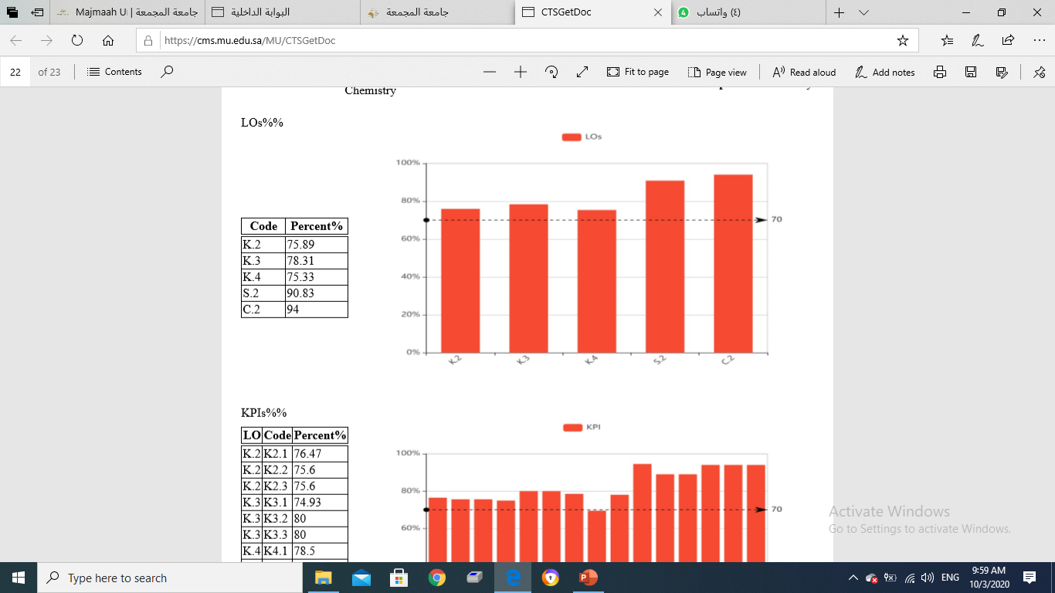
Improvement of course student outcomes
Review course |  | Data sources | Worked well/ Need to improvement |  | comments
Outcomes | K.1 | Direct assessment sheet | Achievement % | Target %
 | K.2 |  | Achievement % | Target %
 | S.1 |  | Achievement % | Target %
 | C.2 |  | Achievement % | Target %
 |  |  | Achievement % | Target %

Slide 19
Filling the improvement plan in course report
G. Course Improvement Plan
1. Course Improvement Actions
Recommended Actions | Actions Taken | Results | Comments
a. Previous course Report Recommendations
 | --- Not applicable ---- | --- Not applicable ----
b. Other Improvement Actions*
-Nil- |  | --- Not applicable ----
--- Not applicable ---- |  | --- Not applicable ----
* (The developmental measures taken during teaching the course and not included in the development plan of it)

Slide 20
Action Plan for Next Semester/Year
Recommendations | Actions | Responsibility For Implementation | Time |  | Needed Support
 |  |  | Start | End

Slide 21
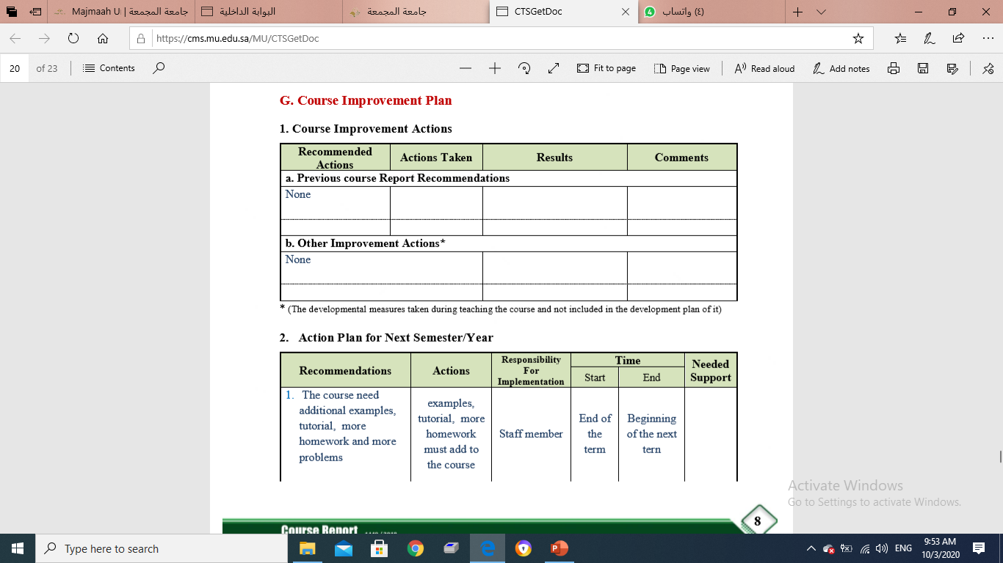
Example of current improvement plan

Slide 22
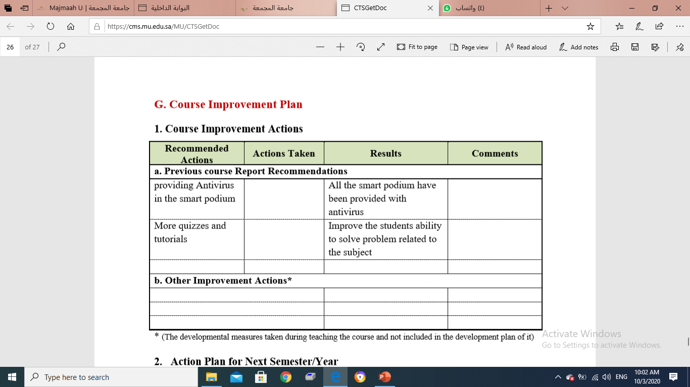
Example of current improvement plan

Slide 23
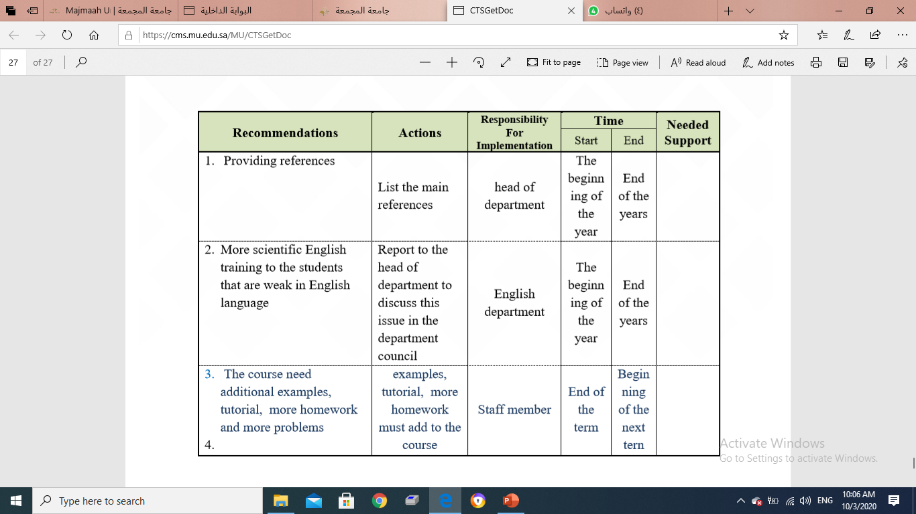
Example od Action Plan for Next Semester/Year

Slide 24
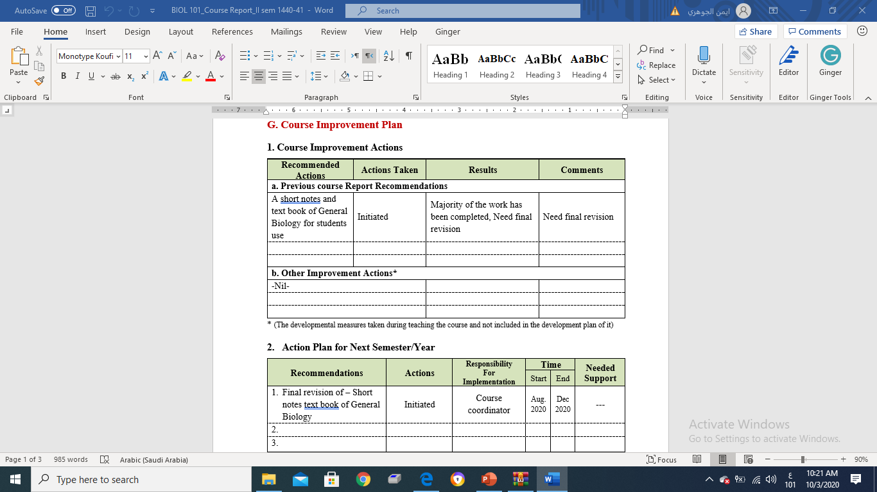

Slide 25
Recommendations

Slide 26
Thanks

