Slide 1
THE CONCLUDING CEREMONY OF STUDENTS ACTIVITIES AT THE UNIVERSITY

Slide 2
The ceremony was initiated a visit to the gallery of student activities made by His Highness the Rector who listened to a detailed explanation of the most important achievements of the deanship for this academic year. The Rector expressed his gratitude with those activities.
A rhetoric ceremony was also held which began by a recitation of the Holy Quran followed by a speech for the dean of student affairs Dr. Hamad Al-Gumaizi who reviewed the achievements of the deanship in the field of student activities at the local and international level. He concluded his speech by thanking everyone who contributed to this success, on top of which His Highness the Rector and the deputies-rector. Thanks were also extended to the governmental sectors and social organizations which also made a contribution to the deanship achievements.

Slide 3
After that, an introductory film was shown about the deanship of student affairs and its activities followed by operetta who gained the admiration of the audience.
Addressing the audience, His Highness the Rector Dr. Khalid Al-Mogren delivered a speech where he extended his thanks to the efforts being exerted by the deanship of student affairs in serving students and conducting activities. He also thanked the dean and the deanship staff. After that, appreciation certificates and shields were presented to active administrations. At the end, memorial photos were taken with the Rector on this occasion.

Slide 4
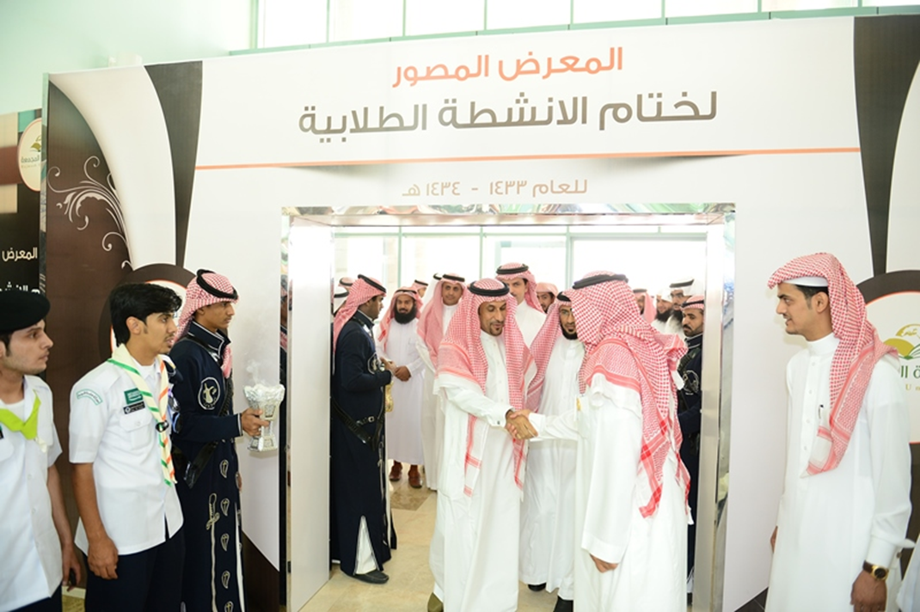

Slide 5
