Slide 1
Cerebrovascular Accident
CVA

Slide 2
Cerebrovascular Accident
Results from ischemia to a part of the brain or hemorrhage into the brain that results in death of brain cells.
Approximately 750,000 in USA annually
  Third most common cause of death
  #1 leading cause of disability
  25% with initial stroke die within 1 year
  50-75% will be functionally independent
  25% will live with permanent disability
Physical, cognitive, emotional, & financial impact

Slide 3
Cerebrovascular Accident
Risk Factors
Nonmodifiable:
  Age – Occurrence doubles each decade >55 years
  Gender – Equal for men & women; women die more frequently than men
  Race – African Americans, Hispanics, Native Americans, Asian Americans -- higher incidence
  Heredity – family history, prior transient ischemic attack, or prior stroke increases risk

Slide 4
Cerebrovascular Accident
Risk Factors
Controllable Risks with Medical Treatment & Lifestyle Changes:
High blood pressure Diabetes
Cigarette smoking TIA (Aspirin)
High blood cholesterol Obesity
Heart Disease Atrial fibrillation
Oral contraceptive use Physical inactivity
Sickle cell disease Asymptomatic carotid stenosis
Hypercoagulability

Slide 5
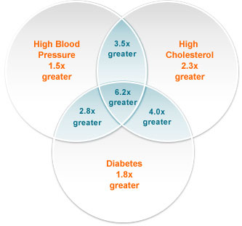
CVA – Risk Factors

Slide 6
Cerebrovascular Accident
Anatomy of Cerebral Circulation
Blood Supply
  Anterior: Carotid Arteries – middle & anterior cerebral arteries
    frontal, parietal, temporal lobes; basal ganglion; part of the diencephalon (thalamus & hypothalamus)
  Posterior: Vertebral Arteries – basilar artery
    Mid and lower temporary & occipital lobes, cerebellum, brainstem, & part of the diencephalon
  Circle of Willis – connects the anterior & posterior cerebral circulation

Slide 7
Cerebrovascular Accident
Anatomy of Cerebral Circulation
Blood Supply
  20% of cardiac output—750-1000ml/min
    >30 second interruption– neurologic metabolism is altered; metabolism stops in 2 minutes; brain cell death < 5 mins.

Slide 8
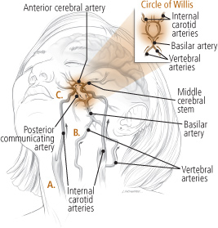

Slide 9
Cerebrovascular Accident
Pathophysiology
Atherosclerosis: major cause of CVA
  Thrombus formation & emboli development
    Abnormal filtration of lipids in the intimal layer of the arterial wall
    Plaque develops & locations of increased turbulence of blood - bifurcations
    Increased turbulence of blood or a tortuous area
    Calcified plaques rupture or fissure
    Platelets & fibrin adhere to the plaque
    Narrowing or blockage of an artery by thrombus or emboli
    Cerebral Infarction: blocked artery with blood supply cut off beyond the blockage

Slide 10
Cerebrovascular Accident
Pathophysiology
Ischemic Cascade
  Series of metabolic events
    Inadequate ATP adenosine triphosphate production
    Loss of ion homeostasis
    Release of excitatory amino acids – glutamate
    Free radical formation
    Cell death
  Border Zone: reversible area that surrounds the core ischemic area in which there is reduced blood flow but which can be restored (3 hours +/-)

Slide 11
Cerebrovascular Accident
Transient Ischemic Attack
Temporary focal loss of neurologic function
Caused by ischemia of one of the vascular territories of the brain
  Microemboli with temporary blockage of blood flow
Lasts less than 24 hrs – often less than 15 mins
Most resolve within 3 hours
Warning sign of progressive cerebrovascular disease

Slide 12
Cerebrovascular Accident
Classifications
Based on underlying pathophysiologic findings

Slide 13
Cerebrovascular Accident
Classifications
Ischemic Stroke
  Thrombotic
  Embolic
Hemorrhagic Stroke
  Intracerebral Hemorrhage
  Subarachnoid Hemorrhage
    Aneurysm
      Berry or Saccular

Slide 14
Cerebrovascular Accident
Classifications
Ischemic Stroke—inadequate blood flow to the brain from partial or complete occlusions of an artery--85% of all strokes
  Extent of a stroke depends on:
    Rapidity of onset
    Size of the lesion
    Presence of collateral circulation
  Symptoms may progress in the first 72 hours as infarction & cerebral edema increase
Types of Ischemic Stroke:
Thrombotic Stroke Embolic Stroke

Slide 15
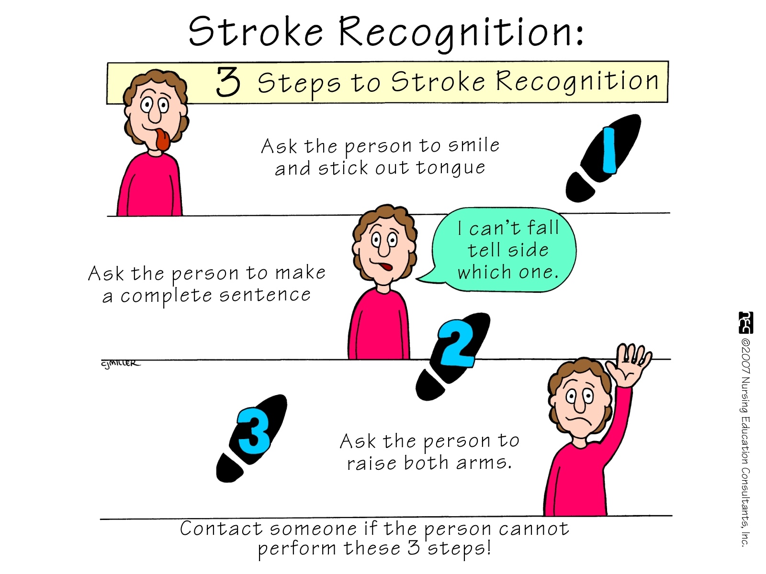
CVA Recognition

Slide 16
Cerebrovascular Accident
Ischemic – Thrombotic Stroke
  Lumen of the blood vessels narrow – then becomes occluded – infarction
  Associated with HTN and Diabetes Mellitus
    >60% of strokes
    50% are preceded by TIA
    Lacunar Stroke: development of cavity in place of infarcted brain tissue – results in considerable deficits – motor hemiplegia, contralateral loss of sensation or motor ability

Slide 17
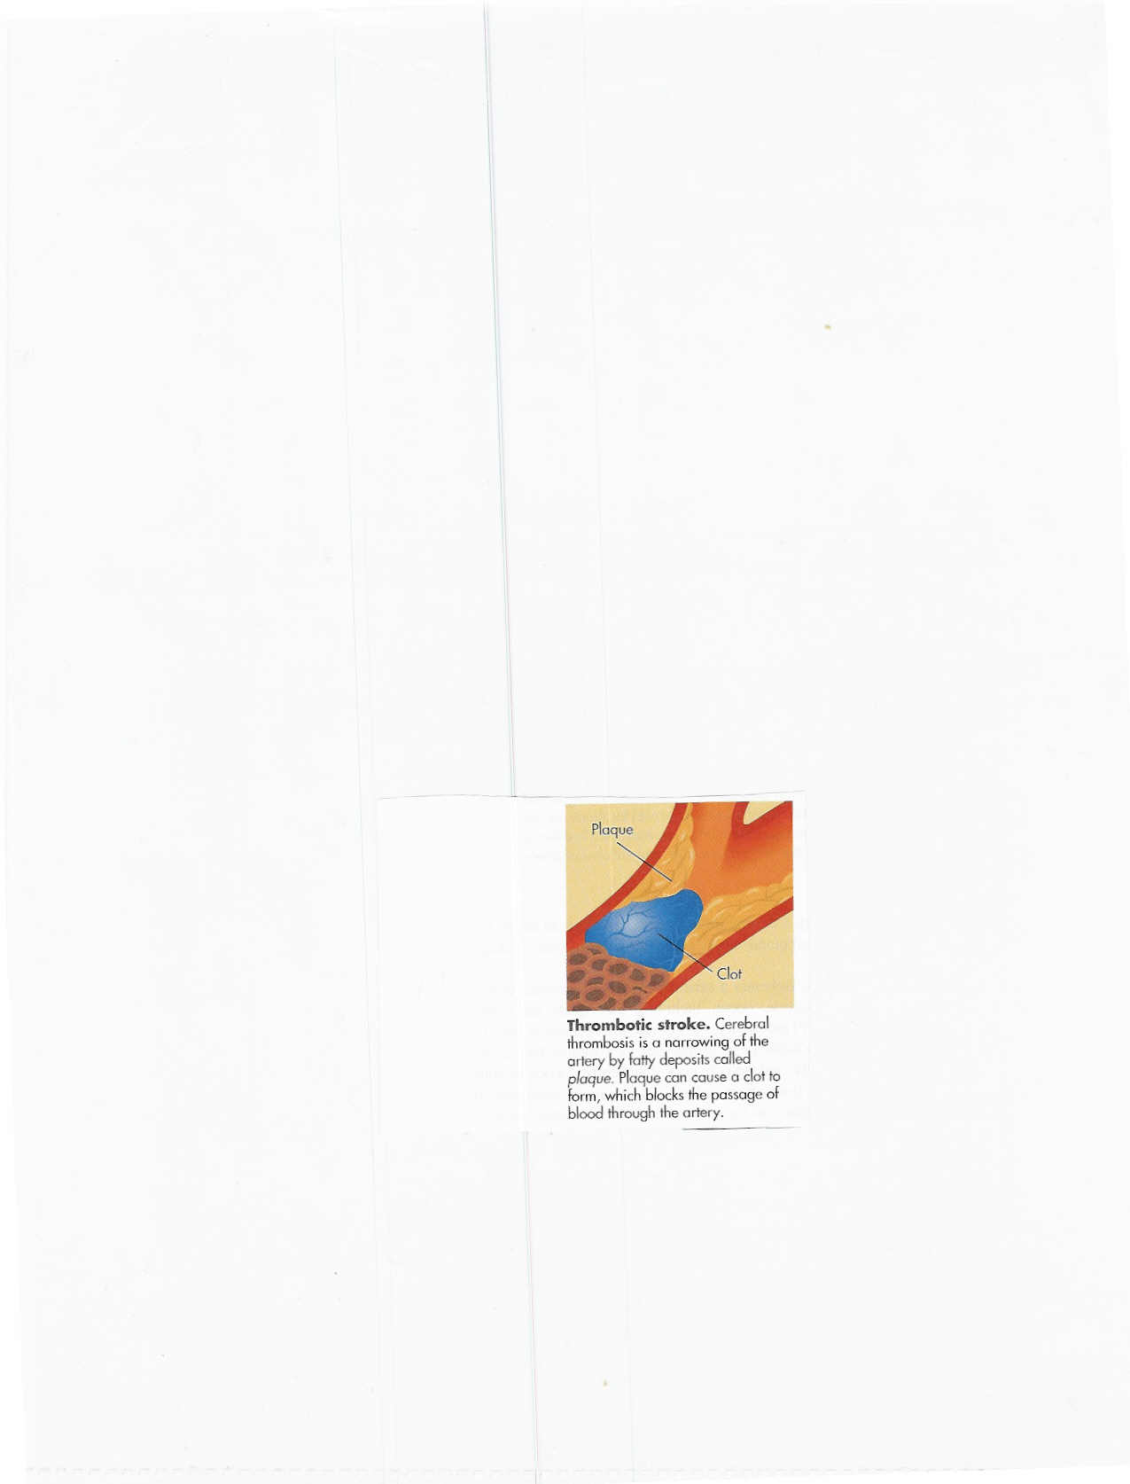
Cerebrovascular Accident
Thrombotic Stroke

Slide 18
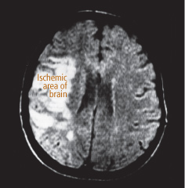

Slide 19
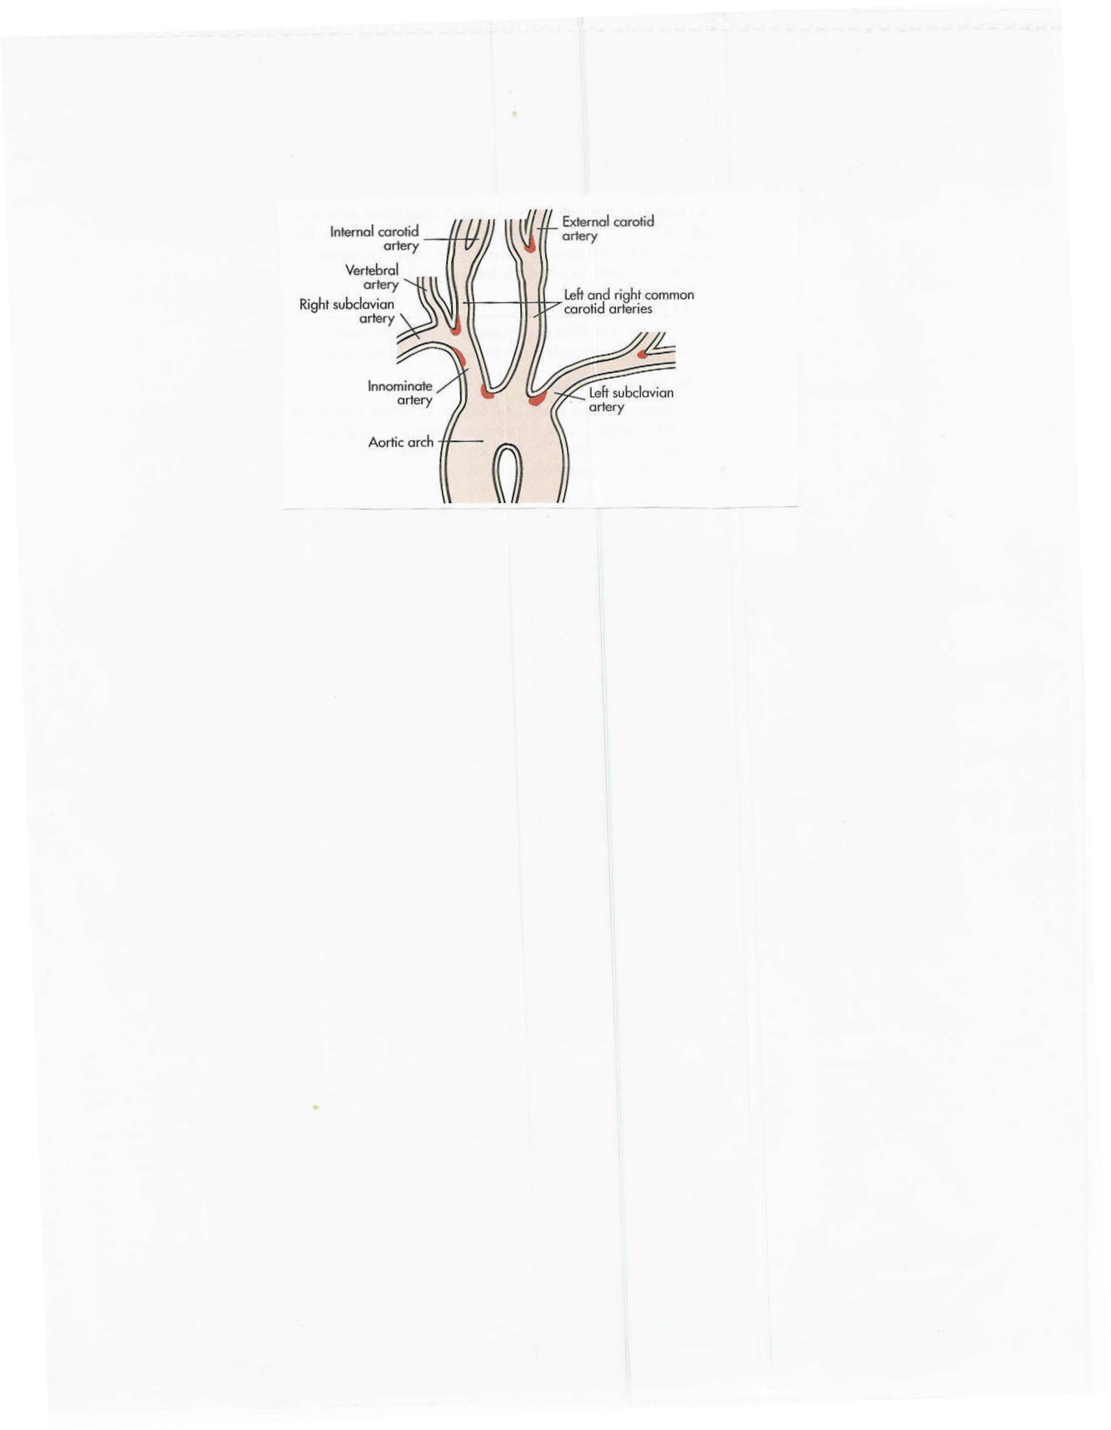
Cerebrovascular Accident
Common Sites of Atherosclerosis

Slide 20
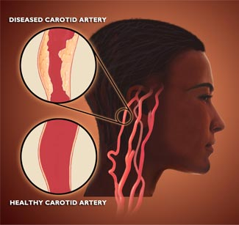

Slide 21
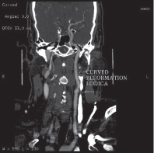

Slide 22
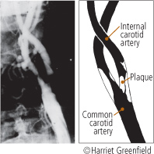

Slide 23
Cerebrovascular Accident
Ischemic – Embolic Stroke
  Embolus lodges in and occludes a cerebral artery
  Results in infarction & cerebral edema of the area supplied by the vessel
  Second most common cause of stroke – 24%
  Emboli originate in endocardial layer of the heart – atrial fibrillation, MI, infective endocarditis, rheumatic heart disease, valvular prostheses
  Rapid occurrence with severe symptoms – body does not have time to develop collateral circulation
  Any age group
  Recurrence common if underlying cause not treated

Slide 24

Cerebrovascular Accident
Embolic Stroke

Slide 25
Cerebrovascular Accident
Hemorrhagic Stroke
Hemorrhagic Stroke
  15% of all strokes
  Result from bleeding into the brain tissue itself
    Intracerebral
    Subarachnoid

Slide 26
Cerebrovascular Accident
Hemorrhage Stroke
Intracerebral Hemorrhage
  Rupture of a vessel
  Hypertension – most important cause
  Others: vascular malformations, coagulation disorders, anticoagulation, trauma, brain tumor, ruptured aneurysms
  Sudden onset of symptoms with progression
  Neurological deficits, headache, nausea, vomiting, decreased LOC, and hypertension
  Prognosis: poor – 50% die within weeks
  20% functionally independent at 6 months

Slide 27
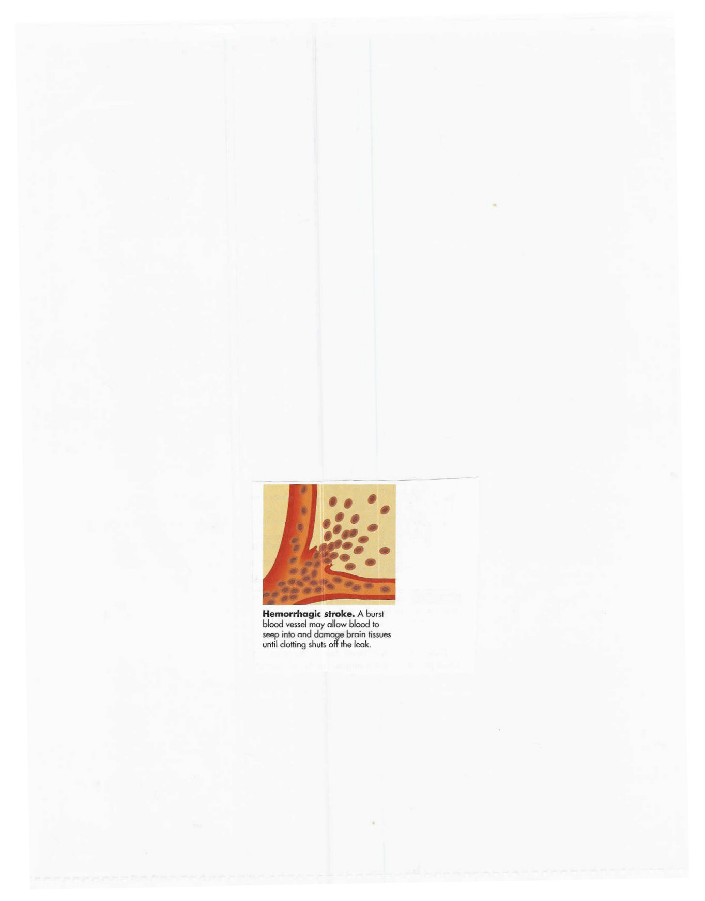
Cerebrovascular Accident
Hemorrhage Stroke
Intracerebral Hemorrhage

Slide 28
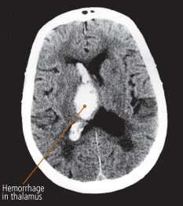

Slide 29
Cerebrovascular Accident
Hemorrhagic-Subarachnoid
Hemorrhagic Stroke–Subarachnoid Hemorrhage
  Intracranial bleeding into the cerebrospinal fluid-filled space between the arachnoid and pia mater membranes on the surface of the brain

Slide 30
Cerebrovascular Accident
Hemorrhagic-Subarachnoid
  Commonly caused by rupture of cerebral aneurysm (congenital or acquired)
    Saccular or berry – few to 20-30 mm in size
    Majority occur in the Circle of Willis
  Other causes: Arteriovenous malformation (AVM), trauma, illicit drug abuse
  Incidence: 6-16/100,000
  Increases with age and more common in women

Slide 31
Cerebrovascular Accident
Hemorrhagic-Subarachnoid
Cerebral Aneurysm
Warning Symptoms: sudden onset of a severe headache – “worst headache of one’s life”
Change of LOC, Neurological deficits, nausea, vomiting, seizures, stiff neck
Despite improvements in surgical techniques, many patients die or left with significant cognitive difficulties

Slide 32
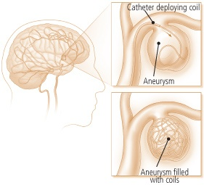

Slide 33
Hemorrhagic-Subarachnoid
Cerebral Aneurysm
Surgical Treatment:
  Clipping the aneurysm – prevents rebleed
  Coiling – platinum coil inserted into the lumen of the aneurysm to occlude the sac
  Postop: Vasospasm prevention – Calcium Channel Blockers

Slide 34
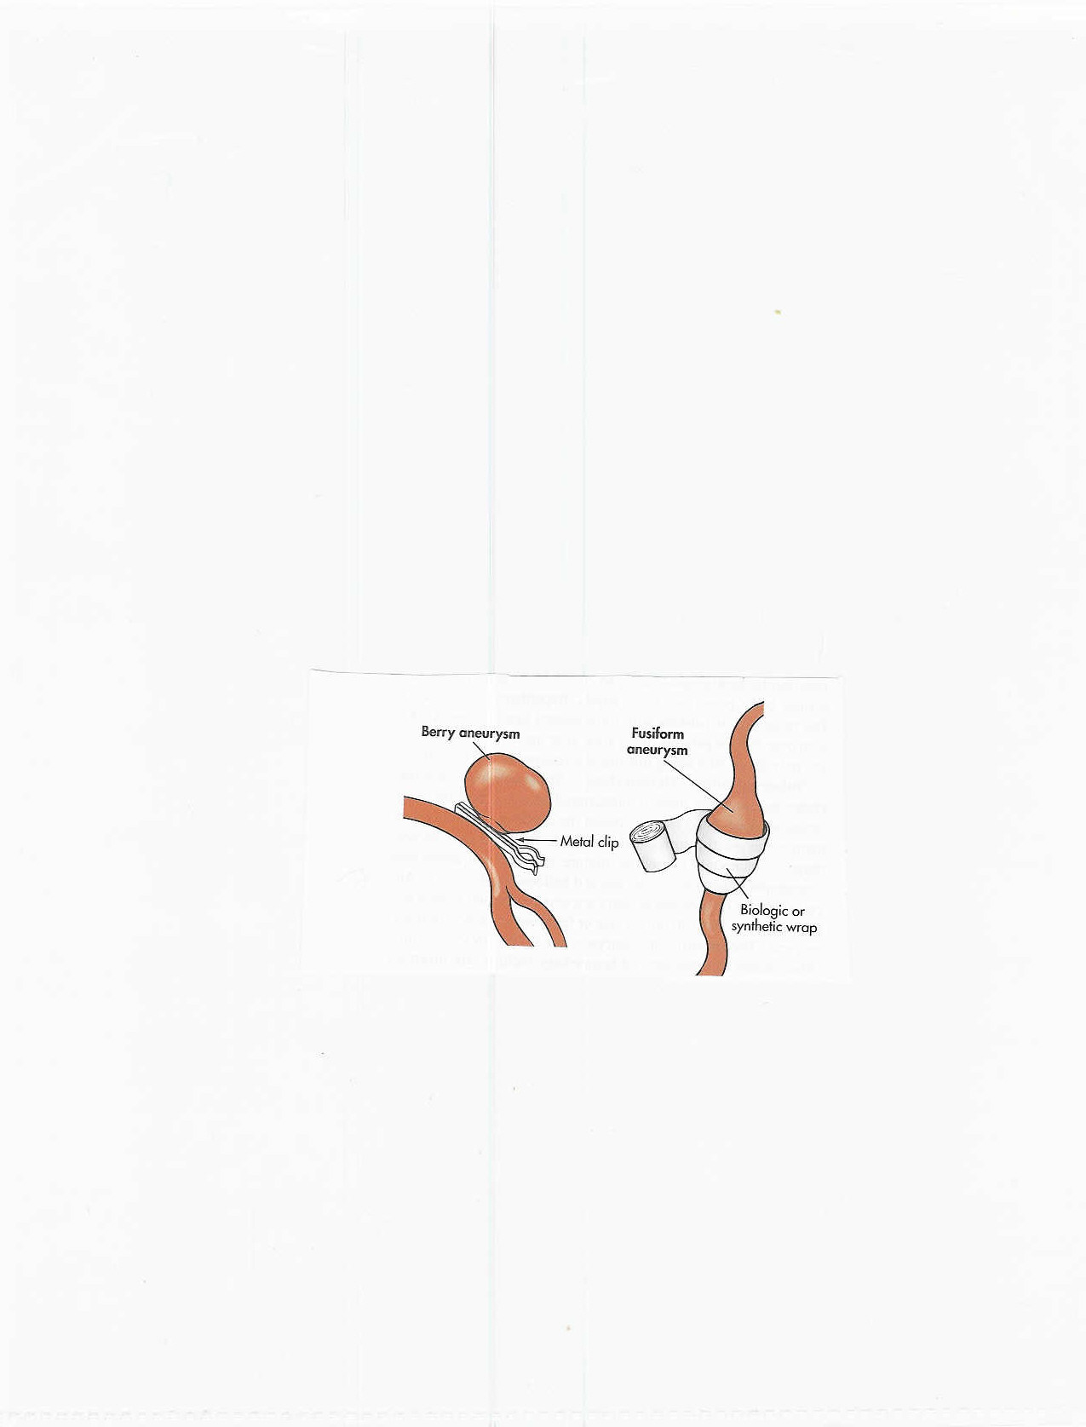
Hemorrhagic-Subarachnoid
Cerebral Aneurysm – Surgical Tx

Slide 35
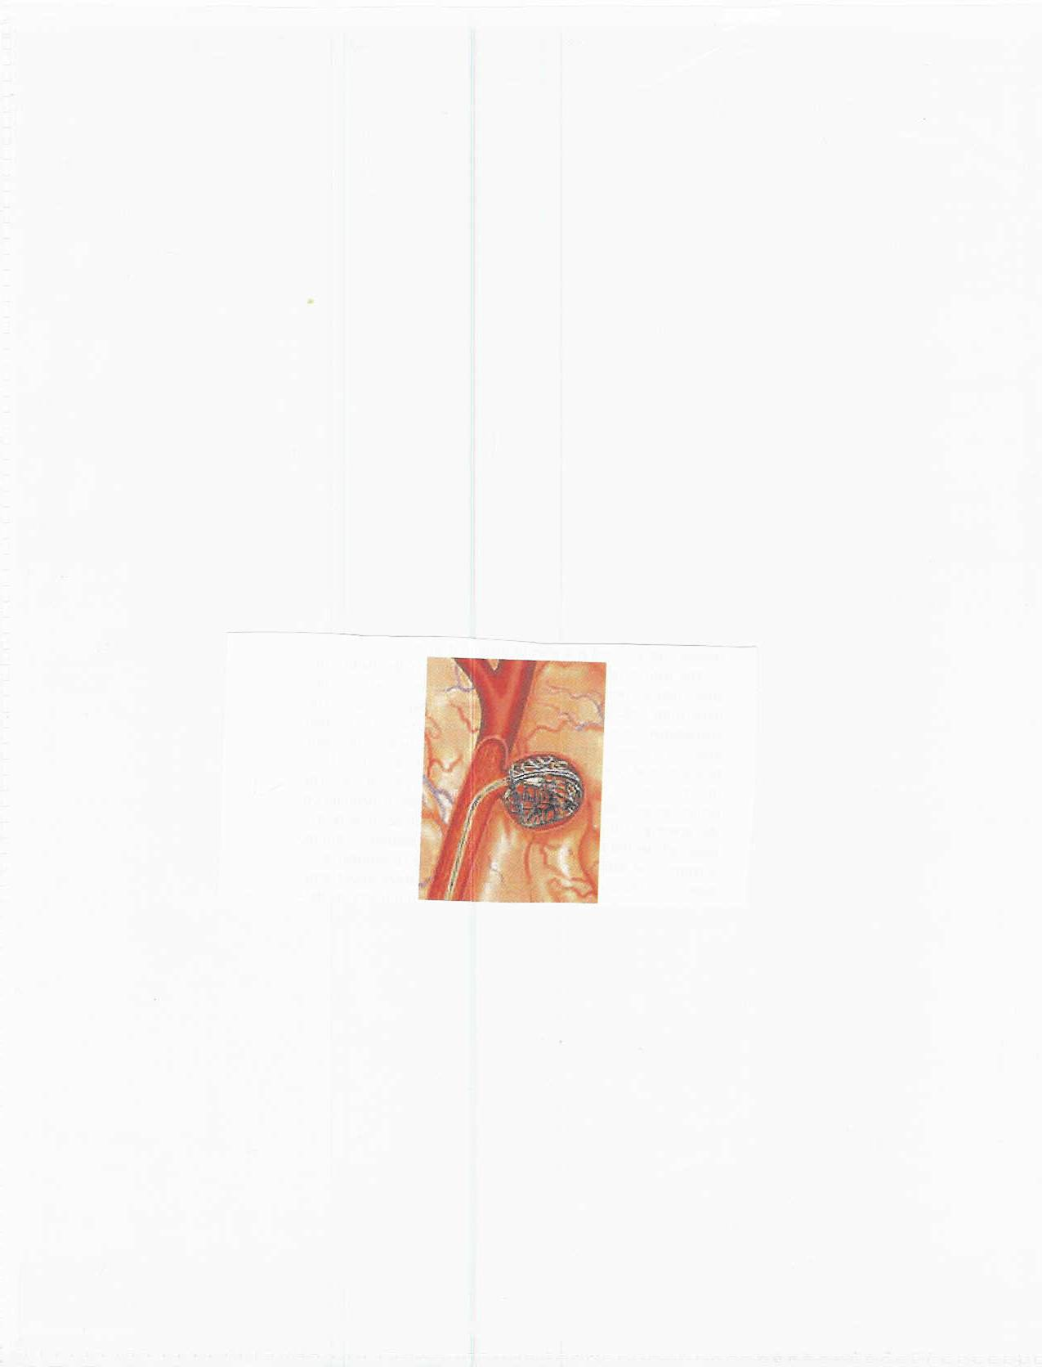
Hemorrhagic-Subarachnoid
Cerebral Aneurysm – Coiling

Slide 36
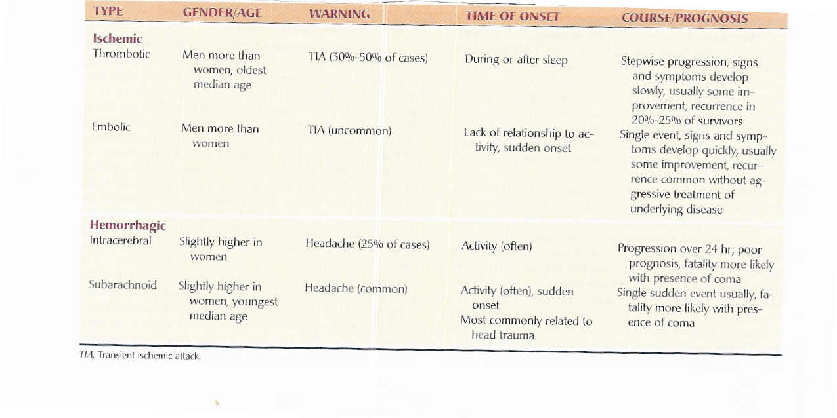
Cerebrovascular Accident
Classification

Slide 37
Cerebrovascular Accident
Clinical Manifestations
Middle Cerebral Artery Involvement
  Contralateral weakness
    Hemiparesis; hemiplegia
  Contralateral hemianesthesia
  Loss of proprioception, fine touch and localization
  Dominant hemisphere: aphasia
  Nondominant hemisphere – neglect of opposite side; anosognosia – unaware or denial of neuro deficit
  Homonymous hemianopsia – defective vision or blindness right or left halves of visual fields of both eyes

Slide 38
Cerebrovascular Accident
Clinical Manifestations
Anterior Cerebral Artery Involvement
  Brain stem occlusion
  Contralateral
    weakness of proximal upper extremity
    sensory & motor deficits of lower extremities
  Urinary incontinence
  Sensory loss (discrimination, proprioception)
  Contralateral grasp & sucking reflexes may be present
  Apraxia – loss of ability to carry out familiar purposeful movements in the absence of sensory or motor impairment
  Personality change: flat affect, loss of spontaneity, loss of interest in surroundings
  Cognitive impairment

Slide 39
Cerebrovascular Accident
Clinical Manifestations
Posterior Cerebral Artery & Vertebrobasilar Involvement
Alert to comatose
Unilateral or bilateral sensory loss
Contralateral or bilateral weakness
Dysarthria – impaired speech articulation
Dysphagia – difficulty in swallowing
Hoarseness
Ataxia, Vertigo
Unilateral hearing loss
Visual disturbances (blindness, homonymous hemianopsia, nystagmus, diplopia)

Slide 40
Cerebrovascular Accident
Clinical Manifestations
Motor Function Impairment
Caused by destruction of motor neurons in the pyramidal pathway (brain to spinal cord)
  Mobility
  Respiratory function
  Swallowing and speech
  Gag reflex
  Self-care activities

Slide 41
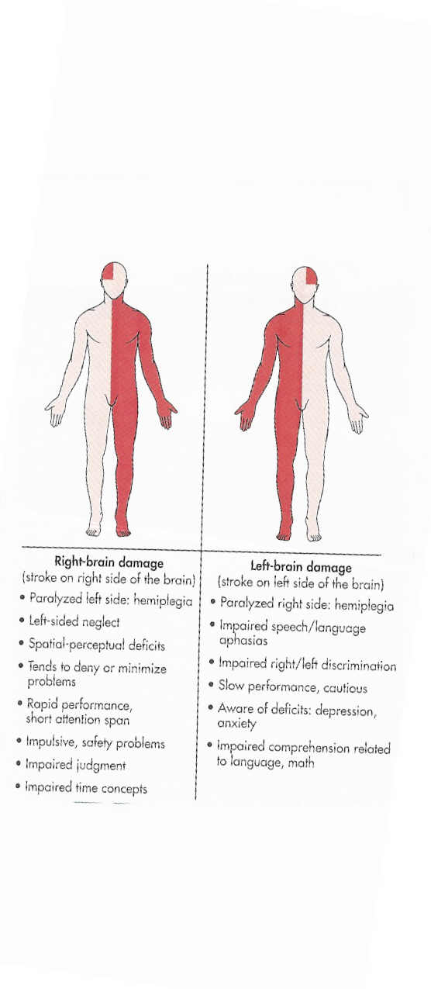
Cerebrovascular Accident
Clinical Manifestations
Right Brain – Left Brain Damage

Slide 42
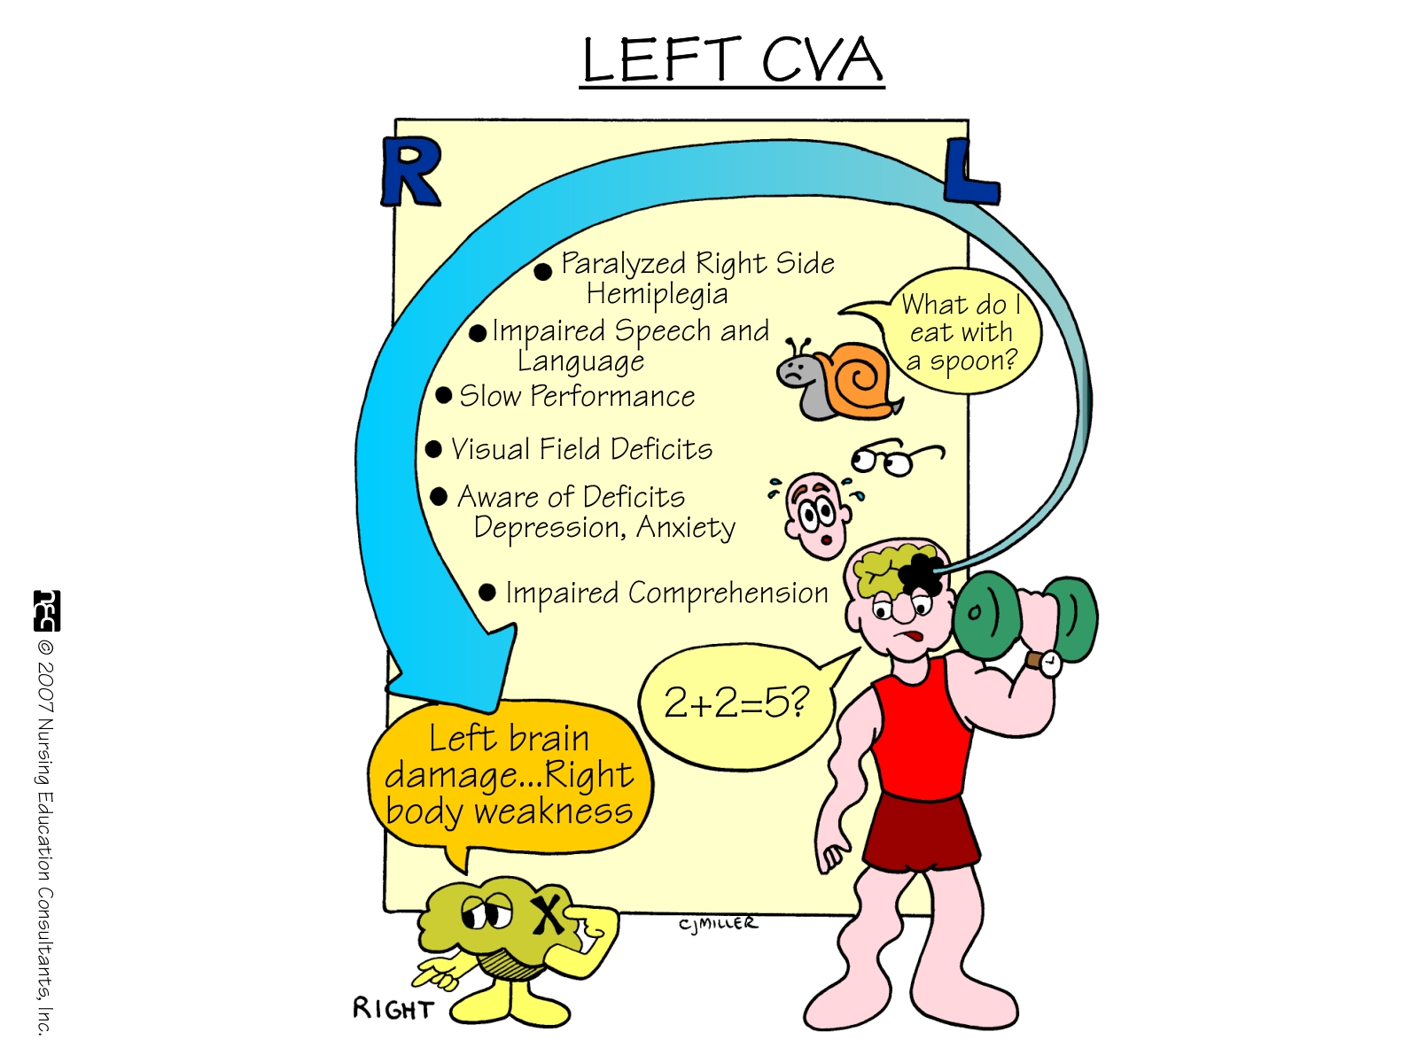

Slide 43
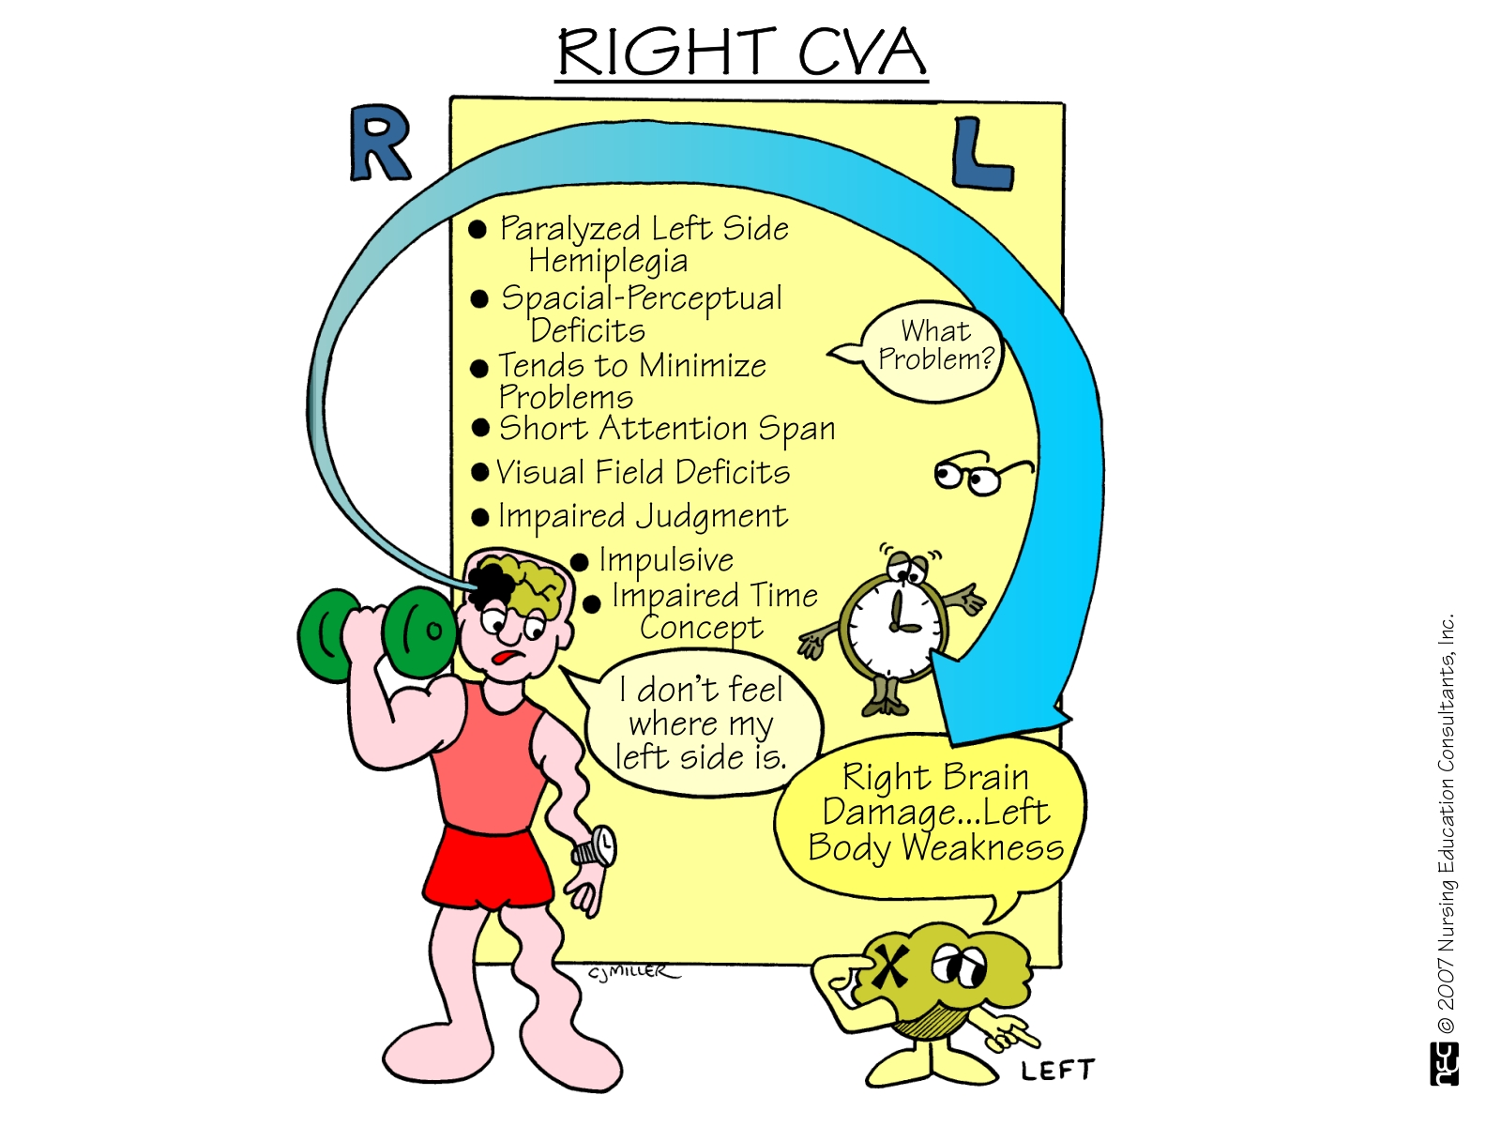

Slide 44
Cerebrovascular Accident
Clinical Manifestations
Affect
  Difficulty controlling emotions
  Exaggerated or unpredictable emotional response
  Depression / feelings regarding changed body image and loss of function

Slide 45
Cerebrovascular Accident
Clinical Manifestations
Intellectual Function
  Memory and judgment
    Left-brain stroke: cautious in making judgments
    Right-brain stroke: impulsive & moves quickly to decisions
  Difficulties in learning new skills

Slide 46
Cerebrovascular Accident
Clinical Manifestations
Communication
Left hemisphere dominant for language skills in the right-handed person & most left-handed persons -- Aphasia/Dysphasia
Involvement Expression & Comprehension
  Receptive Aphasia (Wernicke’s area): sounds of speech nor its meaning can be understood – spoken & written
  Expressive Aphasia (Broca’s area): difficulty in speaking and writing
  Dysarthria: Affects the mechanics of speech due to muscle control disturbances – pronunciation, articulation, and phonation

Slide 47
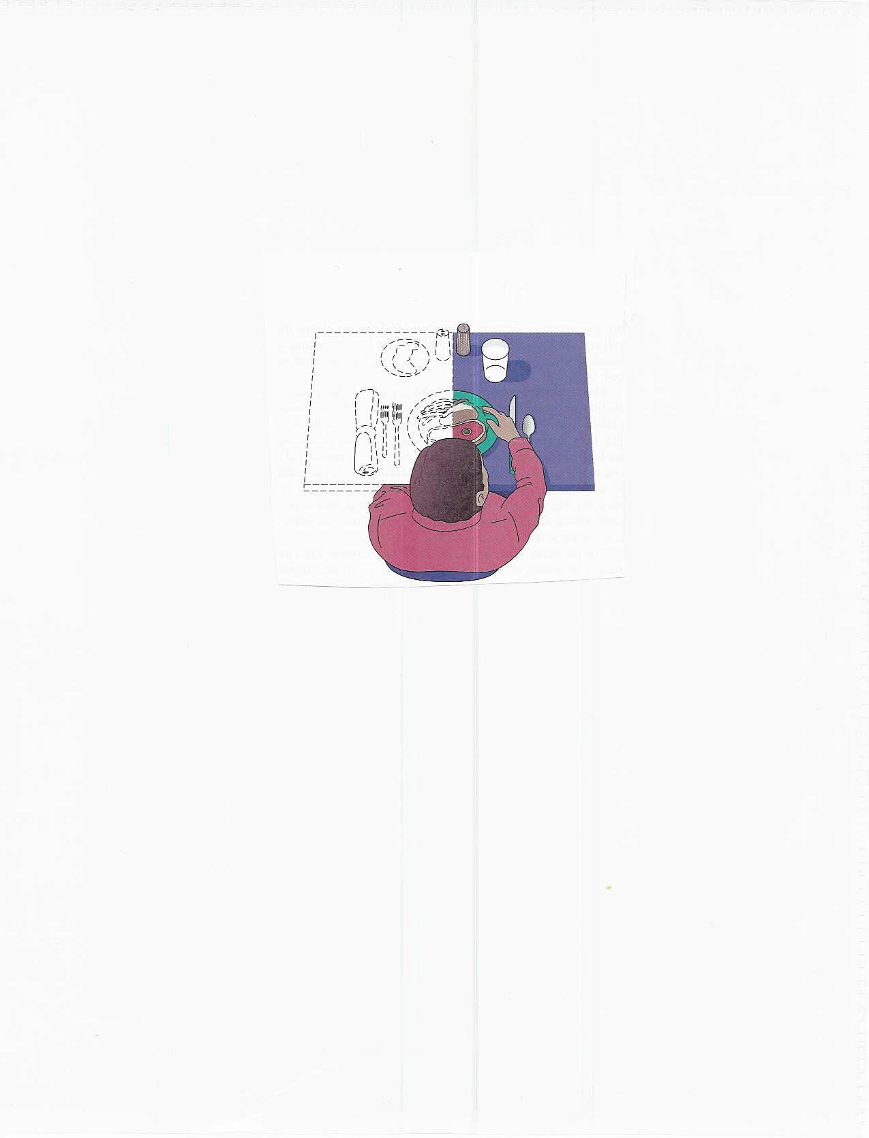
Homonymous Hemianopsia

Slide 48
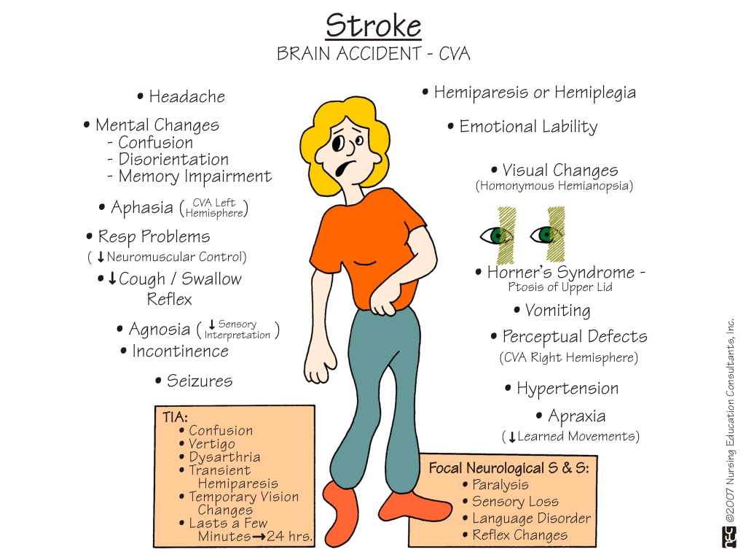

Slide 49
Cerebrovascular Accident
Treatment Goals
Prevention – Health Maintenance Focus:
  Healthy diet
  Weight control
  Regular exercise
  No smoking
  Limit alcohol consumption
  Route health assessment
  Control of risk factors

Slide 50
Cerebrovascular Accident
Treatment Goals
Prevention
Drug Therapy
Surgical Therapy
Rehabilitation

Slide 51
Cerebrovascular Accident
Treatment Goals
Drug Therapy – Thrombotic CVA – to reestablish blood flow through a blocked artery
Thrombolytic Drugs: tPA (tissue plasminogen activator)
  produce localized fibrinolysis by binding to the fibrin in the thrombi
  Plasminogen is converted to plasmin (fibrinolysin)
  Enzymatic action digests fibrin & fibrinogen
  Results is clot lysis
Administered within 3 hours of symptoms of ischemic CVA
  Confirmed DX with CT
  Patient anticoagulated
ASA, Calcium Channel Blockers

Slide 52
CVA - Treatment Goals
Surgical Treatment
  Carotid endarterectomy – preventive – > 100,000/year
    removal of atheromatous lesions
  Clipping, wrapping, coiling Aneurysm
  Evacuation of aneurysm-induced hematomas larger than 3 cm.
  Treatment of AV Malformations

Slide 53
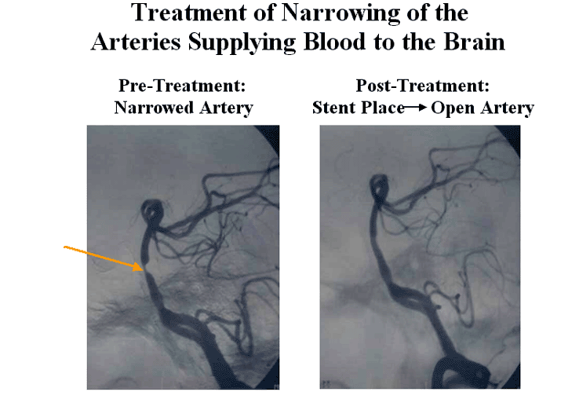
Carotid Artery Stents

Slide 54
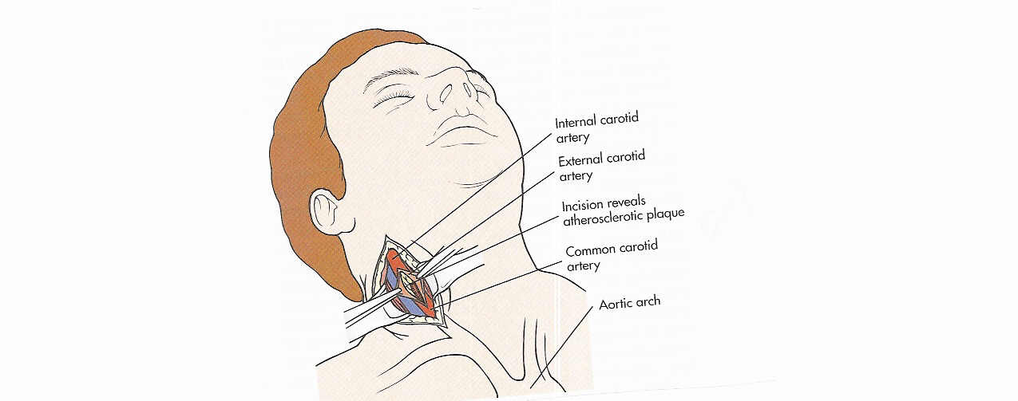
Carotid Endarterectomy

Slide 55
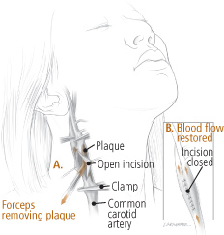

Slide 56
Cerebrovascular Accident
Treatment Goals
Drug Therapy
  Measures to prevent the development of a thrombus or embolus for “At Risk” patients:
    Antiplatelet Agents
      Aspirin
      Plavix
      Combination
    Oral anticoagulation – Coumadin
      Treatment of choice for individuals with atrial fibrillation who have had a TIA

Slide 57
Cerebrovascular Accident
Warning Signs of Stroke
Sudden weakness, paralysis, or numbness of the face, arm, or leg, especially on one side of the body
Sudden dimness or loss of vision in one or both eyes
Sudden loss of speech, confusion, or difficulty speaking or understanding speech
Unexplained sudden dizziness, unsteadiness, loss of balance, or coordination
Sudden severe headache

Slide 58
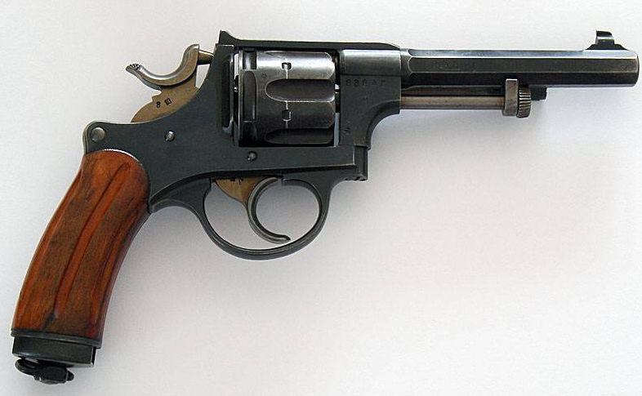

Head Injury
( missile) or non missile
Acceleration, deceleration, rotation
Effects
Early: concussion , skull fracture , lobes contusion , decerebration
Delayed : odema , CSF leak , hematoma/ hrage
  Extradural( epidural)
  Subdural
  Intracerebral
Latter : scarring and shrinking →epilepsy

Slide 59
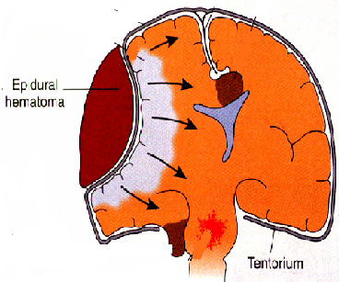
Extradural Hematoma
In linear skull #
Rupture of middle meningeal artery
Rapid recovery – lucid period- ↑ICP
Surgical draining :( Burr holes)

Slide 60
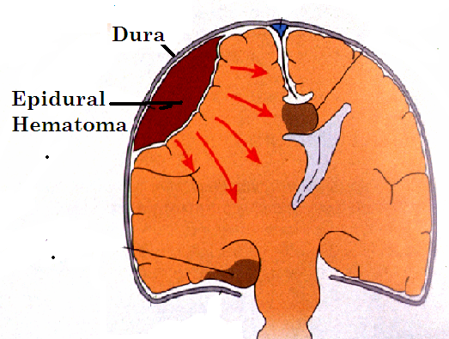
Subdural hematoma
Due to rupture of small bridging veins
Can reach large size ( why)
Lead to herniation
Can be chronic ( granulation tissue)
Sub dural

Slide 61
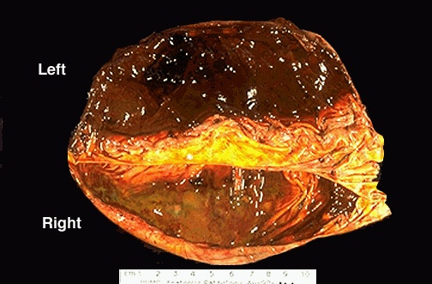
Intracerebral hrge
In sever trauma ( contusion)
Mainly in temporal lobe
Fatal

