Slide 1
MICROBIOLOGICAL EXAM OF CSF
Assist Prof. Dr.
Syed Yousaf Kazmi

Slide 2
OBJECTIVES
Perform Gram & ZN stain of deposit of CSF
Identify the Gram Stain Reaction of the causative organism
Differentiate between polymorphic/ lymphocytic pleocytosis
Interpret a CSF report and give opinion about most likely etiology

Slide 3
CSF CHARACTERISTICS IN MENINGITIS
FUNGAL/TB | VIRAL | AC BACTERIAL | NORMAL CSF | PARAMETERS
300-600 | 150> | 150-1000 | 50-180 | Opening Pressure mm of H₂O
Clear/slight turbid | Clear | Turbid | Clear | Transparency
50-1000 | 50-1000 | 50-2000 | 0-5 | Cell Count/µL
Lymphocytes/Monocytes | Lymphocytes | PMN main | Lymphocytes | Differential
Slightly low | Normal | Low (>1.5) | 2.2-3.5 | Glucose mmol/L
3.0-6.0 | ˂1.5 | 1.5-10 | 0.2 – 0.4 | Protein g/L
AFB/ Yeast cells | No org | Bacteria usually | No org | Deposit

Slide 4
CASE 1
A 24-years-young man developed fever, headache, confusion for last 8 hours. Examination showed neck stiffness and temperature of 100ºF. CSF was tapped that is shown in Fig 1 right. The result of CSF is shown in Table 1.

Slide 5
CSF RESULT
Table 1
Normal value | Patient’s result | PARAMETERS
50-180 | 240 | Opening Pressure mm of H₂O
Clear | Turbid | Transparency
0-5 | 1432 | Cell Count/µL
Lymphocytes | 95% PMN, 5% monocytes | Differential
2.2-3.5 | 0.78 | Glucose mmol/L
0.2 – 0.4 | 2.18 | Protein g/L
Fig 1

Slide 6
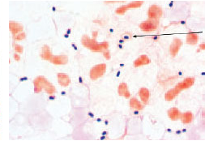
The results of Gram staining is shown in Fig 2.
What is the most likely diagnosis?
What organism is most likely the cause of infection?
What could be the source of infection in this patient?
Fig 2

Slide 7
CASE 2
A 38-years-old lady reported with h/o fever for the past 12 days, nausea and occasional vomiting for past 5 days and headache for past 3 days. Her exam showed temp 103.2ºF, resp rate 21/min, pulse 102/min. Neck stiffness present and medial convergence of right eyeball is noted. Her CSF was withdrawn that showed clear fluid with details shown in table 2. and ZN stain of deposit smear is shown in Fig 2

Slide 8
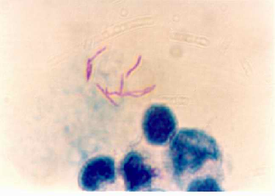
Table 2
Normal value | Patient’s result | PARAMETERS
50-180 | 200 | Opening Pressure mm of H₂O
Clear | Clear | Transparency
0-5 | 876 | Cell Count/µL
Lymphocytes | 91% lymph, 9% monocytes | Differential
2.2-3.5 | 2.18 | Glucose mmol/L
0.2 – 0.4 | 3.2 | Protein g/L
Fig 2

Slide 9
What is most likely diagnosis?
What is significance of ZN staining?
What is the pathology in patient’s right eye?

Slide 10
CASE 3
A 27-years-young man reported with mild headache and low grade fever for the past 36 hours. His examination showed temp 100º F, neck rigidity present and glascow coma scale 14/15. CSF exam showed results shown in table 3. The staining of the deposit showed no organisms in Gram/ ZN and India ink staining.

Slide 11
Normal value | Patient’s result | PARAMETERS
50-180 | 190 | Opening Pressure mm of H₂O
Clear | Clear | Transparency
0-5 | 210 | Cell Count/µL
Lymphocytes | 96% lymph, 4% monocytes | Differential
2.2-3.5 | 3.2 | Glucose mmol/L
0.2 – 0.4 | 1.13 | Protein g/L
No org | No org | Deposit

Slide 12
What is most likely diagnosis?
What organism is likely to be responsible?
What is the usual outcome of this infection?

Slide 13
CASE 4
A 31-years-old person reported to emergency dept with 5 days h/o fever, headache, occasional vomiting and ill health and confusion for the past 2 hours. He was diagnosed as a case of HIV infection three years earlier. His exam showed temp 99.9ºF, neck stiffness positive with positive kernig and brudzinski’s sign. His CSF exam is shown in Table 4 while India Ink preparation in Fig 4.

Slide 14
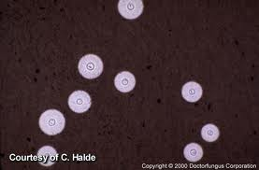
Table 4
Normal value | Patient’s result | PARAMETERS
50-180 | 210 | Opening Pressure mm of H₂O
Clear | Clear | Transparency
0-5 | 810 | Cell Count/µL
Lymphocytes | 95% lymph, 5% monocytes | Differential
2.2-3.5 | 1.8 | Glucose mmol/L
0.2 – 0.4 | 2.9 | Protein g/L
No org | See Fig 4 | Deposit
Fig 4

Slide 15
What is most likely diagnosis?
What organism is visible on India Ink preparation?
What is the association of this organism with HIV infection?

