Slide 1
MENINGITIS
Assist Prof Dr.
Syed Yousaf Kazmi

Slide 2
LEARNING OBJECTIVES
List causes of acute and chronic meningitis
Discuss pathogenesis of acute and chronic meningitis
Discuss mechanism of transmission of pathogens causing acute and chronic meningitis
Discuss pathogenesis of Tuberculous, Cryptococcal and Viral Meningitis
Explain the role of immunization in prevention of acute and chronic meningitis

Slide 3
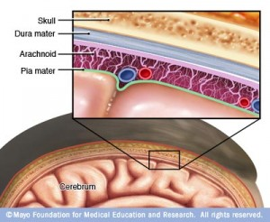
MENINGITIS
Meningitis is an inflammation of the meninges- membranous covering of the brain and the spinal cord
Most commonly caused by infection (bacteria, viruses, or fungi)
Other causes
  Bleeding into the meninges
  Cancer
  Diseases of the immune system
  Inflammatory response to certain chemotherapeutic/ other chemical agents

Slide 4
ACUTE MENINGITIS
BACTERIAL CAUSES
Streptococcus pneumoniae
Neisseria meningitidis
Haemophilis infleunzae
Listeria monocytogenes
Group B streptococci (S agalactiae)
Escherichia coli
Staphylococci
VIRAL CAUSES
Enteroviruses
Mumps virus
Herpesvirus (Epstein-Barr virus, Herpes simplex virus, varicella-zoster virus)
Measles virus
Influenza Virus
Arboviruses
Rarely: LCMV (lymphocytic choriomeningitis virus)

Slide 5
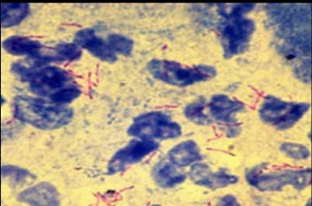
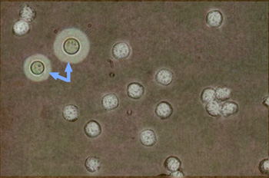
CHRONIC MENINGITIS
Mycobacterium tuberculosis
Cryptococcus neoformans
Sporothrix
Histoplasma
Blastomyces
Borrelia burgdorferi
Treponema pallidum
Leptospira
Brucella
Actinomyces
Listeria
Taenia solium (cysticercosis)
Schistosoma
Ref: http://www.uptodate.com/contents/image?imageKey=ID%2F76402&topicKey=ID%2F1275&source=see_link
TB meningitis CSF
Cryptococcal meningitis CSF

Slide 6
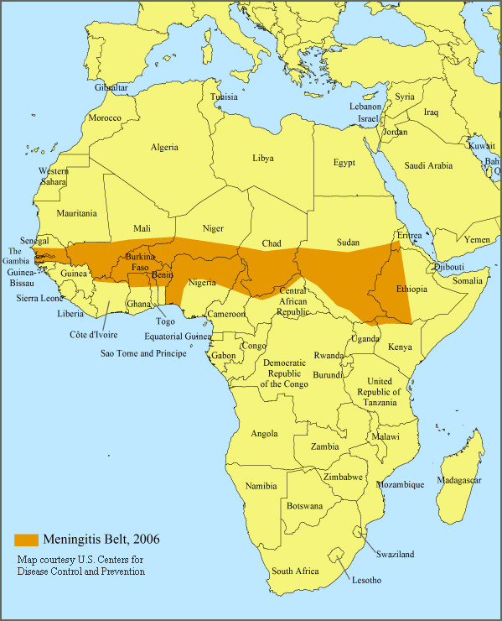
PATHOGENESIS-ACUTE MENINGITIS
RISK FACTORS
  Age
  Community setting e.g. college students living in dormitories and military personnel
  Certain medical conditions e.g. head trauma, CSF otorrhea, shunt placement
  Complement deficiency (C5,6,7,8)
  Viral URTI-RSV, Influenza virus
  Lack of vaccination e.g. Hib
  Working with meningitis-causing pathogens
  Travel to meningitis belt
  Splenectomy, sickle cell disease

Slide 7
PATHOGENESIS-ACUTE MENINGITIS
TRANSMISSION & COLONIZATION
  Some org contagious but not like common cold
  Ns. meningitidis-nasopharyngeal colonization-30% pop
  Colonization increase in epidemics upto 70-80%
  Many org e.g. Strep pneumoniae normal commensal
  Viral infection e.g. Influenza, RSV-damage cilia favors attachment to resp epith
  Viral meningitis-usually a complication of inf e.g. Mumps

Slide 8
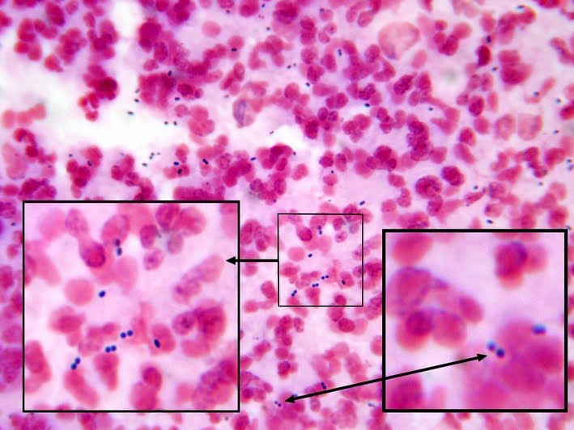
PATHOGENESIS-ACUTE MENINGITIS
INVASION
  Invasion into blood stream- due to risk factors
  Certain org e.g. Ns. meningitidis, Strep pneumoniae –intrinsic virulence factors e.g. pili, IgA protease, capsule
  Org enter blood
  Spleen normally filters org in blood-Splenectomy
  Complement system also kill-Complement def
  Monocytes carry org across blood brain barrier

Slide 9
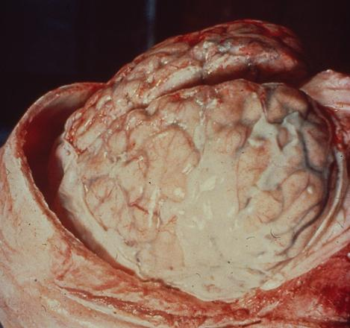
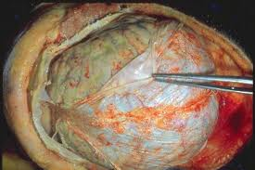
PATHOGENESIS-ACUTE MENINGITIS
HOST RESPONSE
  Once inside CSF-unchecked replication
  Bacterial component-IL-1,6, TNF-chemotactic
  Inflammation-Neutrophils recruited from blood into CSF
  Lymphocyte pleocytosis in viral infection
  Inflammatory cells obstruct CSF reabsorption
  Interstitial edema-limited space-grave consequences

Slide 10
VIDEO

Slide 11
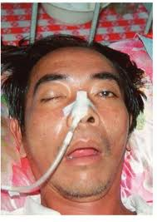
CHRONIC MENINGITIS-PATHOGENESIS
  Mainly TBM, Cryptococcal meningitis
  TB mainly spread via droplet infection-lungs
  Prim TB-ghons complex mainly in lungs but any organ may be involved
  Contained in granuloma-Latent
  Reactivation due to immunosuppression
  If granuloma near ventricles-spill TB bacilli in CSF
  Bacilli spread via CSF-Basilar cistern

Slide 12
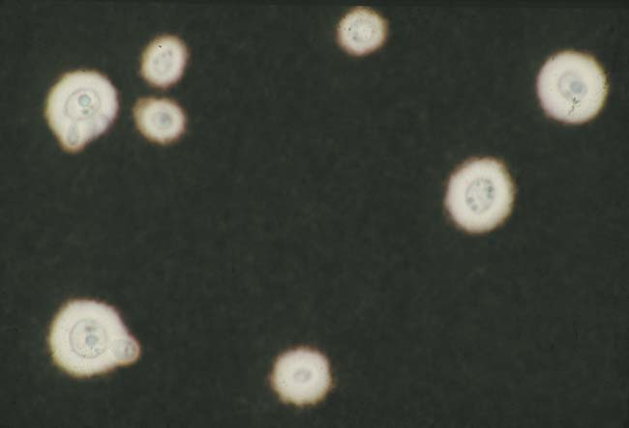
CRYPTOCOCCAL MENINGITIS-PATHOGENESIS
  Cryptococcus neoformans- yeast
  Spores in pigeons/ birds dropping
  No person to person transmission
  Cryptococcal meningitis mostly in AIDS/ other conditions of immunosuppression e.g. malignancies, organ transplants, steroid therapy etc.
  20% infected individuals immuno-competent
  Spores inhaled- lung infection
  Dissemination to brain and meninges
  Chronic inflammation
Cryptococcus capsule in India ink

Slide 13
CRYPTOCOCCAL MENINGITIS-PATHOGENESIS
VIDEO

Slide 14
VIRAL MENINGITIS-PATHOGENESIS
  Mostly Enterovirus(Coxsackievirus, poliovirus, echovirus)
  Others e.g. Mumps, Herspesvirus, arboviruses
  Enteroviruses-transmission via direct contain or feco-oral
  Upper airway multiplication-CNS
  Meninges infection-cell necrosis
  Inflammation-lymphocytes recruited
  Usually mild illness with good prognosis

Slide 15
VIRAL MENINGITIS-PATHOGENESIS
VIDEO

Slide 16
ROLE OF VACCINE
Ns. meningitidis
  A polysaccharide tetravalent vaccine (Menomune®) against serogroups A, C, Y, and W-135-poor immunity
  A tetravalent conjugate vaccine (Menactra™) capsular polysaccharide conjugated to diphtheria toxoid-excellent immunogenicity
  Streptococcus pneumoniae
  A polysaccharide vaccine containing 23 types
  Pneumococcal conjugate vaccine contains capsular polysaccharides conjugated to diphtheria CRM197 protein

Slide 17
ROLE OF VACCINE
Haemophilus influenzae
  Haemophilus b conjugate vaccine (Hib)
  PRPHbOC (conjugated with tetanus toxoid, Ns. meningitidis OMP, diphtheria toxin)
  Mycobacterium tuberculosis
  BCG (bacillus Calmette-Guérin, an attenuated bovine organism)
Viral meningitis
  Vaccine available for Measles, Mumps, Polioviruses, Influenza virus etc.

Slide 18
ROLE OF VACCINE
  Vaccines have dramatically reduced incidence of various causes of meningitis e.g. H. influenzae
  Vaccines for meningitis prevention are given to certain risk groups e.g. pilgrims, travellers to meningitis belt, splenectomized patients, patients with complement deficiencies, etc.
  Close contacts of meningococcal meningitis are also administered vaccine and chemoprophylaxis
  BCG vaccine does not prevent pulmonary disease but may prevent meningitis

Slide 19
THANK YOU

