Slide 1
Blood Supply of Brain and Spinal Cord
Lecture: 17
Dr. Fahim Haider Jafari
PhD

Slide 2
Learning Objectives
Enumerate arterial supply of brain
Explain division of arterial system in carotid and vertebral systems
Enumerate branches of carotid and intervertebral arteries
Explain circle of Willis and identify arterial supply of specific brain areas
Enumerate veins of brain and spinal cord
Identify clinical application

Slide 3
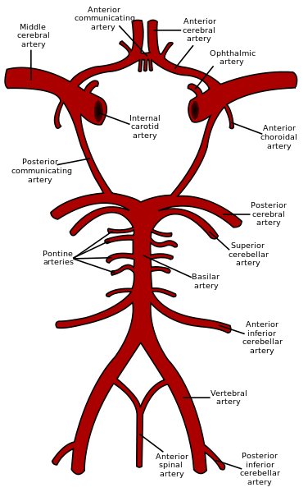
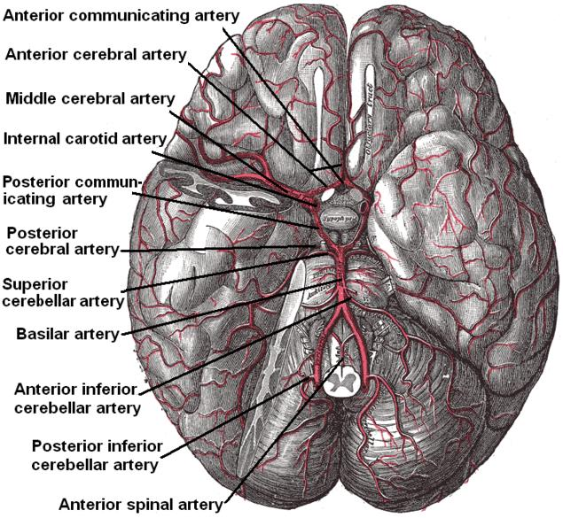
Circle of Willis

Slide 4
Arterial Supply of Brain
The brain receives blood from two sources: the internal carotid arteries, which arise at the point in the neck where the common carotid arteries bifurcate, and the vertebral arteries
The internal carotid arteries branch to form, the anterior and middle cerebral arteries
The right and left vertebral arteries come together at the level of the pons on the ventral surface of the brainstem to form the midline basilar artery
The basilar artery joins the blood supply from the internal carotids in an arterial ring at the base of the brain (in the vicinity of the hypothalamus and cerebral peduncles) called the circle of Willis
The posterior cerebral arteries arise at this confluence, as do two small bridging arteries, the anterior and posterior communicating arteries

Slide 5
Physiological Significance
The arrangement of the brain's arteries into the Circle of Willis creates collaterals in the cerebral circulation
If one part of the circle becomes blocked or narrowed (stenosed) or one of the arteries supplying the circle is blocked or narrowed, blood flow from the other blood vessels can often preserve the cerebral perfusion well enough to avoid the symptoms of ischemia

Slide 6
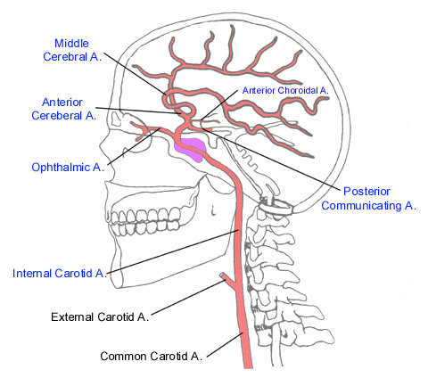
Internal Carotid Artery
Arises from common carotid artery in the neck, entering head at skull base via the carotid canal, and terminates at bifurcation into the anterior cerebral artery and middle cerebral artery
The extracranial segment of the ICA is from the origin of the ICA to the skull base
The intracranial segment of the ICA is divided into petrous, cavernous, supraclinoid portions

Slide 7
Internal Carotid Artery
Upon exiting the cavernous sinus, the ICA extends through the meninges to become the supraclinoid segment
The supraclinoid or cerebral ICA bends posteriorly and laterally between the oculomotor (III) and optic (II) nerves
Branches:
to the superior hypophyseal perforators to the anterior pituitary and stalk
posterior communicating artery (PCoA)
anterior choroidal artery (AChA)
bifurcating into the ACA and MCA

Slide 8
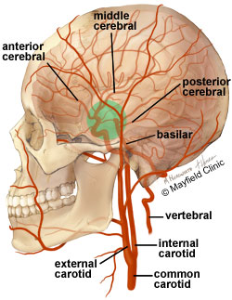
Arterial Supply of Brain
The major branches that arise from the internal carotid artery—the anterior and middle cerebral arteries—form the anterior circulation that supplies the forebrain
Each gives rise to branches that supply the cortex and branches that penetrate the basal surface of the brain, supplying deep structures such as the basal ganglia, thalamus, and internal capsule
Particularly prominent are the lenticulostriate arteries that branch from the middle cerebral artery
These arteries supply the basal ganglia and thalamus

Slide 9
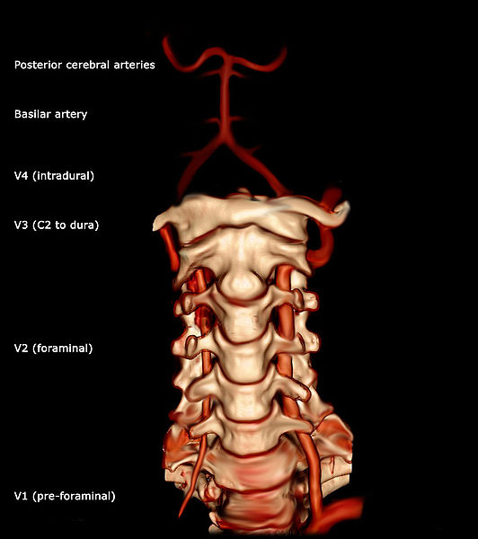
Vertebral arteries
They branch from the subclavian arteries
Enter deep to the transverse process of the level of the C6
Then proceed superiorly, in the transverse foramen of each cervical vertebra until C1
At the C1 level, the vertebral arteries travel across the posterior arch of the atlas through the suboccipital triangle before entering the foramen magnum

Slide 10
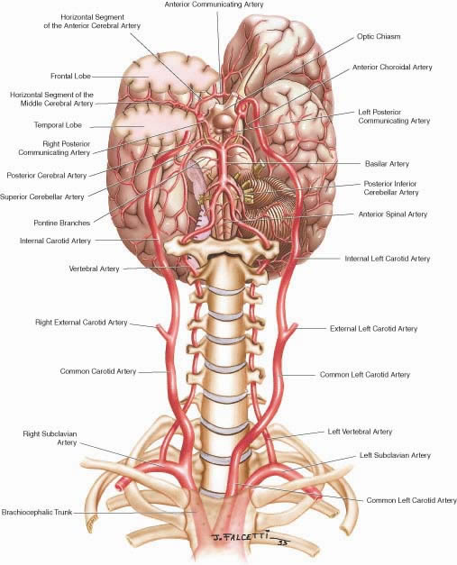

Slide 11
Vertebral arteries
Inside the skull, the two vertebral arteries join up to form the basilar artery at the base of the medulla oblongata
The basilar artery is the main blood supply to the brainstem and connects to the Circle of Willis to potentially supply the rest of the brain if there is compromise to one of the carotids

Slide 12
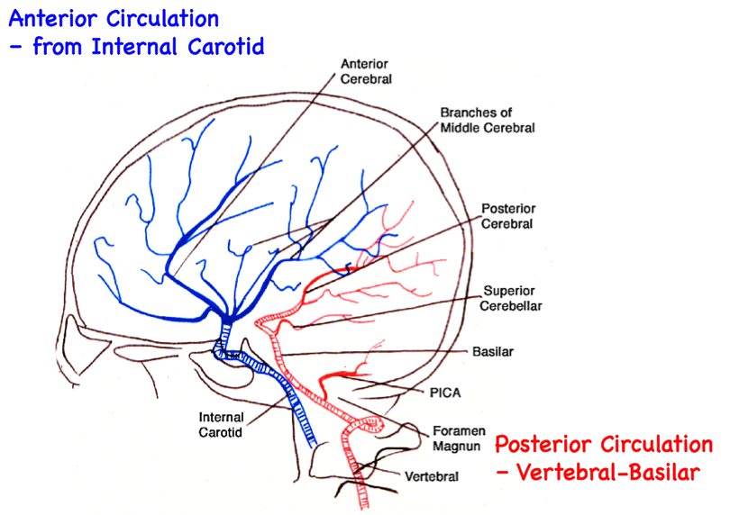
Arterial Supply of Brain
The posterior circulation of the brain supplies the posterior cortex, the midbrain, and the brainstem
Comprises arterial branches arising from the posterior cerebral, basilar, and vertebral arteries
Midline arteries supply medial structures, lateral arteries supply the lateral brainstem, and dorsal-lateral arteries supply dorsal-lateral brainstem structures and the cerebellum

Slide 13
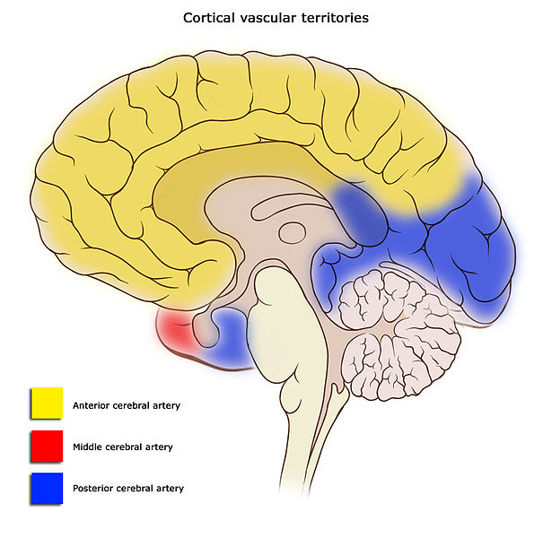
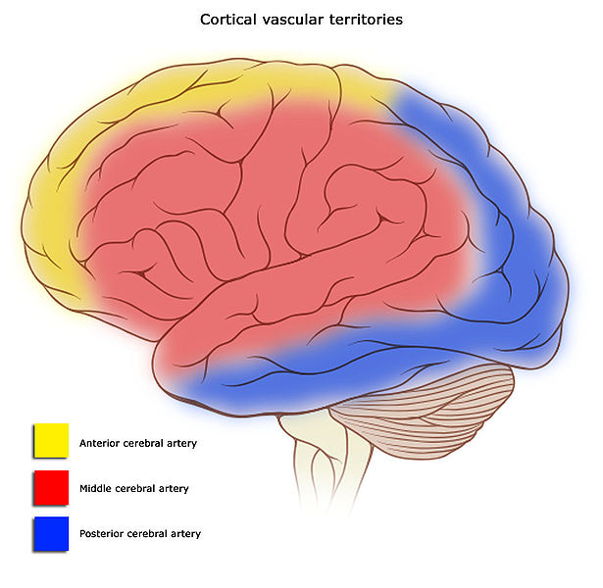
Arterial Supply to Brain

Slide 14
Origin of Arteries
The left and right internal carotid arteries arise from the left and right common carotid arteries
The posterior communicating artery is given off as a branch of the internal carotid artery just before it divides into its terminal branches - the anterior and middle cerebral arteries
The anterior cerebral artery forms the anterolateral portion of the Circle of Willis, while the middle cerebral artery does not contribute to the circle
The right and left posterior cerebral arteries arise from the basilar artery, which is formed by the left and right vertebral arteries
The vertebral arteries arise from the subclavian arteries
The anterior communicating artery connects the two anterior cerebral arteries and could be said to arise from either the left or right side

Slide 15
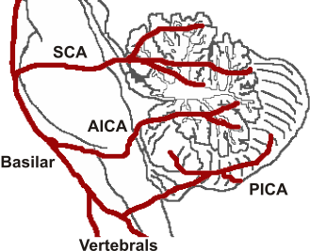
Blood Supply to Cerebellum
Superior cerebellar artery (SCA) from basilar artery
Anterior inferior cerebellar artery (AICA) from basilar artery
Posterior inferior cerebellar artery (PICA) from vertebral artery

Slide 16
Blood Supply to Spinal Cord
The spinal cord is supplied with blood by three arteries that run along its length starting in the brain, and many arteries that approach it through the sides of the spinal column
The three longitudinal arteries are called the anterior spinal artery, and the right and left posterior spinal arteries
These travel in the subarachnoid space and send branches into the spinal cord
They form anastamoses via the anterior and posterior segmental medullary arteries, which enter the spinal cord at various points along its length
Supply blood upto cervical segments

Slide 17
Blood Supply to Spinal Cord
Arterial blood supply below the cervical region comes from the radially arranged posterior and anterior radicular arteries, which run into spinal cord alongside the dorsal and ventral nerve roots
These intercostal and lumbar radicular arteries arise from the aorta, provide major anastomoses and supplement the blood flow to the spinal cord
Largest of the anterior radicular arteries is known as the artery of Adamkiewicz, which usually arises between L1 and L2
Impaired blood flow through these critical radicular arteries, especially during surgical procedures that involve abrupt disruption of blood flow through the aorta for example during aortic aneursym repair, can result in spinal cord infarction and paraplegia

Slide 18
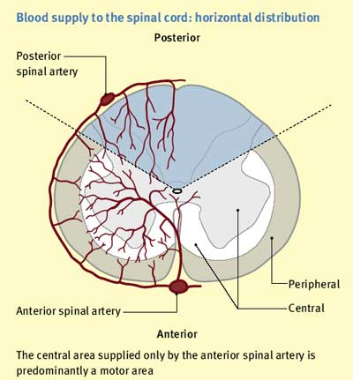

Slide 19
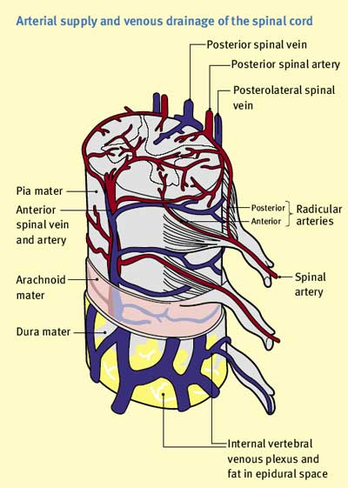

Slide 20
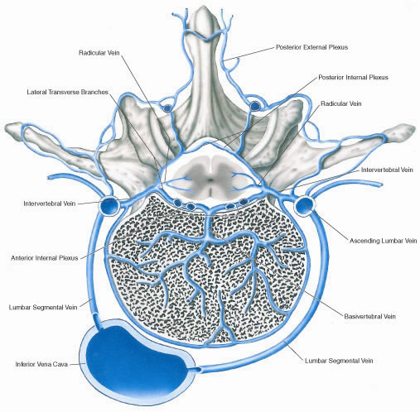

Slide 21
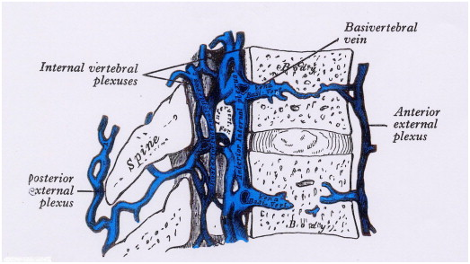

Slide 22
Extra-dural Hemorrhage
It results from injuries of the meningeal arteries or veins
The most common is the anterior branch of the middle meningeal artery
A minor blow to the side of the head result in fracture of the anteroinferior portion of the parietal bone (pterion)
The intracranial pressure rises. The blood clot exerts local pressure on the underlying motor area in the precentral gyrus
Blood may pass out through the fracture line to form a soft swelling under the temporalis muscle
The burr hole through the skull wall should be placed 2.5 to 4 cm above the midpoint of the zygomatic arch to ligate or plug the torn artery or vein

Slide 23
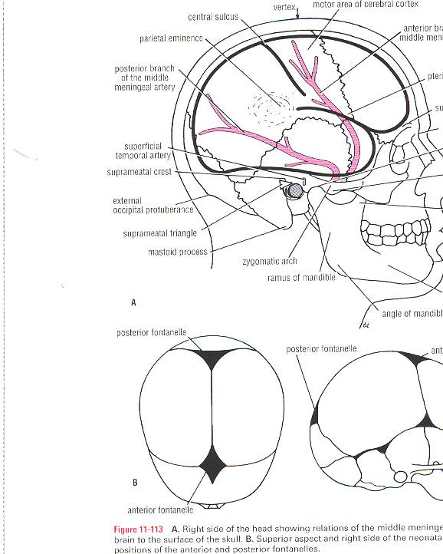

Slide 24
Sub-dural Hemorrhage
It results from tearing of the superior cerebral veins at their entrance into the superior sagittal sinus
Cause is a blow on the front or back of the head causing anteroposterior displacement of the brain within the skull
Blood under low pressure begins to accumulate in the space between the dura and arachnoid
Acute symptoms in the form of vomiting due to rise in the venous pressure may be present. In the chronic form, over a several months, the small blood clot will attract fluid by osmosis so a hemorrhagic cyst is formed and gradually expands produces pressure

Slide 25
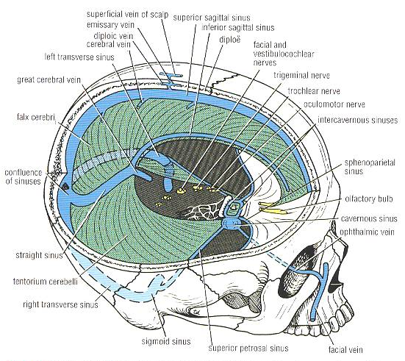
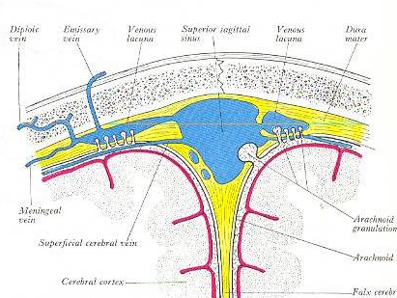
Sub-dural Hemorrhage

Slide 26
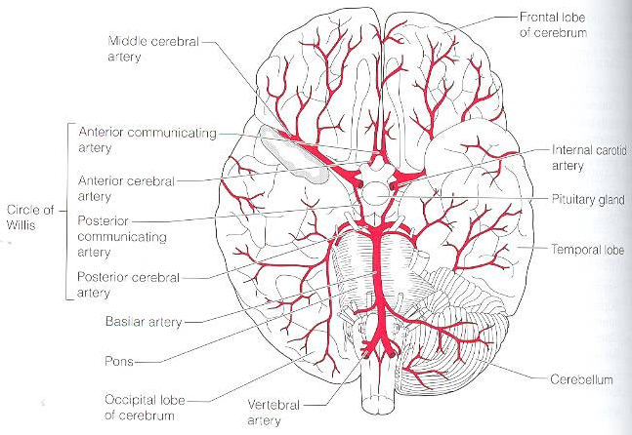
Subarachnoid Hemorrhage
It results from leakage or rupture of a congenital aneurysm on the circle of Willis
The sudden symptoms include severe headache; stiffness of the neck and loss of consciousness
The diagnosis is established by withdrawing heavily blood- stained CSF fluid through a lumbar puncture ( spinal tap )

Slide 27
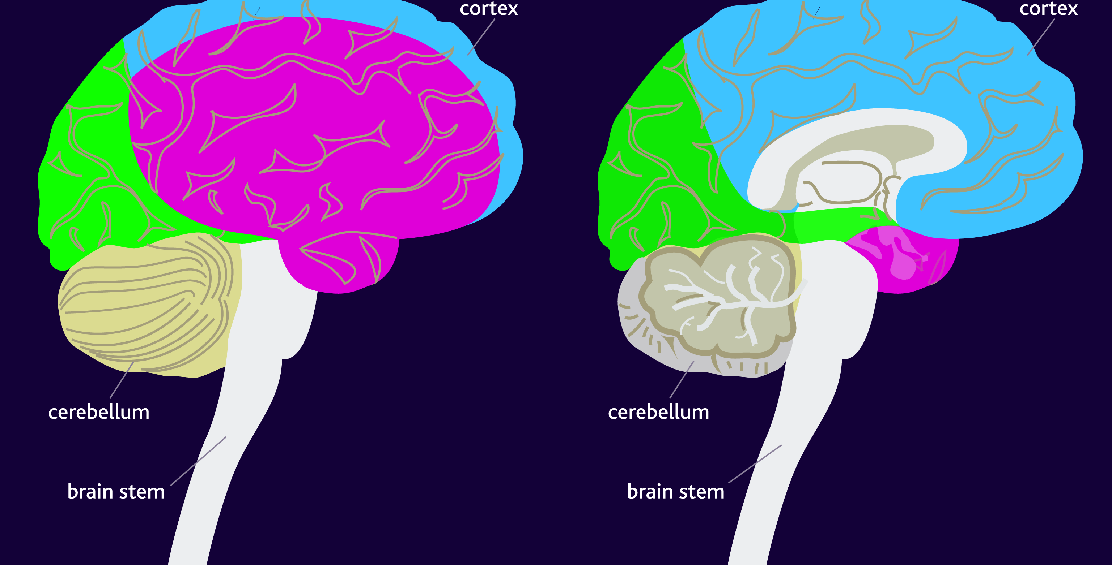
The areas of the brain affected by stroke
A stroke is the sudden damage or death of cells in a localised area of the brain, due to inadequate blood flow. A stroke occurs when blood flow is interrupted causing oxygen starvation. A haemorrhage or thrombosis in the main arteries of the brain can cause this oxygen starvation. The areas of the brain affected by the stroke depend on the particular artery that is affected: middle cerebral artery (pink); posterior cerebral artery (green); and anterior cerebral artery (blue).

