Slide 1
SLEEP
By
DR KAMRAN AFZAL

Slide 2
Learning Objectives
At the end of the lecture the student should be able to
Enumerate different types of sleep and differentiate between them
Explain the sleep cycle
Describe the mechanism of sleep generation
Understand the physiological effects of sleep
Apply his knowledge to understand sleep disorders

Slide 3
SLEEP
Sleep is a universal behaviour that is displayed by all mammals and birds, and some cold-blooded vertebrates.
Human beings spend approximately one third of their lives asleep.
Sleep represents an altered state of consciousness from which a person can be aroused

Slide 4
In a sleep laboratory a subject’s physiological responses while asleep are recorded using a polygraph machine.
Recorded responses include:
Electrical activity of the brain – electroencephalograms (EEGs)
Electrical signals from muscles – electromyograms (EMGs)
Electrical signals from heart – electrocardiograms (EKGs)
Electrical activity caused by eye movement – electro-oculograms (EOGs)

Slide 5
Stages of Sleep
EEG recordings during sleep have helped identify four distinct stages of sleep.
These different stages have distinct frequency (number of cycles per second) and amplitude (height of the recorded waves).

Slide 8
Beta activity is high frequency (15-30 Hz) and low amplitude.
Alpha activity has a medium frequency (8-12 Hz) and a medium-amplitude rhythm.
First stage of sleep (stage 1) is marked by the emergence of theta activity (3.5-7.5 Hz).
Stage 1 is a transition stage between sleep and wakefulness. A person can easily be awakened at this stage.

Slide 9
A person is completely asleep as they enter Stage 2 sleep.
The EEG gets progressively lower in frequency and higher in amplitude.
As sleep becomes deeper sleep spindles emerge – periodic 1 to 2 second bursts of rapid brain-wave activity (12 to 15 Hz). Also K-Complex.
During Stage 2 and Stage 3 sleep muscles become more relaxed, breathing and heart rate slow, becomes harder to be awakened.

Slide 11
Stage 4 sleep consists mainly of delta activity – relatively high-amplitude waves occurring at less than 3.5 Hz.
Sleeper much less responsive to environment and difficult to awaken.
Stages 3 and 4 are collectively known as slow wave or Non Rapid-Eye-Movement (NREM) sleep.

Slide 12
Stage 4 sleep is reached in less than an hour and continues for up to 30 minutes.
EEG records then indicate that the brain shifts back up through stages 4 to 2.
Instead of waking up the sleeper enters Rapid-Eye-Movement sleep.
The associated EEG is very similar to that of the waking brain. Heartbeat and respiration become irregular and the eyes move rapidly back and forth.

Slide 13
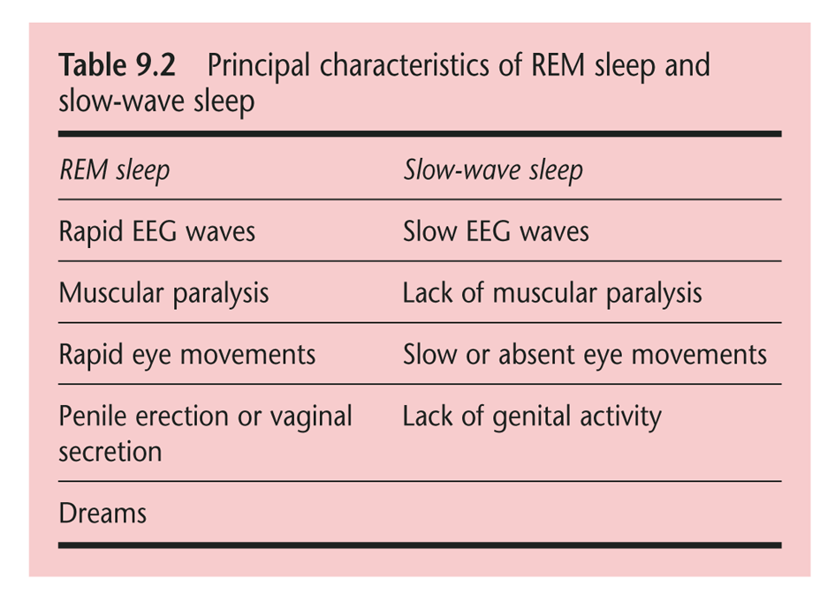

Slide 14
First episode of REM sleep lasts 20-30 minutes, followed by approx. 1 hour of slow-wave sleep.
As night goes on REM episodes get longer and slow-wave intervals grow shorter – total cycle remains approx 90 minutes.
A typical night’s sleep will consist of 4-5 of these cycles.

Slide 16
What is REM sleep for?
Total sleep deprivation is lethal, but what about selective REM sleep deprivation?
EEG recording allows volunteers to be woken up every time they start to enter REM sleep.
After REM sleep deprivation ends subjects experience a REM-rebound effect. This has been demonstrated in both animals and humans.

Slide 17
REM-Rebound Effect

Slide 18
According to Winson (1990) REM sleep is vital for a process of memory consolidation to occur.

Slide 19
However…..
Animals deprived of REM sleep take longer to learn a task, but they can still learn it.
Patients who sustain damage to the brain stem may show little or no REM sleep at all (Lavie et al., 1984; Gironell et al., 1995).
Despite this they show few serious side effects.

Slide 20
Theories of Sleep
Given that we spend a third of our lives asleep, why is it so important?
There are two main types of explanation:
Restoration models
Evolutionary/circadian sleep models

Slide 21
Restoration Models of Sleep
Sleep is necessary to recharge our bodies and allow us to recover from physical and mental fatigue (Hess, 1965).
A meta-analysis of 38 sleep studies by Youngstedt et al. (1997) found people sleep longer by only 10 minutes following exercise.
Shapiro et al. (1981) studied 18- to 26-year-old ultramarathon runners.
Found that they slept longer and spent more time in slow-wave sleep for two days following a 57-mile run.

Slide 22
What is it that gets ‘restored’ during sleep?
One theory is that sleep allows the body to purge build-up of a cellular waste product called adenosine (Mendelson, 2000; Rail, 1980).
Adenosine is produced as cells consume fuel. Build-up decreases alertness and signals that too much cellular fuel has been burned.

Slide 23
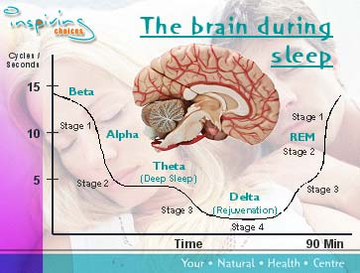

Slide 24
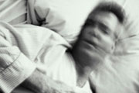
Insomnia

Slide 25
Prevalence
Is a very common sleep disorder that affects approximately 10% of the adult population on a chronic basis
More common among women and older adults
Insomnia can also be associated with chronic pain and psychological disorders such as anxiety or depression
If left untreated, insomnia could lead to major depression
Less than 15% of individuals affected by this disorder receive any treatment

Slide 26
Possible Causes
Most common cause is stress, and insomnia can hit at the most inopportune times in one’s life
The environment one is sleeping in
Excessive napping during the day
Too much caffeine, nicotine, or alcohol before bed
Excessive neural activity and chemical imbalances could also be a factor such as high levels of cortisol and other stress hormones
Psychological disorders such as anxiety, depression, and bipolar disorder can cause insomnia

Slide 27
Symptoms
Individual may fall into a deep sleep for the first few hours and then wake up after about 2 or 3 hours
Person will toss and turn, think and worry about unimportant details, or listens to every sound
Problems falling back asleep even though one is very tired
Feeling sleepy during the day
Having poor and slow judgement
Inability to remember things
Easily irritated

Slide 28
Other Forms and Types of Insomnia
Difficulty falling asleep
Waking up too early
Not feeling refreshed after waking up
Transient
Short-term
Chronic

Slide 29
Treatment for Insomnia
Tips for getting a better night’s sleep:
Avoid or limit use of caffeine, alcohol, tobacco, and/or cold medicines before bed
Exercise more often, but not within a few hours of going to bed
Learn to reduce or manage stress in life
Try eating a light snack before going to bed
Don’t nap during the day if it makes symptoms worse
About 15% of chronic insomniacs need medical treatment

Slide 30
Treatment for Insomnia
Prescription drugs include:
Nefazodone (Serzone)
Chloral hydrate
Barbiturates (Seconal, Nembutal)
However, this treatment can be very dangerous if an overdose occurs and addiction and abuse are common with this drug

Slide 31
Summary
Sleep is essential for human survival, but the reasons why remain unclear.
[Sleep is] the golden chain that ties health and our bodies together.
  Thomas Dekker
  English dramatist (1572 - 1632)

Slide 32
References
Sleep Stages. (1998). Retrieved December 5, 2005, from http://www.sleepdisorderchannel.net/stages/
A Brief History of Sleep Research. (1999, February 3). Retrieved December 5, 2005, from http://www.stanford.edu/~dement/history.html
Sleep 4 Health. (2003). Retrieved December 3, 2005, from http://www.sleep4health.com.au/sleep.asp
Chaudhuri, K. Ray. (2003). The Restless Legs Syndrome: Time to Recognize a Very Common Movement Disorder. Practical Neurology, 4, 204-213. Retrieved December 5, 2005, from EBSCOhost.
Insomnia-The Effects, Symptoms, and Treatment. Retrieved December 5, 2005, from http://miscarriage.homestead.com/insomnia.html
Information of Insomnia-Symptoms, Causes, Treatments. (2002). Retrieved December 4, 2005, from http://scsc.essortment.com/insomniasymptom_roqy.htm
What Are Drug Treatments for Insomnia? (2002, June 30). Retrieved December 5, 2005, from http://www.umm.edu/patiented/articles/what_drug_treatments_insomnia_000 027_8.htm

