Slide 1
Lecture no 21
Dr. Mohammad Rehan Asad

Slide 2
At the end of the lecture the student should be able to
Enlist nuclei, components and course of glossopharyngeal nerve
Enlist nuclei, components and course of vagus nerve
Enlist nuclei, components and course of spinal accessory and hypoglossal nerve.
Identify and describe parasympathetic ganglia of head.

Slide 3
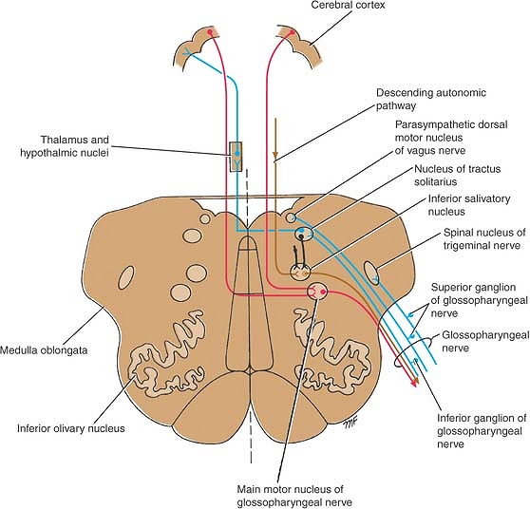
Glossopharyngeal nerve
Mixed: motor and a sensory nerve
Main motor nucleus
Parasympathetic nucleus (inf. Salivatory)
Sensory nucleus

Slide 5
Main motor nucleus
Location: deep in the reticular formation of the medulla oblongata and is formed by the superior end of the nucleus ambiguus.
Afferent
corticonuclear fibers
Efferent
Stylopharyngeus muscle

Slide 6
Parasympathetic Nucleus
Afferent
taste
Nucleus tractus solitarius
Olfactory system via reticular formation
Efferent
Hypothalamus
Preganglionic reach otic ganglion
Via tympanic plexus, lesser petrosal nerve
Post ganglionic fibres reach to parotid gland

Slide 7
Sensory Nucleus
Component of nucleus tractus solitarius
Opposite ventral nuclei of thalamus
and Hypothalamus
Efferent
Taste sensation
Pass through axon and synapse in nucleus
Pass through internal capsule and reach post central gyrus

Slide 8
Sensory Nucleus
Afferent
information common sensation enters the brainstem through the superior ganglion of the glossopharyngeal nerve and ends in the spinal nucleus of the trigeminal nerve
Afferent impulses from the carotid sinus, a baroreceptor situated at the bifurcation of the common carotid artery, also travel with the glossopharyngeal nerve.
terminate in the nucleus of the tractus solitarius and are connected to the dorsal motor nucleus of the vagus nerve.
carotid sinus reflex that involves the glossopharyngeal and vagus nerves assists in the regulation of arterial blood pressure.

Slide 9
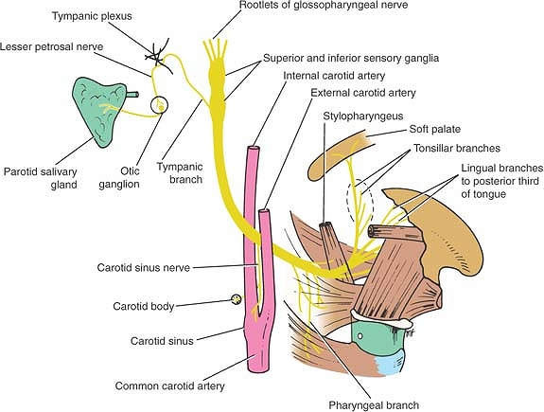
Course
It leaves the skull through the jugular foramen.
superior and inferior glossopharyngeal sensory ganglia are situated on the nerve here.
descends through the upper part of the neck with the internal jugular vein and the internal carotid artery to reach the posterior border of the stylopharyngeus muscle
The nerve then passes forward between the superior and middle constrictor muscles of the pharynx to give sensory branches to the mucous membrane of the pharynx and the posterior third of the tongue

Slide 10
Vagal nerve
Brachial efferent:
Nucleus ambiguus in upper medulla for skeletal muscle, pharynx and upper oesophagus and cricithyroid
Special visceral efferent (parasympathetic):
Dorsal motor nucleus of vagus in upper medulla
Give efferents to cardiac and visceral muscle of thoracic and abdominal viscera
Two motor and two sensory nuclei

Slide 11
Vagal nerve
Special visceral afferent:
nucleus of tractus solitarius
Receive afferent from heart, lungs and abdominal viscera
Baroreceptor of aortic arch, chemoreceptor aortic bodies, taste from epiglottis
Somatic afferent:
spinal nucleus of trigeminal nerve
Receive skin of external acoustic meatus and auricle
Mucous membrane of pharynx and larynx

Slide 12
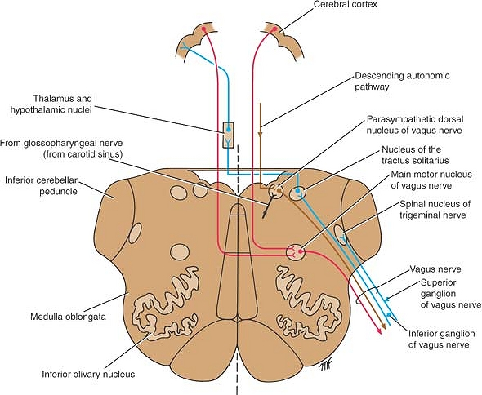

Slide 13
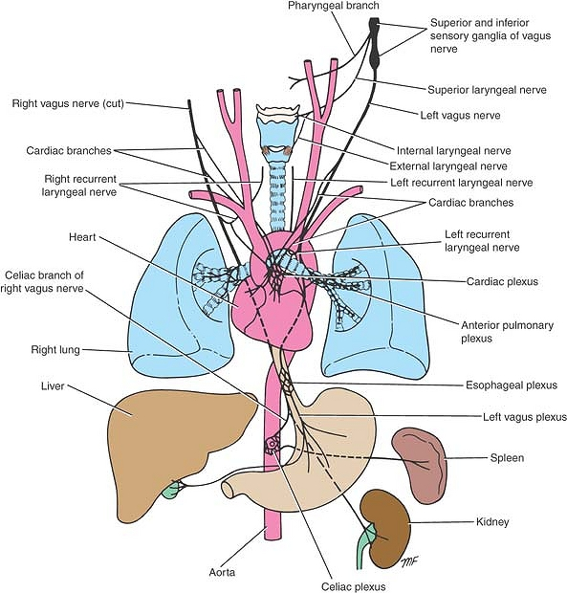
Course
leaves the skull through the jugular foramen.
possesses two sensory ganglia, a rounded superior ganglion within the jugular foramen, and a cylindrical inferior ganglion, just below the foramen.
descends vertically in the neck within the carotid sheath with the internal jugular vein and the internal and common carotid arteries.
The right vagus nerve enters the thorax posterior to the root of the right lung
Supply to the duodenum, liver, kidneys, and small and large intestines as far as the distal third of the transverse colon.
enters the thorax and crosses the left side of the aortic arch and descends behind the root of the left lung

Slide 14
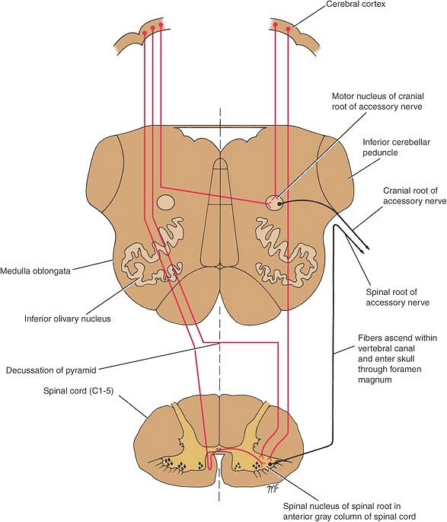
Accessory nerve nuclei
Two motor nuclei
Brachial efferent: two components
Cranial part: Nucleus abiguus in upper medulla
Fibers joining vagus for skeletal muscle of palate and pharynx
Spinal part: anterior horn cells of upper five cervical segments of spinal cord
For sternocleidomastoid and trapezius
The spinal nucleus receive corticospinal fibers from both cerebral hemispheres.

Slide 15
Course
The nerve runs laterally in the posterior cranial fossa and joins the spinal root.
The two roots unite and leave the skull through the jugular foramen.
The roots then separate, and the cranial root joins the vagus nerve and is distributed in its pharyngeal and recurrent laryngeal branches to the muscles of the soft palate, pharynx, and larynx.
Course of the Spinal Root: nerve trunk
Enters skull through the foramen magnum.
joins the cranial root And Exit through the jugular foramen.
the spinal root separates from the cranial root and runs downward and laterally and enters the deep surface of the sternocleidomastoid muscle and trapezius.

Slide 16
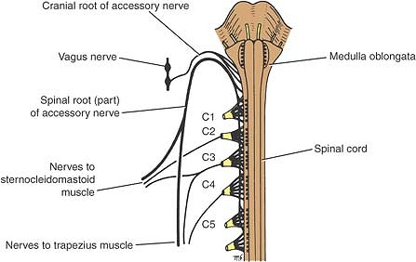
Course

Slide 17
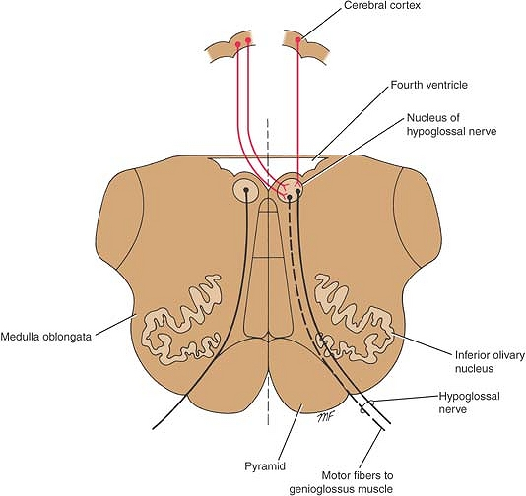
Hypoglossal nucleus
Somatic efferent: hypoglossal nucleus in upper medulla
Receives corticonuclear fibers from both hemisphere
Muscle of tongue

Slide 18
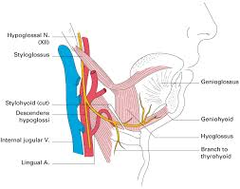
Course
Exit skull through the hypoglossal canal.
Passes forward in the neck between the internal carotid artery and the internal jugular vein until it reaches the lower border of the posterior belly of the digastric muscle.
Turn forward and crosses the internal and external carotid arteries and the loop of the lingual artery.
Passes deep to the posterior margin of the mylohyoid muscle lying on the lateral surface of the hyoglossus muscle.
Nerve then sends branches to the muscles of the tongue.
Hypoglossal nerve controls the movements and shape of the tongue.

Slide 19
Clinical application
Isolated lesions of the glossopharyngeal nerve are rare and usually also involve the vagus nerve
Hoarseness or absence of the voice may occur as a symptom of vagal nerve palsy.
Lesions involving the vagus nerve in the posterior cranial fossa commonly involve the glossopharyngeal, accessory, and hypoglossal nerves as well.

Slide 20
Clinical application
Lesions of the spinal part of the accessory nerve will result in paralysis of the sternocleidomastoid and trapezius muscles.
may result from tumour's or trauma from stab or gunshot wounds in the neck.
lower motor neuron lesion of hypoglossal nerve, the tongue will be observed to deviate toward the paralyzed side.
Patient has a lesion of the corticonuclear fibers, there will be no atrophy.
On protrusion tongue will deviate to opposite side because of genioglossus.

