Slide 1
LECTURE 31- DIENCEPHALON AND PITUITARY GLAND
Dr. Mohammad Rehan Asad

Slide 2
At the end of the lecture the student should be able to
Identify the structure and divisions of diencephalon.
Describe the boundaries of diencephalon.
Discuss external and internal features of thalamus.
Discuss sub thalamus, epithalamus, Habenular nucleus and pineal body.
Identify relations of hypothalamus.
Discuss hypothalamic nuclei in lateral and medial zones.
Identify afferent and efferent connections of hypothalamus.
Describe hypothalamic connections of pituitary gland.

Slide 3
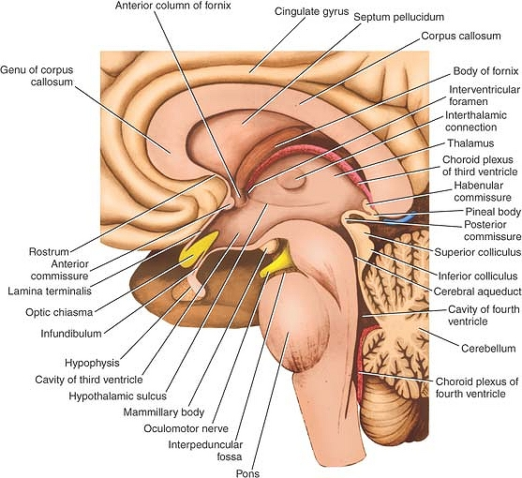
DIENCEPHALON
EPITHALAMUS
THALAMUS
SUBTHALAMUS
HYPOTHALAMUS

Slide 4
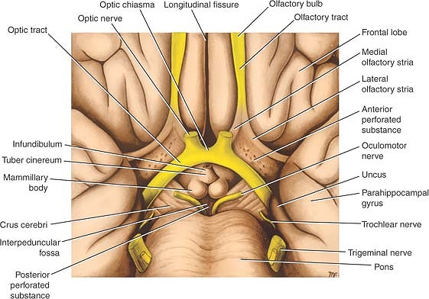
Diencephalon
Extend from interventricular foramen to posterior commissure
Symmetrical right and left halves
Formed by hypothalamic structures and also include, from anterior to posterior, the optic chiasma, with the optic tract on either side; the infundibulum, with the tuber cinereum; and the mammillary bodies.
superior wall of the diencephalon is formed by the roof of the third ventricle
The medial surface: formed in its superior part by the medial surface of the thalamus and in its inferior part by the hypothalamus
lateral surface of the diencephalon is bounded by the internal capsule

Slide 5
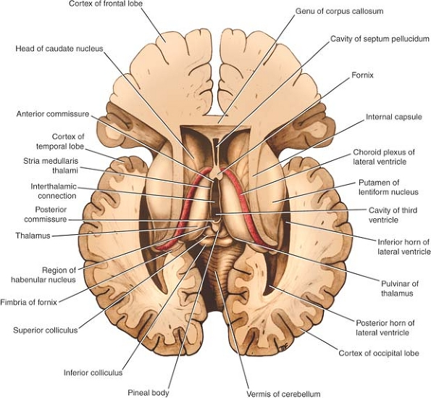
Thalamus
large ovoid mass of gray matter that forms the major part of the diencephalon.
Present on each side of the third ventricle.
The anterior end of the thalamus is narrow and rounded and forms the posterior boundary of the interventricular foramen.
The posterior end is expanded to form the pulvinar, which overhangs the superior colliculus and the superior brachium.
The lateral geniculate body forms a small elevation on the under aspect of the lateral portion of the pulvinar.

Slide 6
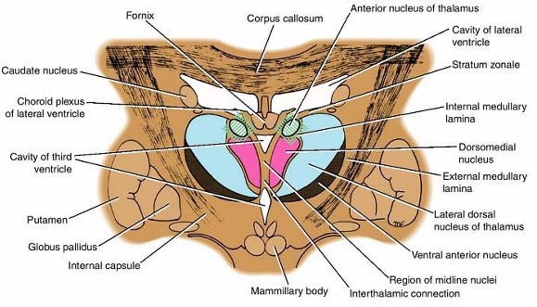
Thalamus
The superior surface is covered medially by the tela choroidea and the fornix
laterally, it is covered by ependyma and forms part of the floor of the lateral ventricle
The inferior surface is continuous with the tegmentum of the midbrain
The medial surface forms the superior part of the lateral wall of the third ventricle and is connected to the opposite thalamus by a band of gray matter, interthalamic adhesion.
The lateral surface is separated from the lentiform nucleus internal capsule

Slide 7
Epithalamus
consists of the habenular nuclei and their connections and the pineal gland
Habenular nucleus is a small group of neurons situated just medial to the posterior surface of the thalamus.
It is a centre for integration of olfactory, visceral, and somatic afferent pathway
The pineal gland is a small, conical structure that is attached by the pineal stalk to the diencephalon.
The base of the pineal stalk possesses a recess that is continuous with the cavity of the third ventricle
The superior part of the base of the stalk contains the habenular commissure
The inferior part of the base of the stalk contains the posterior commissure.

Slide 8
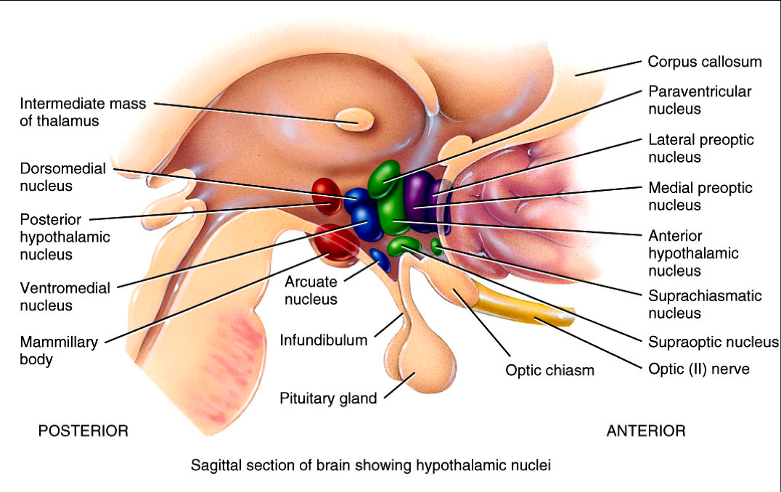
Hypothalamus
Extends from the region of the optic chiasma to the caudal border of the mammillary bodies
Located below the hypothalamic sulcus on the lateral wall of the third ventricle.
The hypothalamus controls and integrates the functions of the autonomic nervous system and the endocrine systems and plays a vital role in maintaining body homeostasis.
It is involved in such activities as regulation of body temperature, body fluids, drives to eat and drink, sexual behaviour, and emotion.

Slide 9
Relations
Anterior: area that extends forward from the optic chiasma to the lamina terminalis and the anterior commissure
Referred as the preoptic area.
Caudally, the hypothalamus merges into the tegmentum of the midbrain.
The thalamus lies superior to the hypothalamus
the subthalamic region lies inferolaterally to the hypothalamus

Slide 10
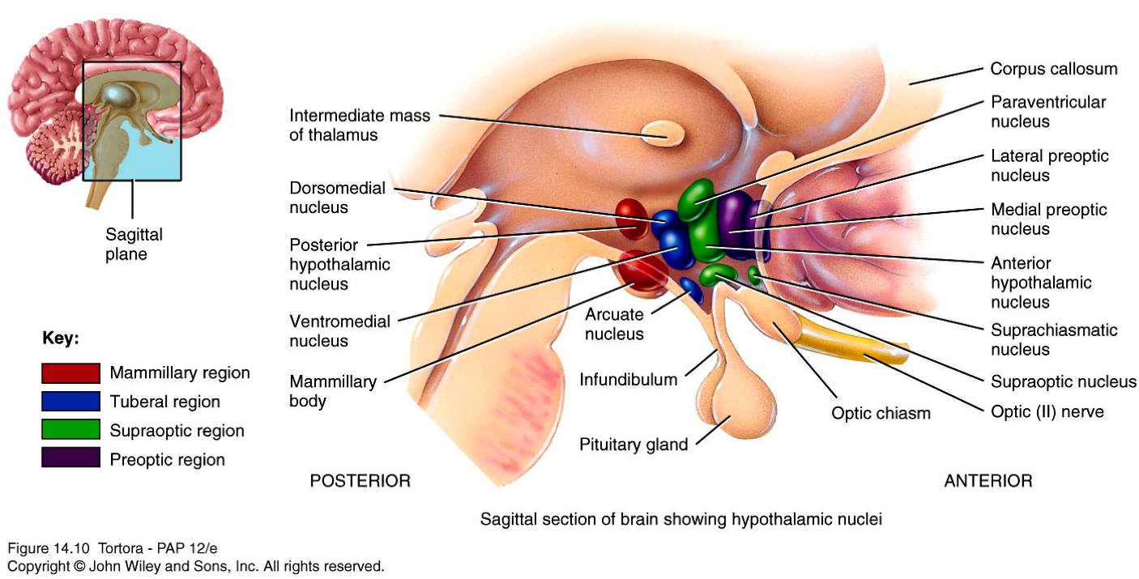
Nuclei
Medial Zone
part of the preoptic nucleus; the anterior nucleus, which merges with the preoptic nucleus; part of the suprachiasmatic nucleus; the paraventricular nucleus; the dorsomedial nucleus; the ventromedial nucleus; the infundibular (arcuate) nucleus; and the posterior nucleus.

Slide 11
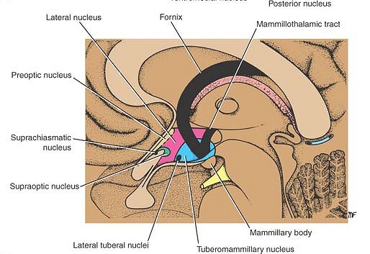
Nuclei
Lateral Zone
part of the preoptic nucleus; part of the suprachiasmatic nucleus ; the supraoptic nucleus; the lateral nucleus ; the tuberomammillary nucleus; the lateral tuberal nuclei.

Slide 12
 | Afferent Connections
Pathway | Origin | Destination
Medial and spinal lemnisci, tractus solitarius, reticular formation | Viscera and somatic structures | Hypothalamic nuclei
Visual fibers | Retina | Suprachiasmatic nucleus
Medial forebrain bundle | Olfactory mucous membrane | Hypothalamic nuclei
Auditory fibers | Inner ear | Hypothalamic nuclei
Corticohypothalamic fibers | Frontal lobe of cerebral cortex | Hypothalamic nuclei
Hippocampohypothalamic fibers; possibly main output pathway of limbic system | Hippocampus | Nuclei of mammillary body
Amygdalohypothalamic fibers | Amygdaloid complex | Hypothalamic nuclei
Thalamohypothalamic fibers | Dorsomedial and midline nuclei of thalamus | Hypothalamic nuclei
Tegmental fibers | Tegmentum of midbrain | Hypothalamic nuclei

Slide 13
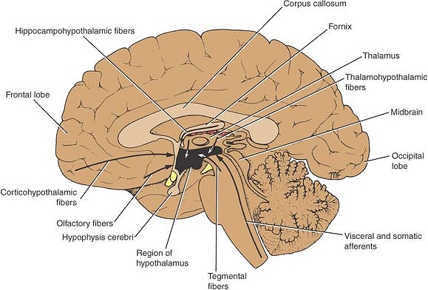
Afferent connections

Slide 14
Efferent connections
Descending fibers in reticular formation to brainstem and spinal cord | Preoptic, anterior, posterior, and lateral nuclei of hypothalamus | Craniosacral parasympathetic and thoracolumbar sympathetic outflows
Mammillothalamic tract | Nuclei of mammillary body | Anterior nucleus of thalamus; relayed to cingulate gyrus
Mammillotegmental tract | Nuclei of mammillary body | Reticular formation in tegmentum of midbrain
Multiple pathways | Hypothalamic nuclei | Limbic system

Slide 15
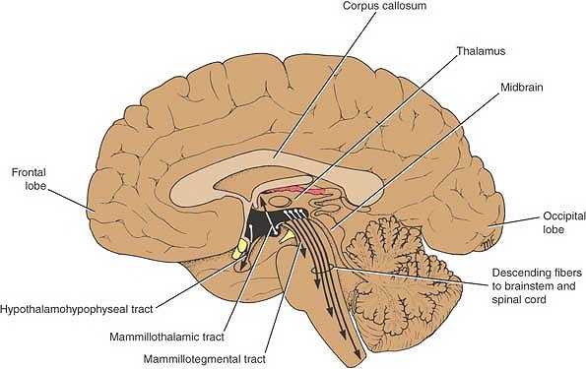
Efferent connections

Slide 16
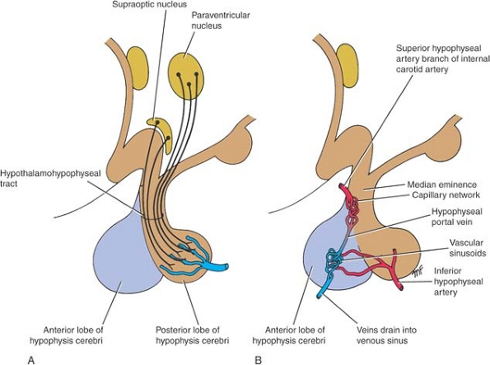
Connections of the Hypothalamus With the Hypophysis Cerebri
Connected to the hypophysis cerebri (pituitary gland) by two pathways: (1) nerve fibers that travel from the supraoptic and paraventricular nuclei to the posterior lobe of the hypophysis and

Slide 17
Connections of the Hypothalamus With the Hypophysis Cerebri
Long and short portal blood vessels that connect sinusoids in the median eminence and infundibulum with capillary plexuses in the anterior lobe of the hypophysis .
These pathways enable the hypothalamus to influence the activities of the endocrine glands.

