Slide 1
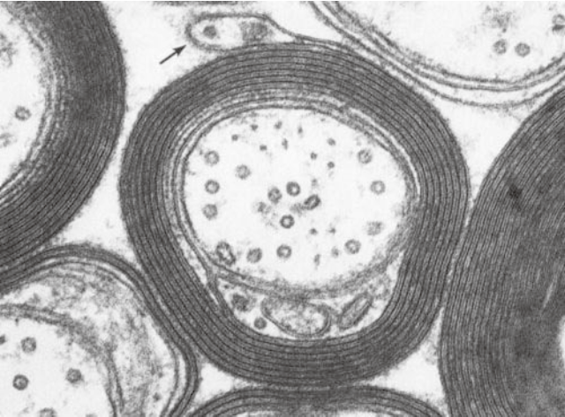
Brain Lipids
Dr. Mohammed Vaseem

Slide 2
Classification of lipids
LIPIDS
Simple Lipids
Compound Lipids
Derived Lipids

Slide 3
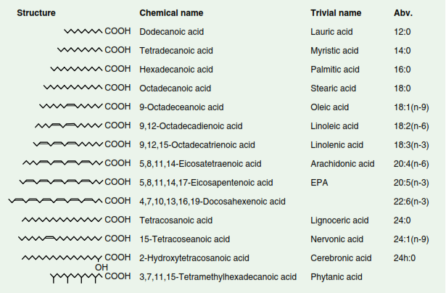
Simple lipids of interest in the brain

Slide 4
Compound Lipids
Esters of fatty acids with various alcohols along
with an additional group.
Simple lipid + Additional group = Compound Lipids
a. Phospholipids
b. Glycolipids

Slide 5
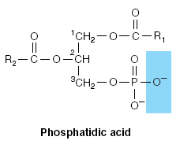
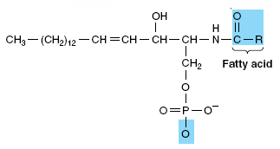
Compound Lipids
a. Phospholipids: Lipids with phosphate group
Glycerophospholipids
Sphingophospholipids
Sphingosine
Glycerol

Slide 6
Phospholipids
Glycerophospholipids
Glycerol
Fattyacid
Phosphate
Base
SATURATED
Unsaturated
BASE
Glycerol
Phosphatidyl choline (also called Lecithin) : Base in this is choline
Phosphatidyl serine (cephalin) : Base in this is serine
Phosphatidyl ethanolamine : Base is ethanolamine

Slide 7
Phospholipids
Sphingopohospholipids
Sphingosine instead of glycerol
Fattyacid
Phosphate
Base
Sphingosine
Base
Ex: Ceramide (Sphingosine + FA)

Slide 8
Compound Lipids
b. Glycolipids:
Cerebrosides
Gangliosides : Glycolipids with one or more N- acetyl neuraminic acid (sialic acid) in addition to other sugars
Sphingosine Carbohydrate
Fattyacid
Cer – Glucose – Galactose – N Acetyl Galactosamine - Galactose
SIALIC ACID

Slide 9
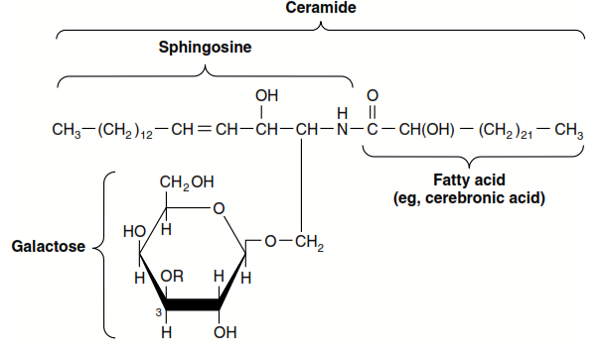
Galactocerebroside (Ceramide + galactose)
Cerebroside with two or more carbohydrates attached are referred to as Globosides

Slide 10
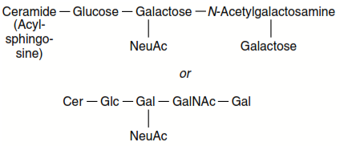
Ganglioside
GM1 ganglioside

Slide 11
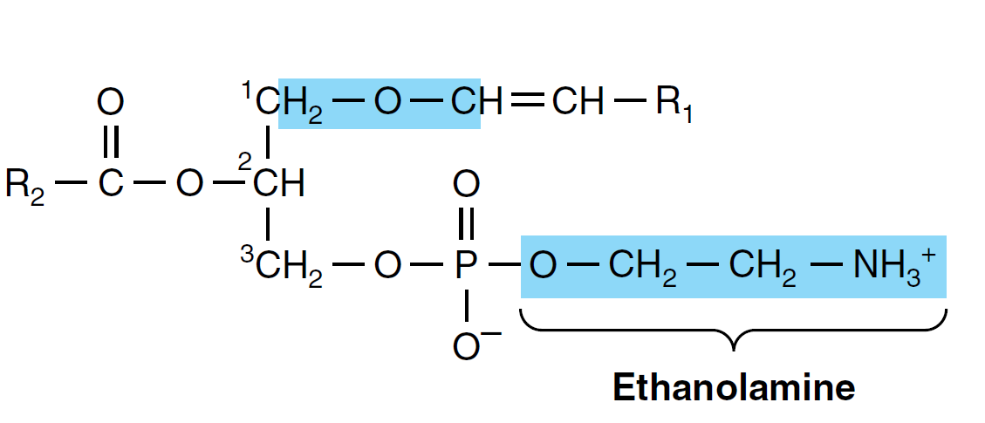
Plasmalogens
Constitute 7-10% of phospholipids in the brain

Slide 13
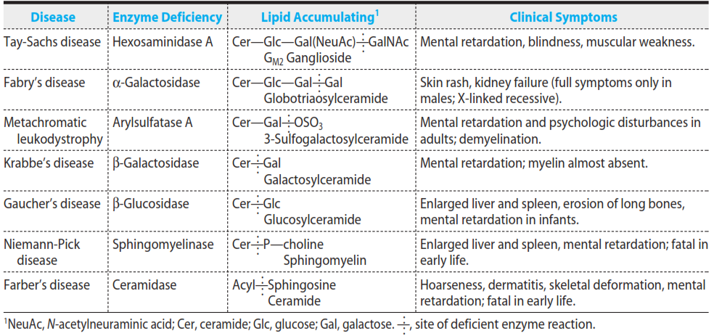
Lipid storage disorders

Slide 14
Myelin from a biochemical perspective
Myelin sheath is a greatly extended and modified plasma membrane wrapped around the nerve axon in a spiral fashion
Oligodendrocytes in the CNS
Schwann cells in the PNS
Responsible for the rapid impulse transmission by “Saltatory impulse transmission”
Also components are involved in various cell signalling processes

Slide 15
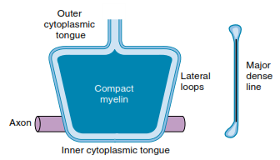
Structure of Myelin sheath

Slide 16
Schmidt – Laterman cleft

Slide 17
Characteristic composition of Myelin
40% water
Dry mass
70-80% - Lipid
15 -30% - Protein

Slide 18
Composition of CNS Myelin and Brain

Slide 19
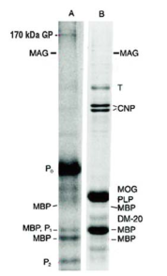
Myelin Proteins
Myelin Basic Proteins
Proteolipid protein 60 – 80 % of total protein
Except MBP none is water soluble

Slide 20
PLP (Proteolipid protein)
Folch – Lees protein
Tetraspan protein, MW - ~ 30000
Structural Protein
Involved in oligodendrocyte migration and maturation
Modulates Vesicle transport and Extracellular matrix interactions

Slide 21
MBP
7 alternately spliced isoforms
Localized on cytoplasmic side of membrane
Stabilization of the myelin structure
May also be involved in process extension of neural cells

Slide 22
Other proteins associated with myelin are
2’ 3’ cyclic mucleotide 3’ phosphodiesterases
P – type glycoproteins
Enzymes
Neurotransmitter receptors – mAch, NMDA etc

Slide 23
Diseases related to Myelin
Multiple Sclerosis
Guilliane – Barre syndrome
Lipid storage disorders (Sphingolipidoses)

